Slide 1
Electronic Circuits and Systems EEE211
Introduction to
Feedback (反馈)
Dept. of Electrical & Electronic Engineering
XJTLU

Slide 2
Electronic Circuits and Systems EEE211
Part 1:
Feedback Structure

Slide 3
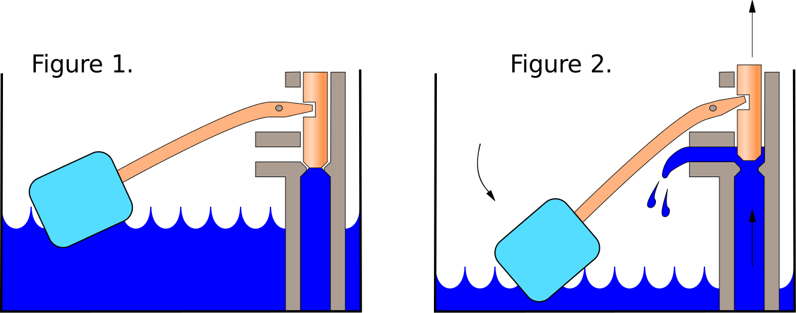
Electronic Circuits and Systems EEE211
Flush toilet (from Wikipedia)

Slide 4


Electronic Circuits and Systems EEE211
Human Hand vs Robot Hand

Slide 5

Electronic Circuits and Systems
Ride a bike

Slide 6
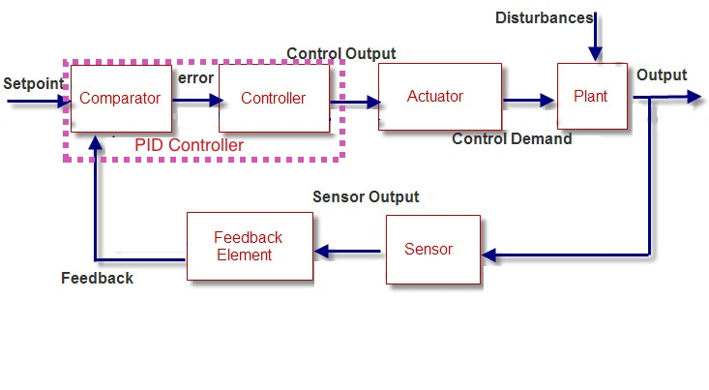
Electronic Circuits and Systems
Feedback System

Slide 7
Electronic Circuits and Systems EEE211
Introduction to Feedback
In this module we are concerned with electronic systems. However, much of what is covered in this topic are general principles that are equally applicable to other feedback systems – e.g pneumatic and hydraulic control systems etc.
Consider the block diagram of a (negative) feedback system
Forward path of signal
NB arrows indicate the direction of signal flow - NOT current !
x
g
x
in
x
o
We use “x” because it represents a ‘signal’ of some description, (but in our case it will be either a voltage or a current).
Note also that A_{OL} and β can transform a signal from one type into another so the signal can be changed as it passes through different parts of the system. e.g. x₀ may be a voltage whilst x_{g}, x_{f} and x_{in} are currents, whilst in a control system, x_{o} might be displacement and x_{g}, x_{f} and x_{in} a voltage.
+
-
A
ol
x
f
β
Feedback path

Slide 8
Electronic Circuits and Systems EEE211
Symbols used
High gain amp with open loop gain A_{ol}
Feedback network with a feedback fraction β
Input “summer”

Slide 9
Electronic Circuits and Systems EEE211
Analysis – derivation of the feedback equation
(Note – negative feedback will be assumed here)
x
g
x
in
x
o
+
-
A
ol
x
f
β
NB. This is the classic equation of feedback theory. Note carefully the terminology used to refer to the various parts of this equation.
‘open loop’ gain
x
A
‘closed loop’ gain
∴
o
=
OL
=
A_{CL}
x
1
+
A
β
g
OL
‘feedback fraction’ β
‘feedback factor’ = 1+βA_{OL}
‘loop gain’ = βA_{OL}

Slide 10
Electronic Circuits and Systems EEE211
Note that the loop being referred to is the feedback loop
x
g
x
in
x
o
+
A
If the loop is broken (anywhere) then the gain given by simply going round the loop once = ‘loop gain’ = -βA_{OL} Note the negative sign is because it is negative feedback
-
ol
x
f
β
The closed loop gain is the gain of the whole system when the loop is closed = A_{CL}
The open loop gain is the gain of the system when the loop is open (i.e. no with feedback applied) = A_{OL}
In practice, it is important that the bias conditions on the amplifier etc are not disturbed when the loop is broken. Some corrective action may be needed to compensate this.

Slide 11
Electronic Circuits and Systems EEE211
If we were to make the loop gain very large (compared to 1), then:
A
1
A_{CL}
=
OL
→
1
+
A
β
β
OL
and the closed loop gain A_{CL} becomes independent of the open loop gain A_{OL}
This is a very important result,
It means that the overall system gain is no longer dependent on the precision with which the gain of the amplifier A can be made. Just make it large (so that βA_{OL}>> 1, remembering that β is a fraction that usually lies between 10⁻³ and 1), and the overall gain will instead be set by the feedback fraction β. This often just involves choosing some resistors that can be tightly controlled quite easily – and adjusted if desired.
Note that the gain is reduced by the feedback factor ,1+βA_{OL} (remember – reduced, because this is negative feedback). This quantity is given its special name because it occurs so frequently in feedback theory – it is this same factor by which almost every property of A_{OL} is changed e.g. input and output impedances as well as bandwidth. – as we shall see !

Slide 12
Electronic Circuits and Systems EEE211
Part 2:
The Effect of Feedback
on Circuits’ Sensitivity and Bandwidth

Slide 13
Electronic Circuits and Systems EEE211
The sensitivity of A_{CL} to A_{OL} can be quantified by differentiating the feedback equation:
So a given fractional change in A_{OL} is attenuated by the feedback factor to give the resultant fractional change on A_{CL}.

Slide 14
Electronic Circuits and Systems EEE211
Example
Suppose
Then
If A_{OL} were now to increase by 10% to 1100 then
i.e. an increase of only 0.18 %
Check
The percentage change in A_{CL} should reduce by the feedback factor i.e
(The minor discrepancy is due to the fact that the 10% change is not a small incremental change, but quite a large one. Better agreement will be obtained if an average feedback factor of 53 were used.)
The important point to remember is that a change in A_{OL} has a significantly diminished effect on A_{CL} when negative feedback is present – and by a factor given by the feedback factor.

Slide 15
Electronic Circuits and Systems EEE211
The Effect of Feedback on Bandwidth
If we now consider an amplifier with bandwidth f_{O},
Log A_{V}
Then
A_{O}
A_{OL} ~ 1/f
where
Log f
f_{OL}
f_{CL}

Slide 16
Electronic Circuits and Systems EEE211
Part 3:
Feedback Topologies

Slide 17
Electronic Circuits and Systems EEE211
Types of amplifier
In our case, x_{f}, x_{g} and x_{in} (taken as a group) could be either voltage or current and so can x_{o}. Any transformation between the two types of signal would be performed by A_{OL} and β
x
x
x
g
+
in
A
o
-
OL
x
f
There are therefore four possibilities to consider:
β
x_{g}, x_{f} and x_{in} | x_{o} | x_{O}/x_{g} | Amplifier type
voltage | voltage |  | voltage amplifier
current | voltage |  | transresistance amplifier
voltage | current |  | transconductance amplifier
current | current |  | current amplifier
‘resistance’ because it is voltage/current, ‘trans’ because it is output voltage and input current (likewise for transconductance)

Slide 18
Electronic Circuits and Systems EEE211
Pause for thought !!
We will now begin to describe the behaviour of the system with reference to ‘constant voltage’ and ‘constant current’ sources.
But what exactly is a ‘constant voltage’ source and ‘constant current’ source?
We can understand a constant voltage source fairly easily because we use them almost every day of our lives.
The source keeps its output terminal voltage constant regardless of the current drawn from it. But it does not necessarily stay constant with time. Examples of sources that try to meet the definition of a constant voltage source would be a car battery and the ac mains.
A constant voltage source keeps the voltage constant at V_{S} regardless of the current drawn from it. It’s output resistance is zero
Voltage V
R_{int} = - slope = 0
V_{S}
R_{int} = - slope = R_{O}
A practical voltage source will not quite achieve the ideal behaviour. It will have an upper current limit and its output resistance will be a small but finite value
Current I

Slide 19
Electronic Circuits and Systems EEE211
In contrast, a constant current source is very rare in every day life (can you think of an example?) – but very common in electronic systems. A transistor, for example, approximates well to a constant current source)
Voltage V
A constant current source keeps the current constant at I_{S} regardless of the voltage required to force it through the load. Its output resistance is infinitely large
V_{S}
As with the constant voltage source, it does not have to stay constant in time – it only has to remain constant with respect to the demands placed on it by the load.
Current I
I_{S}
Note that this is a very different ‘animal’ to the constant voltage source! In no way can the characteristic of a perfect constant current source be regarded as even an approximation to that of a perfect constant voltage source.

Slide 20
Electronic Circuits and Systems EEE211
But note that a real source is neither a perfect voltage or perfect current source (although it can come very close to one or the other) and can instead be regarded as either a degraded voltage source or a degraded current source. Hence the duality between a Thevenin equivalent circuit and a Norton equivalent circuit.
V
R_{S}
Thevenin
V_{S}
V_{S}
V_{O}
Norton
I
I_{S}
I_{S}
R_{S}
V_{O}
Real source characteristic, source resistance = R_{S} = - slope
Armed with that review, we now continue the discussion of amplifier behaviour …..

Slide 21
Electronic Circuits and Systems EEE211
Feedback sensing
The feedback signal may sense either the output voltage or the output current. The action of negative feedback is to try to keep the sensed signal – whatever it is - constant. (NB. not necessarily in time, but with respect to the load or changes to A_{OL})
To the extent that it is successful, the output will therefore approximate to either a constant voltage source (if the output voltage is sensed) or a constant current source (if the output current is sensed)
The output impedance of the closed loop amplifier will be changed from that of the open loop amplifier – again by the feedback factor.
Voltage sensing
The amplifier output impedance will be reduced from that of the open loop amplifier r_{oOL} to that of the closed loop amplifier r_{oCL} = r_{oOL}/(1+βA_{OL}) when negative feedback is applied that uses output voltage sensing (which tries to keep v_{O} constant).
Current sensing
The amplifier output impedance will be increased from that of the open loop amplifier r_{oOL} to that of the closed loop amplifier r_{oCL} = r_{oOL}(1+βA_{OL}) when negative feedback is applied that uses output current sensing, (which tries to keep i_{O} constant).

Slide 22
Electronic Circuits and Systems EEE211
Practical implementation
To sense the output voltage, the feedback signal will need to be obtained from a connection made across the output - i.e. a shunt connection.
The shunt connection reduces the output impedance.
A
OL
v_{O}
to load
β
To sense the output current, the feedback signal must be obtained from a connection made in series with the output – (often by simply taking the voltage developed across a suitable resistor connected in series with the output signal as shown here).
The series connection increases the output impedance
i_{O}
A
OL
to load
β
Unfortunately, it is not always obvious which sensing arrangement a particular circuit is using! The rule to remember is that if it is voltage sensing the feedback signal should be derived from across the output – if it isn’t, then it will be current sensing !

Slide 23
Electronic Circuits and Systems EEE211
Feedback application
Now look at how the feedback signal can be applied at the input
Since we want negative feedback, the feedback signal must be applied in such a way that it subtracts from the input signal from the signal generator
Again there are two ways this can be done – either as a current or a voltage. Which way is chosen affects the resulting input impedance ‘seen’ by the signal generator.
Voltage feedback
i
With this arrangement, the feedback signal is applied in series with the input generator. For this to work the feedback signal must be a voltage and it must subtract from the input voltage (remember - it’s negative feedback).
v_{in}
OL
A
v_{g}
v_{f}
β
For the same input current, the input generator now has to supply a larger voltage than it would if there was no feedback signal (v_{f} + v_{in} instead of just v_{in}). The input impedance ‘seen’ by the generator, r_{iCL} is therefore increased from r_{iOL} to r_{iOL}(1+βA_{OL}) by virtue of the series applied feedback. Note the appearance once again of the feedback factor !

Slide 24
Electronic Circuits and Systems EEE211
Current feedback
i_{g}
i_{in}
With this arrangement, the feedback signal is applied across the input generator. i.e. a shunt connection. For this to work the feedback signal must be a current that subtracts from the input current (it’s negative feedback).
A
OL
v_{g}
i_{f}
β
For the same input voltage, the input generator now has to supply more current with the feedback applied than it would if there was no feedback signal (i_{f} + i_{in} instead of just i_{in}). The input impedance ‘seen’ by the generator, r_{iCL} is therefore reduced from r_{iOL} to r_{iOL}/(1+βA_{OL}) by virtue of the feedback.

Slide 25
Electronic Circuits and Systems EEE211
Ideal amplifier configurations
We next look at some ideal amplifier specifications. You just need to remember:
1. If you choose to use a series feedback connection at the input or output of the amplifier, the relevant impedance is increased.
2. If you choose to use a shunt feedback connection at the input or output of the amplifier, the relevant impedance is decreased.
There is no need to remember the individual equations – it’s just the relevant open loop impedance divided or multiplied by the feedback factor as appropriate.

Slide 26
Electronic Circuits and Systems EEE211
Review of Feedback sensing
The feedback signal may sense either the output voltage or the output current. The action of negative feedback is to try to keep the sensed signal – whatever it is - constant. (NB. not necessarily in time, but with respect to the load or changes to A_{OL})
To the extent that it is successful, the output will therefore approximate to either a constant voltage source (if the output voltage is sensed) or a constant current source (if the output current is sensed)
Note that the input impedance, output impedance , gain and bandwidth are all changed from those of the open loop amplifier by the feedback factor.
Negative feedback will reduce the gain and increase the bandwidth from that of the open loop amplifier - by the feedback factor.
series applied feedback will increase the input resistance, shunt applied feedback will reduce the input resistance - in each case by the feedback factor.
series derived feedback will increase the output resistance , shunt derived feedback will reduce the output resistance - again, in each case by the feedback factor)

Slide 27
Electronic Circuits and Systems EEE211
In this lecture we have seen:
How to organize feedback system, and knowledge of feedback elements –feedback fraction, loop gain, feedback factor.
Feedback sensitivity and its analysis, calculation comparison.
Feedback topology for different types of configuration.

