Slide 1
Electronic Circuits and Systems EEE211
Feedback Application to Amplifiers 1
Dept. of Electrical & Electronic Engineering
XJTLU

Slide 2
Electronic Circuits and Systems EEE211
Part 1: Ideal Amplifier Configurations

Slide 3
Electronic Circuits and Systems EEE211
Ideal amplifier configurations
We next look at some ideal amplifier specifications and decide which feedback configuration we will need to use to create them. You need to remember:
1. If you choose to use a series feedback connection at the input or output of the amplifier, the relevant impedance is increased.
2. If you choose to use a shunt feedback connection at the input or output of the amplifier, the relevant impedance is decreased.
We now use this to create four different types of amplifier:
A voltage amplifier
A current amplifier
A transresistance amplifier
A transconductance amplifier
x_{i}
x_{O}
A

Slide 4
Electronic Circuits and Systems EEE211
1) The voltage amplifier
Consider first the case of a typical voltage amplifier
Amplifier equivalent circuit
Typical voltage source
R_{S}
r_{O}
v_{S}
v_{i}
r_{i}
R_{L}
v_{L}
v_{O=}A_{v}v_{i}
So for this case, the voltage developed across the load will be dependent not only on its nominal voltage gain but also on:
1) the output resistance of the signal source
2) the resistance of the load to which it is attached

Slide 5
Electronic Circuits and Systems EEE211
The ideal voltage amplifier
But an ideal voltage amplifier should have a voltage gain that is independent of the source and load resistance values
Amplifier equivalent circuit
R_{S}
r_{O}
v_{S}
v_{i}
r_{i}
R_{L}
v_{L}
v_{O=}A_{v}v_{i}
To achieve this, we need to make r_{i} >> R_{S} and r_{O} << R_{L} . Then,
In the limit, an ideal voltage amplifier would have:
So to produce a good voltage amplifier, we want a series feedback connection at the input to make a high input impedance and a shunt connection at the output to make a low output impedance.
i.e. a voltage amplifier would need a SERIES-SHUNT feedback configuration

Slide 6
Electronic Circuits and Systems EEE211
2) The current amplifier
Now consider the case of a typical current amplifier
Typical current source
Amplifier equivalent circuit
i_{i}
i_{L}
i_{O=}A_{i}i_{i}
i_{S}
R_{S}
r_{i}
r_{O}
R_{L}
v_{L}
So to make this into an ideal current amplifier we need r_{i} << R_{S} and r_{O} >>R_{L} so that:
independent of the values of R_{S} and R_{L}
So to produce a good current amplifier, we need a shunt feedback connection at the input to make a low input impedance and a series connection at the output to make a high output impedance
i.e. a SHUNT-SERIES feedback configuration

Slide 7
Electronic Circuits and Systems EEE211
3) The ideal transresistance amplifier
i_{i}
v_{O}
A_{r}
(also can be described as a current to voltage converter or a current dependent voltage source)
Amplifier equivalent circuit
i_{i}
r_{O}
i_{S}
R_{S}
r_{i}
R_{L}
v_{O}
A_{r} i_{i}
Applying the same principles as in the previous two cases results in the conclusion that to produce a good transresistance amplifier, we need a SHUNT-SHUNT feedback configuration so that:

Slide 8
Electronic Circuits and Systems EEE211
4) The ideal transconductance amplifier
v_{i}
i_{O}
A_{g}
(also can be described as a voltage to current converter or a voltage dependent current source)
Amplifier equivalent circuit
i_{O}
R_{g}
v_{i}
r_{i}
A_{g} v_{i}
r_{O}
R_{L}
v_{g}
To produce a good transconductance amplifier, we need a SERIES-SERIES feedback configuration so that:

Slide 9
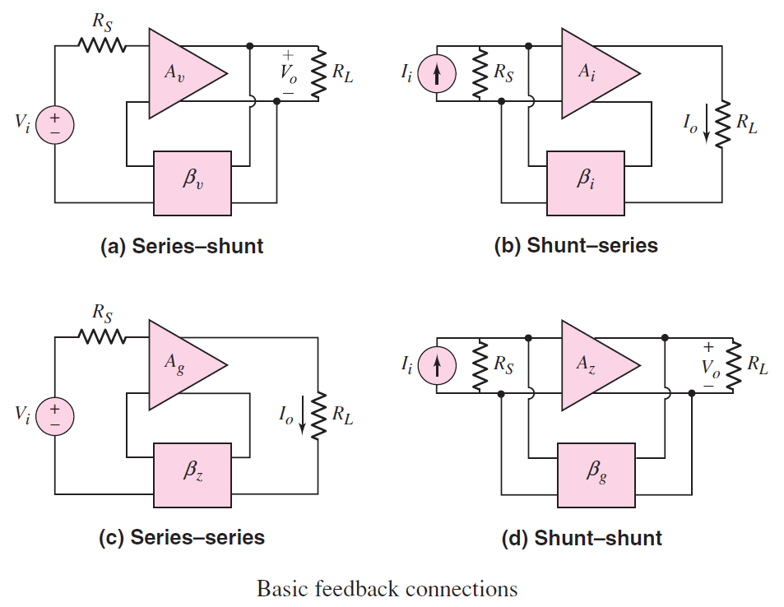
Electronic Circuits and Systems EEE211

Slide 10
Electronic Circuits and Systems EEE211
Summary
 | Ideal voltage amplifier | Ideal current amplifier | Ideal trans-conductance amplifier | Ideal Trans-resistance amplifier
Input resistance | infinite | zero | infinite | zero
Output resistance | zero | infinite | infinite | zero

Slide 11
Electronic Circuits and Systems EEE211
For the practical case, feedback is used to approximate the ideal amplifier
Amplifier type | A | Feedback configuration | r_{I(CL)} | r_{O(CL)}
Voltage amplifier |  | series-shunt
Current amplifier |  | shunt-series
Transresistance amplifier |  | shunt-shunt
Transconductance amplifier |  | series-series

Slide 12
Electronic Circuits and Systems EEE211
Part 2: Identification of Feedback Topologies on Discrete Circuits

Slide 13
Electronic Circuits and Systems EEE211
Practical implementation Lecture 7. 22
To sense the output voltage, the feedback signal will need to be obtained from a connection made across the output - i.e. a shunt connection.
The shunt connection reduces the output impedance.
A
OL
v_{O}
to load
β
To sense the output current, the feedback signal must be obtained from a connection made in series with the output – (often by simply taking the voltage developed across a suitable resistor connected in series with the output signal as shown here).
The series connection increases the output impedance
i_{O}
A
OL
to load
β
Unfortunately, it is not always obvious which sensing arrangement a particular circuit is using! The rule to remember is that if it is voltage sensing the feedback signal should be derived from across the output – if it isn’t, then it will be current sensing !

Slide 14
Electronic Circuits and Systems EEE211
Some practical examples
V_{CC}
Output voltage sensing
R_{C}
C_{C}
In this example, the feedback signal is being taken from the collector of a common emitter amplifier as a shunt connection
R_{L}
v_{o}
R_{E}
0 v
There is a direct connection to the output voltage terminal so it is clearly sensing the output voltage. It is therefore SHUNT derived feedback.
Feedback to input
The output impedance will be reduced by the feedback (shunt connection)

Slide 15
Electronic Circuits and Systems EEE211
V_{CC}
Output current sensing
i_{C}
In this example the output voltage is being taken from across an un-bypassed emitter resistor but the feedback is taken from across a collector resistor in series with R_{E}.
There is no direct connection to the output voltage – so the feedback must be sensing the current and is SERIES derived.
Feedback to input
R_{C}
i_{O}
R_{E}
R_{L}
v_{o}
0 v
The feedback acts to keep i_{C} constant (the feedback signal is monitoring i_{c}R_{c})
The feedback is SERIES derived so the output impedance will be increased by the feedback

Slide 16
Electronic Circuits and Systems EEE211
Current feedback Lecture 7. 24
i_{g}
i_{in}
With this arrangement, the feedback signal is applied across the input generator. i.e. a shunt connection. For this to work the feedback signal must be a current that subtracts from the input current (it’s negative feedback).
A
OL
v_{g}
i_{f}
β
For the same input voltage, the input generator now has to supply more current with the feedback applied than it would if there was no feedback signal (i_{f} + i_{in} instead of just i_{in}). The input impedance ‘seen’ by the generator, r_{iCL} is therefore reduced from r_{iOL} to r_{iOL}/(1+βA_{OL}) by virtue of the feedback.

Slide 17
Electronic Circuits and Systems EEE211
Input current summing
V_{CC}
This feedback is a shunt connection. It forms a node at which the currents sum.
Kirchoff’s current law gives:
R_{C}
i_{S}
i_{i}
R_{S}
i_{f}
R_{E}
C_{E}
v_{S}
i_{O}
or
Feedback from output
So the current into the amplifier is increased by the feedback.
The input impedance will therefore be reduced by this SHUNT applied feedback connection.

Slide 18
Electronic Circuits and Systems EEE211
Feedback application Lecture 7. 23
Now look at how the feedback signal can be applied at the input
Since we want negative feedback, the feedback signal must be applied in such a way that it subtracts from the input signal from the signal generator
Again there are two ways this can be done – either as a current or a voltage. Which way is chosen affects the resulting input impedance ‘seen’ by the signal generator.
Voltage feedback
i
With this arrangement, the feedback signal is applied in series with the input generator. For this to work the feedback signal must be a voltage and it must subtract from the input voltage (remember - it’s negative feedback).
v_{in}
OL
A
v_{g}
v_{f}
β
For the same input current, the input generator now has to supply a larger voltage than it would if there was no feedback signal (v_{f} + v_{in} instead of just v_{in}). The input impedance ‘seen’ by the generator, r_{iCL} is therefore increased from r_{iOL} to r_{iOL}(1+βA_{OL}) by virtue of the series applied feedback. Note the appearance once again of the feedback factor !

Slide 19
Electronic Circuits and Systems EEE211
Input voltage summing
V_{CC}
a)
In this example, there is no direct connection to the source, so it must be a series connection.
R_{C}
Assuming the source impedance is small compared to the input impedance of the stage, then:
R_{S}
v_{i}
v_{f}
~v_{S}
v_{S}
R_{E}
Feedback from output
Again, the signal voltage into the amplifier is being reduced by the feedback - as is required for the feedback to be negative. An increase in the base voltage causes the feedback signal to increase the emitter voltage also, therefore the feedback is trying to keep the net voltage across the emitter-base junction constant.
The input impedance will be increased by this SERIES applied feedback connection.

Slide 20
Electronic Circuits and Systems EEE211
Input voltage summing
V_{CC}
b)
The second example requires a differential input stage. Note again there is no direct connection to the source. In this case it is clearly a series connection giving a difference signal as a consequence of the differential input stage
R_{C}
Feedback from output
R_{S}
P
~v_{S}
v_{f}
v_{S}
Again, the signal voltage into the stage is reduced by the negative feedback.
The input impedance will be increased by this series feedback connection. A voltage increase of v_{S} results in a voltage increase of v_{f} (and hence also an increase of the emitter potential at point P) via the feedback loop. The input impedance ‘seen’ by v_{S} is therefore increased.

Slide 21
Electronic Circuits and Systems EEE211
Example circuit 1
1) feedback topology?
ac and DC negative feedback
series(indirect connect) - Shunt(Direct connect)
2) feedback type?
3) Effect on:
V_{CC} = 10V
the gain ?
ri ?
ro?
reduced
increased
C1
decreased
RC1
10k
R1
4.7k
6.8μ
4) Amplifier type?
Q3
A voltage amplifier
2N2907A
Rg
Q1
Q2
Rf2
2N2222
100
2k
RL
v_{OUT}
Vg
Rb1
Rf1
10k
2N2222
100
100mV
RC
10k
10k
Rb2
10k
4.7k
-V_{EE} = -10 V

Slide 22
Electronic Circuits and Systems EEE211
Example circuit 2
Feedback resistor
Rf 26.1k
Vcc
Vcc
+
12V
Vcc
1) What is the feedback topology of the circuit shown?
Re2
Ce2
-
Rc1
4.7k
2k
6.8u
Rc3
+
Vee
if
12V
Shunt(Direct connect)-series(indirect connect)
Q2N2907A
3.48k
-
i
in
C1
Q1
Q2
Vee
2) What Is the type of feedback?
Rg
2.2u
Q2N2222
Q3
ac and DC negative feedback
750
Q2N2222
Vg
Re1
C3
Rc2
6.2k
i
out
C2
v
out
3.9k
82u
1mV
Re3
1u
3) What (qualitative) effect would you expect the feedback to have on:
6.2k
RL
1k
Vee
the overall gain of the amplifier?
the input impedance
the output impedance?
Reduced
Decreased
Increased
4) What is the best description for type of amplifier?
A current amplifier

Slide 23
Electronic Circuits and Systems EEE211
Example circuit 3
1) feedback topology?
2) feedback type ?
Shunt(Direct connect)- Shunt(Direct connect)
negative ac and DC feedback
3) Effect on:
the gain ?
ri ?
ro?
reduced
decreased
+V_{CC}
decreased
4) Amplifier type?
12kΩ
A transresistance amplifier
i_{S}
Q₃
i_{i}
Q₁
4.7kΩ
Q₂
4.7kΩ
1kΩ
v_{o}
v
g
5.1kΩ
i_{f}
10kΩ
0V
0V
R_{f} = 100kΩ

Slide 24
Electronic Circuits and Systems EEE211
Example circuit 4
1) feedback topology?
2) feedback type?
series(indirect connect) - series(indirect connect)
3) Effect on:
negative ac and DC feedback
the gain ?
ri ?
ro?
reduced
V_{CC}= 10V
increased
increased
1k
RE2
1.2k
4) Amplifier type?
9.1k
A transconductance amplifier
Q2
2N2907A
v_{OUT}
600
1μF
2N2222
Q1
Rf
Vg
220k
2.2k
11k
15k
V_{EE}= -10V

Slide 25
Electronic Circuits and Systems EEE211
Advantages of Negative Feedback
1. Negative feedback reduces the sensitivity of the gain on parameters of an amplifier such as transistor current gain etc.
2. Negative feedback allows us to set gain to any value we want (up to the limit of A_{OL}).
3. Negative feedback increases the bandwidth of the amplifier.
4. Negative feedback reduces distortion
5. Negative feedback allows us to adjust the input and output impedances of an amplifier.
BUT these advantages do not come FREE!
Disadvantages of Negative Feedback
1. Negative feedback always reduces the gain of an amplifier.
2. Over certain frequency ranges, it can be that negative feedback changes from negative to positive with catastrophic results. Positive feedback increases the gain of the amplifier and the amplifier could then oscillate – no longer any use as an amplifier
MUST REMEMBER THESE!

Slide 26
Electronic Circuits and Systems EEE211
In this lecture we have seen:
Four types of Feedback topology analysis.
Actual circuit are analyzed.

