Slide 1
Electronic Circuits and Systems EEE211
Feedback Application to Amplifiers 2
Dept. of Electrical & Electronic Engineering
XJTLU

Slide 2
Electronic Circuits and Systems EEE211
Part 1: Perfect Amplifiers with exercise

Slide 3
Electronic Circuits and Systems EEE211
Exercise 1
The amplifier shown in the circuit opposite is a perfect current amplifier with A_{i} = 10.
a) if R_{g} = 750Ω, R_{L} = 3k, find
i) The current gain,
ii) The voltage gain,
iii) The transresistance gain,
iv) The transconductance gain,

Slide 4
Electronic Circuits and Systems EEE211
Answer - part a
i_{in}
i_{o}
The equivalent circuit is shown opposite.
750Ω
v_{o}
i) The current gain,
3kΩ
+
The amplifier is a current amplifier with current gain
v_{g}
10 i_{in}
ii) The voltage gain,
iii) The transresistance gain,
iv) The transconductance gain,

Slide 5
Electronic Circuits and Systems EEE211
Exercise 1 (cont’d)
b) if the generator and load resistors are changed, so that R_{g} = 1kΩ, R_{L} = 100Ω, find
i) The current gain,
ii) The voltage gain,
iii) The transresistance gain,
iv) The transconductance gain,

Slide 6
Electronic Circuits and Systems EEE211
Answer – part b
i_{in}
i_{o}
The equivalent circuit is shown opposite.
1kΩ
v_{o}
i) The current gain,
100Ω
+
v_{g}
10 i_{in}
The amplifier is a current amplifier with current gain
ii) The voltage gain,
iii) The transresistance gain,
iv) The transconductance gain,
N.B. the only quantity not to change because of the change in the circuit resistors is the current gain – and that is because the amplifier is a current amplifier

Slide 7
Electronic Circuits and Systems EEE211
Exercise 3
An ideal transconductance amplifier is connected as shown in fig Q2. The overall voltage gain of the circuit, v_{o} / v_{g}, was found to be 100 when R_{L} was 5kΩ. Calculate the gain of the ideal transconductance amplifier.
Fig Q2
Answer
i_{out}
The equivalent circuit is shown opposite.
Rg
v_{in}
v_{o}
5kΩ
+
v_{g}
A_{C} v_{in}

Slide 8
Electronic Circuits and Systems EEE211
Exercise 4
Find voltage gain,
for the circuit opposite if
R_{g} = 750Ω, R_{L} = 3k and the amplifier is a perfect transconductance amplifier with A_{C} = 20 mA/V.
v
o
i_{g}
R_{g}
v_{g}
R
L
Answer
i_{o}
The equivalent circuit is shown opposite.
v_{in}
i_{g}
750Ω
20x10⁻³
v
3kΩ
v_{o}
in
[Current gain = i_{o}/i_{g} = 15, transresistance gain = v_{o}/i_{g} = 4.5 x 10⁴Ω, transconductance gain = i_{o}/v_{in} = 20 x 10⁻³ Ω⁻¹]

Slide 9
Electronic Circuits and Systems EEE211
Part 2: Feedback and Stability

Slide 10
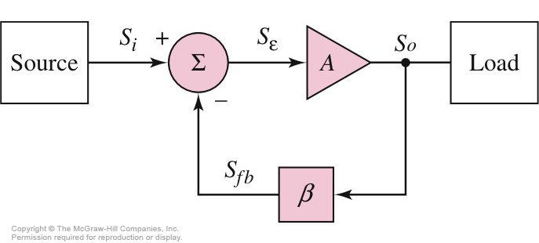
Configuration of Feedback Amplifier
T is the loop gain transfer function

Slide 11
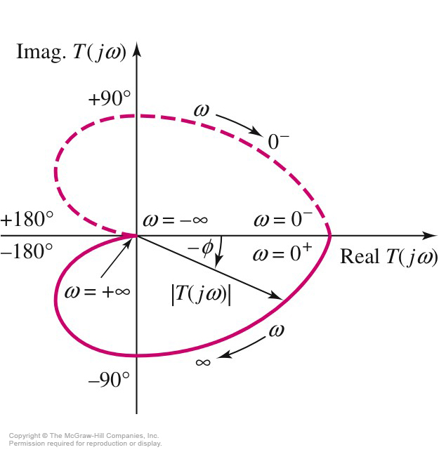
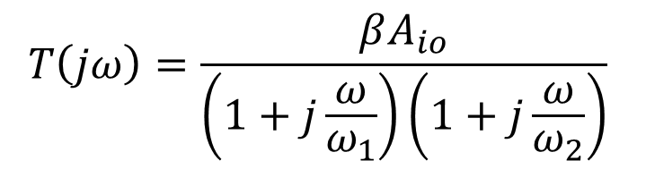

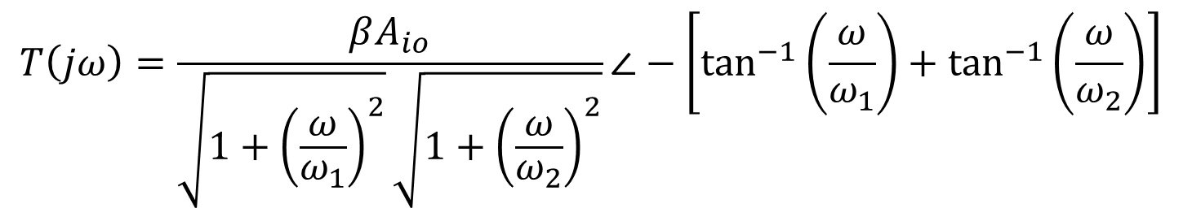
Nyquist Plot: Two-Stage CE
$$T\left(jω\right)=\frac{βA_{io}}{\left(1+j\frac{ω}{ω_{1}}\right)\left(1+j\frac{ω}{ω_{2}}\right)}$$
$$⇓$$
$$T\left(jω\right)=\frac{βA_{io}}{\sqrt{1+{\left(\frac{ω}{ω_{1}}\right)}^{2}}\sqrt{1+{\left(\frac{ω}{ω_{2}}\right)}^{2}}}∠−\left[\tan^{−1}\left(\frac{ω}{ω_{1}}\right)+\tan^{−1}\left(\frac{ω}{ω_{2}}\right)\right]$$

Slide 12
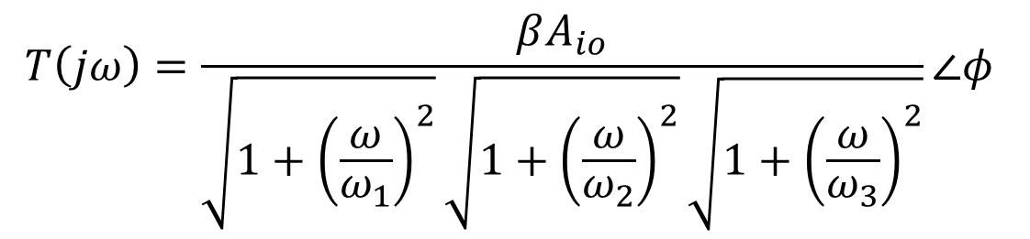
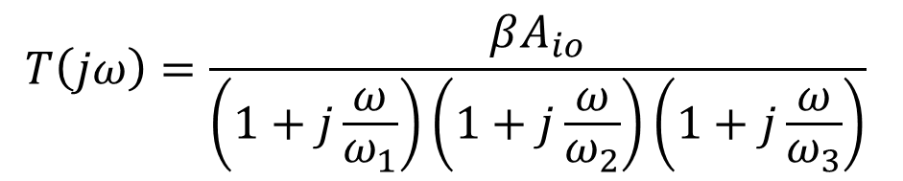
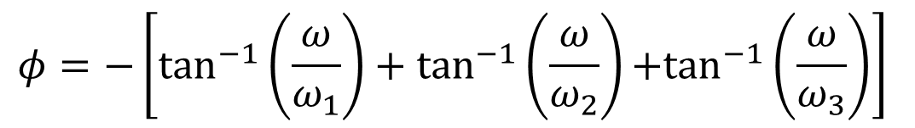
Nyquist Plot: Three-Stage CE
$$T\left(jω\right)=\frac{βA_{io}}{\left(1+j\frac{ω}{ω_{1}}\right)\left(1+j\frac{ω}{ω_{2}}\right)\left(1+j\frac{ω}{ω_{3}}\right)}$$
$$T\left(jω\right)=\frac{βA_{io}}{\sqrt{1+{\left(\frac{ω}{ω_{1}}\right)}^{2}}\sqrt{1+{\left(\frac{ω}{ω_{2}}\right)}^{2}}\sqrt{1+{\left(\frac{ω}{ω_{3}}\right)}^{2}}}∠φ$$
$$φ=−\left[\tan^{−1}\left(\frac{ω}{ω_{1}}\right)+\tan^{−1}\left(\frac{ω}{ω_{2}}\right)+\tan^{−1}\left(\frac{ω}{ω_{3}}\right)\right]$$

Slide 13
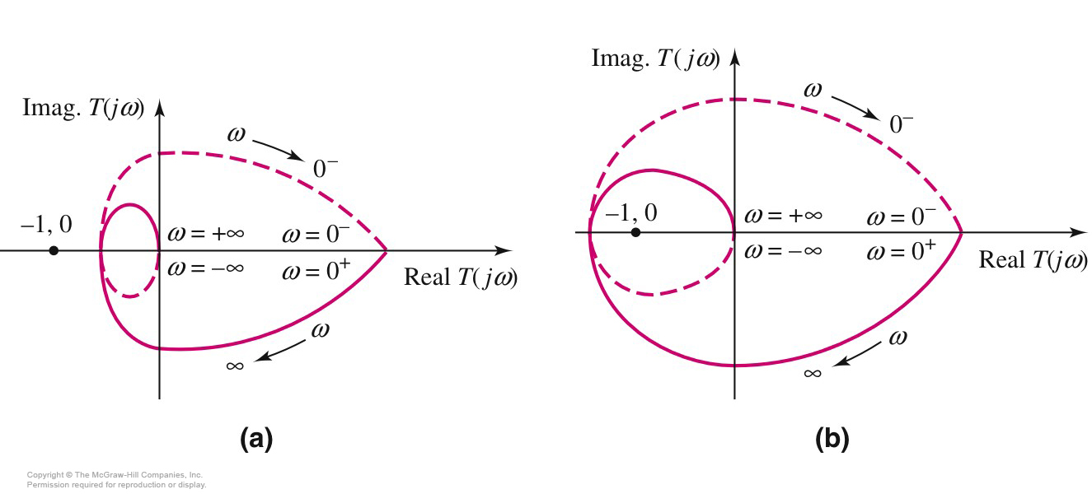
Nyquist Plot: Three-Stage CE
Stable System
Unstable System

Slide 14
Nyquist Plot: Three-Stage CE
For three-pole amplifier, the Nyquist criterion for stability of the amplifier can be stated as the follows:
“If the Nyquist plot encircles or goes through the point (-1,0), the amplifier is unstable.”

Slide 15
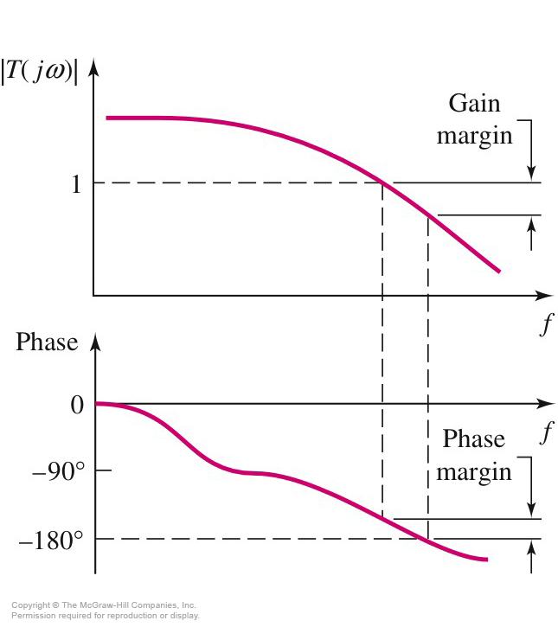
Bode Plot: Phase and Gain Margins

Slide 16
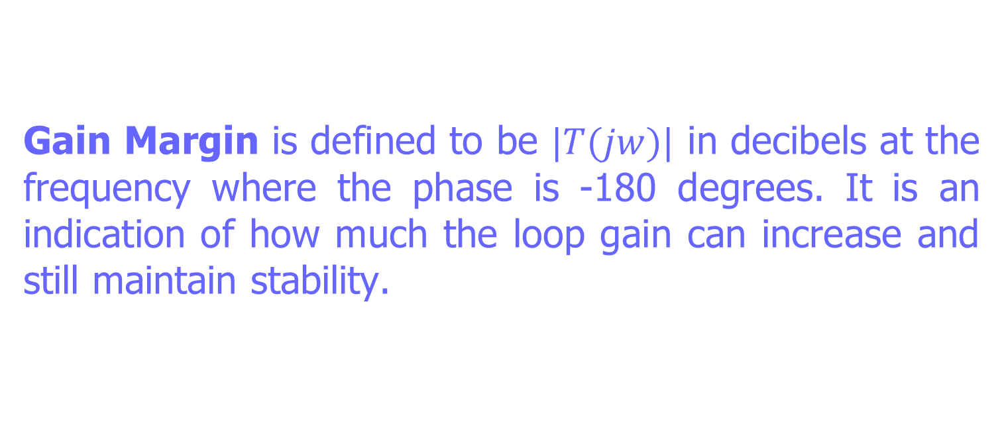
Bode Plot: Phase and Gain Margins
Gain Margin is defined to be $|T(jw)|$ in decibels at the frequency where the phase is -180 degrees. It is an indication of how much the loop gain can increase and still maintain stability.

Slide 17
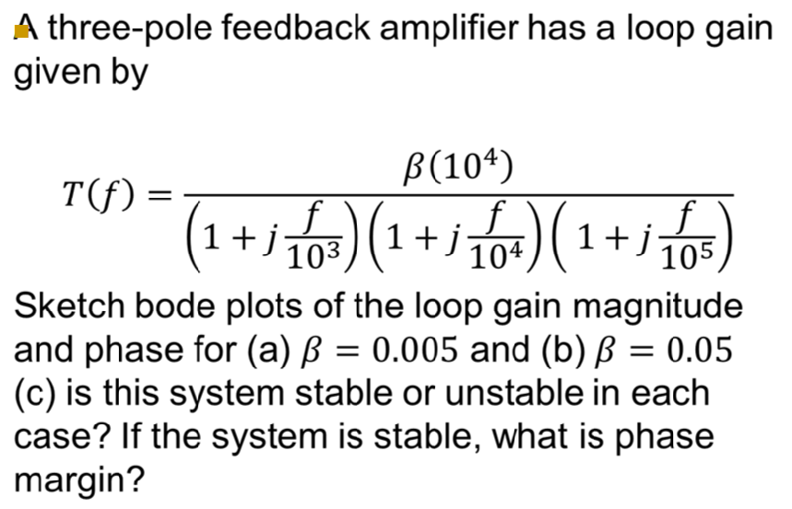
Feedback and Stability
Question:

Slide 18
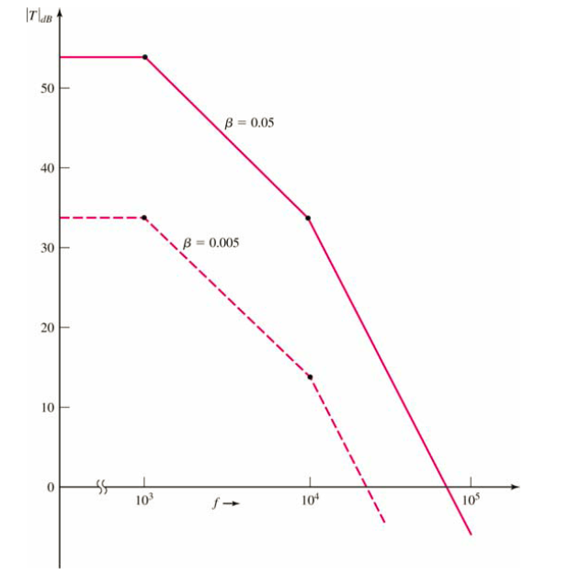

Solution

Slide 19
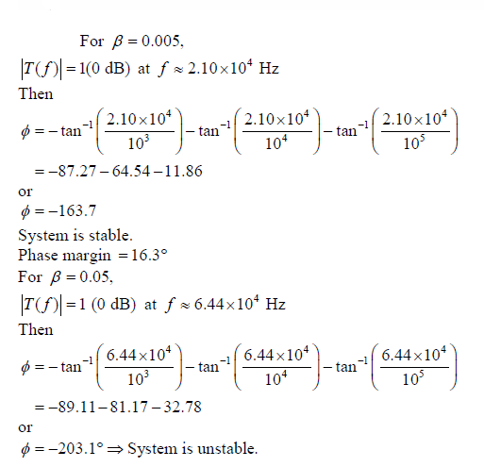
Solution (c)

Slide 20
Nyquist Plot: Three-Stage CE
Stable System
Unstable System

Slide 21
Electronic Circuits and Systems EEE211
In this lecture we have seen:
Four types of perfect amplifiers.
Stability analysis with Nyquist plot.

