Slide 1
Electronic Circuits and Systems EEE211
Feedback Applications to Amplifiers 3
Dept. of Electrical & Electronic Engineering
XJTLU

Slide 2
Electronic Circuits and Systems EEE211
Last lecture we saw that the required input and output impedances for an ideal amplifier depends upon the type of amplifier being considered.
 | Ideal voltage amplifier | Ideal current amplifier | Ideal trans-conductance amplifier | Ideal Trans-resistance amplifier
Input resistance | infinite | zero | infinite | zero
Output resistance | zero | infinite | infinite | zero

Slide 3
Electronic Circuits and Systems EEE211
These ideal values can be approached more closely if appropriate feedback is applied
The feedback can be DERIVED as either SHUNT or SERIES feedback from the output and then APPLIED as SHUNT or SERIES feedback at the input.
Note:
If the feedback connection is taken directly from the output line then it is SHUNT derived feedback. If not, it is SERIES derived feedback.
The same reasoning applies at the input.
i.e.
If the feedback connection is connected directly to the input line then it is SHUNT applied feedback. If not, it is SERIES applied feedback.

Slide 4
Electronic Circuits and Systems EEE211
Note:
SHUNT feedback results in a low impedance.
SERIES feedback results in a high impedance
For example, if an amplifier with a low input impedance and a high output impedance is required (to approximate to a current amplifier), then shunt applied - series derived feedback should be used.
Alternatively, if an amplifier with a high input impedance and a high output impedance is required (to approximate to a transconductance amplifier – [or current to voltage converter]), then series applied - series derived feedback should be used.
Etc. for a voltage amplifier and a transresistance amplifier – [or voltage to current converter]

Slide 5
Electronic Circuits and Systems EEE211
Amplifier type | A | Feedback configuration | r_{IiCL)} | r_{O(CL)}
Voltage amplifier |  | series-shunt
Current amplifier |  | shunt-series
Transresistance amplifier |  | shunt-shunt
Transconductance amplifier |  | series-series

Slide 6
Electronic Circuits and Systems EEE211
Part 1: Current Amplifier (Shunt-Series)

Slide 7
Electronic Circuits and Systems EEE211
Consider the feedback circuit given as example 1 again:
Inspection of this circuit shows:
The amplifier uses series derived, shunt applied feedback which will result in a low input impedance and high output impedance. We concluded that this can be best described as a current amplifier.
The feedback signal is obtained by first inserting a resistance R_{c3} in series with the collector current of Q3 to develop a voltage proportional to i_{c3}
A feedback resistor R_{f} is then connected between this point and the input line. Because the ac input impedance to ground at the input (especially with the feedback applied) is very low, we can approximate it to be an ac ground. The ac voltage across R_{f} is therefore approximately i_{c3}(R_{c3}// r_{o3}) and the current through it will be i_{f} = i_{c3}(R_{c3}// r_{o3})/R_{f}
Feedback
Vcc
Rf 26.1k
Vcc
+
Vcc
Re2
Ce2
12V
Rc1
4.7k
6.8u
-
2k
+
Vee
Rc3
12V
Q1
Q2N2907A
3.48k
-
i
C1
Q2
Vee
in
2.2u
Q2N2222
i_{c3}
Rg
Q3
750
Re1
C3
Q2N2222
Vg
3.9k
82u
Rc2
6.2k
i
out
C2
v
out
1mV
Re3
1u
RL
1k
6.2k
Vee

Slide 8
Electronic Circuits and Systems EEE211
Feedback
If the current gain of Q3 is large, then i_{C3} ≈ i_{E3}
Vcc
Vcc
Rf 26.1k
+
Vcc
12V
Re2
Ce2
-
But
Rc1
4.7k
2k
6.8u
+
Rc3
12V
Vee
Q2N2907A
3.48k
-
i
in
C1
Q1
Q2
Vee
2.2u
Q2N2222
i_{c3}
Recall that for a feedback system, β is the proportion of the output signal that is fed back to the input, which in this case is:
Rg
Q3
750
C3
Q2N2222
Vg
Re1
Rc2
6.2k
i
out
C2
v
out
3.9k
82u
1u
1mV
Re3
RL
1k
6.2k
Vee
( if we assume r_{o3} >>R_{c3})
Recall also that:
if the loop gain βA_{iOL} is large
So we expect that the closed loop current gain of this amplifier
[ PSpice gives 7.36 - better agreement would be obtained if our estimate had included r₀₃ ]

Slide 9
Electronic Circuits and Systems EEE211
Example circuit 1 – a more detailed analysis
Feedback
We look for an approximate analysis. If more accurate results are needed, a simulation package should be used.
Rf 26.1k
Vcc
Vcc
+
12V
Vcc
Re2
Ce2
-
Rc1
4.7k
2k
6.8u
Rc3
12V
+
Vee
An approximate analysis is still very useful as a check that the results obtained from a computer package are reasonable.
Q2N2907A
3.48k
-
i
in
C1
Q1
Q2
Vee
Rg
2.2u
Q2N2222
Q3
750
Q2N2222
Re1
C3
Rc2
6.2k
i
out
C2
v
out
Vg
3.9k
82u
1mV
Re3
1u
To perform the approximate analysis we will assume:
6.2k
RL
1k
Vee
high gain transistors (β >> 1) so I_{C} ≈ I_{E}
current gain independent of I_{C} and V_{CE}
V_{BE} = 0.6v

Slide 10
Electronic Circuits and Systems EEE211
DC Analysis
All capacitors are open circuit to DC, so the circuit simplifies to that shown here
Feedback
Rf 26.1k
Vcc
Vcc
+
12V
Vcc
Let potential of Q1 base = V_{b1}
Re2
-
Then
Rc1
4.7k
2k
Rc3
+
Vee
12V
V_{b1}
Q2N2907A
3.48k
-
Q1
Q2
Vee
Q2N2222
Q3
Q2N2222
Re1
Rc2
6.2k
3.9k
Re3
6.2k
Vee

Slide 11
Electronic Circuits and Systems EEE211
Feedback
Rf 26.1k
Vcc
Vcc
+
12V
Vcc
Re2
-
Rc1
4.7k
2k
Rc3
+
Vee
12V
Q2N2907A
3.48k
-
Q1
Q2
Vee
Q2N2222
Q3
But
Q2N2222
Re1
Rc2
6.2k
3.9k
Therefore
Re3
6.2k
Vee
( PSpice gives 4.85v )
Hence for Q1
( 1.06 mA )
For Q2
( 2.13 mA )
For Q3
( 2 mA )

Slide 12
Electronic Circuits and Systems EEE211
We can now calculate the values for g_{m}, r_{π} and r_{o} for each transistor:
For Q1 (2N2222)
I_{C} = 1.05mA, V_{CE} = 3v, β = 200, V_{A} = -75v
For Q2 (2N2907)
I_{C} = 2.17mA, V_{CE} = 6v, β = 250, V_{A} = 120v
For Q3 (2N2222)
I_{C} = 2.07mA, V_{CE} = 4v, β = 200, V_{A} = -75v
We are now able to revise our previous estimate for β by taking into account the output resistance of Q3.
Previously we had:
But we now know that r_{o} = 38kΩ, so:
so
( 7.36 )

Slide 13
Electronic Circuits and Systems EEE211
Are we justified in assuming βA_{iOL} >> 1 ?
Feedback
Rf 26.1k
Vcc
To obtain the open loop gain, open the feedback loop by removing R_{f.} (We can ignore the effect this would have on the DC bias in practice)
Vcc
+
12V
Vcc
Re2
Ce2
-
Rc1
4.7k
2k
6.8u
Rc3
12V
+
Vee
i_{e}
Q2N2907A
3.48k
-
i
in
C1
Q1
Q2
Vee
Rg
2.2u
Q2N2222
Q3
where i_{e} is the current entering the base of Q1
750
R_{in}
Q2N2222
Vg
Re1
C3
Rc2
6.2k
i
out
C2
v
out
3.9k
82u
1mV
Re3
1u
RL
1k
So to obtain A_{iOL} we need A_{vOL} and and R_{in}
6.2k
Vee
Output load on stage 3 = R_{e3}//R_{L} =0.86k
3rd stage is CC
c.f. lecture 3.
2nd stage is CE

Slide 14
Electronic Circuits and Systems EEE211
Feedback
Rf 26.1k
Vcc
Vcc
+
12V
Vcc
Re2
Ce2
-
Rc1
4.7k
2k
6.8u
Rc3
12V
+
Vee
i_{e}
Q2N2907A
3.48k
-
i
in
C1
Q1
Q2
Vee
Rg
2.2u
Q2N2222
Q3
750
R_{in}
Q2N2222
Vg
Re1
C3
Rc2
6.2k
i
out
C2
v
out
3.9k
82u
1mV
Re3
1u
RL
1k
6.2k
1st stage is CE
Vee
Overall voltage gain is
Therefore
We have previously calculated β = 0.14, so
loop gain = βA_{iOL}=0.14 x 1.68 x 10⁵ = 2.4 x 10⁴ >> 1
So we are justified in assuming A_{iCL} ≈1/β

Slide 15
Electronic Circuits and Systems EEE211
Part 2: Voltage Amplifier (Series-Shunt)

Slide 16
Electronic Circuits and Systems EEE211
V_{CC} = 10V
Example circuit 2
C₁
R_{c1}
10k
R₁
4.7k
6.8μ
Q3
2N2907A
R_{g}
Q1
Q2
R_{f2}
2N2222
v_{OUT}
V_{g}
100
R_{f1}
2k
R_{L}
100mV
R_{b1}
100
10k
2N2222
R_{C}
10k
10k
R_{b2}
10k
4.7k
-V_{EE} = -10 V
Inspection of this circuit shows:
The amplifier uses series applied, shunt derived feedback which will result in a high input impedance and low output impedance. We conclude this can be best described as a voltage amplifier.
Feedback resistors R_{f1} and R_{f2} take a proportion of the output voltage and apply it to the inverting input of the differential input stage. The input signal (V_{g}) feeds to the non-inverting input. The ac input impedance to ground at the base of Q2 will be very high (especially with the feedback applied), so the feedback voltage is therefore simply given by the two resistors R_{f1} and R_{f2}. That is the input impedance into the base of transistor Q2 is very high and therefore does not affect the resistor attenuation ratio

Slide 17
Electronic Circuits and Systems EEE211
V_{CC} = 10V
R_{g}
+Vcc
C₁
+
v_{out}
R_{c1}
10k
R₁
4.7k
6.8μ
V_{g}
Q3
-
2N2907A
-V_{EE}
R_{f2}
R_{g}
Q1
Q2
R_{f2}
R_{L}
2N2222
R_{f1}
V_{g}
100
R_{f1}
2k
R_{L}
v_{OUT}
R_{b1}
100
10k
2N2222
R_{C}
10k
10k
You should recognise this as an example of the familiar schematic shown above.
R_{b2}
10k
4.7k
-V_{EE} = -10 V
Because the transistor Q2 will not affect the resistor attenuation ratio
Hence we can estimate the closed loop voltage gain of this circuit is approximately:
provided the loop gain βA_{vOL} >> 1
To confirm βA_{vOL} >> 1 we need to determine A_{vOL}

Slide 18
Electronic Circuits and Systems EEE211
DC Analysis
Note that if the voltage gain is large (check later) then the feedback will ensure that the potentials of Q1 and Q2 are approximately equal, so the current through the ‘tail’ of the first stage will split equally between them.
V_{CC} = 10V
R_{c1}
10k
R₁
4.7k
Q3
2N2907A
R_{g}
Q1
Q2
R_{f2}
2N2222
V_{g}
100
R_{b1}
R_{f1}
2k
R_{L}
v_{OUT}
100
10k
2N2222
R_{C}
10k
Q4
10k
R_{b2}
10k
4.7k
-V_{EE} = -10 V
Therefore

Slide 19
Electronic Circuits and Systems EEE211
V_{CC} = 10V
DC Analysis
R_{c1}
10k
R₁
4.7k
Q3
R_{g}
2N2907A
Q1
Q2
R_{f2}
2N2222
V_{g}
100
R_{b1}
R_{f1}
2k
R_{L}
v_{OUT}
100
10k
2N2222
R_{C}
10k
Q4
10k
R_{b2}
10k
4.7k
-V_{EE} = -10 V
Therefore

Slide 20
Electronic Circuits and Systems EEE211
V_{CC} = 10V
AC Analysis
R₁
4.7k
C₁
R_{c1}
10k
R_{i2}
6.8μ
Q3
2N2907A
R_{g}
Q1
Q2
2N2222
R_{L}
V_{g}
100
R_{b1}
10k
v_{OUT}
2N2222
R_{C3}
10k
Q4
10k
R_{b2}
10k
4.7k
-V_{EE} = -10 V
To find the open loop gain, open the feedback loop by removing the two resistors R_{f1} and R_{f2}
Load on output stage = R_{c3}//R_{L} = 10k//10k =5k
2nd stage is CE
First stage is long tailed pair
Overall open loop voltage gain
Loop gain

Slide 21
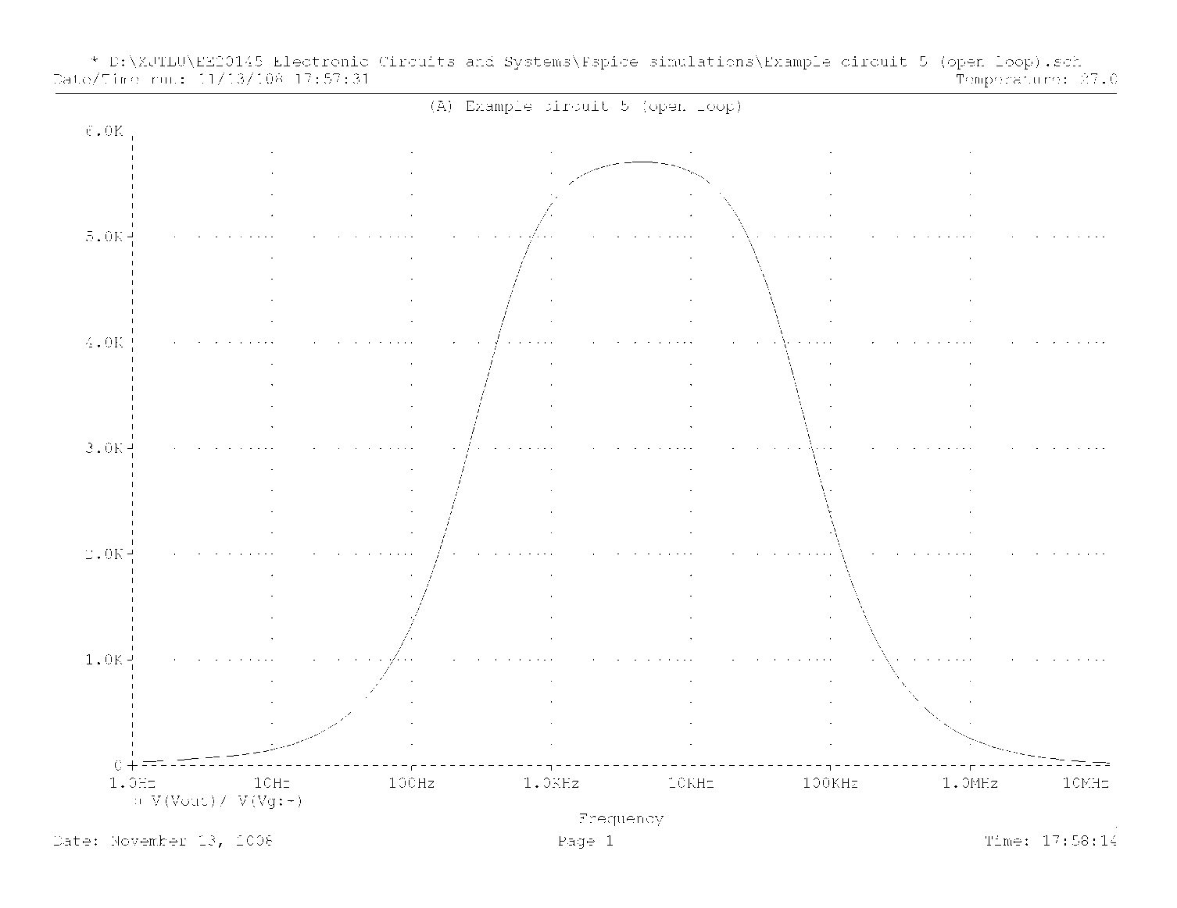
Electronic Circuits and Systems EEE211
PSpice simulation of open loop gain
Example 2 Open loop gain
A_{vOL} = 5800

Slide 22
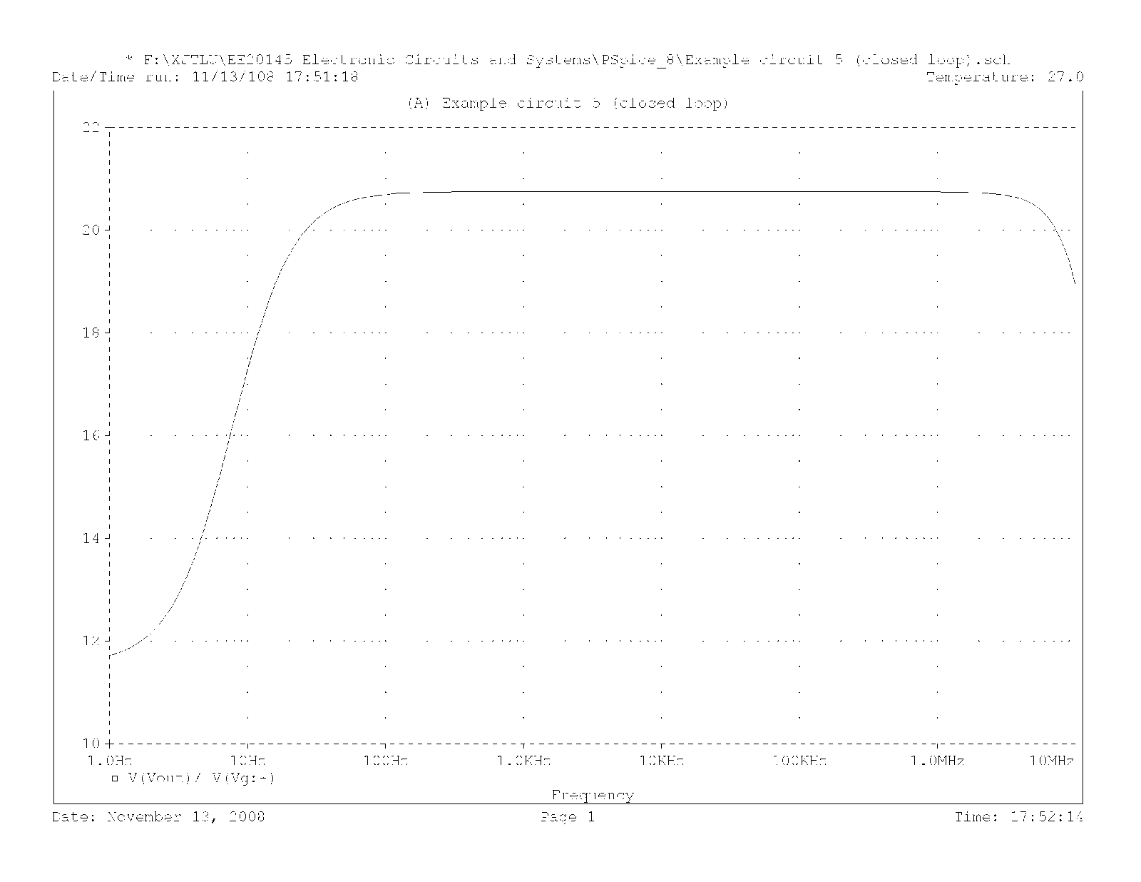
Electronic Circuits and Systems EEE211
PSpice simulation of closed loop gain with R_{f2} = 2kΩ
Example 2 Rf2 = 2kΩ

Slide 23
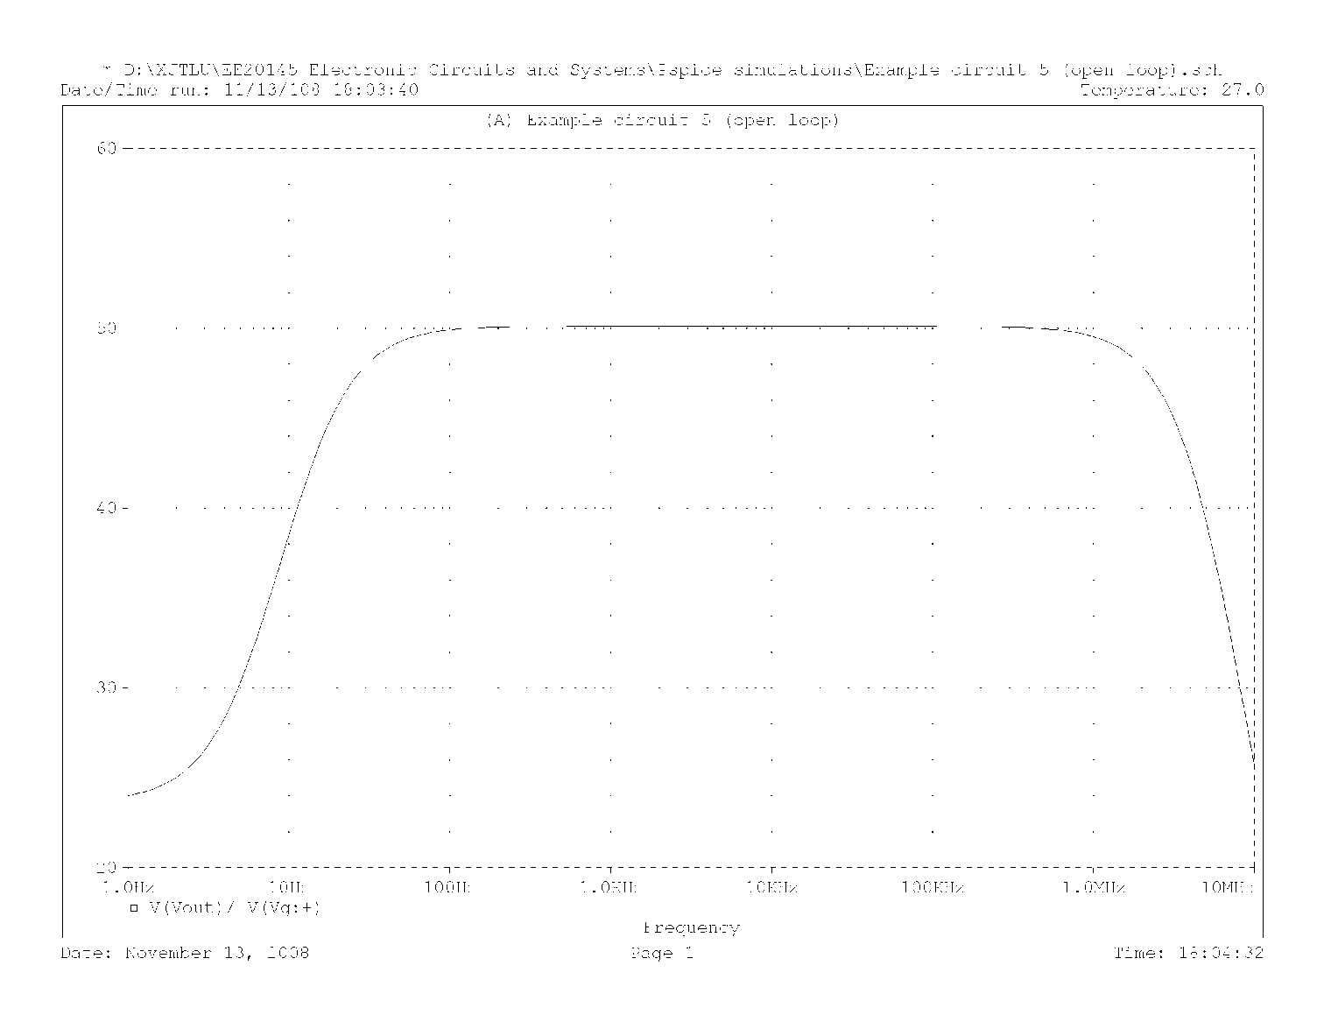
Electronic Circuits and Systems EEE211
PSpice simulation of closed loop gain with R_{f2} = 5kΩ
Example 2 Rf = 5kΩ

Slide 24
Electronic Circuits and Systems EEE211
Part 2: Trans-resistance Amplifier (Shunt-Shunt)

Slide 25
Electronic Circuits and Systems EEE211
Example circuit 3
+V_{CC}
R_{f}
12kΩ
R_{g}
i_{f}
i_{g}
-
v_{out}
i_{g}
Q₃
V_{g}
Q₁
R_{g}
i_{f}
Q₂
+
4.7kΩ
v_{g}
4.7kΩ
1kΩ
v_{out}
R_{L}
5.1kΩ
10kΩ
0V
0V
-V_{CC}
This is an example of the familiar schematic shown.
R_{f} = 100kΩ
Inspection of this circuit shows:
The amplifier uses shunt applied, shunt derived feedback which will result in a low input impedance and low output impedance. We conclude this can be best described as a transresistance amplifier (or current to voltage converter).
The summing point is a low impedance to ac (with the feedback applied) The feedback resistor R_{f} is connected between the output voltage and the low impedance summing point (~ ac ground). The voltage across the feedback resistor is therefore -v_{out} which it effectively converts into a current i_{f} , so

Slide 26
Electronic Circuits and Systems EEE211
+V_{CC}
R_{f}
12kΩ
R_{g}
-
v_{out}
i_{in}
i_{e}
Q₃
V_{g}
Q₁
+
R_{g}
i_{f}
Q₂
4.7kΩ
4.7kΩ
1kΩ
v_{out}
R_{L}
v_{g}
5.1kΩ
10kΩ
0V
0V
-V_{CC}
R_{f} = 100kΩ
Provided the loop gain βA_{rOL} >> 1, then the closed loop gain of the circuit is approximately
[ Note that the voltage gain, defined as v_{out}/v_{g} , is given by:
as expected ]

Slide 27
Electronic Circuits and Systems EE20145
DC analysis
+12
Let potential of Q1 base = V_{b1}
V_{b1}
12kΩ
I_{e}
Q₃
Q₁
Q₂
5.1kΩ
4.7kΩ
10kΩ
-12v
I_{f}
R_{f} = 100kΩ
If we make the approximation that V_{f} ≈0 then V_{e3} = V_{b1} giving:
[ 1.98 mA ]
[ 0.96 mA ]
[ 2.52 mA ]

Slide 28
Electronic Circuits and Systems EEE211
AC analysis
+V_{CC}
For Q1
I_{C} = 2mA, V_{CE} = 14v, β = 200, V_{A} = -75v
12kΩ
i_{g}
Q₃
Q₁
R_{g}
i_{f}
Q₂
4.7kΩ
v_{g}
4.7kΩ
1kΩ
5.1kΩ
10kΩ
0V
0V
-V_{CC}
R_{f} = 100kΩ
For Q2
I_{C} = 0.96mA, V_{CE} = 3v, β = 200, V_{A} = -75v
For Q3
I_{C} = 2.52mA, V_{CE} = 12v, β = 200, V_{A} = -75v

Slide 29
Electronic Circuits and Systems EEE211
+V_{CC}
3rd Stage is CC
12kΩ
R_{i1}
R_{i3}
i_{g}
Q₃
Q₁
R_{i2}
R_{g}
i_{f}
Q₂
4.7kΩ
R_{E3}
R_{L}
v_{g}
5.1kΩ
4.7kΩ
1kΩ
10kΩ
2nd Stage is CE
0V
0V
-V_{CC}
R_{f} = 100kΩ
The overall open loop voltage gain A_{vOL} is therefore
1st stage is CC

Slide 30
Electronic Circuits and Systems EEE211
+V_{CC}
12kΩ
R_{i3}
i_{g}
Q₃
Q₁
R_{i2}
R_{g}
i_{f}
Q₂
4.7kΩ
R_{E3}
R_{L}
v_{g}
5.1kΩ
4.7kΩ
1kΩ
10kΩ
0V
0V
-V_{CC}
The open loop transresistance gain A_{rOL} is
R_{f} = 100kΩ
Therefore loop gain

Slide 31
Electronic Circuits and Systems EEE211
MUST REMEMBER these!
Advantages of Negative Feedback
1. Negative feedback reduces the sensitivity of the gain on parameters of an amplifier such as transistor current gain etc.
2. Negative feedback allows us to set gain to any value we want (up to the limit of A_{OL}).
3. Negative feedback increases the bandwidth of the amplifier.
4. Negative feedback reduces distortion
5. Negative feedback allows us to adjust the input and output impedances of an amplifier.
Disadvantages of Negative Feedback
1. Negative feedback always reduces the gain of an amplifier.
2. Over certain frequency ranges, it can be that negative feedback changes from negative to positive with catastrophic results. Positive feedback increases the gain of the amplifier and the amplifier could then oscillate – no longer any use as an amplifier

