Slide 1
Forward Converters
Presented by
Xinbo Ruan
Aero-Power Sci-tech Center
Nanjing University of Aeronautics & Astronautics

Slide 2
Outlines
Introduction
Forward Converter with Reset Windings
Dual-Switch Forward Converter
Forward Converter with RCD Snubber
Forward Converter with Active Clamp Reset
Other Magnetic Reset Methods
Summary

Slide 3
Introduction
Forward Converter with Reset Windings
Dual-Switch Forward Converter
Forward Converter with RCD Snubber
Forward Converter with Active Clamp Reset
Other Magnetic Reset Methods
Summary

Slide 4
How to Select a Suitable dc/dc Converters
ƀ Questions
- Input: 100VDC;
- Output: 48VDC/10A;
- Switching frequency: 100kHz.
Please design a dc/dc converter, determine
the voltage and current stress on the power switch, and
the voltage and current stress on the the diode.
Given the ripple current of the filter inductance 20%I_{omax}.

Slide 5
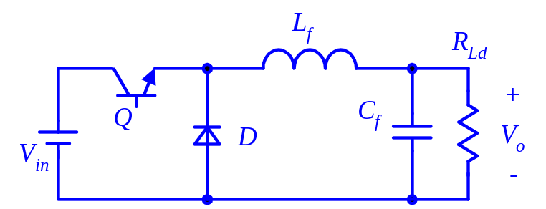
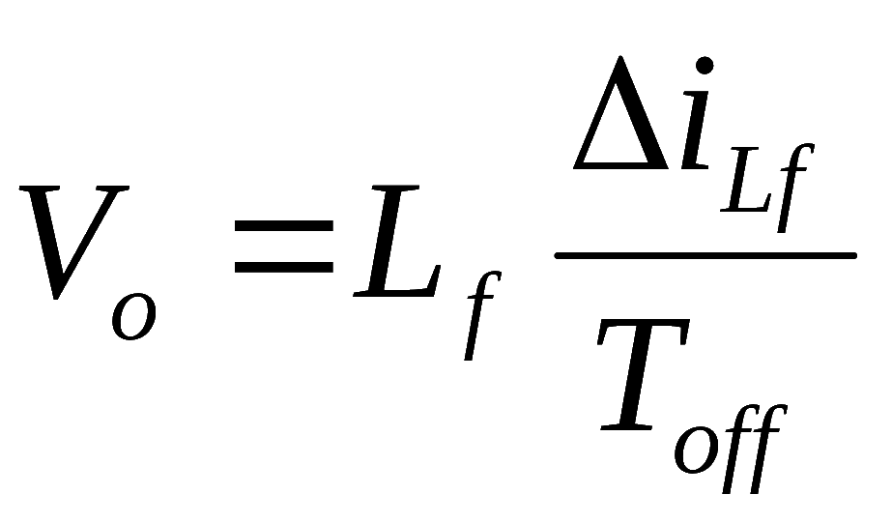
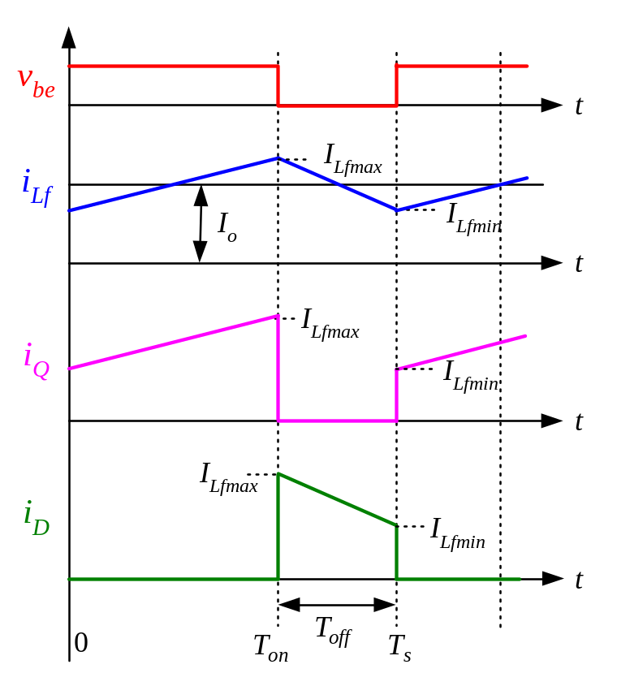
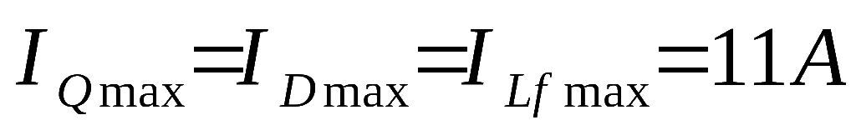
Buck: 60Vin; 48Vout/10A
20%I_{omax}= 2A
D=V_{o}/V_{in}=0.8
T_{off}=(1-D)T_{s}=2us
L_{f}=48uH

Slide 6
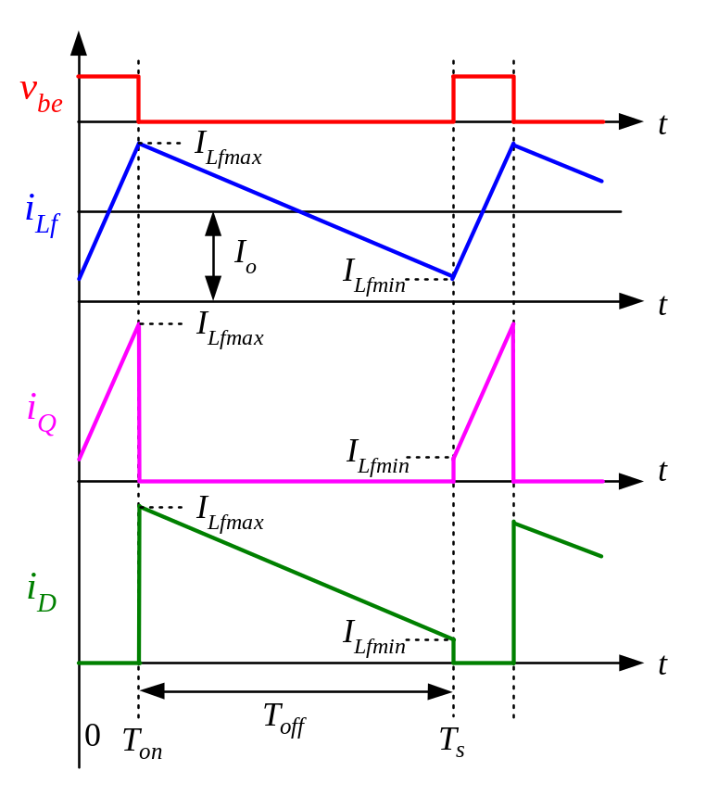
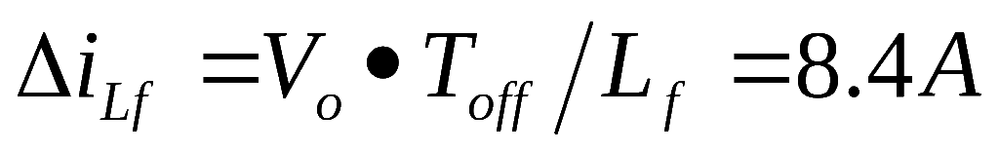
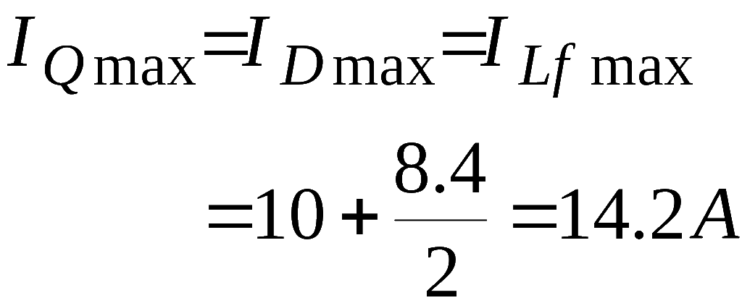
Buck: 300Vin; 48Vout/10A
D=V_{o}/V_{in}=0.16
T_{off}=(1-D)T_{s}=8.4us

Slide 7
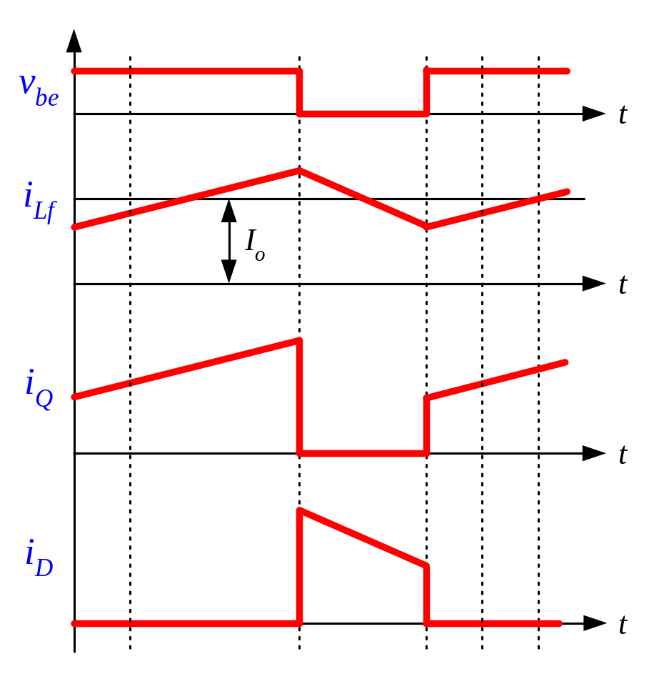

Buck: Comparison of Different Input Voltage
Problems:
The current ripple becomes larger;
The switching devices suffer high voltage;
Duty cycle is too small.
The input is not isolated with the output.
?
Answer:
The input voltage is not so matched with the output voltage.

Slide 8
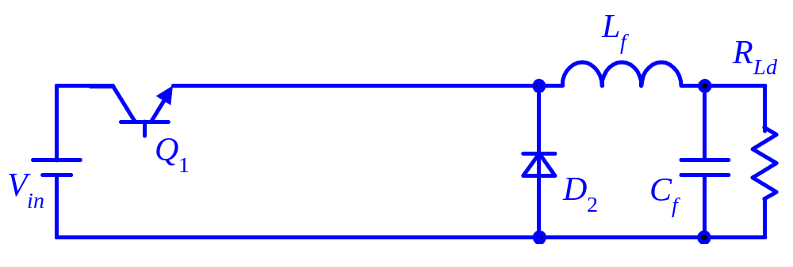

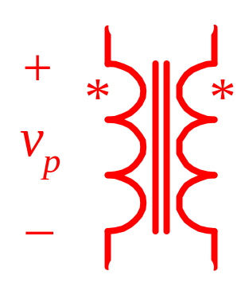
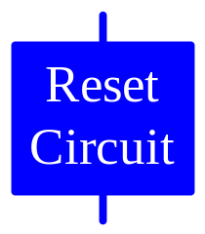
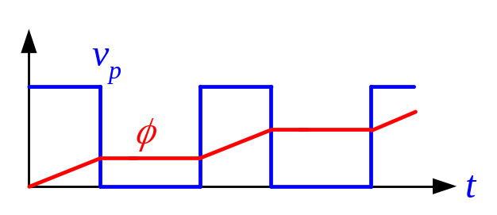
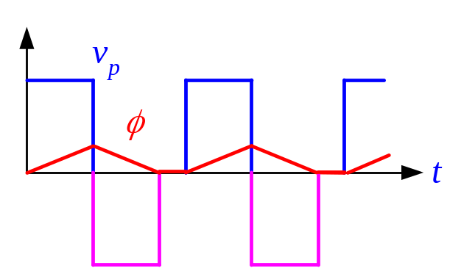
Derivation of Forward Converter
Step 1: Introduce a transformer;
Step 2: Magnetic Reset circuit;
Step 3: Introduce a rectifier diode.

Slide 9
Introduction
Forward Converter with Reset Windings
Dual-Switch Forward Converter
Forward Converter with RCD Snubber
Forward Converter with Active Clamp Reset
Other Magnetic Reset Methods
Summary

Slide 10
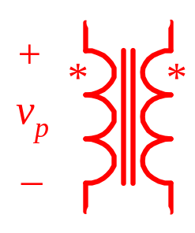
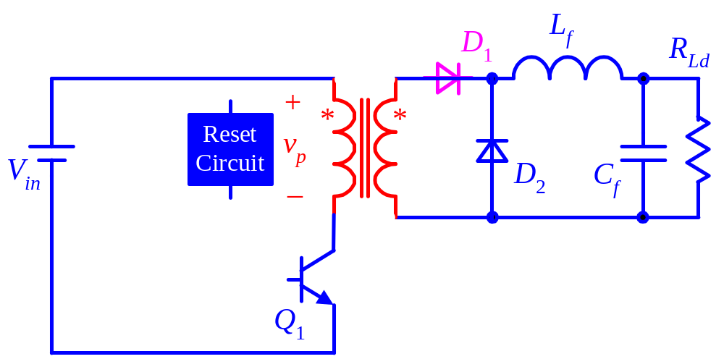
Another Form of Forward Converter

Slide 11
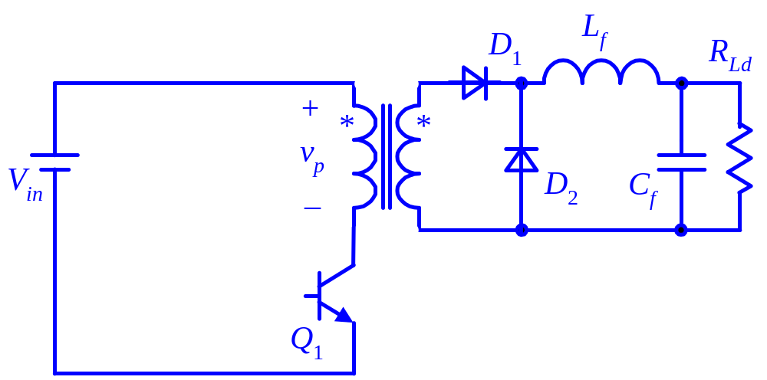

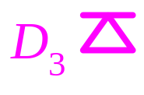
Basic Reset Method

Slide 12
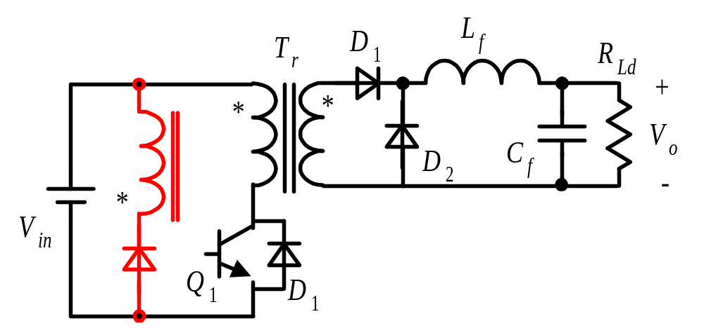
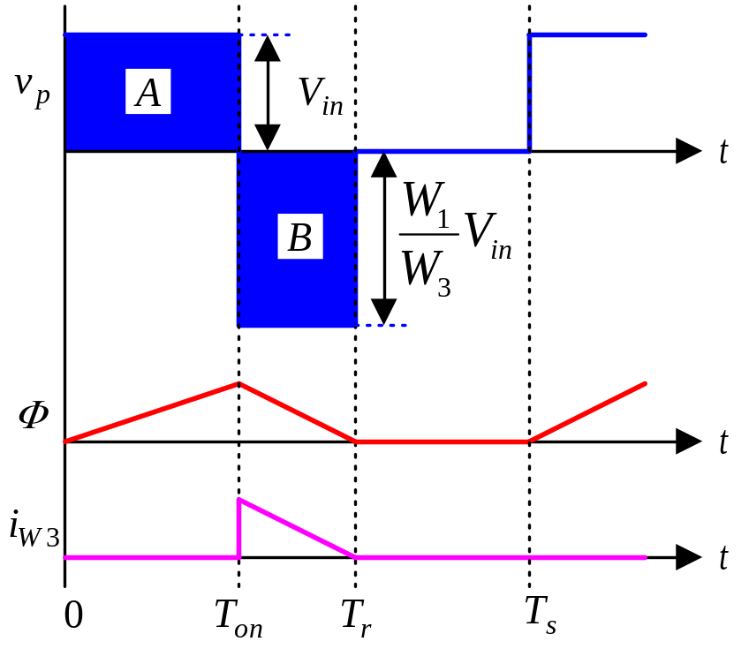
Forward Converters with reset winding
Duty cycle;
Voltage stress of Q₁.
W3/W1

Slide 13
Introduction
Forward Converter with Reset Windings
Dual-Switch Forward Converter
Forward Converter with RCD Snubber
Forward Converter with Active Clamp Reset
Other Magnetic Reset Methods
Summary

Slide 14
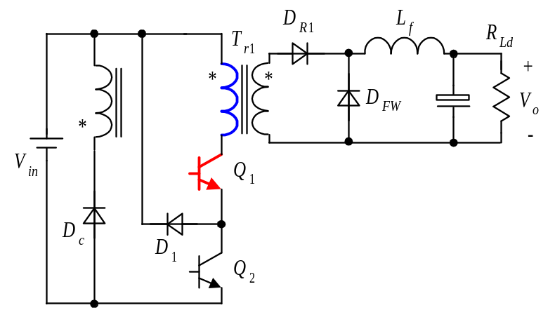
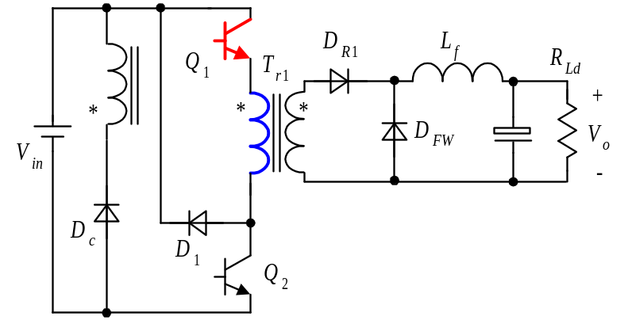
Dual-Switch Forward Converters

Slide 15
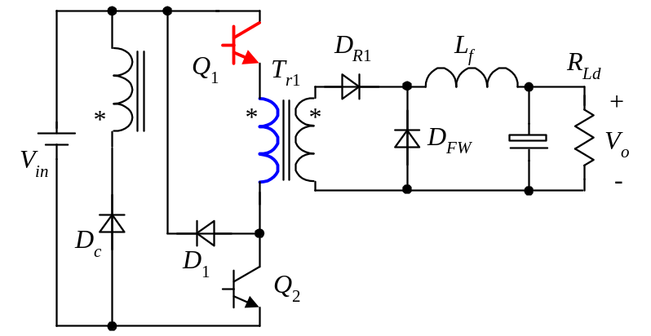
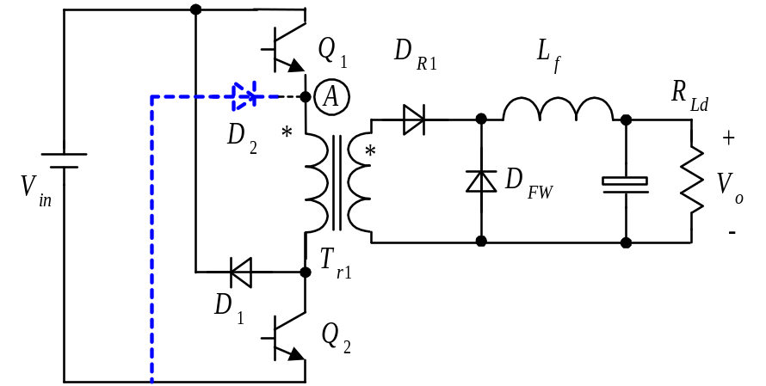

Simplification of Dual-Switch Forward Converters
Q1 and Q2 conduct
Q1 on, Q2 off
Q1 off, Q2 off

Slide 16

Introduction
Forward Converter with Reset Windings
Dual-Switch Forward Converter
Forward Converter with RCD Snubber
Forward Converter with Active Clamp Reset
Other Magnetic Reset Methods
Summary

Slide 17
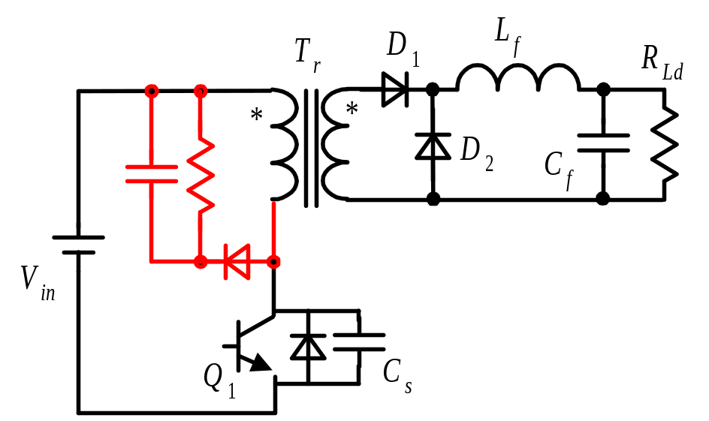
Forward Converters with RCD Snubber

Slide 18
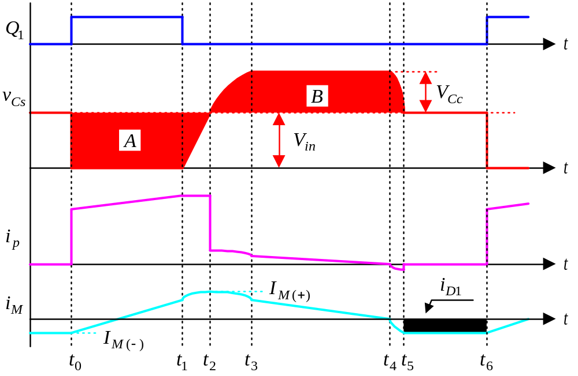
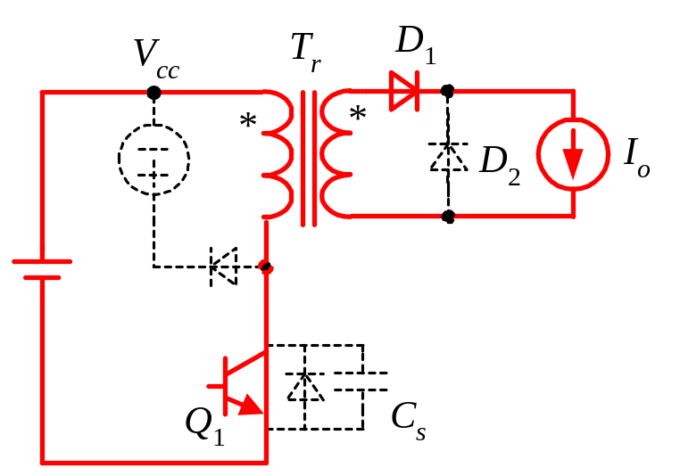
Operation Principle: [t₀ , t₁]

Slide 19
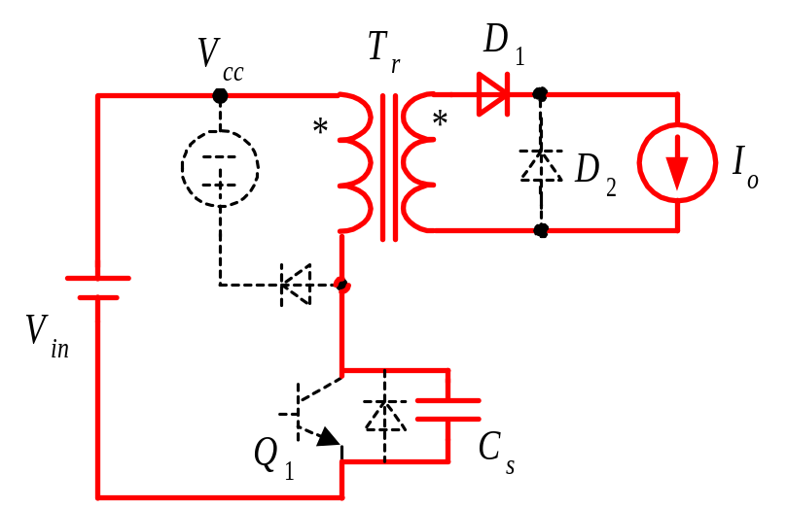
Operation Principle: [t₁ , t₂]

Slide 20
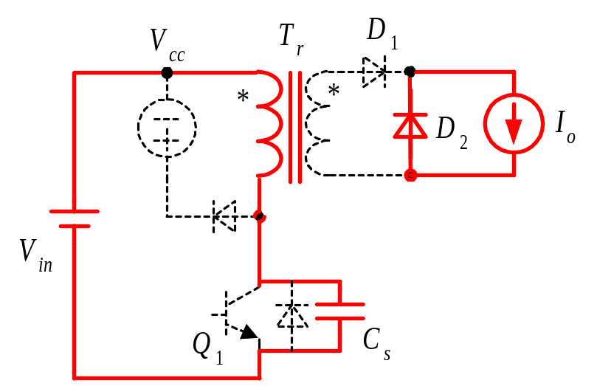
Operation Principle: [t₂ , t₃]

Slide 21
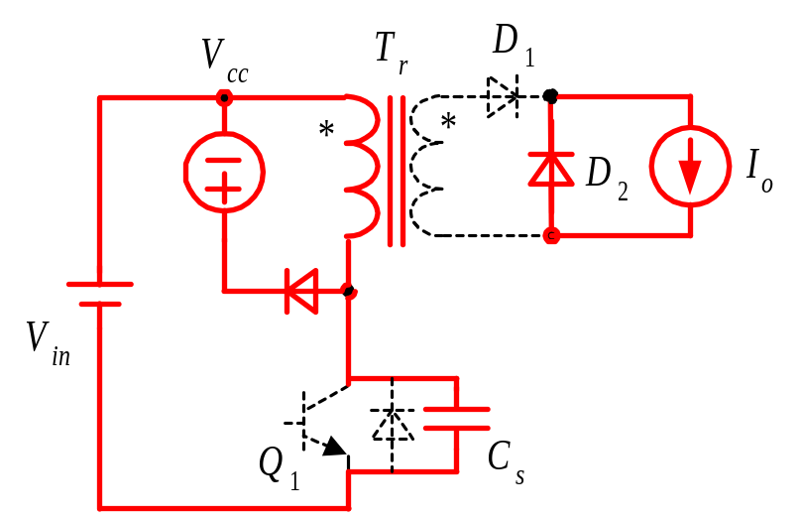
Operation Principle: [t₃ , t₄]

Slide 22
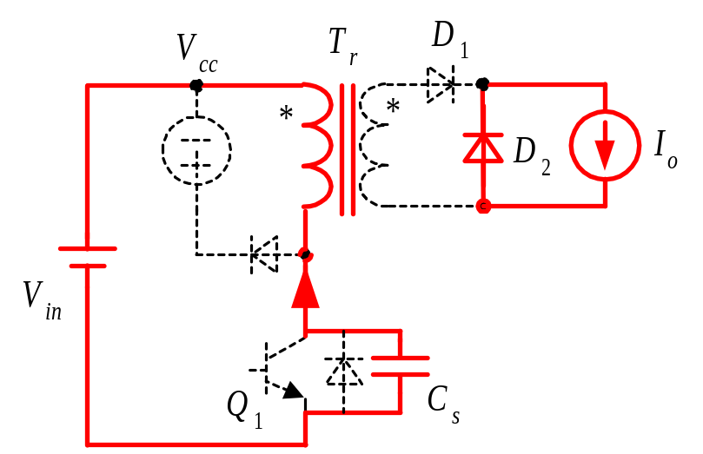
Operation Principle: [t₄ , t₅]

Slide 23
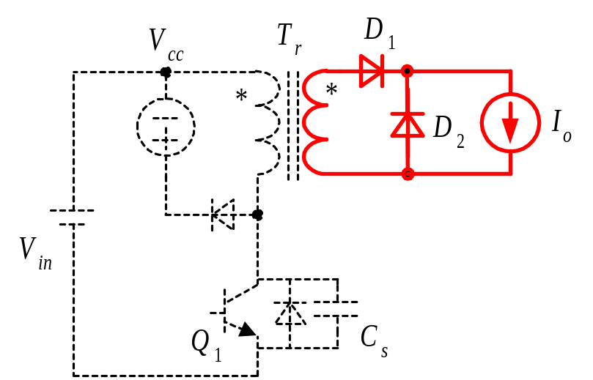
Operation Principle: [t₅ , t₆]

Slide 24
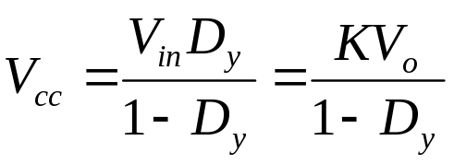
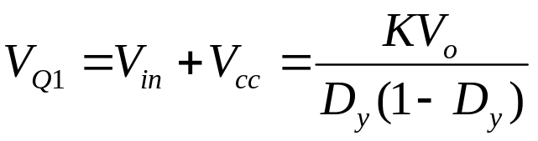
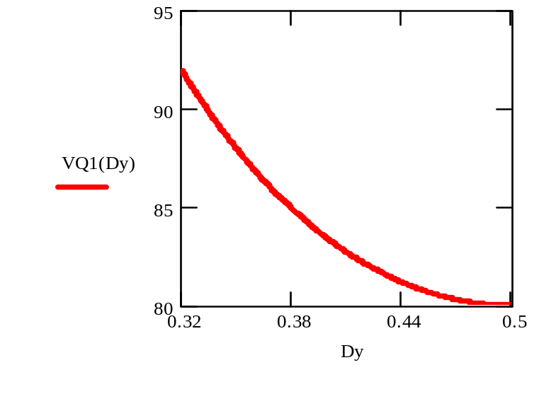
Parameters Design (1)
1. V_{cc}
Vin=40-60V

Slide 25
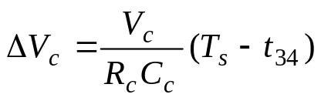
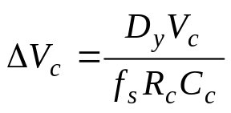
Parameters Design (2)
2. R_{c}
Stored by Junction capacitor
Magnetic Energy
Dissipated in the resistance
3. C_{c}
⇨
If ΔV_{c} ≈ 5%V_{cc} ⇨C_{c} = 10 / (f_{s}·R_{c})

Slide 26
Introduction
Forward Converter with Reset Windings
Dual-Switch Forward Converter
Forward Converter with RCD Snubber
Forward Converter with Active Clamp Reset
Other Magnetic Reset Methods
Summary

Slide 27
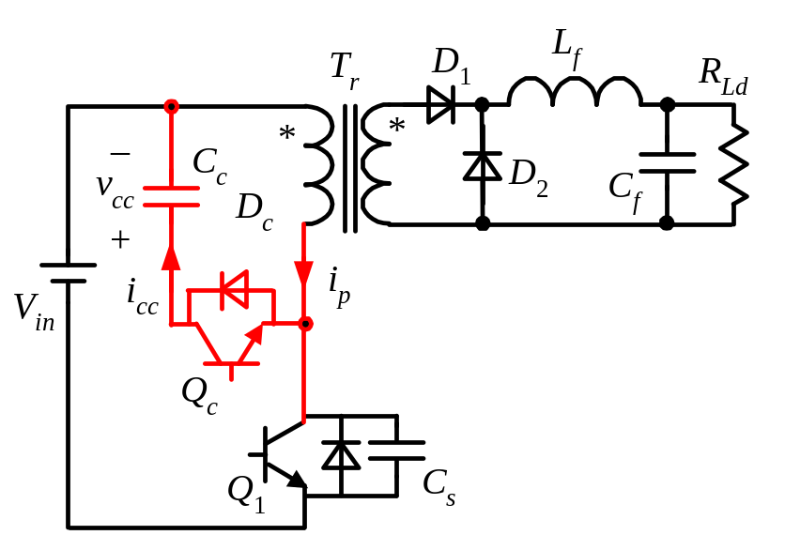
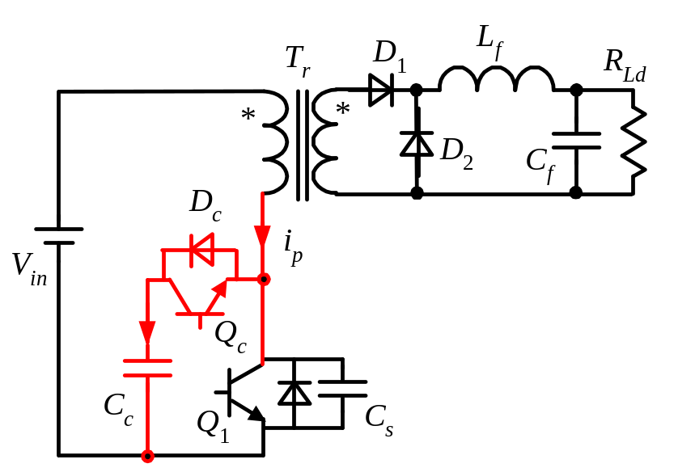
Active Clamp Forward Converter

Slide 28
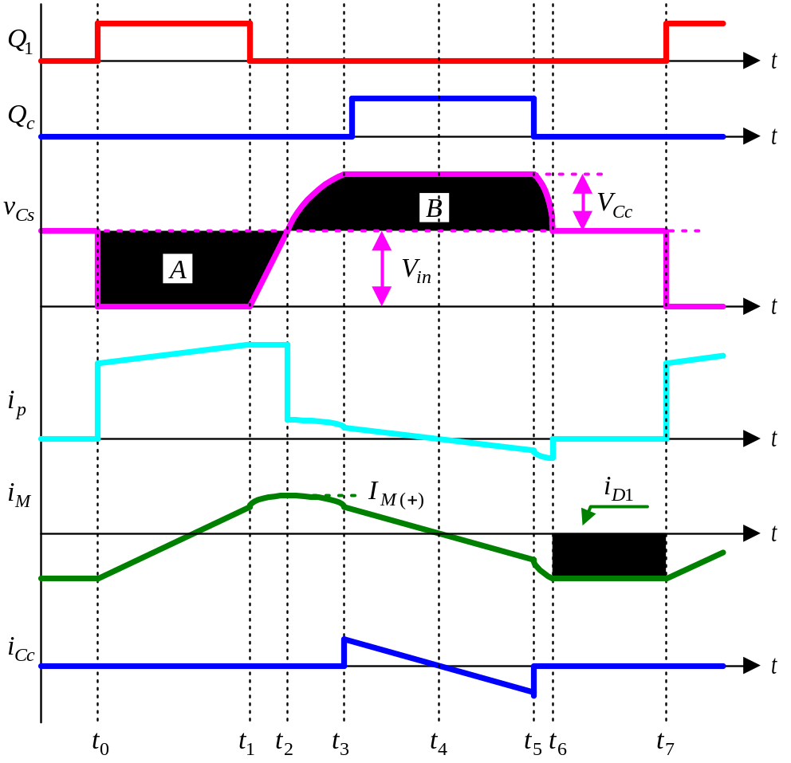
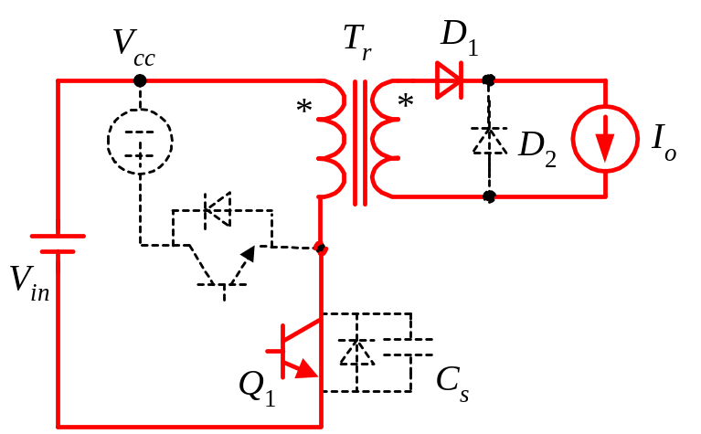
Operation Principle: [t₀ , t₁]

Slide 29
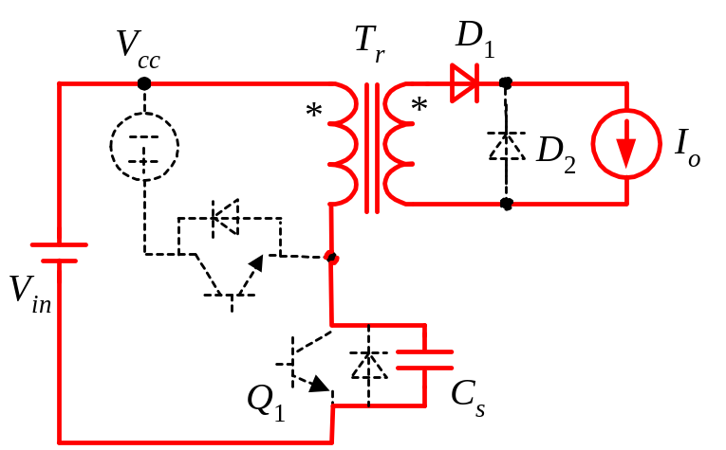
Operation Principle: [t₁ , t₂]

Slide 30
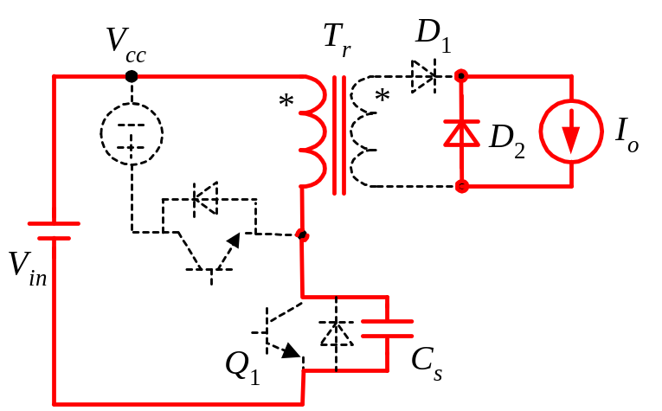
Operation Principle: [t₂ , t₃]

Slide 31
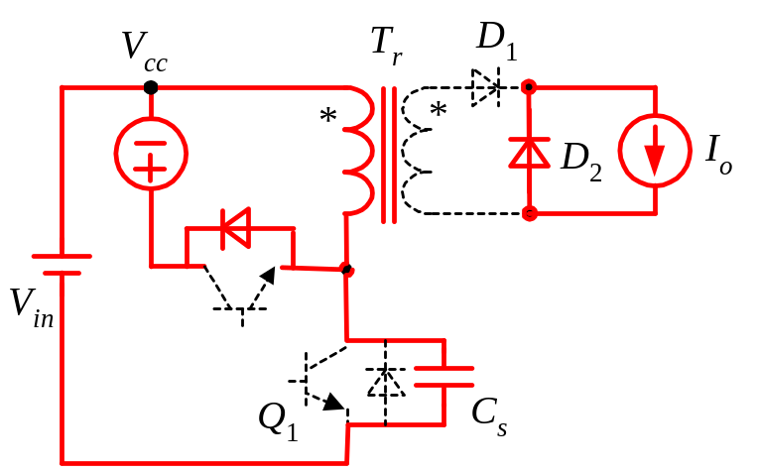
Operation Principle: [t₃ , t₄]

Slide 32
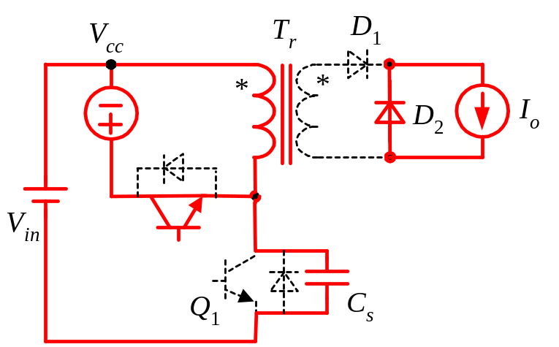
Operation Principle: [t₄ , t₅]

Slide 33

Operation Principle: [t₅ , t₆]

Slide 34
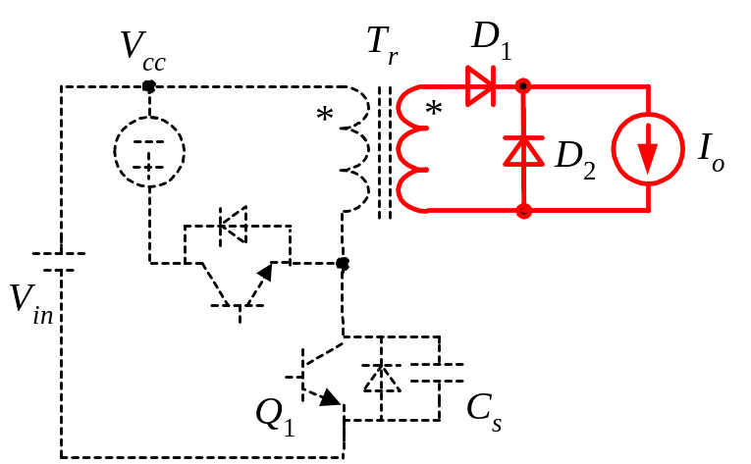
Operation Principle: [t₆ , t₇]

Slide 35
Introduction
Forward Converter with Reset Windings
Dual-Switch Forward Converter
Forward Converter with RCD Snubber
Forward Converter with Active Clamp Reset
Other Magnetic Reset Methods
Summary

Slide 36
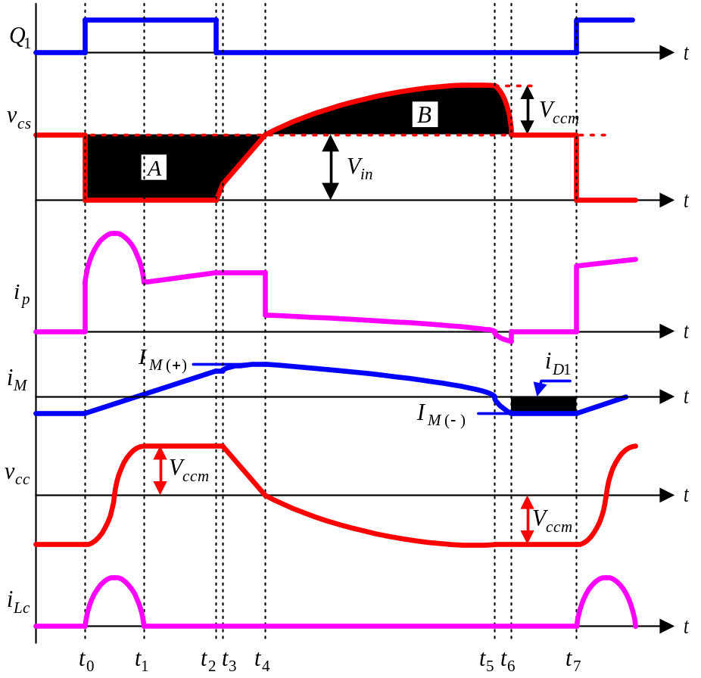
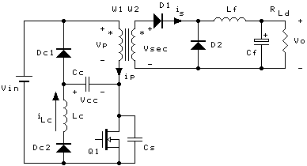

Slide 37
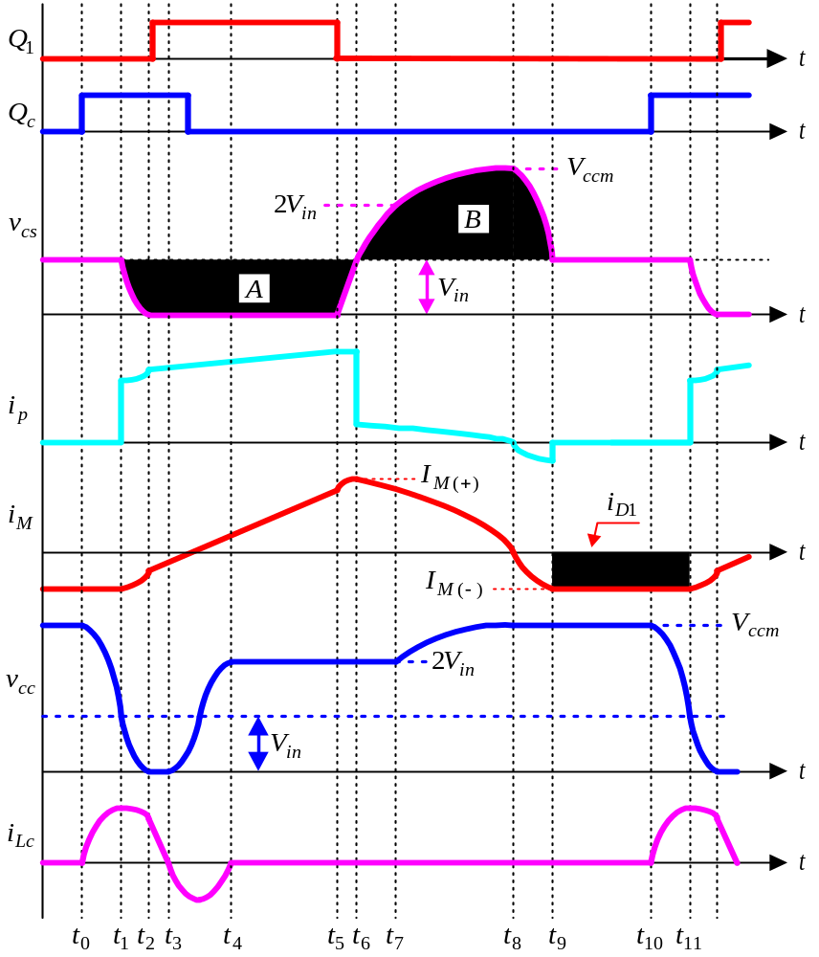
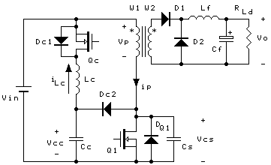
Zero-Voltage-Transition Forward Converter

Slide 38
Introduction
Forward Converter with Reset Windings
Dual-Switch Forward Converter
Forward Converter with RCD Snubber
Forward Converter with Active Clamp Reset
Other Magnetic Reset Methods
Summary

Slide 39



Comparison of Reset Circuit
Reset Winding
Dual-
Switch
RCD Snubber
Active Clamp
LCD
ZVT
Topology
Simple
Simple
Very Simple
Simple
Not Simple
Not Simple
Voltage Stress of Main Switch
2V_{inmax}
V_{inmax}
<2V_{inmax}
<2V_{inmax}
<2V_{inmax}
<2V_{inmax}
Switching of Main Switch
Hard-Switching
Hard-Switching
Hard-Switching
Hard-Switching
Hard-Switching
Zero-Voltage-
Switching
Magnetic Core
Unidirectional magnetization
Unidirectional magnetization
Unidirectional magnetization
Bidirectional magnetization
Unidirectional magnetization
Unidirectional magnetization
Duty Cycle
< 0.5
< 0.5
> 0.5
> 0.5
> 0.5
> 0.5
Efficiency
Not so high
high
low
High
Not so high
High
Input Voltage Range
Narrow
Narrow
Wide
Wide
Wide
Wide

Slide 40
Thanks for your attention !
Questions? / Answer!

