Slide 1
Fund-Raising Campaign for Local Foundation
Xuecheng Liu

Slide 2
Problem Summary
General Strategy
Goal: Increasing fundations of asset base from 15 to at least 100 million dollars in 10 years.
Each year invest in one of the 7 mixes to maximize the expected utility in next year.
Stochastic Programming
Sampling mix returns randomly
Dynamic Programming
Select the mix that maximizes the expected utility in the next year

Slide 3
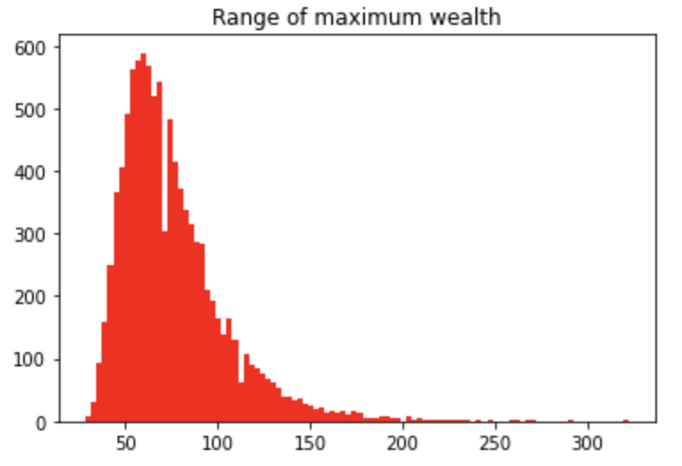
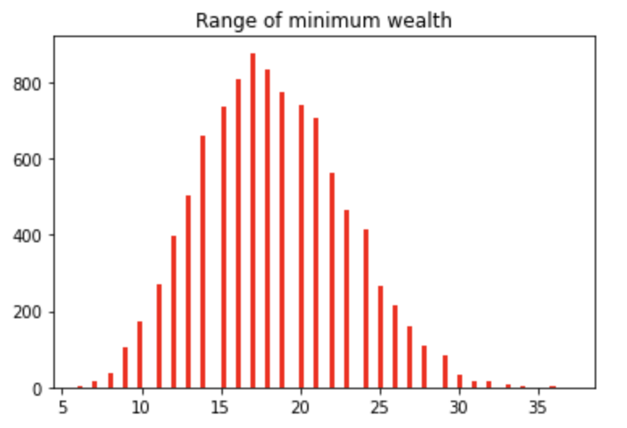
Future wealth estimation
Randomly pick a return from each scenario each year
Wealth range for year 10: [5,6,7,...120]

Slide 4
Implementation
Testing
Construct table for each stage
W ( wealth level)
EU (Expected Utility)
Decision ( which mix to invest)
Fix wealth range from [5..120] for each state
For a specific wealth level in each table, calculating the expected utility from next table and pick the best decision ( the decision that maximizes the expected utility)
Difficulty: how to select the expected utility if could not find a exact wealth level in next table
Choice:
Lower/upper bound of expected utility
Linear increment in expected utility

Slide 5
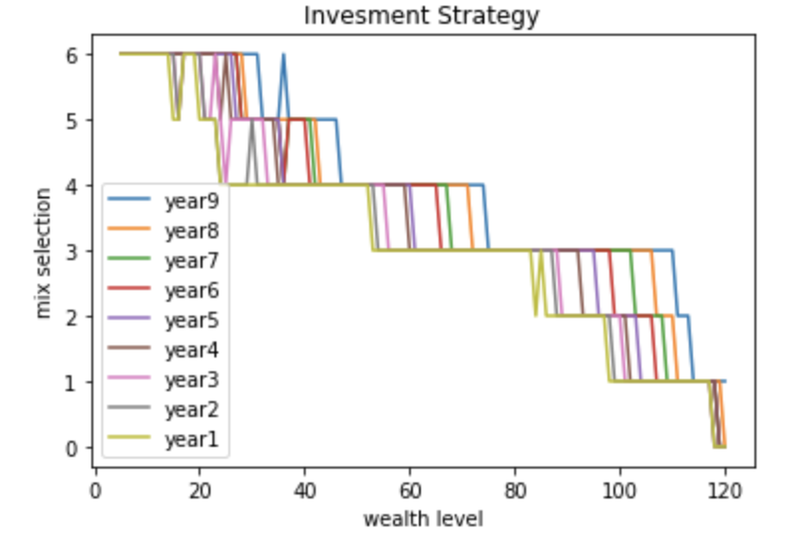
Investment Strategy
We are more likely to take aggressive investment (i.e. mix 5,6,7) when our wealth level is low
We are more likely to be risk adversely when our wealth level is high.
The actual strategy depends on the wealth level at each stage

Slide 6
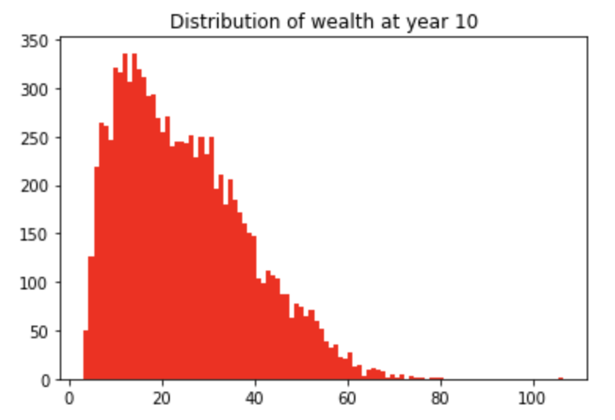
Model Testing
Generate 1 scenario per year, follow the strategy listed in each table
Repeat the whole process for 10000 times
Almost 0% chance to succeed.

Slide 7
Conclusion
Current mix
Wealth level is [15,17,20,22] for year 1
Under the current simulation, we might take mix [6,7,6,6]
The selection might differs for different simulation of returns
The effect of different choices of expected utility to decision is minor if interval of wealth range is small.
Wealth range for each year is the same, easier to implement, waste space.
Impact of death of donor A or B
Look for the corresponding decisions in the same table with different wealth level
Advantage of wide wealth range for each stage

Slide 8
Thank you!

