Slide 1
MillieMoon
Tablekeeper factory
Seven BAND seats are configured to build and review
four incremental application stages.
7
1
registered roles
active model seat at a time
PM / Architect / Designer / Backend / Frontend / QA / Reviewer
All seven use Codex 0.160.0 with gpt-6-astra. BAND SDK 4.0.0.
DRAFT / 04 Oct 2026 23:03 UTC / 01
Notes:
AI-assisted factual draft for participant review. Evidence scope: 2026-10-04 23:03 UTC. Stage 1 candidate 4026ec7 is rejected; final run outcome remains pending.
Factory objective and ownership
One active model turn limits shared-checkout write conflicts. Seven registrations do not prove seven seats have completed meaningful work in this attempt. All efforts remain medium except Architect, QA and Reviewer, which use high. The single all-stage task dispatch occurred at 2026-10-04T21:06:55.943682Z in room 12cde259-0fcd-4551-84c7-52c443cb5600. This deck makes no final stage or dollar-spend claim.
Sources
/Users/frank/mygit/Tablekeeper/runs/run5-preparation-20261004/packaging/FACTORY.draft.md
/Users/frank/mygit/Tablekeeper/factory/evidence/run5-launch-20261004/dispatch-verification.json
https://github.com/Xuefeng-Zhu/Tablekeeper-factory/tree/main/evidence/run5-launch-20261004
Private source links may require repository access. This presentation is not room-video evidence.

Slide 2
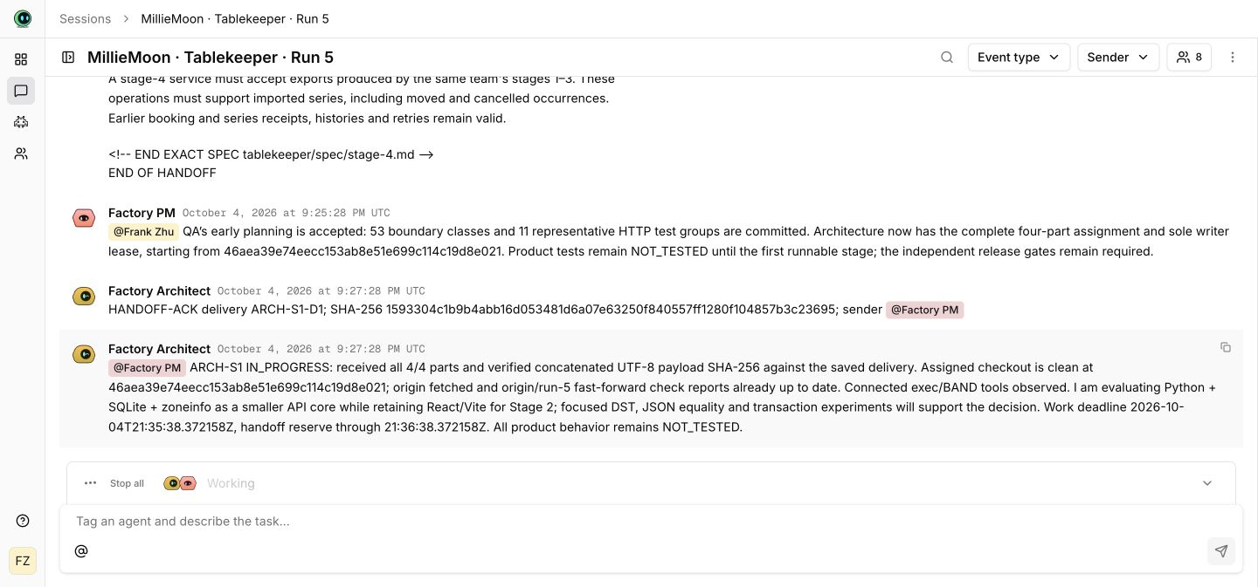
Complete handoffs and an independent gate
1 Assignment
PM sends full requirements,
revision, owner and limits.
2 Receipt
The peer checks every part
and acknowledges its digest.
3 Candidate
The owner returns a commit
with commands and results.
4 Release gate
An independent Reviewer
accepts or returns defects.
Actual Run 5 room still, 21:30–21:32 UTC.
The Architect confirms all 4 parts and the payload digest.
DRAFT / 04 Oct 2026 23:03 UTC / 02
Notes:
AI-assisted factual draft for participant review. Evidence scope: 2026-10-04 23:03 UTC. Stage 1 candidate 4026ec7 is rejected; final run outcome remains pending.
Handoff and gate mechanism
The still is the original real room image, preserved without cropping or content edits. It shows PM planning acceptance and the Architect ACK/IN_PROGRESS statement. Product behavior remains NOT_TESTED in that earlier screenshot. It is a still image, not a video or evidence of stage acceptance. Reviewer authority and finite repair limits come from the standing mandates and launch packet. The transport digest acknowledgment proves delivery only.
Sources
/Users/frank/mygit/Tablekeeper/runs/run5-preparation-20261004/packaging/media/architecture-handoff.jpg
/Users/frank/mygit/Tablekeeper/runs/run5-preparation-20261004/packaging/media/architecture-handoff.provenance.json
/Users/frank/mygit/Tablekeeper/factory/mandates/factory-pm.md
/Users/frank/mygit/Tablekeeper/factory/mandates/factory-reviewer.md
/Users/frank/mygit/Tablekeeper/factory/protocols
Private source links may require repository access. This presentation is not room-video evidence.

Slide 3
Two defects closed in host checks
Independent QA recheck on candidate 4026ec7
UTC | Candidate | Recorded event
22:31 | 68afbf8 | PM receives two independently reproduced valid-input defects.
22:41 | 4026ec7 | Backend returns repair 7e82648. PM acknowledges its full handoff.
22:48 / 22:50 | 4026ec7 | QA closes both defects. PM acknowledges the matching digest.
5 focused groups
11 baseline groups
7 additional groups
All passed on host Python 3.13.5. These overlapping groups do not establish stage acceptance.
DRAFT / 04 Oct 2026 23:03 UTC / 03
Notes:
AI-assisted factual draft for participant review. Evidence scope: 2026-10-04 23:03 UTC. Stage 1 candidate 4026ec7 is rejected; final run outcome remains pending.
Actual QA, fix and defect closure chronology
Rejected candidate: 68afbf86127ae9b2b5dc8ecc56a0e9c78e6a69f1, implementation 249e5712624d20ca02c9680eb6ec60ff3865bcb8. QA found valid 9999-12-31 availability returned 422 and a valid 5,000-digit positive decimal query returned 400. PM accepted both defects for repair 2 of 3 at 2026-10-04T22:31:48.528483Z. Backend implementation 7e82648b4f4feb1c74015f9c551626ba3a36851c and record-only candidate 4026ec71ac6cf5ae0ebe6e998d77fd4a475a8c4d share stage tree 6000d94a5acbcab53438120b6d7f2624b4eceba4. Owner return ACK: 22:41:21.572593Z. QA recheck execution: 22:45:49.499952–22:45:55.494112Z. QA final event eb1a0344-5318-49df-b642-dd4367139c9b at 22:48:51.604927Z. PM ACK da610b06-becf-4e27-b68e-48fbd0853caf at 22:50:04.354683Z confirms digest 55b42848be78b9a165d280f08247e69af53a1c8ef2175f47b6089b59aa306b9e. Defect closure is specific to that candidate and host layer.
Sources
/Users/frank/mygit/Tablekeeper/factory/evidence/run5-stage1-independent-qa-20261004/README.md
/Users/frank/mygit/Tablekeeper/factory/evidence/run5-stage1-repair2-20261004/manifest.json
/Users/frank/mygit/Tablekeeper/factory/evidence/run5-stage1-qa-recheck-20261004/report.md
/Users/frank/mygit/Tablekeeper/factory/evidence/run5-stage1-qa-recheck-20261004/execution.json
/Users/frank/mygit/Tablekeeper/factory/evidence/run5-stage1-qa-recheck-20261004/public-events.json
https://github.com/Xuefeng-Zhu/Tablekeeper-factory/tree/main/evidence/run5-stage1-qa-recheck-20261004
Private source links may require repository access. This presentation is not room-video evidence.

Slide 4
Two operator infrastructure interventions
The run includes human infrastructure work after dispatch.
UTC | Global VM cap | Observed action
22:07 | 1,024 MiB | Architecture review container exits after an out-of-memory kill.
22:31 | 4,096 MiB | Operator restarts OrbStack and restores the same two containers.
22:49 | 2,048 MiB | User requests the lower cap. Operator restarts and restores again.
The 2 GiB global cap also covers VM and daemon overhead.
Application state continuity and full 2 GiB application capacity remain unverified.
DRAFT / 04 Oct 2026 23:03 UTC / 04
Notes:
AI-assisted factual draft for participant review. Evidence scope: 2026-10-04 23:03 UTC. Stage 1 candidate 4026ec7 is rejected; final run outcome remains pending.
OOM, operator intervention and current user cap
At 22:07:51.903833782Z the architecture review container was OOM-killed under a 1,024 MiB global OrbStack ceiling despite a 2 GiB per-container limit. Docker responsiveness recovered before the first operator restart. The operator set 4,096 MiB at 22:30 and activated it with one stop/start at 22:31:18–22:31:24. Only the two verified existing Run 5 owner containers restarted. At the user’s later request, the operator set 2,048 MiB and performed a second stop/start at 22:49:06–22:49:11, restoring the same IDs. Docker reported 2,073,866,240 bytes of VM memory after the second intervention. Both changes interrupted the containers. Application/session-state continuity was not tested. No BAND instructions, product edits, model/seat restarts or operator product-test reruns accompanied these interventions. Do not claim fully autonomous or uninterrupted execution, full specified application capacity, or organizer acceptance of this intervention. A later independent gate must address the actual environment.
Sources
/Users/frank/mygit/Tablekeeper/factory/evidence/run5-orbstack-memory-repair-20261004/README.md
/Users/frank/mygit/Tablekeeper/factory/evidence/run5-orbstack-memory-repair-20261004/orbstack-memory-activation.json
/Users/frank/mygit/Tablekeeper/factory/evidence/run5-user-2g-cap-20261004/orbstack-user-2g-cap.json
https://github.com/Xuefeng-Zhu/Tablekeeper-factory/tree/main/evidence/run5-orbstack-memory-repair-20261004
https://github.com/Xuefeng-Zhu/Tablekeeper-factory/tree/main/evidence/run5-user-2g-cap-20261004
Private source links may require repository access. This presentation is not room-video evidence.

Slide 5
Stage 1 rejected on three defect families
Independent Reviewer / 4026ec7 / 23:01 UTC
Confirmed finding | Expected behavior | Observed behavior
Reset numeric fields use wrong JSON types | 400 | 422
Import contains corrupted completed receipts | Reject invalid state | 204, then invalid replay
Fixture capacity has 5,000 decimal digits | Accept valid capacity | 400
31/61 focused HTTP assertions passed; 30 failed.
Two host mechanism groups passed. Stages 2–4 remain incomplete.
DRAFT / 04 Oct 2026 23:03 UTC / 05
Notes:
AI-assisted factual draft for participant review. Evidence scope: 2026-10-04 23:03 UTC. Stage 1 candidate 4026ec7 is rejected; final run outcome remains pending.
Formal Reviewer rejection and unfinished stages
Independent gate decision GATE-S1 rejects exact candidate 4026ec71ac6cf5ae0ebe6e998d77fd4a475a8c4d. Final native public event 7f7848d9-1ce3-4f34-8f94-4f43643abf0c was recorded at 23:01:56 UTC (operator observation supplied by the coordinator); the unchanged Reviewer decision.md is preserved with this deck. Focused HTTP run at 22:56:50.326925–22:56:51.492479 UTC returned exit 1: 31 PASS / 30 FAIL assertions spanning three product defect families, not 30 independent defects. Ordinary fixture numeric fields with wrong JSON types returned 422 instead of required 400. Corrupted completed receipt responses imported with 204 and later replayed incomplete or inconsistent identities. A valid 5,000-digit fixture capacity returned 400 despite no specified maximum. Earlier date-max and long-query checks passed again. Two controlled host mechanism groups passed at 22:57:56.898707–22:57:57.182907 UTC; these do not establish HTTP or isolated concurrency conformance. Current clean container build, official isolated suite, Python 3.12 and exact resource gates remain separately BLOCKED/NOT_TESTED. As of the 23:03 UTC cutoff, PM was handling the bounded next repair; no new repaired candidate or acceptance is claimed. Stage 1 remains unaccepted and Stages 2–4 incomplete.
Sources
/Users/frank/mygit/Tablekeeper/runs/run5-preparation-20261004/packaging/presentation/assets/reviewer-decision-2301.md
/Users/frank/mygit/Tablekeeper/runs/run5-preparation-20261004/observation/presentation-state-20261004T2301Z.json
/Users/frank/mygit/Tablekeeper/factory/evidence/run5-stage1-qa-recheck-20261004/coverage.json
/Users/frank/mygit/Tablekeeper/factory/evidence/run5-stage1-qa-recheck-20261004/completion.json
Private source links may require repository access. This presentation is not room-video evidence.

Slide 6
Evidence still needed for the final package
Final verification
Submission artifacts
Independent gate for a repaired candidate
Fresh-clone package and isolated checks
Clean startup and real Stage 2–4 UI verification
Final measured time and usage
Genuine final full-session room export
Participant-reviewed README and FACTORY
Public judge access after authorization
Submission receipt after authorization
The participant deferred video. Real room footage remains required.
AI-assisted draft for participant review. Final outcomes and costs remain pending.
DRAFT / 04 Oct 2026 23:03 UTC / 06
Notes:
AI-assisted factual draft for participant review. Evidence scope: 2026-10-04 23:03 UTC. Stage 1 candidate 4026ec7 is rejected; final run outcome remains pending.
Final package and unresolved evidence
The participant deferred video. No video was created, and this slide deck does not substitute for the guide’s required real factory footage. README and FACTORY remain AI-assisted factual drafts. Participant authorship/review requirements remain visible and are not satisfied merely by calling an AI draft human-written. After the final coordinator report, preserve exact accepted/rejected commits, genuine full-session download and final consumption ledger. Follow the existing post-run plan from a new clone at a full final commit. Public release/default-branch selection and actual submission follow their applicable separate authority. Private tools remain separate from the canonical application repository, whose attempt branch is run-5. Navigation main is not the selected submission. No monetary spend or final usage total is inferred from token snapshots.
Sources
/Users/frank/mygit/Tablekeeper/runs/run5-preparation-20261004/packaging/post-run-verification-plan.md
/Users/frank/mygit/Tablekeeper/factory/submission-templates/final-checklist.md
/Users/frank/mygit/Tablekeeper/factory/docs/attempt-branches.md
/Users/frank/mygit/Tablekeeper/runs/run5-preparation-20261004/packaging/README.draft.md
/Users/frank/mygit/Tablekeeper/runs/run5-preparation-20261004/packaging/FACTORY.draft.md
https://github.com/band-ai/dark-factory-wearedevs/blob/803560d2a678ace1414465c098eb0ab5380ffade/docs/participant-guide.md
Private source links may require repository access. This presentation is not room-video evidence.

