Slide 1
NurseBridge
Voice intake with context for the nurse
AssemblyAI Voice Agent Hackathon
Simulation only. Fictional information. Not for medical care.
Notes:
NurseBridge is a fictional simulation, not for medical care. Product sources: docs/architecture.md, docs/voice-agent.md and docs/demo-script.md. Actual app captures under artifacts/demo/source show labeled local mock replay. No production, clinical, physical-device or real telephone-network acceptance is claimed.
AssemblyAI Voice Agent Hackathon submission deck. All caller information is fictional.

Slide 2
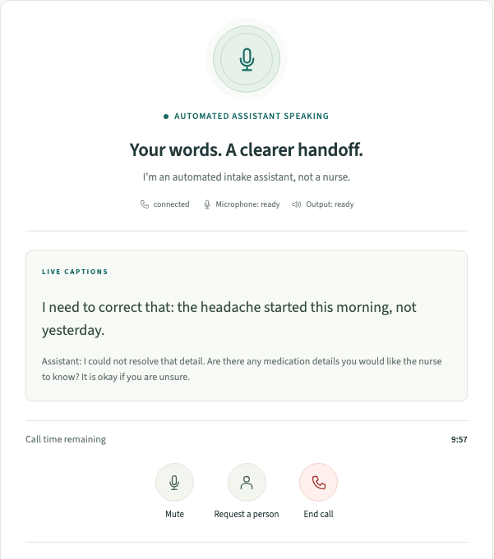
The intake handoff
A caller has a story.
The nurse needs usable context.
Details can change during a conversation. A useful intake draft needs to retain corrections and uncertainty.
NurseBridge explores collecting that context while the caller waits for a nurse.
Mock replay interface
02
Notes:
NurseBridge is a fictional simulation, not for medical care. Product sources: docs/architecture.md, docs/voice-agent.md and docs/demo-script.md. Actual app captures under artifacts/demo/source show labeled local mock replay. No production, clinical, physical-device or real telephone-network acceptance is claimed.
The problem and proposed benefit are hypotheses for nurse workflow research. Screenshot: artifacts/demo/source/caller-intake.png.

Slide 3
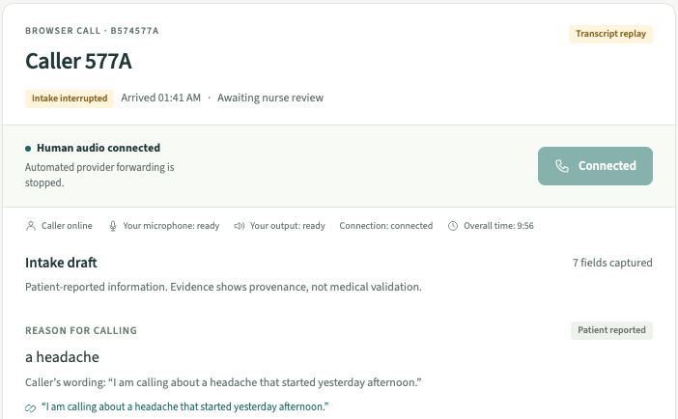
Caller to nurse
1
Join the queue
Human access remains available.
2
Share a fictional story
The assistant collects intake details.
3
Review the draft
A nurse can inspect source words.
4
Take over the call
Automated forwarding stops.
Fictional mock replay with browser human audio
03
Notes:
NurseBridge is a fictional simulation, not for medical care. Product sources: docs/architecture.md, docs/voice-agent.md and docs/demo-script.md. Actual app captures under artifacts/demo/source show labeled local mock replay. No production, clinical, physical-device or real telephone-network acceptance is claimed.
Screenshot: artifacts/demo/source/human-handoff.png. Mock intake fixtures and actual browser audio transport are separate layers. The capture uses synthetic microphone inputs.

Slide 4
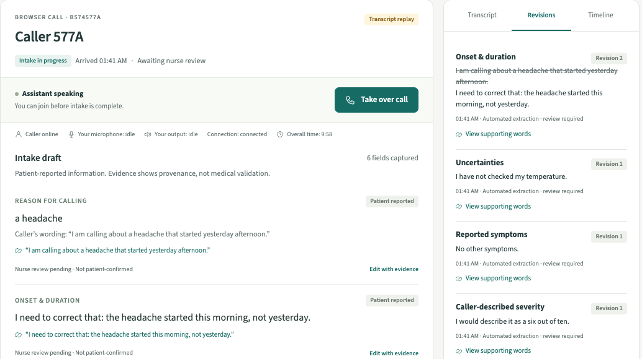
Corrections retain source words
“The headache started this morning, not yesterday.”
The current draft changes. The original words and correction history remain available for review.
Unmeasured and uncertain details remain explicit. The draft awaits nurse review.
04
Notes:
NurseBridge is a fictional simulation, not for medical care. Product sources: docs/architecture.md, docs/voice-agent.md and docs/demo-script.md. Actual app captures under artifacts/demo/source show labeled local mock replay. No production, clinical, physical-device or real telephone-network acceptance is claimed.
Screenshot: artifacts/demo/source/nurse-evidence.png. Original fictional correction: I need to correct that: the headache started this morning, not yesterday. Supporting words establish provenance rather than medical accuracy.

Slide 5
Technology and control
Conversation
Application authority
AssemblyAI Voice Agent
Cloudflare Workers
Speech, turn-taking and agent audio
Next.js through OpenNext
Durable Object
Nebius Nemotron-3.5-Lightning
Consent, evidence revisions and nurse takeover
Conversation model and independent structured extraction
D1 stores projections. R2 holds private exports.
Human conversation bypasses the automated providers after takeover.
05
Notes:
NurseBridge is a fictional simulation, not for medical care. Product sources: docs/architecture.md, docs/voice-agent.md and docs/demo-script.md. Actual app captures under artifacts/demo/source show labeled local mock replay. No production, clinical, physical-device or real telephone-network acceptance is claimed.
The AssemblyAI conversation uses configured Nebius Nemotron-3.5-Lightning. Independent extraction validates finalized caller evidence. The CallSession Durable Object controls consent and human takeover. D1 stores projections and R2 private exports.

Slide 6
Evidence and its limits
168
177
29
Unit tests pass
Workers tests pass
Browser tests pass
29 Sep 2026 local regression run. 19 tooling tests also passed.
The regression run skipped one separate live-provider test.
Local real-provider proof
Remaining release gates
29 Sep 2026: finalized transcript, evidence-linked fact and two-way browser audio using recorded microphones.
Hosted operation, physical-device audio, provider recording controls and real telephone calls.
06
Notes:
NurseBridge is a fictional simulation, not for medical care. Product sources: docs/architecture.md, docs/voice-agent.md and docs/demo-script.md. Actual app captures under artifacts/demo/source show labeled local mock replay. No production, clinical, physical-device or real telephone-network acceptance is claimed.
Sources: docs/test-results.md and docs/evidence/polished-live-voice-2026-09-29.json. Regression results: 168 unit, 177 Workers, 19 tooling, 29 browser, with one live-provider test skipped in that regression run. Separate opted-in local AssemblyAI/Nebius acceptance passed on the polished source revision 743cce2 on 29 Sep 2026 in 30.8 seconds, using recorded microphones. It produced one finalized caller turn, one evidence-linked fact, three assistant turns, non-silent human playback in both receiving worklets, zero stale agent samples, and zero dropped frames. The case finished CLOSED and deleted, with no pending provider deletions or unresolved provider connections. These are individual local observations, not reliability or latency guarantees. Provider API logical deletion is not proof of physical erasure or backup expiry. Public live activation still requires recording-control and physical-device acceptance. No hosted deployment or real telephone-network acceptance is claimed.

Slide 7
Proposed users and next validation
Proposed users
Next validation
Nurses who need caller context before joining a conversation.
Nurse interviews and fictional case reviews
Two physical devices and audible handoff
Business hypothesis
Provider recording controls and hosted acceptance
A paid workspace for nurse-line operators, if interviews and workflow trials establish value.
Live telephone call for the optional phone path
07
Notes:
NurseBridge is a fictional simulation, not for medical care. Product sources: docs/architecture.md, docs/voice-agent.md and docs/demo-script.md. Actual app captures under artifacts/demo/source show labeled local mock replay. No production, clinical, physical-device or real telephone-network acceptance is claimed.
Proposed users and business model remain hypotheses. No customers, clinical partners, user interviews, measured time savings or clinical outcomes are claimed. Pending verification sources: docs/production-readiness.md, docs/phone-inbound.md and docs/safety-and-privacy.md.

