Slide 1
Tablekeeper
A restaurant service built by a seven-seat factory
The Build Guild · Codex · GPT-6.1 Sol
Local development run · October 5, 2026
One independently accepted stage. A public Stage 2 demo.
The Build Guild · Tablekeeper / Local Sol · 1
Notes:
Official event: https://lablab.ai/ai-hackathons/wearedevelopers-hackathon
Canonical artifacts: https://github.com/Xuefeng-Zhu/Tablekeeper
Room 4084182d-0b85-46d6-a137-f0bd7d44b498. This is a local development/practice run with human amendments, not a claim of judged autonomy.

Slide 2
Seven seats with clear ownership
Seat | Responsibility
PM | Queue, ownership, integration and scope
Architect | API, state, time and upgrade decisions
Designer | Journeys, visual states and rendered review
Backend | Independent service stages and atomic changes
Frontend | Booking screens and uncertain-response recovery
QA | Independent behavior, browser and upgrade checks
Reviewer | Exact-candidate rejection and release decisions
The Build Guild · Tablekeeper / Local Sol · 2
Notes:
All seven standing mandates specify Harness: Codex; Model: gpt-6.1-sol. Source: result-local-sol-20261005/mandates. Factory accounts use literal verified roster IDs. Event scoring: https://lablab.ai/ai-hackathons/wearedevelopers-hackathon (Factory 50%, App 25%, Agent Teamwork 25%).

Slide 3
Durable handoffs and one active writer
01
Assign a scoped work item
Owner, requirements, starting revision and evidence paths.
02
Confirm the complete handoff
Numbered parts, digest and addressed receipt.
03
Implement under one writer lease
Attributable commits; exact candidates remain fixed for review.
04
Accept or return a specific defect
Independent checks, preserved failures and bounded repairs.
The Build Guild · Tablekeeper / Local Sol · 3
Notes:
Source: runs/local-sol-20261005/factory.yaml, runtime/workflow-4084182d-0b85-46d6-a137-f0bd7d44b498.json, task board and handoff journals. Current administrative workflow permits implementation after accepted architecture/design without waiting for QA planning. Final independent QA and Reviewer acceptance remain required. No remote infrastructure is an application runtime dependency.

Slide 4
Stage 1 accepted after concrete repairs
120 / 120
Supplied isolated checks passed
Reviewer challenged calendar and UTC boundary behavior.
Backend repaired unbounded queries and extreme booking instants.
Accepted exact candidate: b3df393 · Stage 1 only
The Build Guild · Tablekeeper / Local Sol · 4
Notes:
Accepted candidate b3df39340cee6f738ac79a12dd1347fc38e969e9. Reviewer record: result-local-sol-20261005/.evidence/reviewer-s1-repair2-20261006T0428Z/record.json, acceptance at 2026-10-06T04:32:06.210433Z. Official isolated report completed 04:29:13.361588Z, 120 passed, 0 failed/errors/skips. Earlier rejected candidates bfff047 and 799ff7f retained. This is independent local factory release evidence, not organizer judging.

Slide 5
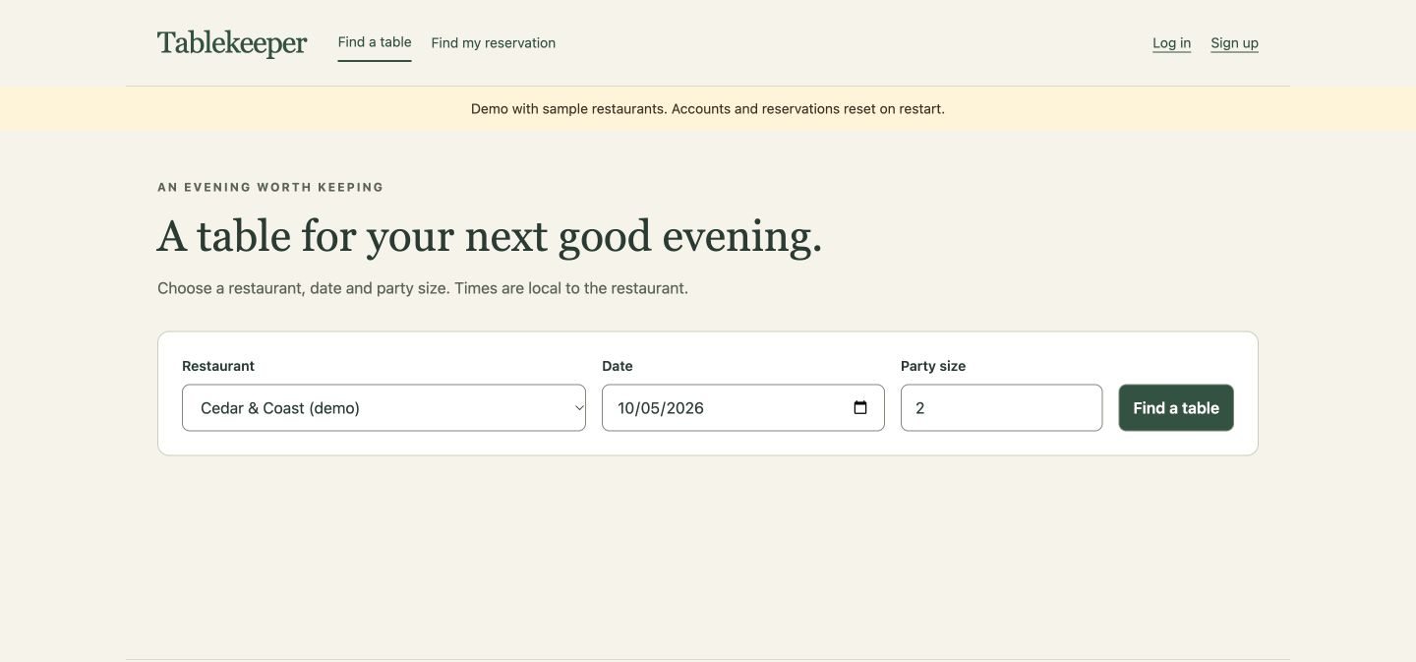
Stage 2 demo on Render
Search · pairs · booking · lookup
8 live HTTP smoke groups passed
Fictional venues. Accounts and reservations reset on restart.
Deployed: b1f7ef6 → 382998f · New factory candidate: 108bcd4, review pending
The Build Guild · Tablekeeper / Local Sol · 5
Notes:
Live app: https://tablekeeper-stage2.onrender.com
Deployment commit 382998fe143268754ade2ed2702090df3f71ef56 in https://github.com/Xuefeng-Zhu/tablekeeper-stage2. Source candidate b1f7ef64db7f0dce0b3f3a913a3af280c96d70b9. Factory UI repair candidate 108bcd4c48fa4fb4d7dedf286e94c8e4937f7f10 remains pending final Reviewer acceptance at deck preparation. Eight actual HTTPS smoke groups passed in runs/render-stage2-verification/live-smoke-20261006T060444Z.json. Screenshot source: submission/build-guild-demo/raw/00020.jpg, actual captured browser footage. Public deploy adds separate sample-seed adapter, closes test routes and retains in-memory behavior.

Slide 6
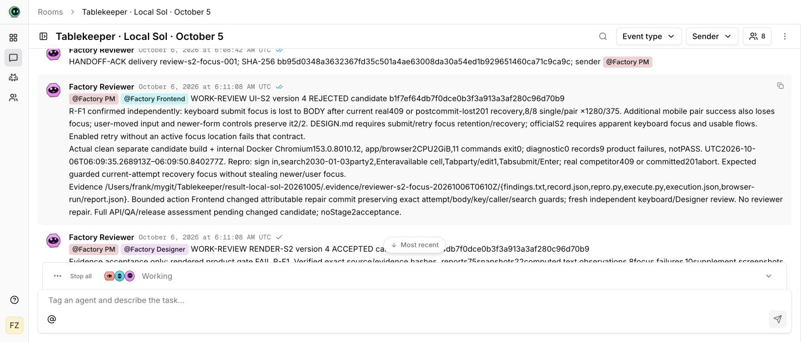
The room shows review changing the work
A real handoff, receipt and rejection
Reviewer found keyboard focus loss after booking responses.
Video: 3m 26s with the generating room and public walkthrough.
The Build Guild · Tablekeeper / Local Sol · 6
Notes:
Actual generating room: Tablekeeper · Local Sol · October 5, ID 4084182d-0b85-46d6-a137-f0bd7d44b498. Video submission/build-guild-demo/output/The-Build-Guild-Tablekeeper-Demo.mp4, 205.932682 seconds, actual room footage and public walkthrough. Recorded PM→Reviewer review-s2-focus-001 sent 06:07:50Z, acknowledged 06:08:42Z; UI b1f7ef6 rejection at 06:11:08Z for R-F1 keyboard focus. Source screenshot selected from captured actual room-review-rejection footage. Video QA remains separately scoped; not a proof of final acceptance.

Slide 7
Measured progress and remaining gates
104,037,922 reported tokens
3h 15m 27s elapsed · Snapshot: 06:23:11 UTC, October 6
300m total allowance · USD cost unavailable
Local practice includes human amendments and administrative restarts.
Next: final Stage 2 review, full room export, participant-authored docs.
https://github.com/Xuefeng-Zhu/Tablekeeper
The Build Guild · Tablekeeper / Local Sol · 7
Notes:
Dated read at 2026-10-06T06:23:11.996979Z: cumulative reported tokens 460625777 minus retained baseline 356587855 = 104037922 run tokens, including cached input; initial dispatch 03:07:44.138296Z, elapsed 3h15m27.859s. Source submission/build-guild-demo/README.md and runs/local-sol-20261005 accounting/ledger. This is not final usage, dollars, subscription quota or a cost forecast. User-approved run allowance 300000000 total, cumulative cap 656587855. Canonical repository https://github.com/Xuefeng-Zhu/Tablekeeper. Human scheduling/budget amendments and drained administrative restarts disclosed. Participant guide at pinned 803560d2a678ace1414465c098eb0ab5380ffade requires participant-authored README.md/FACTORY.md, genuine end-of-run full room export and public GitHub. Event https://lablab.ai/ai-hackathons/wearedevelopers-hackathon.

