Slide 1
Eggshell Homebuilders
“Making Dreams Come True”
Final Project: Group 3:
Benjamin Gummoe
Sonal Malavia
Katarina Shaw
Xuefeng Zhai

Slide 2

Meet William and Kate...
They just got married, and he wants to surprise her with a dream home.

Slide 3

The Eggshell Homebuilder Team will make their dream come true.

Slide 4
William can do much of the planning without stopping by the Eggshell Homebuilder offices

Slide 5
During his lunch break, William...
Becomes a Customer
Researches Locations
Creates user account
Researches schools
Logs on
Views subdivisions
Views available lots

Slide 6
After work, William visits Eggshell
Becomes a Customer
Researches Locations
Purchases a House
Creates user account
Researches schools
Chooses lot
Logs on
Views subdivisions
Submits forms and agreements
Views available lots
Submits contract

Slide 7
At his apartment, William...
Becomes a Customer
Researches Locations
Purchases a House
Customizes Home
Views Progress
Creates user account
Researches schools
Chooses lot
Selects house layout
Views current stage
Logs on
Views subdivisions
Submits forms and agreements
Selects options/
upgrades
Views task completion percentage
Views available lots
Submits contract
Views task status updates

Slide 8
Eggshell can manage William’s construction project
… and many others

Slide 9






Employee Roles
Admin
Sales Manager
Construction Manager

Slide 10
Admin Dashboard
Function: Number of active employees
Report: The project manager assignments
The default access for the database owner.

Slide 11
Sales Manager Dashboard
View: All empty lots
Package: List the sales record of each sales agent
Enforced using a ‘sales_agent’ database role. This role is designed to provide access to sales-related tables, views, and objects.

Slide 12
Construction Manager Dashboard
Report: The construction project status for a specified house.
View: All houses that are still under construction.
Job: Receive automatic updates about which construction projects are ending today.
Enforced using a ‘project_manager’ database role. This role is designed to provide access to sales-related tables, views, and objects.

Slide 13
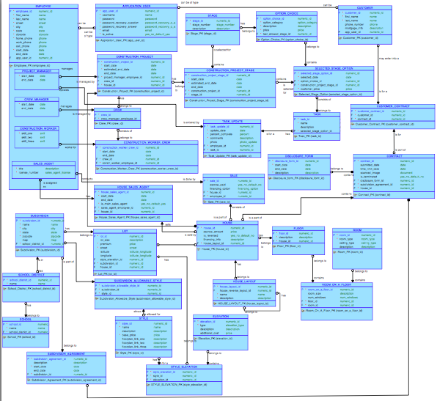
ERD Model
Overview
2 instances of denormalization (Construction worker skills and layout links)

Slide 14
Enforcing Business Rules & Database Constraints

Slide 15
Option Triggers
Enforce timing for “Option Selection”
Trigger 1
Blocks options that are selected beyond the current construction stage
Blocks options that are selected too far behind the current construction stage
Only allows options valid for a specified construction stage
Trigger 2
Sets no price markup on options selected for the appropriate stage
Calculates and sets 15% price markup on options selected late (for the previous construction stage)

Slide 16
Trigger 1 Result
Trigger 2 Result

Slide 17
Additional Design Constraints
Design Constraints
Ensure subdivision only allows certain styles
Ensure construction crew membership
‘Run-of-the-mill’ Check Constraints
Validate email address format
Validate address components
Validate option category
Validate room types
Boolean fields

Slide 18
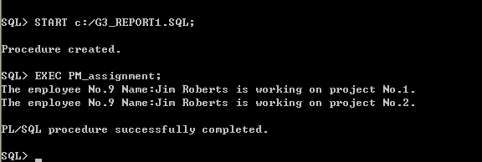
Report 1
DIsplays the assignment of project managers to projects.

Slide 19
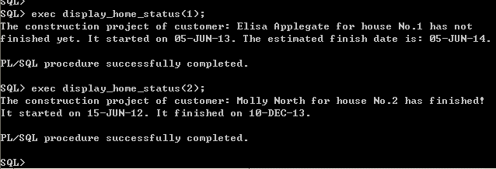
Report 2
Displays the construction project status of a house.

Slide 20

Happy Holidays!
Like William, we hope that all of your dreams come true.

