Slide 1
Using DenseFly algorithm for cell searching on massive scRNA-seq datasets
Test Datasets
Yixin Chen ^{[0000-0002-2946-5122]}, Sijie Chen ^{[0000-0003-4331-0773]} and Xuegong Zhang* ^{[0000-0002-9684-5643]}

Slide 2
Simulation Datasets

Slide 3
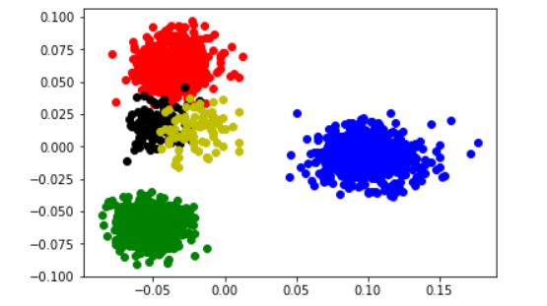
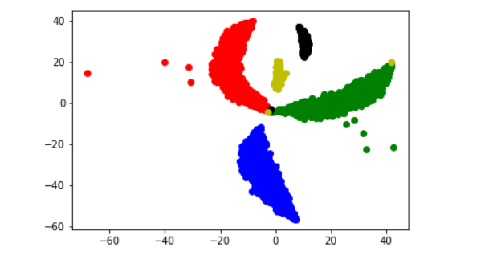
SIM I
Size: 2000 samples * (10000Genes + 1 label dimension)
Clusters: 1 batch with 5 clusters (0.3, 0.3, 0.3, 0.05, 0.05)
Accession: generated by splatter with the script: Toy_Data.R
Explanation: the toy data (simplest) without dropout and batch effect
Usage: to check the feasibility of a method
PCA
tsne

Slide 4
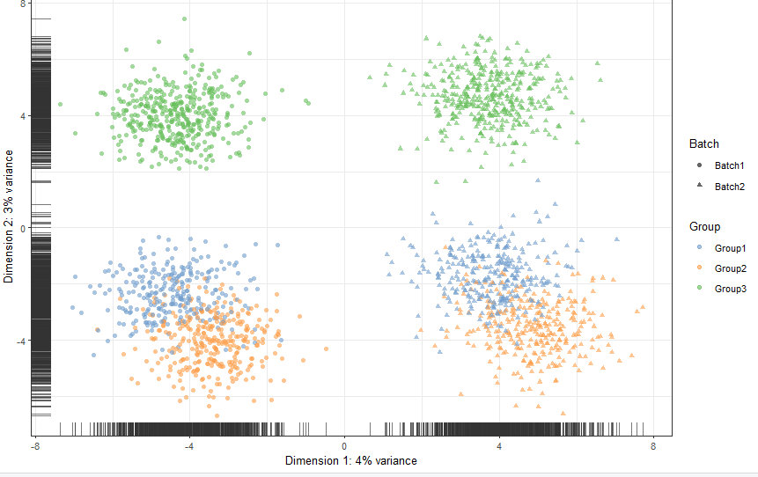
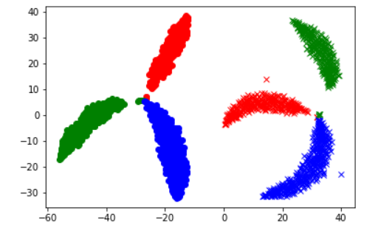
SIM II
Size: (1k + 1k) samples * (10000Genes + 2 label dimensions)
Clusters: 2 batches each 3 clusters (0.3, 0.3, 0.4)
Accession: generated by splatter with the script: Batch_Data.R
Explanation: the toy data with batch effect
Usage: to study the resistance to batch effect
PCA
tsne

Slide 5
SIM III
Size: 2000 samples * (10000Genes + 1 label dimension)
Clusters: 1 batch with 5 clusters (0.3, 0.3, 0.3, 0.05, 0.05)
Accession: generated by splatter with the script: Dropout_Data.R
Explanation: the toy data with dropout
Usage: to study the resistance to dropout
Dataset Num. | 0 | 1 | 2 | 3 | 4 | 5
Dropout rate | 0 | 0.1544 | 0.2515 | 0.3528 | 0.4341 | 0.5360
P.S: The initial dataset(without dropout) has about 45% zero counts.

Slide 6
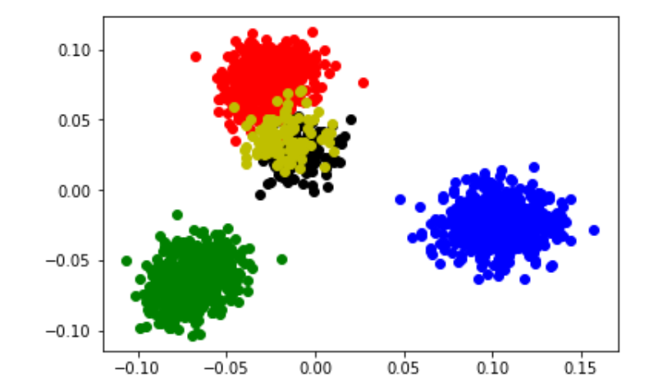
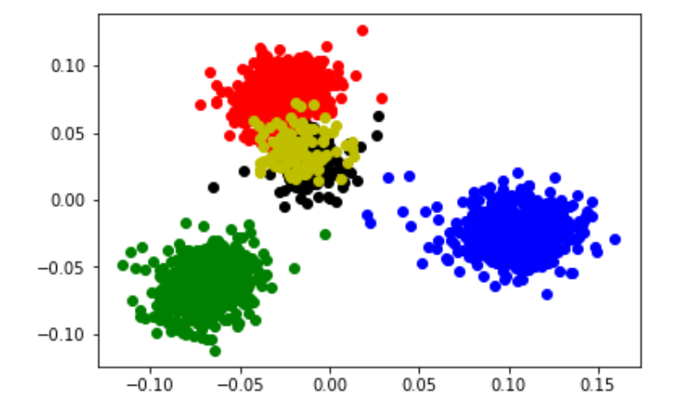
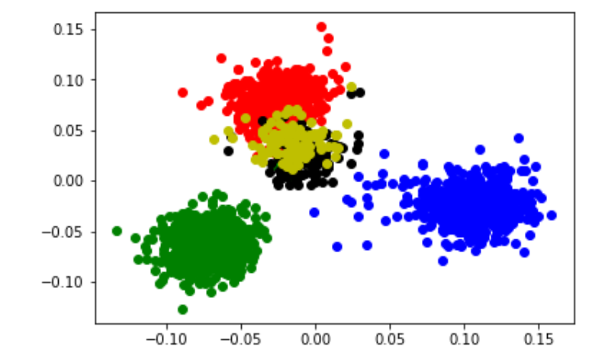
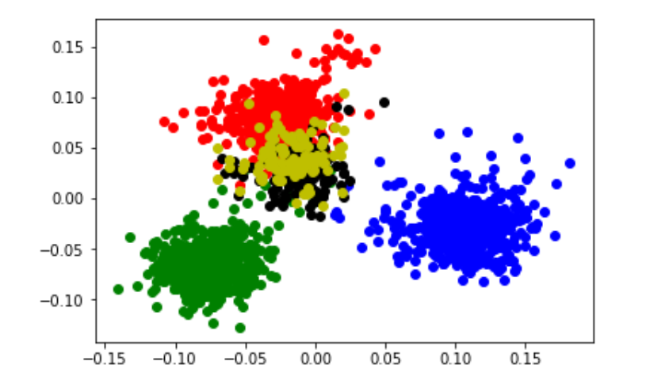
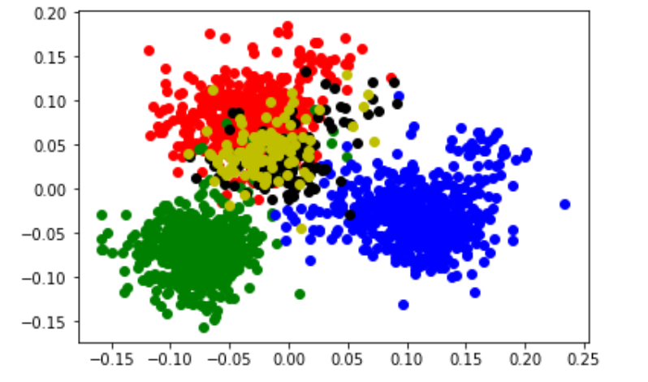
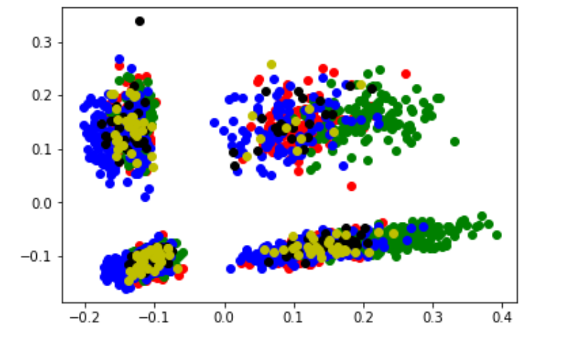
PCA_dataset0
PCA_dataset1
PCA_dataset2
PCA_dataset3
PCA_dataset4
PCA_dataset5

