Slide 1
Using DenseFly algorithm for cell searching on massive scRNA-seq datasets
Additional File 1: details of simulation datasets
Yixin Chen, Sijie Chen, Xuegong Zhang* Tsinghua University

Slide 2
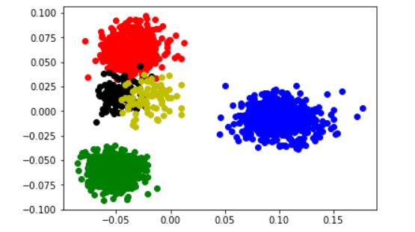
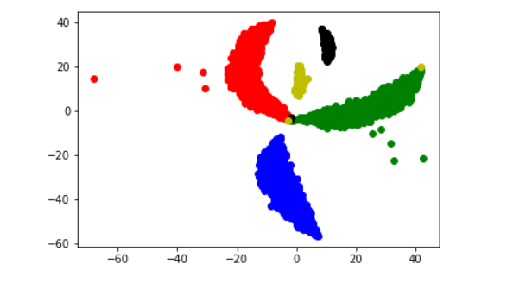
SIM I
Size: 2000 cells * 10000 Genes
Clusters: 1 batch with 5 clusters, proportions= (0.3, 0.3, 0.3, 0.05, 0.05)
Accession: generated by splatter with the script: data_generator/SIM_I.R
Explanation: the dataset for self-mapping without dropouts or batch effects
Usage: to prove the feasibility of a method
PCA
tsne

Slide 3
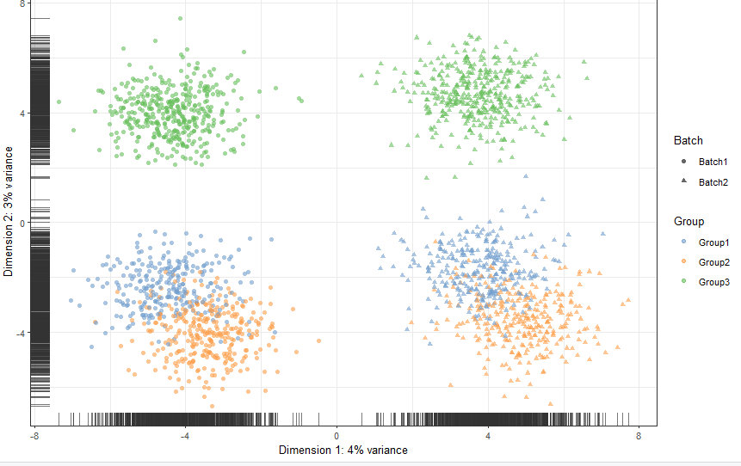
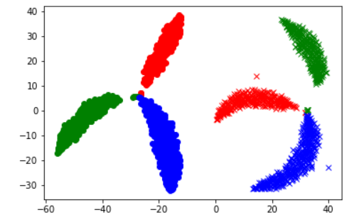
SIM II
Size: (1,000 + 1,000) samples * 10000Genes
Clusters: 2 batches, each with 3 clusters, proportions= (0.3, 0.3, 0.4)
Accession: generated by splatter with the script: data_generator/SIM_II.R
Explanation: the dataset with batch effects
Usage: to study the resistance to batch effects of the algorithm
PCA
tsne

Slide 4
SIM III
Size: 2000 samples * (10000Genes + 1 label dimension)
Clusters: 1 batch with 5 clusters, proportions=(0.3, 0.3, 0.3, 0.05, 0.05)
Accession: generated by splatter with the script: data_generator/SIM_III.R
Explanation: the datasets with dropout events
Usage: to study the resistance to dropout of the algorithm
Dataset No. | 0 | 1 | 2 | 3 | 4 | 5
Dropout rate | 0 | 0.1544 | 0.2515 | 0.3528 | 0.4341 | 0.5360
P.S: The initial simulated dataset(without dropout) has about 45% zero counts. Hence the percentage of zero in SIM III. 5 is as high as 98%.

Slide 5
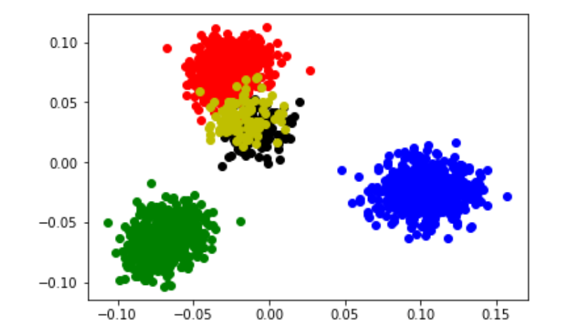
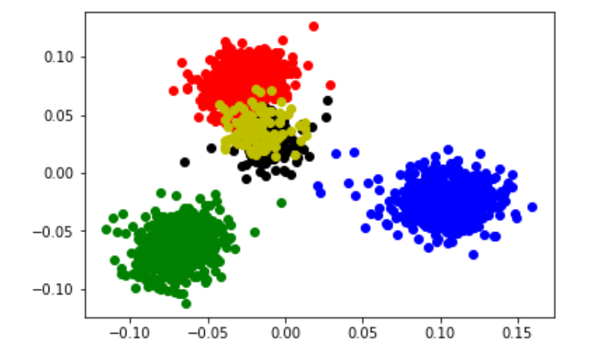
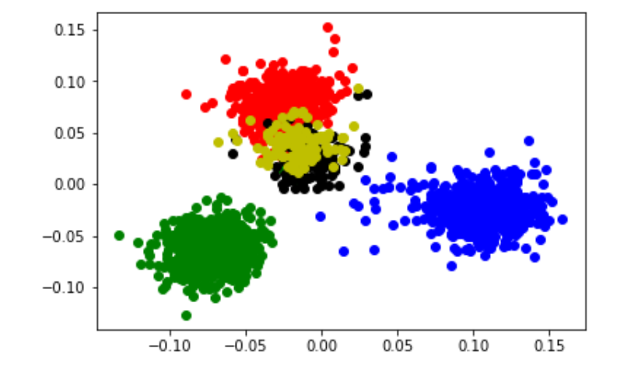
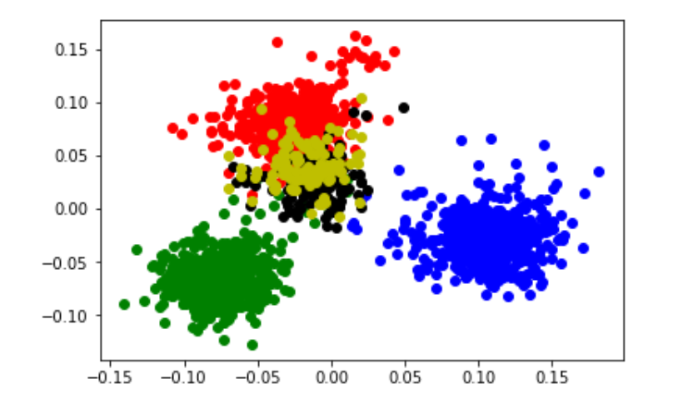
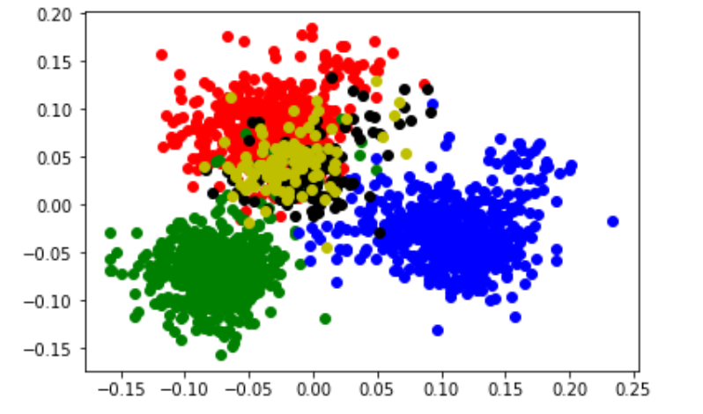
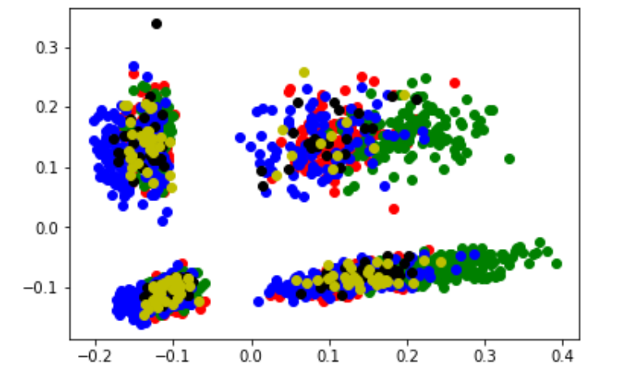
SIM III
PCA_dataset0
PCA_dataset1
PCA_dataset2
PCA_dataset3
PCA_dataset4
PCA_dataset5

