Slide 1







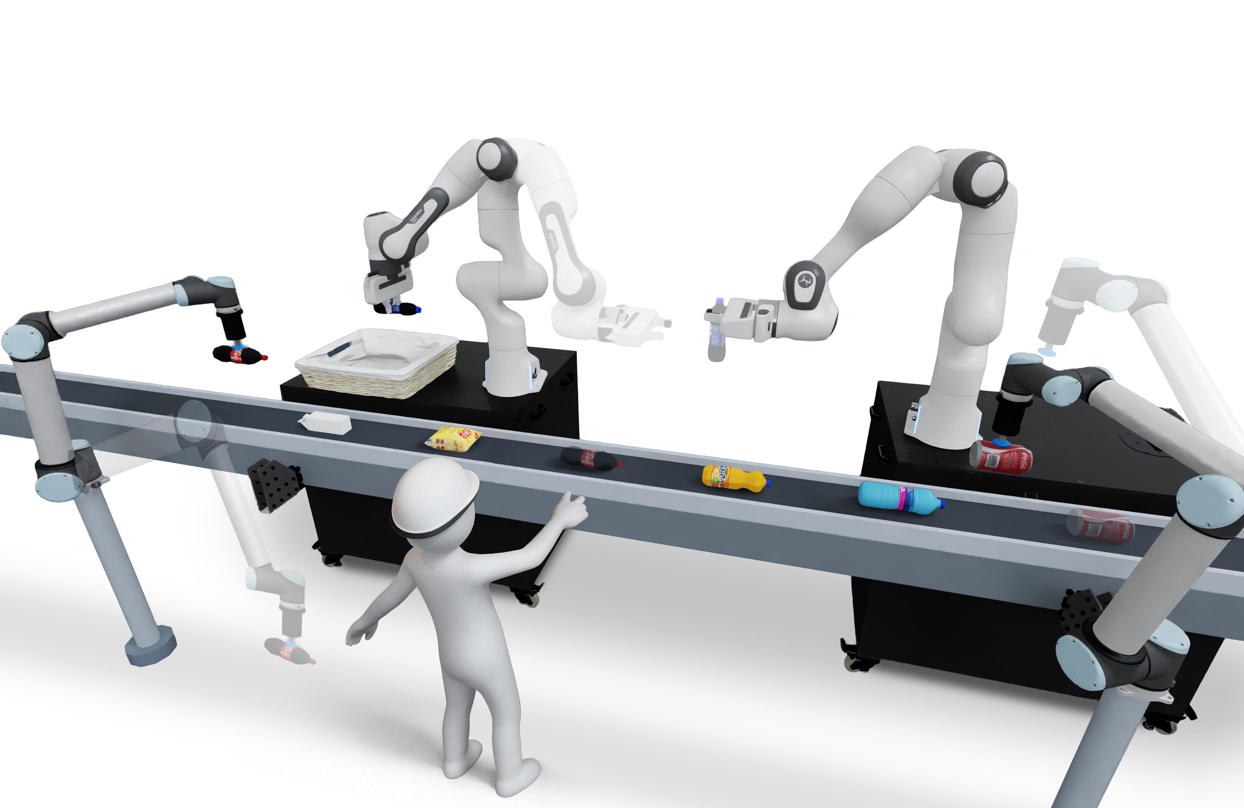
Figure 3 | Ours Event-driven G_assign Update
n1
n2
n3
n1
n2
n3
E1
E1
n4
n5
n4
n5
n1
n2
n3
n1
n2
n3
E2
E2
n4
n5
n4
n5
n1
n2
n3
n1
n2
n3
E3
E3
n4
n5
n4
n5
blue dashed: executed | red dashed: affected | values: ***

