Slide 1







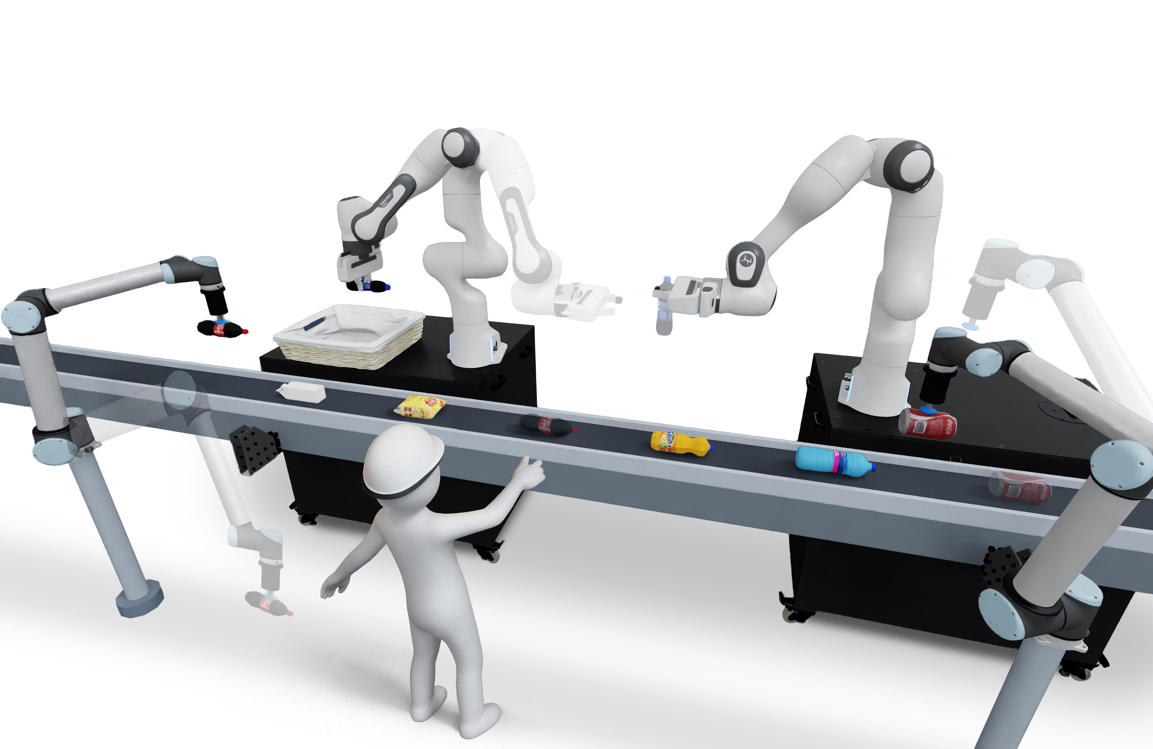
Figure 6 | Ablation Failure Count
Invalid Capability
Execution Anomaly
Assignment Conflict
Task Timeout
***
***
***
***
***
***
***
***
***
***
***
***
Ours
w/o Role Separation
w/o Selective Replanning

