Slide 1


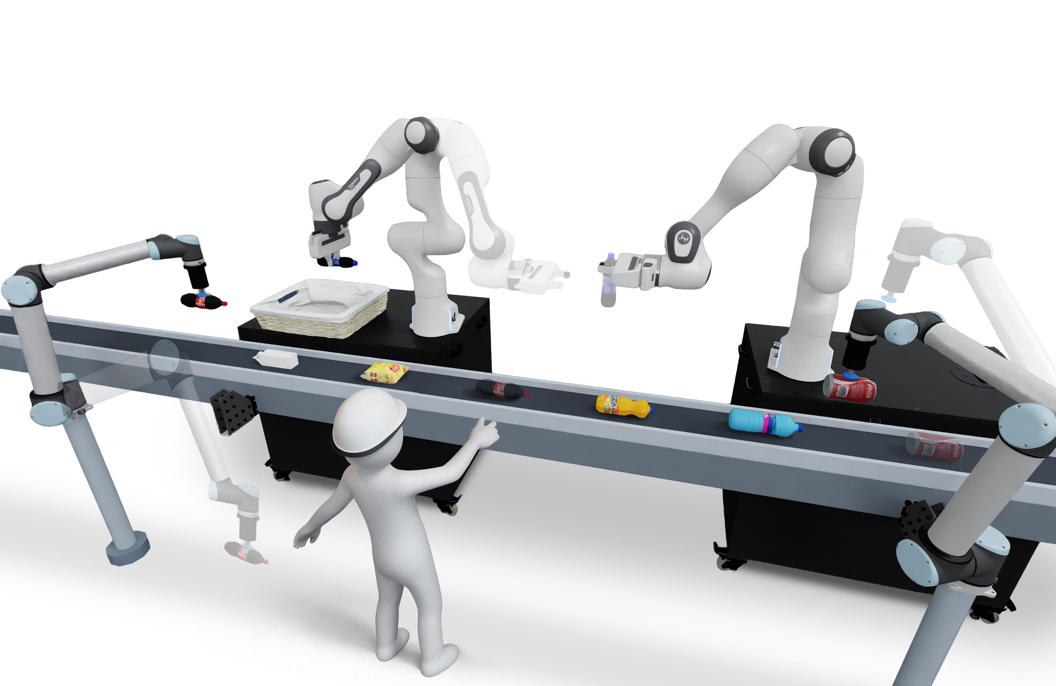





Task Instruction
“I need two bottles of cola in the basket
and clear the right table.”
Affordance Role
Verification Role
Interpret objects, relations,
and feasibility facts.
Planning Role
Verify intended effects
and task progress.
Decompose tasks and assign compatible manipulators.
Visual
observation
Execution
evidence
External
disturbance
Task
Update
Shared Semantic State
shared task and scene understanding
Primitive command
“Actually I want one more can of cola.”
manipulator · target · action
Upstream Suction
pick up fallen cola
Conveyor Moving
Downstream Suction
additionally holds cola can
Sorry for dropping that～

