Slide 1
DATA-AI-Hackathon
University of Leeds
Hackathon Track1: Prescription Refill Risk & Recommendations
Team leader: Xuekun Li
Team member: Dr. Shuang Li (Visiting Research Fellow in School of Biology)
EC Stoner Cluster 6.61
30-31,Mar,2026

Slide 2
content
University of Leeds
Background
Theme && Methodology
Results
Conclusion

Slide 3
Background
University of Leeds
As the UK's largest online pharmacy, Pharmacy2U handles a significant amount of digital prescription management for the NHS (National Health Service).
In chronic disease management, patient medication adherence directly impacts treatment outcomes and public health expenditures.

Slide 4
Theme
University of Leeds
Prescription refill risk & responsible, built only from prescription order events.
Questions:
Reactive Risk Identification
Difficulty in Quantifying Behaviors

Slide 5
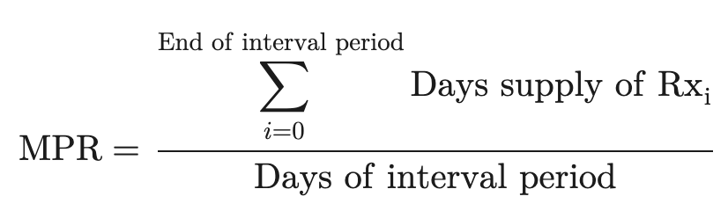
University of Leeds
Methodology
Risk score
Data loading
Data preprocessing and censoring
Data preparing for Model training
Model validation
Machine Learning Algorithm
Random Forest

Slide 6
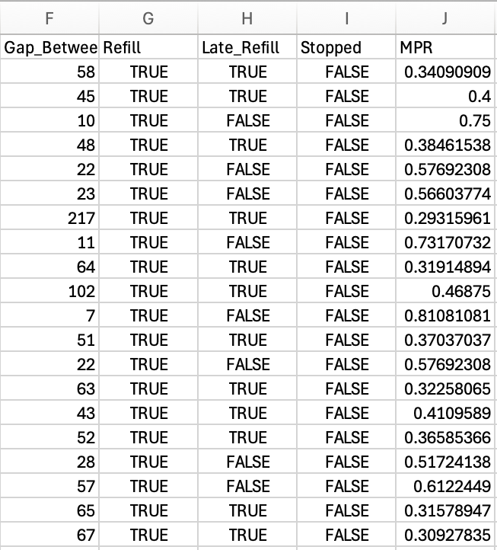
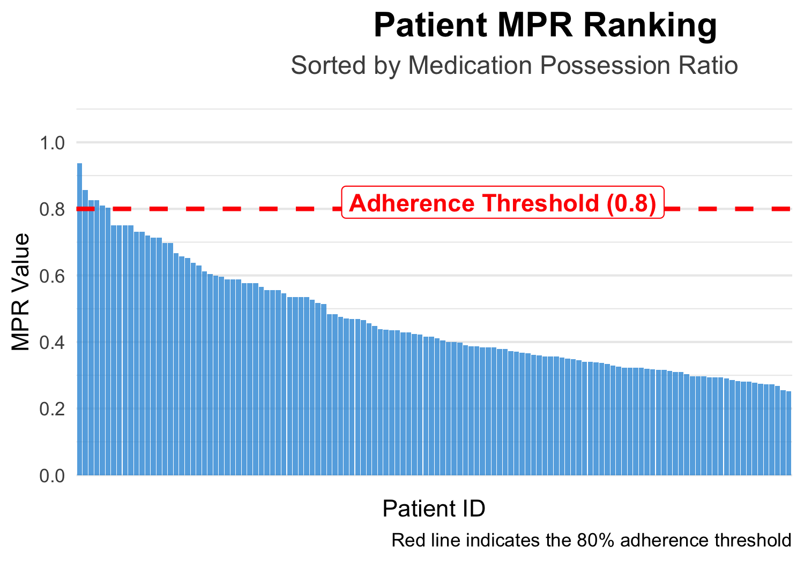
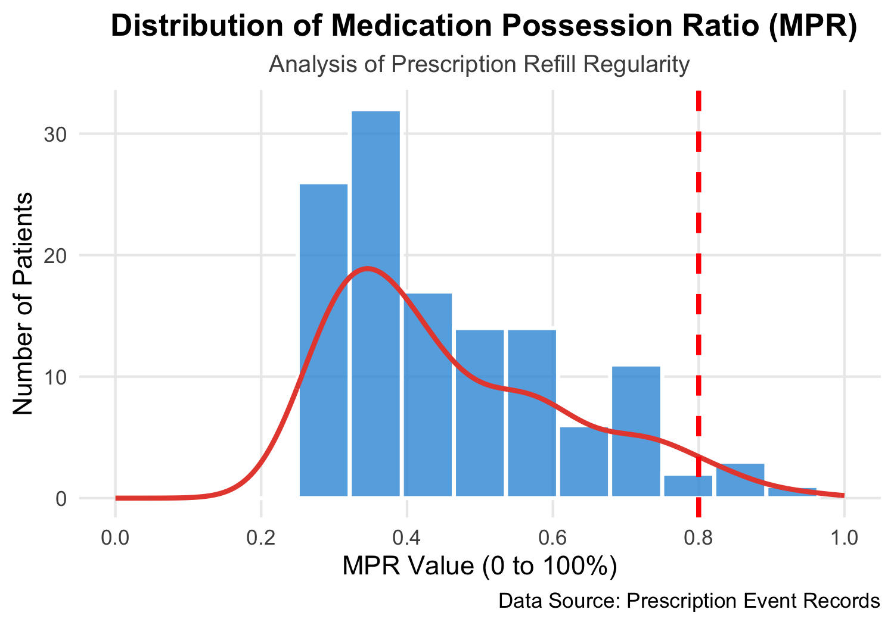
Results
University of Leeds
MPR for the Patients from Dataset
A
B
C
Fig.1 the MPR the adherence threshold selection and the distribution.
A: the adherence threshold; B: the distribution of the MPR; C: the form of the MPR data

Slide 7
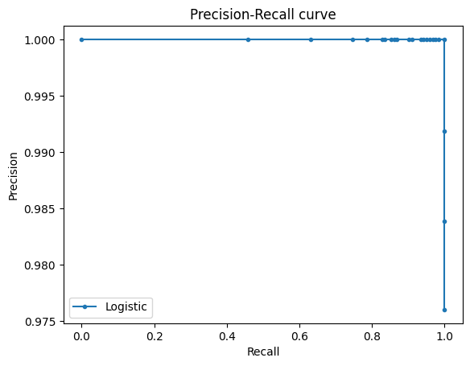
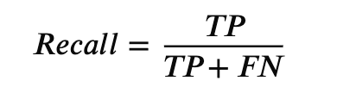
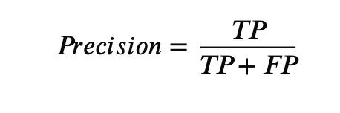
Results
University of Leeds
The evaluation of Metric
The model maintains near-perfect precision across the recall spectrum, with only a marginal decline to 0.976 at the maximum recall threshold.
Fig.2 Precision-Recall Curve for the Logistic Regression Model

Slide 8
University of Leeds
Thanks for attention

