Slide 1



PowerScore – Whisper
Feb 2022

Slide 2
Results: Performance
Case | Call network time period | Nodes | Edges | Unique edges | Bad tag | Matched bads
1 | 01-Feb-2020 to 29-Feb-2020 | 21,982,227 | 465,711,390 | 67,806,912 | Fraud (Tunaiku) | 180
2 | 01-Feb-2020 to 29-Feb-2020 | 21,982,227 | 465,711,390 | 67,806,912 | Risk (Tunaiku) | 220
3 | 01-Feb-2020 to 29-Feb-2020 | 21,982,227 | 465,711,390 | 67,806,912 | Risk (Tunaiku+Others) | 3.8k
Univariate Gini values
Network attribute | Case-1 |  | Case-2 |  | Case-3
Network feature | zero_payers_90d | fraud | zero_payers_90d | fraud | zero_payers_90d | fraud
whisper_score | 0.28 | 0.22 | 0.29 | 0.22 | 0.32 | 0.31
Pagerank (influence) | 0.16 | 0.17 | 0.16 | 0.17 | 0.16 | 0.17
Outdegree (outgoing calls) | 0.17 | 0.16 | 0.17 | 0.16 | 0.17 | 0.16
Total_community_members | 0.19 | 0.20 | 0.19 | 0.20 | 0.19 | 0.20
Good_by_bad_ratio in the community | 0.18 | 0.19 | 0.18 | 0.19 | 0.17 | 0.18

Slide 3
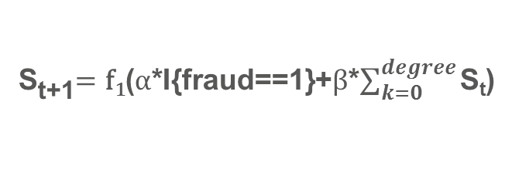

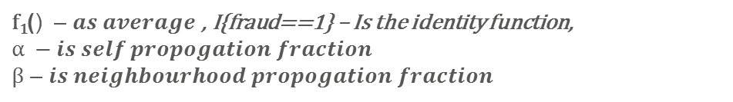
Whisper – Overview of the algorithm
Score calculated by our algorithm after convergence
Sample call Network
In this call graph pink denotes identified risky/fraudulent customers whereas blue are normal customers, our algorithm gives a susceptibility score to each individual. We can calculate such score for all 22 mn active Indosat users on a fortnightly basis
a
b
0.51
0.52
c
S_{t+1}$=\text{f}\text{1}\text{(}α\text{∗}\text{I}\text{\{}\text{fraud}\text{==1\}}$+$β$*$\sum_{k=0}^{degree}{\text{S}\text{t}}$)
i
0.01
0.11
$$where we have defined:$$
$\text{f}\text{1}\text{(}\text{) }$ – $as average \text{, }\text{I}\text{\{}\text{fraud}\text{==1\}}$ – Is the identity function,
$$α −is self propogation fraction$$
$β$ – $is neighbourhood propogation fraction$
h
d
0.06
0.08
General properties of the score (test edge cases) –
Convergence guarantee
For a given configuration node having higher number of fraud degrees should have higher score
Specific property –
Score should provide good rank ordering
Score for known frauds shall be higher than derived score
f
0.53
e
g
0.63
0.63
Above results are generated using $α$=1 and $β$=0.5
Notes:
Tunaiku current volumes, score usage doubles

Slide 4
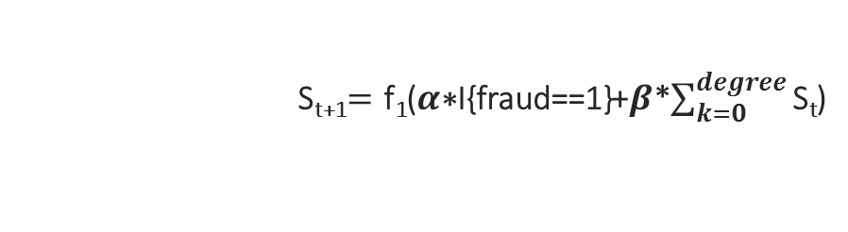
Algorithmic brilliance Innovative message passing algorithm design
Iterative message passing algorithm with convergence guarantee
Mathematically derived algorithm parameters to ensure better discrimination
Highly efficient and cost-effective infrastructure
Iterative message passing algorithm
Edge cases to determine
parameter bounds
Efficient graph data structure
a
b
Nodes (Users) ~22mn
S_{t+1}
S_{t}
c
Edges (Indosat calls) ~465mn
a
b
S_{t+1}$=\text{f}\text{1}\text{(}α\text{∗}\text{I}\text{\{}\text{fraud}\text{==1\}}$+$β$*$\sum_{k=0}^{degree}{\text{S}\text{t}}$)
Each state is a derivative of previous state. Update happens as per the algorithmic relationship
c
Solved by using Graph frame representation of the data which supports distributed dataflow system
Notes:
Tunaiku current volumes, score usage doubles

Slide 5
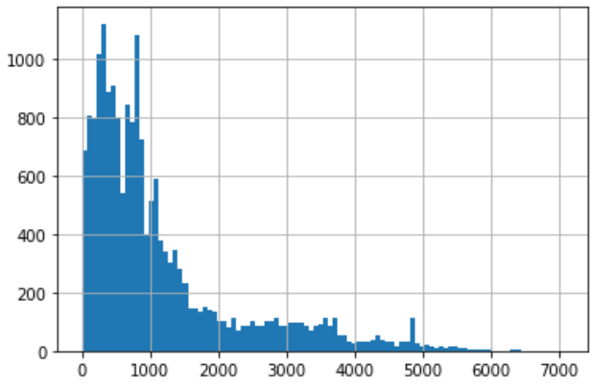
Experiment 1- Network Snapshot
Case | Call network time period | Nodes | Unique edges | Seed Type | Seed Size | Matched Seed
1 | 2020 Feb | 21,982,227 | 67,806,912 | Risk (Fraud + Risk) | 10.4k | 3.8k
2 | 2019 Oct | 19,313,931 | 59,608,729 | Risk (Fraud + Risk) | 10.4k | 4.4k
The whisper score result is verified on Kredivo data from 2020 Mar – 2020 June:
Histogram of Age active of the user:
There are around 10% of ppl’s tenure is less than 180 days.
 | Total | Bads* | Telco AUC
Kredivo Data Summary | 18382 | 2585 | 0.74
*Bad Definition: Ever 60+dpd in 120 days
 | Whisper Missing Rate | Single AUC | Whisper + Telco AUC
Network1 - Feb | 27% | 0.56 | 0.759
Network2 - Oct | 50% | 0.54 | 0.741

Slide 6
Experiment 2- More Recent Kredivo Data
Case | Call network time period | Nodes | Unique edges | Seed Period | Seed Type | Seed Size | Matched Seed
1 | 2021 Mar | 66,067,756 | 150,581,928 | Oct-20 - Dec 20 | Risk (Kredivo) | 2.6k | 1.8k
2 | 2021 Mar | 66,067,756 | 150,581,928 | All bads before Dec 20 | Risk (All) | 33k | 13k
The whisper score result is verified on Kredivo data from 2021 Apr – 2021 July:
 | Total | Bads* | Telco AUC
Kredivo Data Summary | 52214 | 4698 | 69.9%
*Bad Definition: Ever 30+dpd in 60 days
 | Whisper Missing Rate | Single AUC
Case 1 - New Seed | 15% | 45.6%
Case 2 - All Risk Seed | 15% | 45.7%

Slide 7
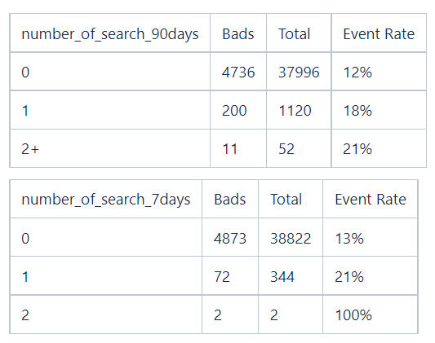
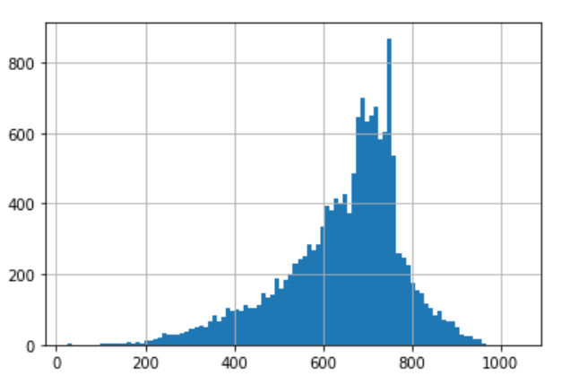
Experiment 3 - Enquiry Data
Enquiry Data | 202004 | 202005 | 202006 | 202007 | 202008 | 202009 | 202010 | 202011 | 202012 | 202101 | 202102 | 202103
CICIL | 14 | 325 | 377 | 3,760 | 547 | 500 | 401 | 303 | 292 | 308 | 331 | 477
DANAMAS |  |  |  |  |  |  |  | 43 | 75 | 56 | 143 | 150
KREDIVO |  | 8,715 | 18,237 | 23,361 | 23,330 | 26,056 | 37,345 | 39,727 | 43,229 | 51,305 | 56,495 | 70,088
TUNAIKU |  |  |  |  |  | 119 | 262 | 810 | 2,016 | 1,751 | 2,627 | 4,484
Enquiry time with Event Rate:
Enquiry Score distribution:
Defined the seed as:
Enquiry more than twice in 7 days.
Score is less than 600 points and flag as 0.5.
Score is less than 400 points and flag as 1
Final Seed size: 4.5k
 | Whisper Missing Rate | Single AUC
Case 1 - Enquiry Data | 15% | 43.1%
The whisper score result is verified on Kredivo data from 2021 Apr – 2021 July:
Case | Call network time period | Nodes | Unique edges | Seed Period | Seed Type | Seed Size | Matched Seed
1 | 2021 Mar | 66,067,756 | 150,581,928 | Enquiry before Apr 21 | Multiply Enquiry with 7 days and score <=600 | 4.5k | 2.2k

