Slide 1

Section 10
Chapter 1
closed interval on continuousfunction's property
I. 最 valueTheorem
II. intermediate valueTheorem
*III. uniform continuity性

Slide 2
I. 最 valueTheorem
Theorem1. inclosed interval on continuous's function
in theinterval on 一定 has 最大
value and minimum value.
i.e.: Let
then
使
(Proof略)
Note: iffunctioninopen interval on continuous,
or inclosed interval inside has discontinuity
point ,
conclusion not 一定 holds .

Slide 3
for example,
无maximum value and minimum value
又 such as,
also 无maximum value and minimum value

Slide 4
Corollary.
inclosed interval on continuous's functionin theinterval on bounded.
Proof: Let
fromTheorem1 we see that has
on bounded .
II. intermediate valueTheorem
Theorem2. ( zero pointTheorem )
and
至少 has 一 point
使
( Proof略 )

Slide 5
Theorem3. ( intermediate valueTheorem )
Let
and
then对 A and B between's 任一 number C ,
至少 has
一 point
使
Proof: 作辅助function
then
and
hencefromzero pointTheorem知, 至少 has 一 point
使
i.e.
Corollary:
inclosed interval on 's continuousfunction
must take get介于minimum value and 最
大 valuebetween's 任 what value .

Slide 6
Example1. Proofequation
ininterval
inside 至少 has
一 root .
Proof: clearly
又
hence according tozero pointTheorem, 至少existence一 point
使
i.e.
Note:
bisection method
then
inside must has equation's root ;
take
's midpoint
then
inside must has equation's root ;
can use this法 findapproximateroot.

Slide 7
Example2. Let
in
on continuous , and恒 is 正 ,
Proof:
对arbitrary's
must existence一 point
使
Proof:
let
, then
当
when ,
take
or
, then has
hencefromzero pointTheorem知 , existence
使
i.e.
Notes:
若不讲一致连续 , 则运行时点击“小结“按钮跳过它

Slide 8
*三. uniform continuity性
i.e.:
已知function
ininterval I on continuous,
generalcase,
就引 out
了uniform continuity's concept .
Definition:
对arbitrary's
all has
in I on uniform continuity .
clearly:

Slide 9
for example,
but not uniform continuity .
because
take point
then
can以arbitrary小
but
thisNote
in ( 0 , 1 ] on not uniform continuity .
Theorem.
on uniform continuity.
(Proof略)

Slide 10
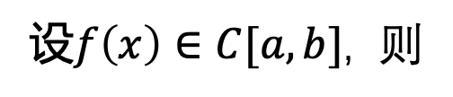
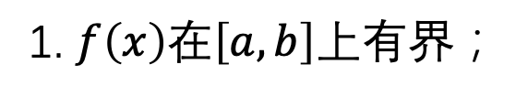
Summary
使

Slide 11
Think and Exercise
1. 任 give一张面 product is A 's 纸片( such as图),
Proof must can will it
一刀剪 is 面 product相 etc.'s two片.
Hint:
建立坐标系 such as图.
then面 productfunction
因
hencefromintermediate valueTheorem we see that:

Slide 12

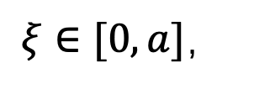


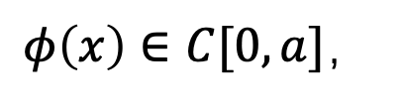

2. Let
Proof至少existence
一 point
使
Hint: let
then
then
易Proof
Homework
P71 3; 5

