Slide 1
Chapter 1
Functions and Limits
function — object of study
Analytical Foundations
limit — method of study
continuous — bridge of study

Slide 2

Section 1
Chapter 1
Mappings and Functions
I. mapping
II. function

Slide 3






I. set
1. Definition and denotes 法
Definition 1.
has some kind 特定property's 事物's 总体is calledset.
组成set's 事物is calledelement.
denoted by  .
not contain任 whatelement's setis called空集 ,

Slide 4


denotes 法:
列举法:
according tosome kind 方 formula列 outset in 's 全体element .
has 限set
from然 number集
describe法:
整 numberset
or
has 理 number集
real numberset
is has 理 number or 无理 number
open interval
closed interval

Slide 5






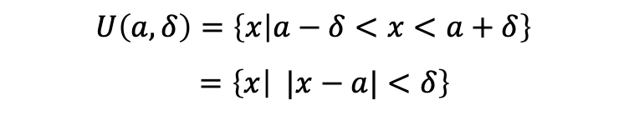





半open interval
unboundedinterval
left  neighbourhood
rightδ neighbourhood

Slide 6
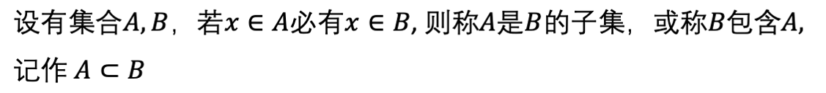



2. setbetween's relation and operation
Definition2 .
clearly under 列relation holds:

Slide 7

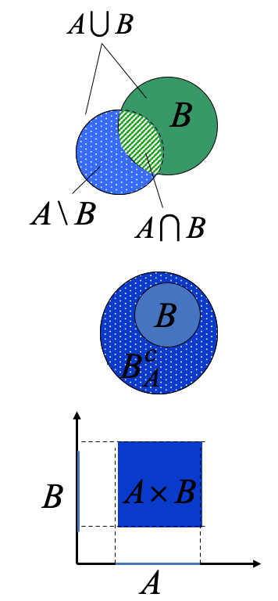




denote
特Example:
is 平面 on 's 全体 point集

Slide 8
I. mapping
1. mapping's concept
引Example1.
according to一定规then查号
深技大学生's set
学号's set
some教室座位
's set
some班学生's set
according to一定规then入座

Slide 9
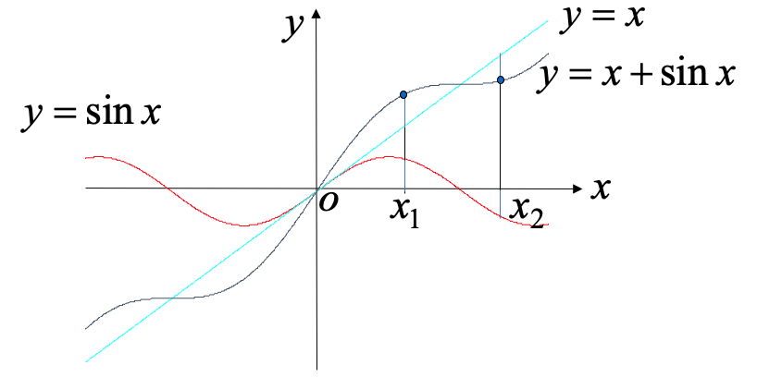
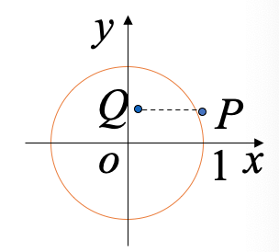
引Example2.
引Example3.
( point集)
( point集)
向 y 轴投影

Slide 10


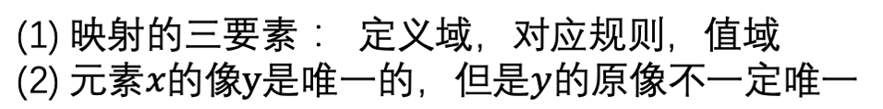
Definition.
Note:

Slide 11
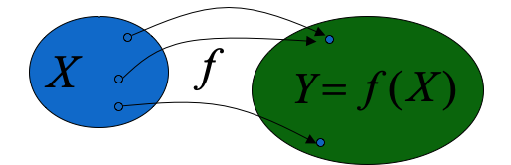
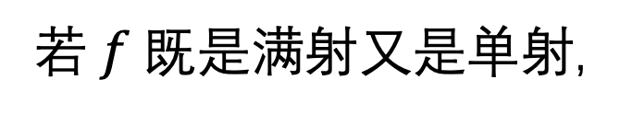
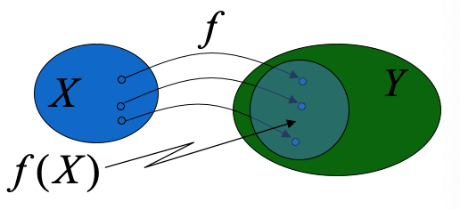
对mapping
then称 f is surjective;
if
引Example2, 3
if
has
then称 f is injective;
引Example2
then称 f is bijective or 一一mapping.
引Example2

Slide 12
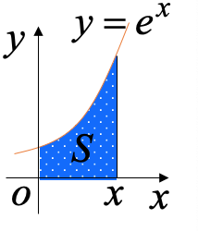
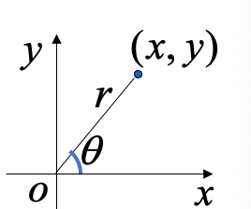
Example1.
(surjective)
Example2.
, right图 in 对应阴影part's 面 product
, thenin number集
(surjective)
from身betweenDefinition了一 kind mapping
Example3.
such as图 示,
then has
(surjective)

Slide 13
Note:
mapping又is called算子.
in not 同 number学分支 in has not 同's 惯 use名称.
for example
X (≠ ∅ )
Y ( number集)
is calledX on 's 泛函
X (≠ ∅ )
X
is calledX on 's 变换
R
is calledDefinitionin X on 's is function
X ( number集 or point集 )

Slide 14
2. 逆mapping and compositemapping
(1) 逆mapping's Definition
Definition:
ifmapping
is injective,
thenexistence一逆mapping
使
where
称 thismapping
is 's 逆mapping .
习惯 on ,
's 逆mapping denote成
for example, mapping
its逆mapping is

Slide 15
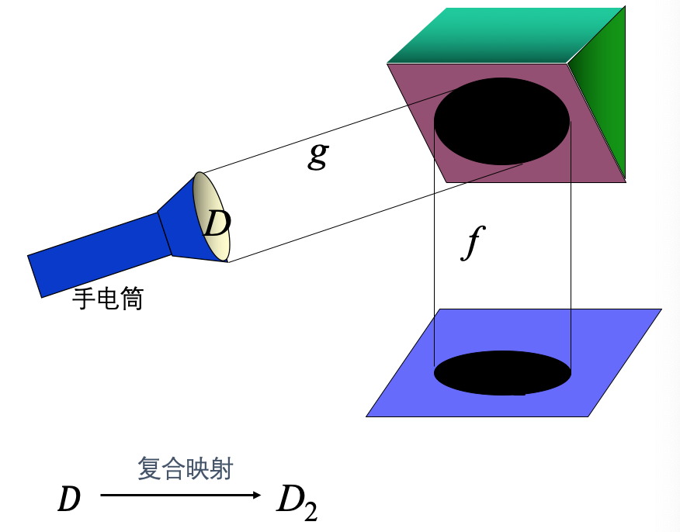
(2) compositemapping
引Example

Slide 16
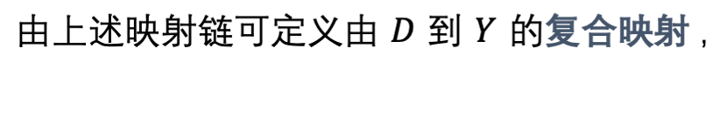
Definition
Let has mapping链
then当
when ,
denoted by
or
Note: 构成compositemapping's condition
not can少.
Note: 构成compositemapping's condition
以 on Definition also can推广 to 多 mapping's case.

Slide 17

II. function
1. function's concept
Definition. Let number集
then称mapping
is Definitionin
D on 's function,
denote is
domain
independent variable
dependent variable
function图 form:

Slide 18
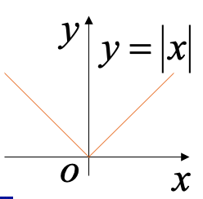
domain
(对应规then)
(range)
domain
使表达 formula and actualQuestion题 all has meaning's independent variableset.
Solution析法,
图象法,
列表法
对应规律's denotes method:
for example, 反正弦主 value
domain
range
又 such as, absolute valuefunction
domain
value 域

Slide 19
Example4.
已知function
find
and
and写 outdomain and range .
Solution:
function无Definition
domain
value 域

Slide 20



2. function's 几 kind 特性
Letfunction
and has interval
(1) boundedness
使
称
is boundedfunction.
使
称
Note: 还 canDefinition has upper bound, has lower bound, unbounded
(见 on 册 P7 )
(2) monotonicity
当
when ,
称 is has upper bound
称
monotone增function ;
称 is has lower bound
称
monotone减function .
if对arbitrarypositive number M , 均existence
使
then称 f ( x ) unbounded.

Slide 21

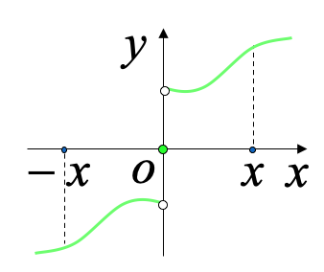


(3) parity性
and has
if
if
Note: if
then当
is 奇function when ,
must has
for example,
偶function
denote
双曲余弦

Slide 22
又 such as,
奇function
denote
双曲正弦
再 such as,
奇function
denote
双曲正切

Slide 23

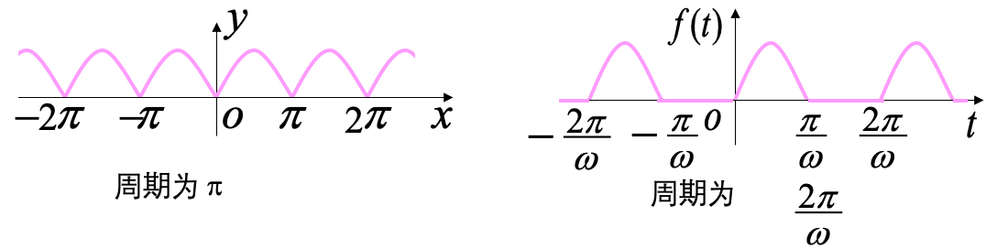


(4) period性
and
if
then称
is periodfunction ,
( general指最小正period ).
Note: periodfunction not 一定existence最小正period .
for example, 常 quantityfunction
狄里克雷function

Slide 24


3. inverse function and compositefunction
(1) inverse function's concept and property
iffunction
is injective,
thenexistence逆mapping
称 thismapping
习惯 on ,
's inverse function denote成
property:
(减)
itsinverse function
and also monotone increasing
(减) .

Slide 25
2) function
and itsinverse function
's 图 form关于line
symmetry .
for example ,
exponential function
互 is inverse function ,
logarithmic function
it all monotone increasing,
symmetry .
its图 form关于line

Slide 26

(2) compositefunction
- compositemapping's 特Example
Let has function链
①
②
then
is calledfrom①, ②确定's compositefunction ,
not can少.
Note: 构成compositefunction's condition
for example, function链 :
canDefinitioncompositefunction
butfunction链
not can 构成compositefunction .

Slide 27
two以 on function also can构成compositefunction,
for example,
canDefinitioncompositefunction:

Slide 28
4. elementary function
(1) basic elementary function (反对power三指)
inverse trigonometric function,
logarithmic function,
powerfunction,
trigonometric function,
exponential function,
(2) elementary function
fromconstant and basic elementary function after过 has finite times四thenoperation and composite步骤 构成
and can use一 formula子 denotes 's function ,
is calledelementary function .
otherwiseis called非elementary function .
for example ,
can表 is
hence is elementary function.
又 such as , 双曲function and 反双曲function also is elementary function .
( from学, P13 – P15 )

Slide 29
非elementary function举Example:
signfunction
当 x > 0
当 x = 0
当 x < 0
take整function
当

Slide 30
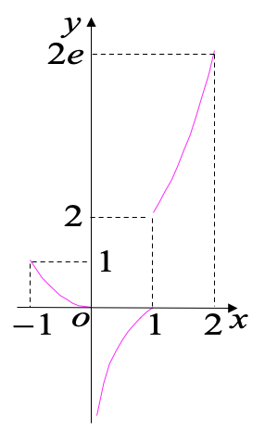
Example5.
find
's inverse function and itsdomain.
Solution:
当
when ,
then
当
when ,
then
当
when ,
then
domain is
inverse function

Slide 31
Summary
domain
correspondence rule
range
1. function's Definition and function's 三 need素
2. function's 特性
boundedness, monotonicity,
parity性, period性
3. elementary function's 结构
Homework:
P16 1 (2),(4),(6),(8); 9(2),(4),(6);
12(2),(4)

