Slide 1

Section 3
Chapter 1
Limits of Functions
I. independent variabletends to has 限 value when Limits of Functions
II. independent variabletends toinfinity when Limits of Functions

Slide 2
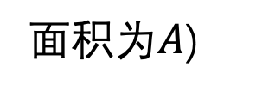
I. independent variabletends to has 限 value when Limits of Functions
1.
when functionlimit's Definition
引Example. measure quantity square form面 product.
(真 value: 边长 is
direct observation value
确定 direct observation valueprecision  :
边长
indirect observation value
任 giveprecision  ,
need find
面 product

Slide 3
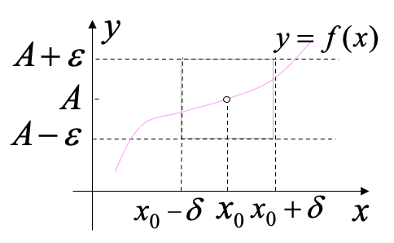
Definition1 .
Letfunction
in point
's somedeleted neighbourhood inside has Definition ,
if
当
when , has
then称constant A is function
当
when 's limit,
denote is
or
i.e.
当
when , has
this shows:
geometricSolution释:
limitexistence
function局部bounded
(P32Theorem2)

Slide 4
Example1. Proof
Proof:
hence
对arbitrary's
当
when ,
总 has
therefore

Slide 5
Example2. Proof
Proof:
欲使
as long as
take
then当
when , must has
therefore

Slide 6
Example3. Proof
Proof:
hence
take
当
when , must has
therefore

Slide 7
Example4. Proof: 当
when
Proof:
欲使
as long as
and
而
can use
preserveProof .
hence take
then当
when ,
must has
therefore

Slide 8
2. sign-preserving propertyTheorem
Theorem1 . if
( A < 0 )，
thenexistence
and A > 0
(P32Theorem3)
Proof: 已知
i.e.
当
when , has
当 A > 0 when ,
takepositive number
(< 0)
thenin对应's neighbourhood
on

Slide 9
Corollary:
if
thenexistence
使当
when , has
(P32 Corollary)
analysis:
if take
thenin对应's neighbourhood
on

Slide 10
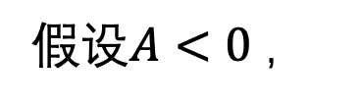
Theorem 2 . ifin
's somedeleted neighbourhood inside
, and
then
Proof: use反Proof法.
thenfromTheorem 1,
existence
's somedeleted neighbourhood ,
使in theneighbourhood inside
and 已知condition矛盾, therefore假Let not 真, hence
(similarly canProof
's case)
Think: ifTheorem 2 in 's condition改 is
is 否 must has
not can !
such as

Slide 11
3. left limit and right limit
left limit :
当
when , has
right limit :
当
when , has
Theorem 3 .
( P30 )

Slide 12
Example5. Letfunction
discuss
when
's limit is 否existence .
Solution: 利 useTheorem 3 .
because
clearly
therefore
not existence .

Slide 13
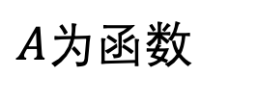
II. independent variabletends toinfinity when Limits of Functions
Definition2 . Letfunction
greater than some一positive number when has Definition,
if
then称constant
when 's limit,
denoted by
geometricSolution释:
line y = A is curve
's horizontal asymptote

Slide 14
Example6. Proof
Proof:
hence
欲使
i.e.
take
就 has
therefore
Note:

Slide 15
two kind special case :
当
when , has
当
when , has
geometricmeaning :
for example,
all has horizontal asymptote
又 such as,
all has horizontal asymptote

Slide 16
Summary
1. functionlimit's
or
Definition and application
2. functionlimit's property:
uniqueness, 局部boundedness, 局部sign-preserving propertyTheorem
and leftright limitequivalentTheorem
Think and Exercise
1. iflimit
existence,
is necessarily has
？
2. Letfunction
and
existence, then
Homework
P34 5 (2)(3); 6(2); 7 ;

