Slide 1


Kevin Wang Distinguished Engineer Juniper Networks
Global Load Balancing (GLB)
for AI/ML Fabrics

Slide 2

Agenda
Introduction to Global Load Balancing (GLB)
GLB in 3-CLOS Networks
GLB in 5-CLOS Networks
GLB in General CLOS Networks
IETF Standardization Efforts
GLB Test Results

Slide 3
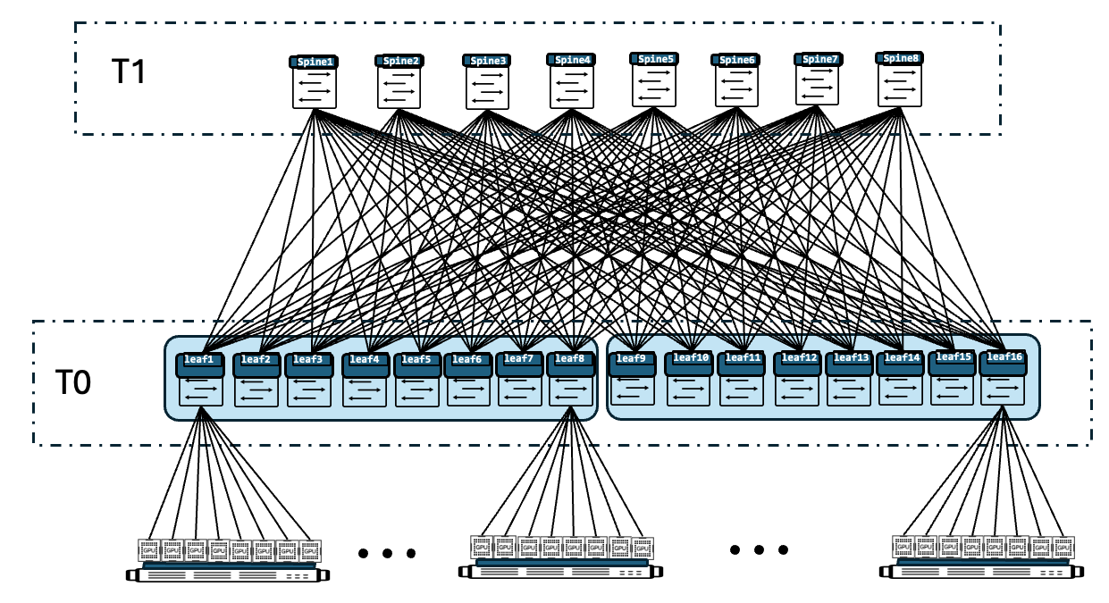
Key Facts about AI/ML Fabrics
CLOS topology
IP/IPv6 routing
BGP as the routing protocol
Packet delay and loss are very costly for AI/ML flows
High throughput, low entropy
Congestion avoidance and mitigation is essential

Slide 4
Local Congestion: Dynamic Load Balancing
Spine1
Spine2
Spine3
Congestion
Leaf1
Leaf2
Leaf3
Random ECMP hashing can’t guarantee each link has the same load
When congestion is detected locally (Leaf1 to Spine1), Dynamic Load Balancing (DLB) can help to mitigate the congestion

Slide 5
Remote Congestion: Global Load Balancing
Spine1
Spine2
Spine3
Congestion
Leaf1
Leaf2
Leaf3
When Congestion happens on a remote link (Spine1 to Leaf1), DLB on Leaf2 and Leaf3 does not help
Global Load Balancing (GLB) is needed to mitigate remote congestion

Slide 6
GLB in 3-CLOS: Topology Discovery
S1
Routes on L1
Destination | Next-hop | Next-next-hop
L2 | A | X2
 | B | Y2
 | C | Z2
L3 | A | X3
 | B | Y3
 | C | Z3
S2
S3
X3
Y3
X2
Y2
Z2
Z3
A
B
C
L1
L2
L3
For routes received from L2, L3, L1 keeps track of the <next-hop, next-next-hop> tuple for each path
BGP protocols is extended to carry the next-nex-hop nodes of each next-hop

Slide 7
GLB in 3-CLOS: Link Quality Exchange
Each spine broadcast its link qualities to all leaves
L1 uses the combined link qualities <Q(A), Q(X3)>, <Q(B), Q(Y3)>, <Q(C), Q(Z3)> to make load balancing decisions
When link X3 is congested, L1 learns it via Q(X3) and reduces traffic to link A to mitigate the congestion on X3
The Router Information protocol is used to exchange link qualities between neighboring routers within sub-millisecond
S1
S2
S3
Q(X3)
Q(Y3)
Q(Z3)
Q(X3)
X3
Y3
Z3
X3
A
B
C
L1
L3

Slide 8
GLB in 5-CLOS: Leaves
SS1
SS2
Routes on L1.1
Destination | Next-hop | Next-next-hop
L1.2 | A | C
 | B | D
J
K
L
E
E
I
G
H
I
F
S1.1
S1.2
S2.1
S2.2
C
D
L2.1 | A | E, F
 | B | G, H
POD-1
POD-2
A
B
L1.1
L1.2
L2.1
L2.2
L2.2 | A | E, F
 | B | G, H
Intra-pod GLB is same as 3-CLOS GLB
Inter-pod routes have more than 2 hops, but only <next-hop, next-nex-hop> needs to be kept for each route
When L1.1 knows link E is congested, it will reduce inter-pod traffic towards link A
On the other hand, L1.1 does not care about congestion on link I because GLB on S1.1 and S1.2 reacts to it equally. There is no need for L1.1 to prefer S1.1 or S1.2

Slide 9
GLB in 5-CLOS: Spines
SS1
SS2
Routes on S1.1
Destination | Next-hop | Next-next-hop
L2.1 | A | E, F
 | B | G, H
L2.2 | A | E, F
 | B | G, H
F
G
H
A
E
B
E
S1.1
S1.2
S2.1
S2.2
I
C
D
POD-1
I
J
K
L
POD-2
L1.1
L1.2
L2.1
L2.2
L1.1 | C | -
L1.2 | D | -
Spines also need to run GLB for inter-pod traffic
When S1.1 knows link E is congested, it reduces traffic towards link A
On the other hand, S1.1 does not care about the congestion on link I because GLB on SS1 and SS2 reacts to it equally. There is no need for S1.1 to prefer SS1 or SS2

Slide 10
GLB in General CLOS Networks
The symmetry and rich redundancy of CLOS networks ensure that only next-hop or next-next-hop link congestion impacts load balancing decisions
Each node tracks only the <next-hop, next-next-hop> for each route
Congestion beyond the next-next-hop has no impact on GLB
This allows non-link-state protocols like BGP to determine topology for GLB
It also allows link quality exchange to be limited to direct neighbors
The design works for any levels of CLOS networks

Slide 11
IETF Standardization: IDR
GLB needs to discover next-hop to next-next-hop mapping via BGP
https://www.ietf.org/archive/id/draft-wang-idr-next-next-hop-nodes-02.txt defines NNHN TLV for the NHC attribute:
0 1 2 3
0 1 2 3 4 5 6 7 8 9 0 1 2 3 4 5 6 7 8 9 0 1 2 3 4 5 6 7 8 9 0 1
+-+-+-+-+-+-+-+-+-+-+-+-+-+-+-+-+-+-+-+-+-+-+-+-+-+-+-+-+-+-+-+-+
| Capability Code = TBD | Capability Length (variable) |
+-+-+-+-+-+-+-+-+-+-+-+-+-+-+-+-+-+-+-+-+-+-+-+-+-+-+-+-+-+-+-+-+
| Next-hop BGP ID |
+-+-+-+-+-+-+-+-+-+-+-+-+-+-+-+-+-+-+-+-+-+-+-+-+-+-+-+-+-+-+-+-+
~ Next-next-hop BGP IDs (variable) ~
+-+-+-+-+-+-+-+-+-+-+-+-+-+-+-+-+-+-+-+-+-+-+-+-+-+-+-+-+-+-+-+-+

Slide 12
IETF Standardization: RTGWG
GLB also needs neighboring nodes to exchange link quality information
https://www.ietf.org/archive/id/draft-zzhang-rtgwg-router-info-01.txt defines a UDP based protocols for neighboring routers to exchange router information TLVs
The Neighbor Path Information TLV is used for GLB
0 1 2 3 0 1 2 3
0 1 2 3 4 5 6 7 8 9 0 1 2 3 4 5 6 7 8 9 0 1 2 3 4 5 6 7 8 9 0 1 0 1 2 3 4 5 6 7 8 9 0 1 2 3 4 5 6 7 8 9 0 1 2 3 4 5 6 7 8 9 0 1
+-+-+-+-+-+-+-+-+-+-+-+-+-+-+-+-+-+-+-+-+-+-+-+-+-+-+-+-+-+-+-+-+ +-+-+-+-+-+-+-+-+-+-+-+-+-+-+-+-+-+-+-+-+-+-+-+-+-+-+-+-+-+-+-+-+
| (Type) 1 | Length |S| Refresh Rate| | Neighbor ID |
+-------------------------------+-------------------------------+ +---------------+---------------+-------------------------------+
~ repeated per-Neighbor Records ~ | encoded info |
+---------------------------------------------------------------+ +---------------+

Slide 13
Test Results for 3-CLOS (100G Links)
90G
90G
Spine1
Spine2
Spine1
Spine2
Leaf1
Leaf2
Leaf1
Leaf2
17.5G
17.5G
17.5G
17.5G
Without GLB: drops happened on Spine1 => Leaf2
With GLB: no drop

Slide 14




Summary
AI/ML flows are prone to congestion but are less tolerant of it
GLB is designed to prevent and mitigate congestions for AI/ML flows
GLB keeps the simplicity of the existing AI/ML fabrics
CLOS networks
IP/IPv6 routing
BGP as the routing protocol
The scalable design enables sub-millisecond level reaction to potential congestions

Slide 15
Thank you!

