Slide 1


BBX Local Shopping Platform
Team Member:
Jingyu Bao 001529873
Yue Bi 001568978
Xuexian Xie 001674636

Slide 2
About Ecosystem
During Covid-19 pandemic, social distance becomes necessary for everyone, which means going shopping outside door might increase the risk of getting infected. Therefore, BBX Local Shopping Platform comes into being, aiming at bringing the convenience of shopping online to the local reatailers in order to help people get easy access towards daily necessities as well as strengthening the local economy.

Slide 3
Global Use
BBX local shopping platform is able to expand its business at the global level, since worldwide network can be freely added into our system. As the amount of networks being created increases, our system will be applied globally, considering dividing a whole into parts.

Slide 4
System Structure
4 Enterprise: Food retailer, Costume retailer, Delivery company, BBX shopping platform
8 Organization: Food supplier, Food order management, Costume supplier, Costume order management, Delivery service department, Customer payment, Recommend system, Customer service
10 Roles: System administrator, Customer, Food retailer manager, Food order manager, Costume retailer manager, Costume order manager, Delivery manager, Delivery man, Platform manager, Customer manager

Slide 5
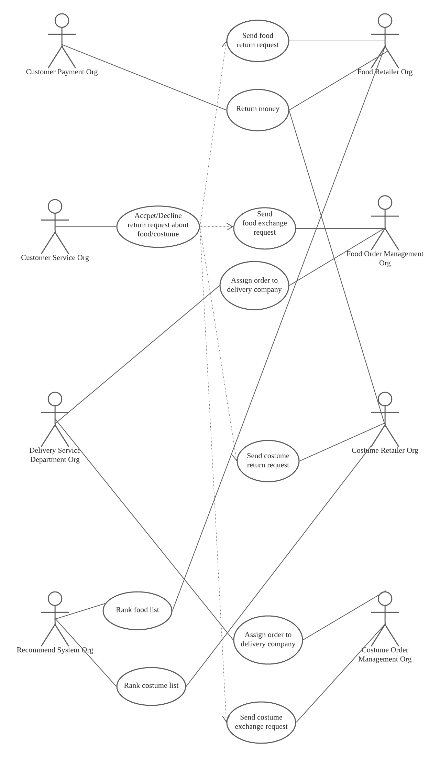
System Structure

Slide 6
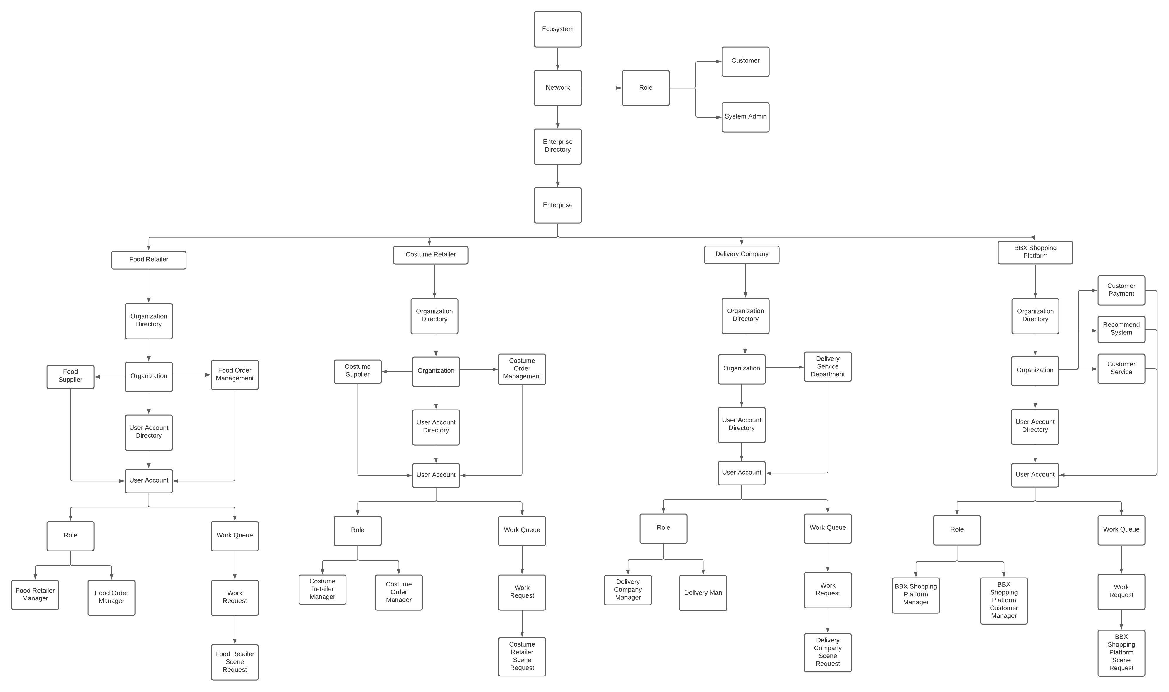
UML Diagram

Slide 7
Thank you!

