Slide 1


BBX Local Shopping Platform
Team Member:
Jingyu Bao 001529873
Yue Bi 001568978
Xuexian Xie 001674636

Slide 2
About Ecosystem
During Covid-19 pandemic, social distance becomes necessary for everyone, which means going shopping outside door might increase the risk of getting infected. Therefore, BBX Local Shopping Platform comes into being, aiming at bringing the convenience of shopping online to the local reatailers in order to help people get easy access towards daily necessities as well as strengthening the local economy.

Slide 3
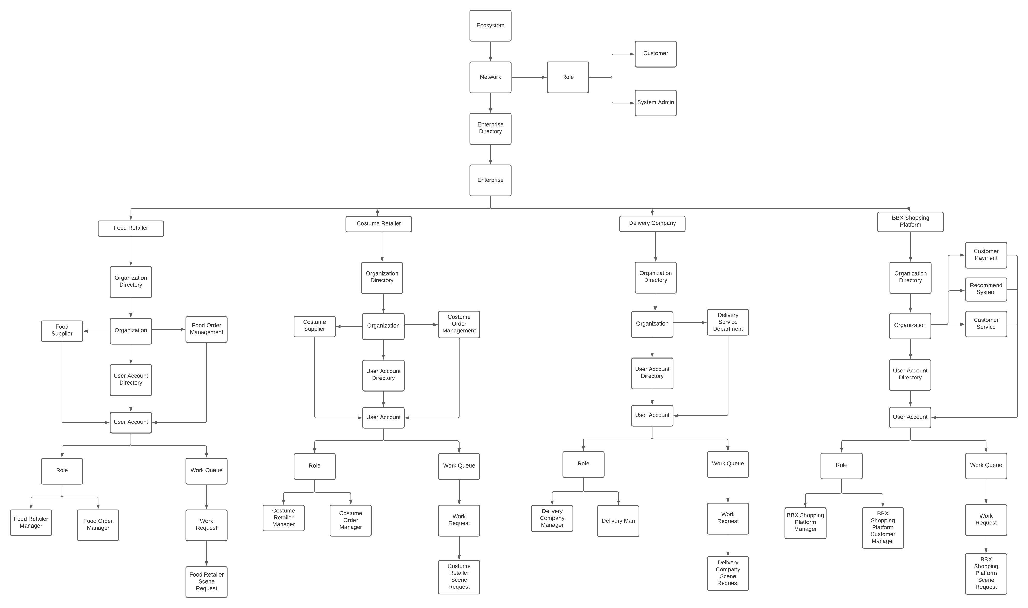
UML Diagram

Slide 4
Thank you!

