Slide 1
The Collocation of Measurement Points in Large Open Indoor Environment
Kaikai Sheng, Zhicheng Gu, Xueyu Mao
Xiaohua Tian, Weijie Wu, Xiaoying Gan
Department of Electronic Engineering, Shanghai Jiao Tong University
Xinbing Wang
School of Electronic, Info. & Electrical Engineering, Shanghai Jiao Tong University

Slide 2
Outline
Introduction
Background
Motivation
Metrics & Definitions
Two Preliminary Cases
General Case
Summary

Slide 3
Background
Indoor localization cannot be addressed by GPS due to large attenuation factor of electromagnetic wave.
Traditional localization techniques use Infrared, RF or ultrasound.

Slide 4
Background
With the pervasion of smartphones and Wi-Fi Access Points (APs), the received signal strength (RSS) fingerprint based method is the most popular solution.
Collect location fingerprints in each measurement point.
Estimate the user location by matching user’s RSS vector with fingerprint library.

Slide 5
Motivation
Large open indoor environment
Large indoor area & high population density
Sparse indoor obstacles
Challenges
Fingerprint Similarity
Computation Complexity
Budget Constraint
The number of measurement
points is limited !!!

Slide 6
Outline
Introduction
Metrics & Definitions
EQLE
Neighboring region
Neighboring triangle
Two Preliminary Cases
General Case
Summary

Slide 7
EQLE
Expected quantization location error (EQLE): expected (average) distance error from the user actual location to the nearest measurement point.

Slide 8
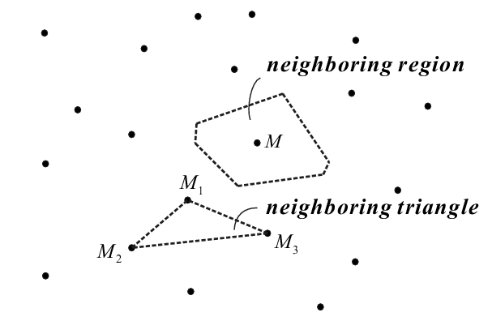
Neighboring region & triangle
Neighboring region: the region which M is the nearest measurement point to any user located in.
Neighboring triangle: the triangle combined by three measurement points with no other measurement points in.

Slide 9
Outline
Introduction
Metrics & Definitions
Two Preliminary Cases
Regular Collocation
Random Collocation
General Case
Summary

Slide 10
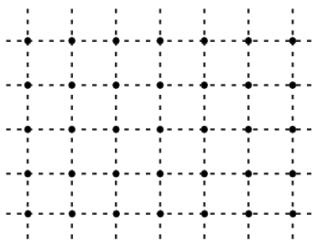
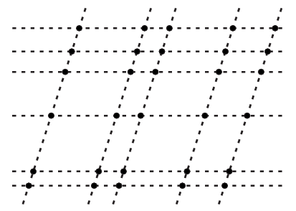
Regular Collocation
Definition of “regular”
measurement points are at the intersecting locations of a mesh network that two groups of parallel lines with the various spacing intersect at a certain angle.
Generalize

Slide 11
Regular Collocation
Assumption & Approximation
Users are uniformly distributed.
There is no obstacle and the whole region is accessible to people and measurement points.
Ignore the effect of measurement points at the region boundary.

Slide 12
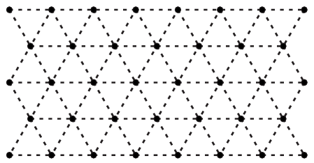
Regular Collocation
EQLE, MQLE can be minimized when measurement points are collocated as follow.
The distance of nearest neighboring measurement points (DNN) can be maximized when measurement points are collocated as follow.

Slide 13
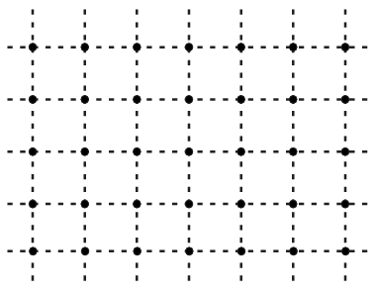
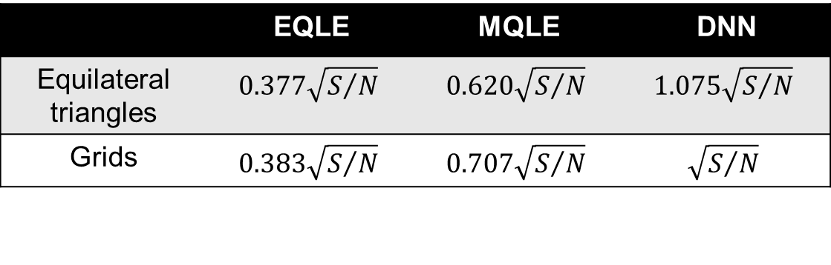
Regular Collocation
Comparison of collocation patterns
VS
 | EQLE | MQLE | DNN
Equilateral triangles | $$0.377\sqrt{S/N}$$ | $$0.620\sqrt{S/N}$$ | $$1.075\sqrt{S/N}$$
Grids | $$0.383\sqrt{S/N}$$ | $$0.707\sqrt{S/N}$$ | $$\sqrt{S/N}$$

Slide 14
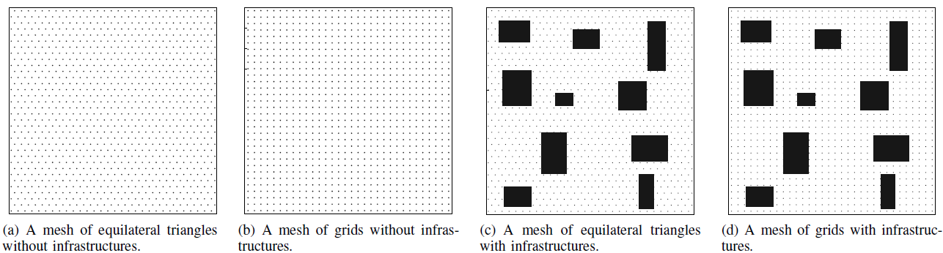
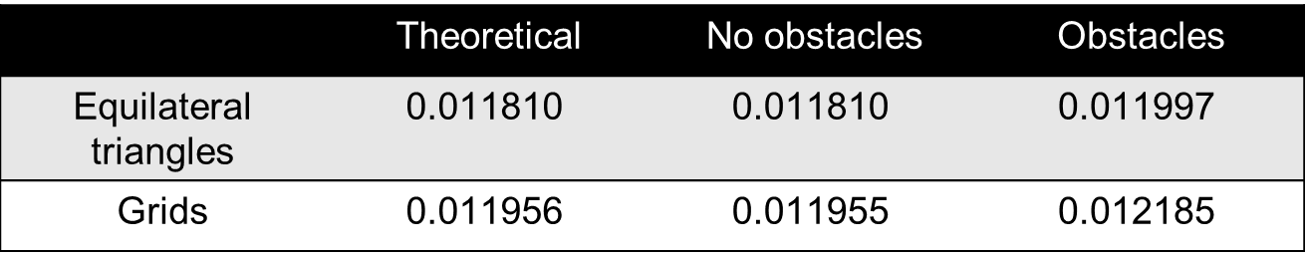
Regular Collocation
Simulation results
 | Theoretical | No obstacles | Obstacles
Equilateral triangles | $$\text{0.011}\text{810}$$ | $$\text{0.011}\text{810}$$ | $$\text{0.011997}$$
Grids | $$\text{0.011956}$$ | $$\text{0.011955}$$ | $$\text{0.012185}$$

Slide 15
Random Collocation
Assumption & Approximation
Users are uniformly distributed.
Measurement points are uniformly randomly collocated

Slide 16
Random Collocation
EQLE is lower bounded by , this bound becomes tight when point number is large.
Actually, .
Hence, can be regarded as the approximate value for
the EQLE of this region when N is large.

Slide 17
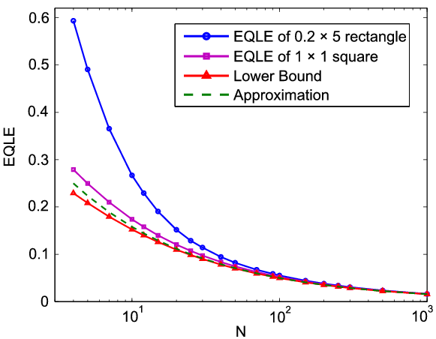
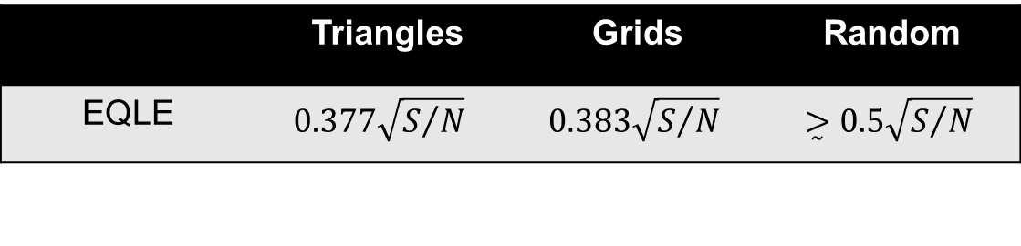
Random Collocation
Simulation results
Comparisons
 | Triangles | Grids | Random
EQLE | $$0.377\sqrt{S/N}$$ | $$0.383\sqrt{S/N}$$ | $$\overset{̰}{>}0.5\sqrt{S/N}$$

Slide 18
Outline
Introduction
Metrics & Definitions
Two Preliminary Cases
General Case
Challenge & Model
Theoretical Results
Simulation
Summary

Slide 19
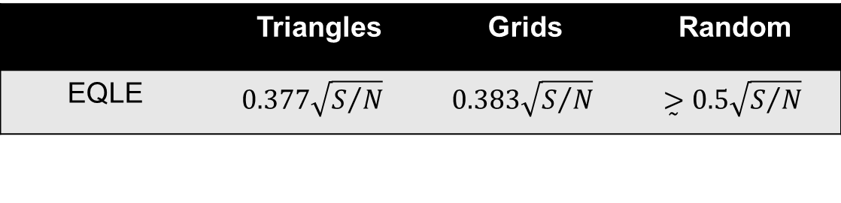
Challenge & Model
Challenge
User density varies in different parts of the region.
Model
The p.d.f. of user in different parts of region denoted by
is respectively.
In each part, the EQLE is .
 | Triangles | Grids | Random
EQLE | $$0.377\sqrt{S/N}$$ | $$0.383\sqrt{S/N}$$ | $$\overset{̰}{>}0.5\sqrt{S/N}$$

Slide 20
Theoretical Results
Using Holder’s Inequality, EQLE of the whole region is minimized when
.
Defining measurement point density as
.
EQLE can be minimized when .
As a special case, if collocation pattern in each part is identical, EQLE can be minimized when .

Slide 21
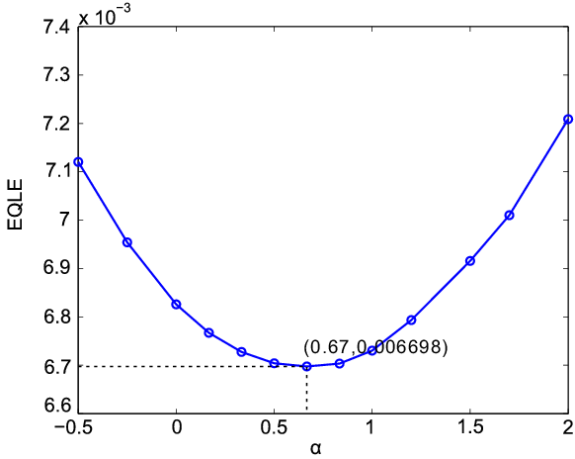
Simulation
Testbed
Allocate measurement points following .
1×2 rectangular region

Slide 22
Outline
Introduction
Metrics & Definitions
Two Preliminary Cases
General Case
Summary
Conclusion
More Applications

Slide 23
Conclusion
Two preliminary cases
If measurement points are collocated regularly, equilateral triangle pattern can minimize EQLE and MQLE while maximize DNN.
If the measurement points are collocated randomly, EQLE has a tight lower bound.
General case
EQLE can be minimized when .
Choose collocation pattern considering deployment budget, target localization accuracy in each part.

Slide 24
Thank you !

