Slide 1


Heart Disease
around the World
Heart Disease
around the World
By:
Minwoo Sohn
Changzhou Li
Xueuyan Li
Amogh Vig
Team 09

Slide 2



Research Idea
The goal of our project was to look at mortality due to heart disease from multiple key standpoints:
Climate
Political Freedom
Economic Indicators
Central question: How is heart disease mortality related to these variables, if at all?
We also wanted to see if we could make predictions about future heart disease mortality rates.

Slide 3
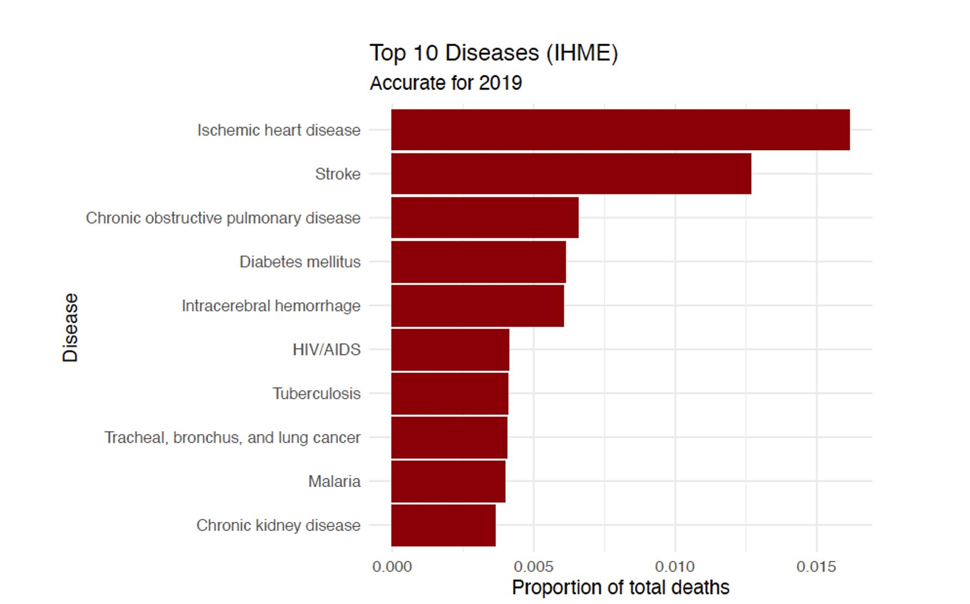
Which disease is the deadliest?
We first looked at cause of death data from the Institute for Health Metrics and Evaluation (IHME)
The goal was to find the disease responsible for the most mortality in the world
Found that ischemic/coronary heart disease is the #1 killer:
Responsible for around 1.6% of all deaths in 2019

Slide 4
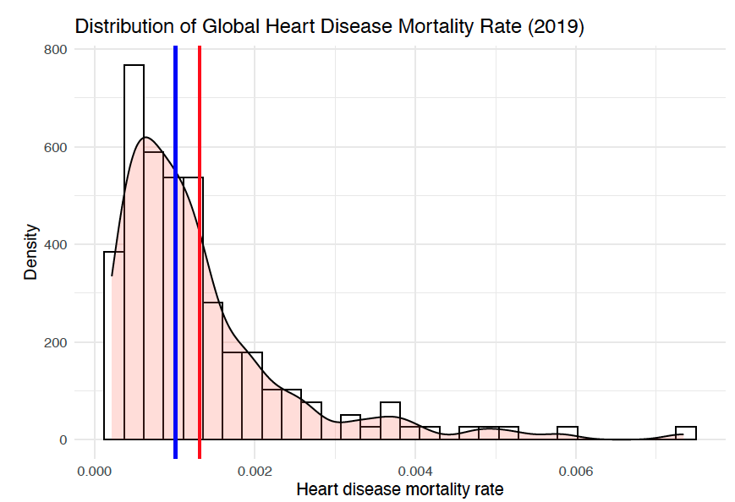
Heart Disease Mortality Distribution
Distribution of mortality is heavily right-skewed (positive skewness)
Mean > Median > Mode
Lower rates of heart disease mortality are more common than higher rates
Note: We define mortality rate as total deaths due to heart disease divided by population

Slide 5
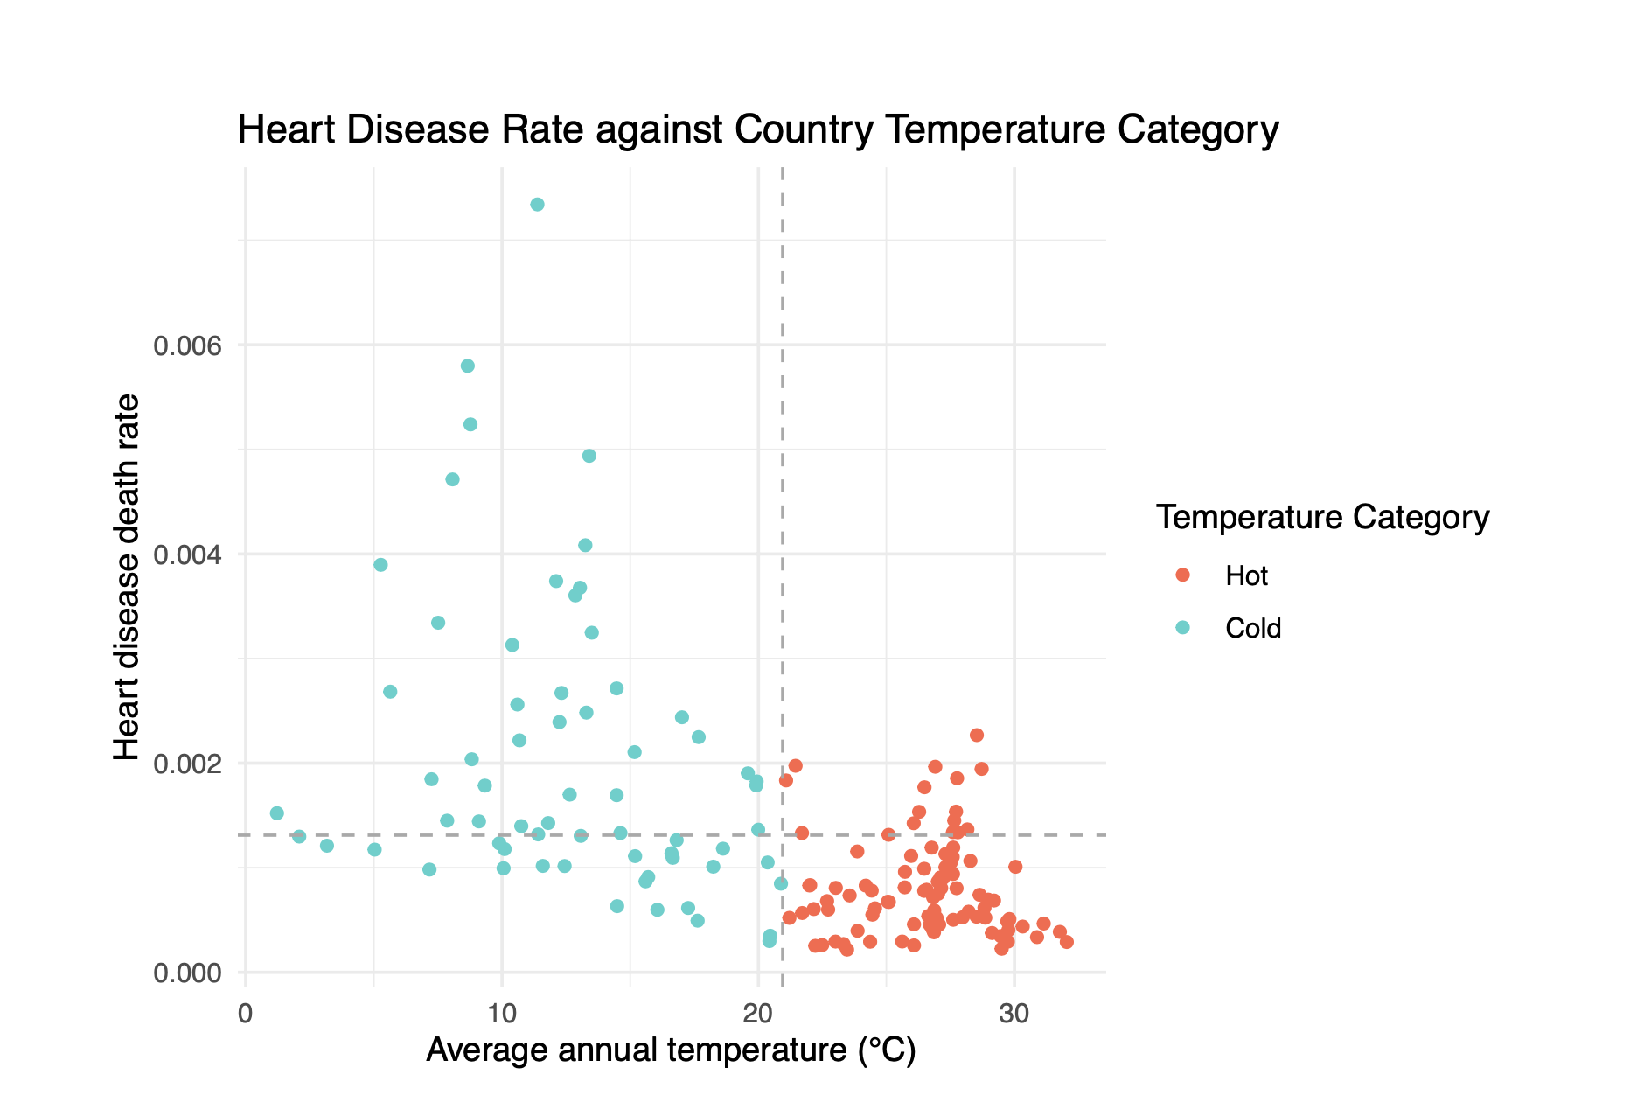
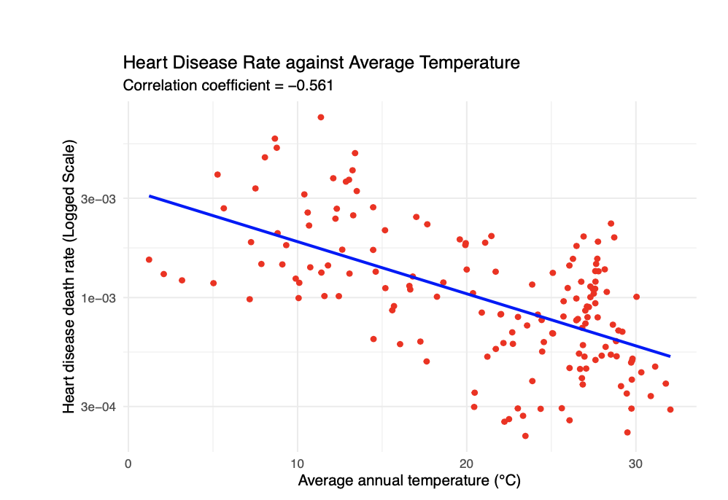
Heart Disease and Average Annual Temperatures
Cold countries exhibit higher mortality rates than hot countries
Linear regression showed that about 56.1% of the variation in death rate could be explained by average annual temperature

Slide 6
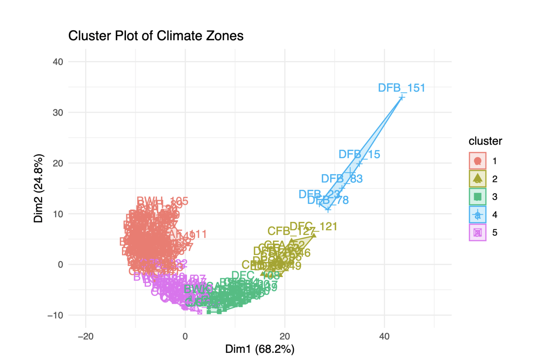
What about Heart Disease and Climate?
Variables used were:
Climate zone codename (label) from Köppen classification (18 total)
Average annual temperature
Mortality rate
Most clusters had a mixture of different climate zones, but cluster 4 was an exception
Regions with a DFB climate (cold continental without dry season) showed higher rates of mortality than other regions

Slide 7
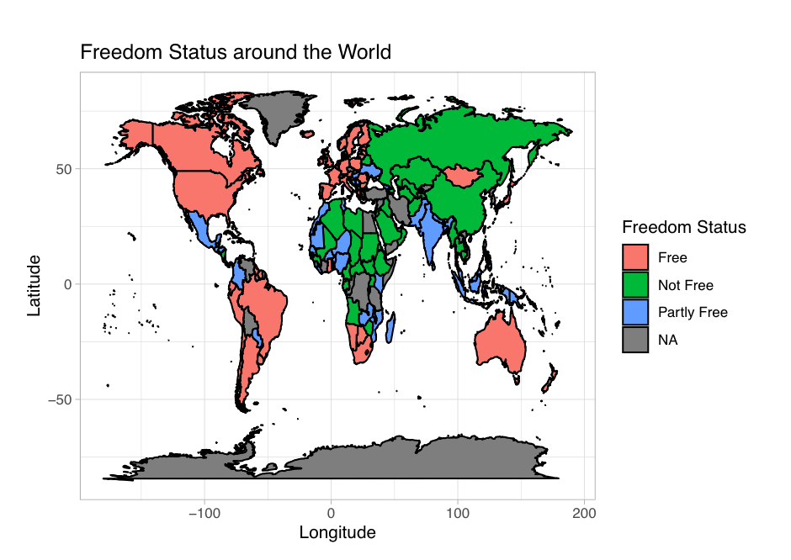
Could Political Freedom be a Factor?
Freedom score measures access to political rights and civil liberties among 210 countries and territories on a scale of 1 to 100
The scores are divided into 3 categories, “Free”, “Partly Free”, and “Not Free”.
Notes:
Talk about the interpretation: most of the western world, countries in North America, South America,
and Western Europe have a freedom score above 70 and are considered free. Countries in Southern Africa,
Oceania, and East Asia also fall within the free category. Central American countries, East and Western
African countries, Southern Asia, and Southeast Asian countries obtained freedom scores between 35 and 70
and are classified as partly free. The rest of the world, Central Africa, part of Southeast Asia, Central Asia,
and Middle East countries received a freedom score below 35 and are considered not free.

Slide 8
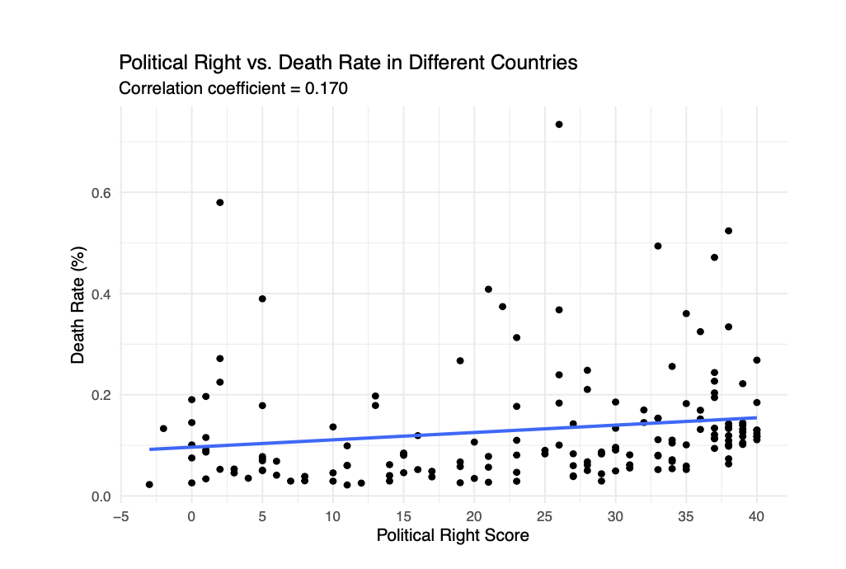
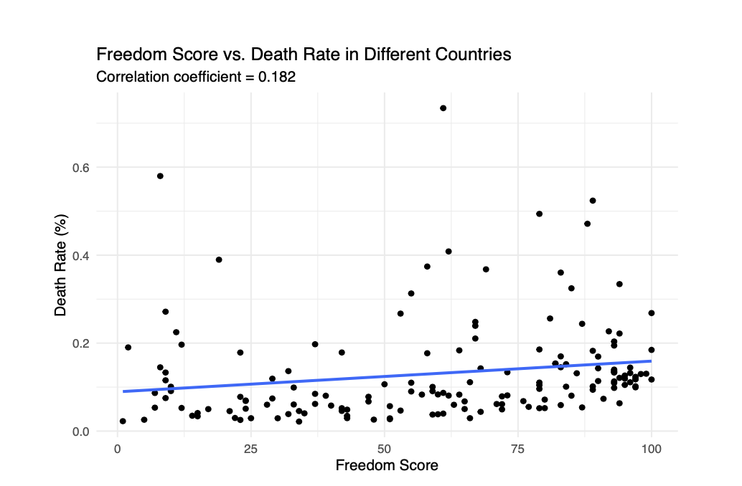
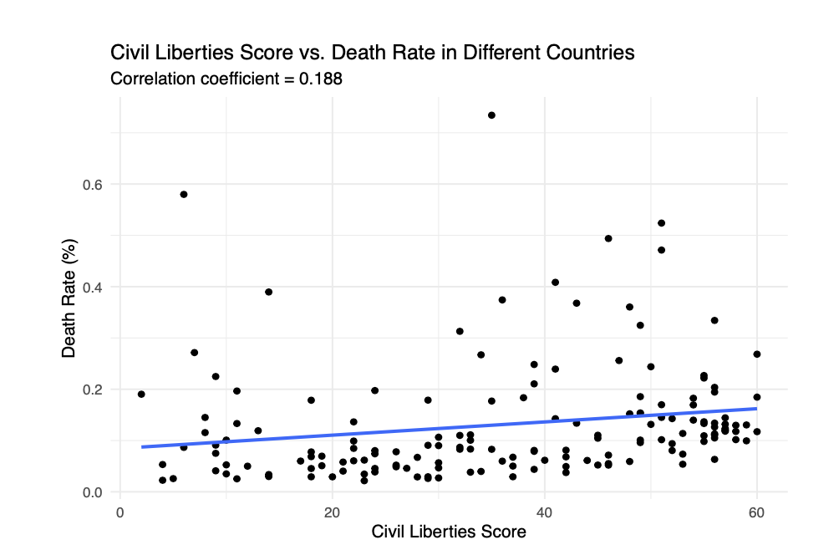
Heart Disease and Political Freedom
Notes:
Compared the death rate vs. freedom score
- Most of the countries, regardless of the freedom score, have the death rate in lower ends, clustering around 0.2%.
Couldn’t find the apparent relationship, correlation coefficient = 0.1816,
Further analysis done on political rights and civil liberties, still couldn’t find good relationship.

Slide 9
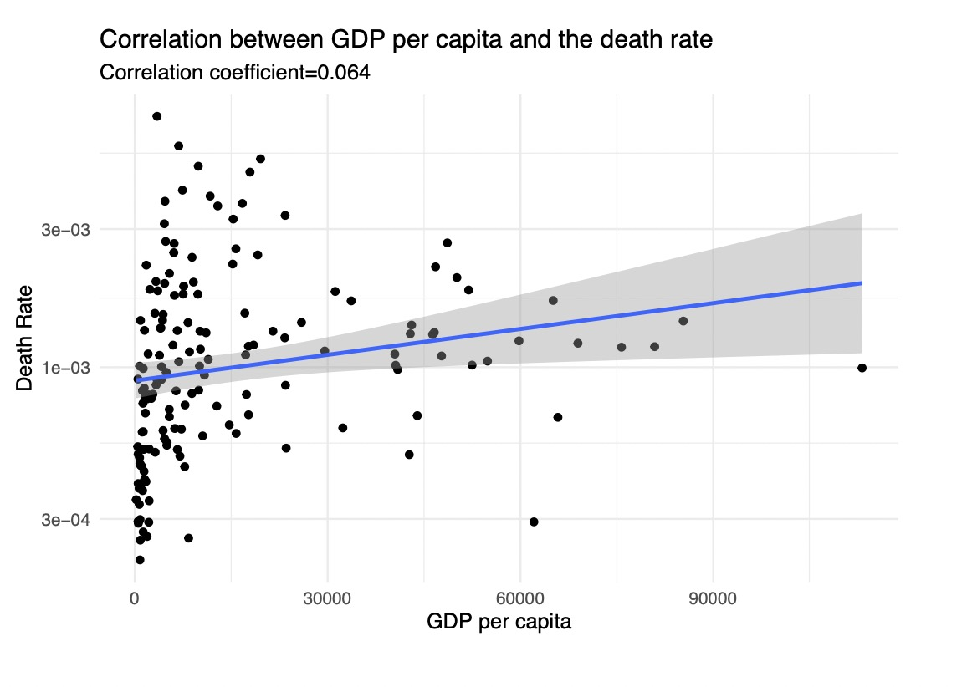
Heart Disease and GDP
Correlation coefficient = 0.064
A very low
positive correlation
Notes:
-> Assume: negative correlation : because GDP could reflect the living quality of people in this country to some degree.
-> But after we did the correlation analysis, we found that the CC=0.064 : which is a very low positive correlation

Slide 10
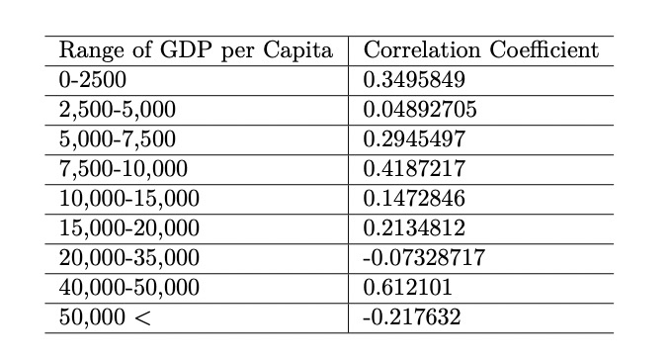
Heart Disease and GDP
Divided all countries into 9
groups by GDP per capita:
Despite some outliers, in
general, there is a weak positive
correlation between GDP per
capita and death rate.
Notes:
So we decides to divide all countries into 13 groups by GDP per capita:
->according to CC, in general , a weak positive correlation
->result conflicts our original assumption

Slide 11
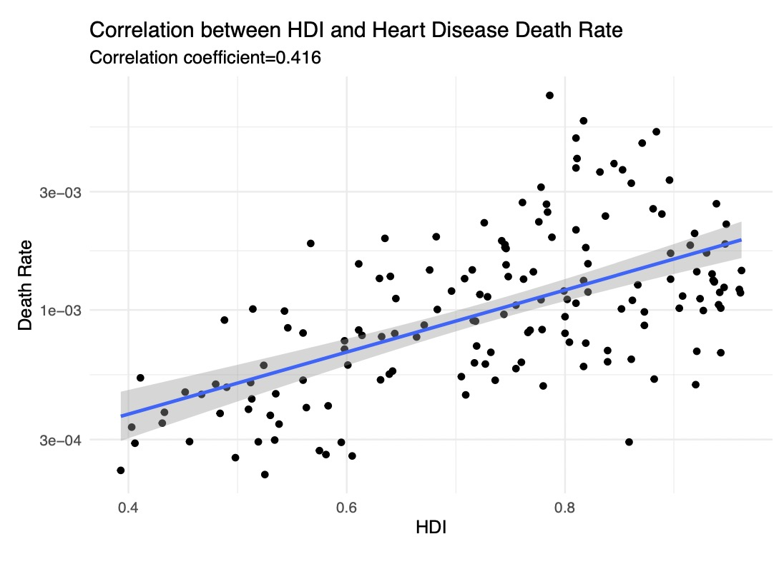
Heart Disease and HDI
Correlation coefficient: 0.416
A Positive correlation
Notes:
Assume: negative correlation : HDI is used to measure the level of economic and social development of the United Nations member countries.
-> CC=0.416 , positive
-> conflicts the original assumption

Slide 12
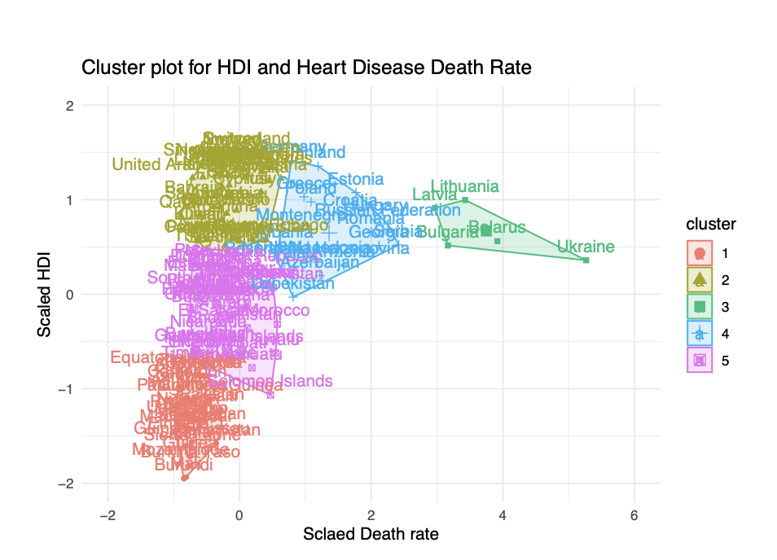

Heart Disease and HDI
Five countries:
Lithuania
Latvia
Bulgaria
Belarus
Ukraine
Variables used were:
HDI
Death Rate
Notes:
Then we try to use k-mean cluster plot to find which countries have the similar heart disease and HDI.
From this plot, we can see in cluster 3, there are 5 countries with similar HDI and Death rate.
-> so we want to find is there any relationship among these countries.

Slide 13
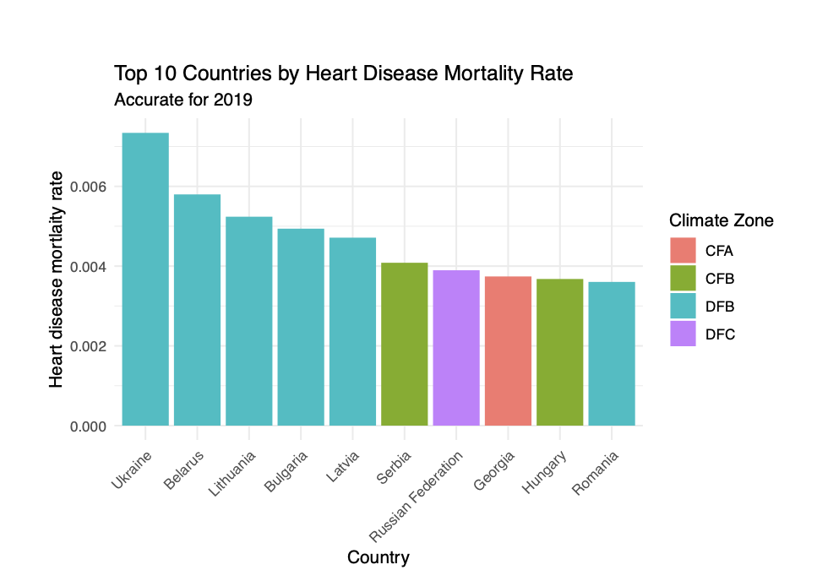
Climate Analysis Key Insight
Countries with the top 5 highest mortality rates have the same climate – DFB (cold continental)

Slide 14
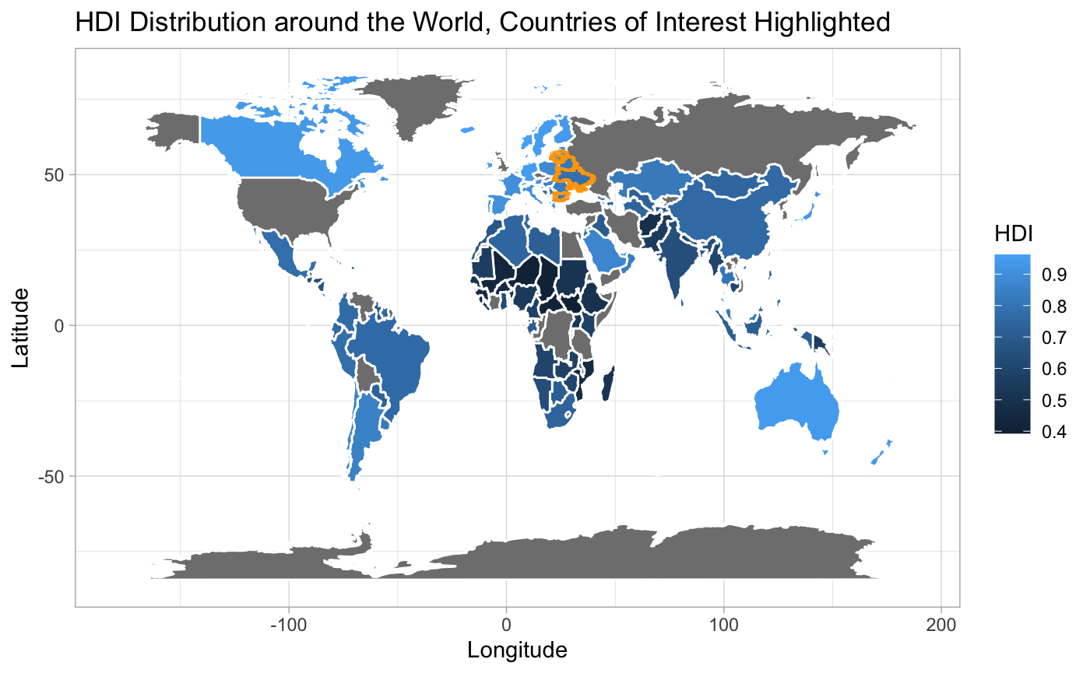
Heart Disease and HDI
The orange highlight depicts:
Eastern Europe
Most of countries in Eastern Europe have similar :
Climate
HDI
Death Rate.
Notes:
Then We highlight these 5 countries in the world map. And surprisingly find that they are all Eastern European Countries.
Same as previous finding, most of countries in Eastern Europe have similar climate, HDI, and Death Rate.

Slide 15
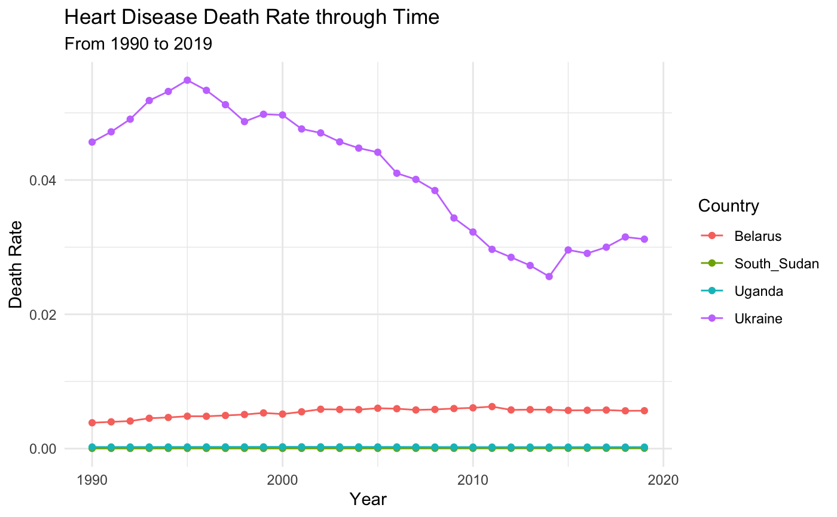
Time Series Analysis: Recent Trends for Heart Disease
Two highest death rates:
Belarus & Ukraine
Two lowest death rates:
South Sudan & Uganda
Based on recent trends, mortality levels are projected to remain constant
Copyrightⓒ. Saebyeol Yu. All Rights Reserved.
Notes:
Uganda and South Sudan has remained essentially constant at close to zero;
Belarus has also remained fairly constant;
Ukraine has changed a lot-> But heart disease death rate is projected to remain fairly constant in the near future.

Slide 16
Conclusions
Heart disease is the disease that kills the most people globally based on our most recent data (2019)
Countries that suffer from high rates of heart disease mortality are concentrated in Eastern Europe and have a similar climate and HDI.
Recent trends from time series analysis suggest that heart disease mortality rates will generally remain constant for the near future
출처 : XXX YYY ZZZ (2014)

Slide 17
References
[1] OECD (2022), OECD Economic Outlook, Volume 2022 Issue 2: Preliminary version, OECD Publishing, Paris, https://doi.org/10.1787/f6da2159-en.
[2] Human Development Reports, 2019.HUMAN DEVELOPMENT REPORT 2018-19. Publisher name. https://hdr.undp.org/data-center/human-development-index#/indicies/HDI
[3] Human Development Index (HDI) by Country 2022. https://worldpopulationreview.com/country-rankings/hdi-by-country
[4] Weather and Climate. (2022), World Climate Data. List of countries by climate zone and average yearly temperatures. Retrieved December 7, 2022, from https://tcktcktck.org/countries
[5] Arnfield, J. (2022), Köppen Climate Classification. Encyclopædia Britannica. Retrieved December 6, 2022, from https://www.britannica.com/science/Koppen-climate-classification
[6] World Health Organization. (2020, December 9). The top 10 causes of death. World Health Organization. Retrieved December 6, 2022, from https://www.who.int/news-room/fact-sheets/detail/the-top-10-causes-of-death
[7] Freedom House. (2020), Countries and territories. Freedom House. Retrieved December 7, 2022, from https://freedomhouse.org/countries/freedom-world/scores
[8] Belarus population 1950-2022. MacroTrends. (2022), Retrieved December 7, 2022, from https://www.macrotrends.net/countries/BLR/belarus/population
[9] South Sudan population 1950-2022. MacroTrends. (2022), Retrieved December 7, 2022, from https://www.macrotrends.net/countries/SSD/south-sudan/population
[10] Uganda population 1950-2022. MacroTrends. (2022), Retrieved December 7, 2022, from https://www.macrotrends.net/countries/UGA/uganda/population
[11] Ukraine population 1950-2022. MacroTrends. (2022), Retrieved December 7, 2022, from https://www.macrotrends.net/countries/UKR/ukraine/population
[12] Institute for Health Metrics and Evaluation. (2022, December 6). Retrieved December 8, 2022, from https://www.healthdata.org/

Slide 18
Q&A
Copyrightⓒ. Saebyeol Yu. All Rights Reserved.

