Slide 1
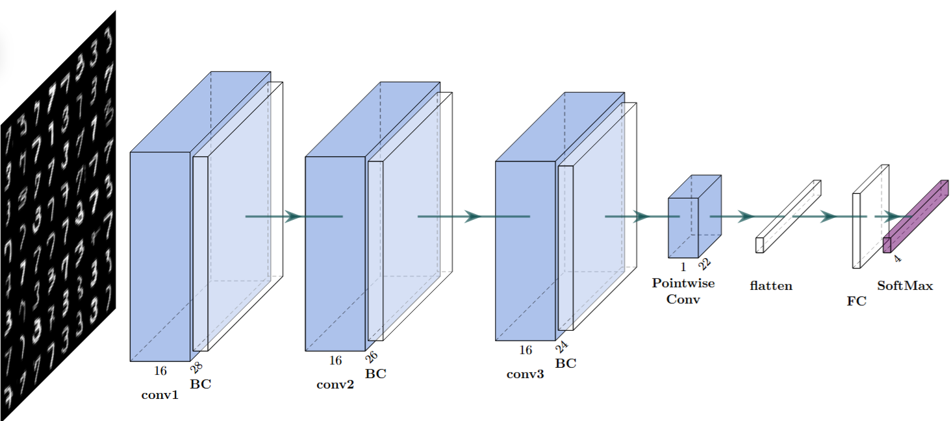
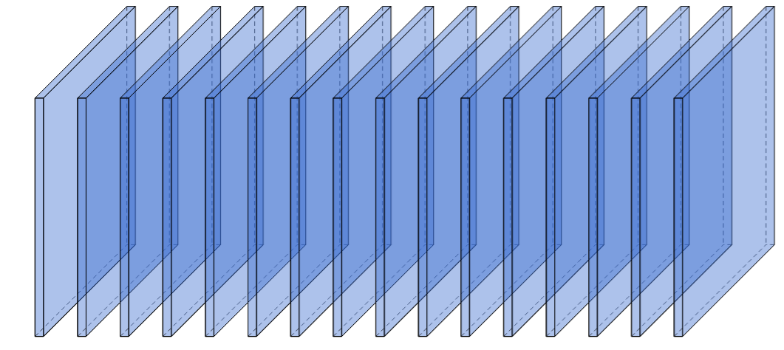
QD incoherent
laser
MZI
Programmable
Convulution
Core
(PCC)
VOA
PD
......
......
MCU
SG
ADC
DAC
RAM
One filter
Filter 1-16
Composed by

