Slide 1
Cookies & Privacy
Copyright 2012-2016 Ellis Horowitz

Slide 2
Overview
What is a Cookie? Basic Facts
Working with Cookies: Code & Demo
Cookie based Marketing
Cookies, Privacy & Legislation
Conclusion
Copyright 2012-2016 Ellis Horowitz

Slide 3
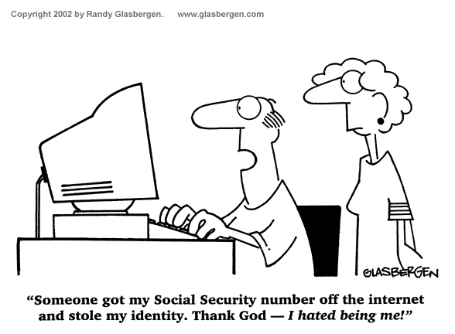
“Google has been bypassing the privacy settings of millions of people using Apple’s Safari web browser on their iPhones and computers - Tracking the web-browsing habits of people who intended for that kind of monitoring to be blocked.” Wall Street Journal, Feb. 17, 2012
“Google to pay $22.5 million fine for Safari privacy evasion”, CNN Money, July 11, 2012 [largest penalty ever levied on a single company by the FTC]

Slide 4
What is a Cookie?
Short pieces of text generated during web activity and stored in the user’s machine by the user’s web browser for future reference
Cookies are created by website authors who write software for reading and writing cookies
Cookies were initially used so websites would remember that a user had visited before, allowing customization of sites without need for repeating preferences
The official 1997 specification for cookies can be found at:
http://www.w3.org/Protocols/rfc2109/rfc2109
Copyright 2012-2016 Ellis Horowitz

Slide 5
Elements of a Cookie
A cookie is associated with a website’s domain and includes: name, value, path, and expiration date
For example here is one that was placed on my machine from research.google.com
  Name: _utma
  Content: 180832036.353394603.1325873813.1325873813.1329750652.2
  Domain: .research.google.com
  Path: /
  Created: Monday, February 20, 2012 7:12:45 AM
  Expires: Wednesday, February 19, 2014 7:12:45 AM
Such cookies are sometimes referred to as HTTP cookies because they are placed there using the HTTP protocol as the delivery mechanism
Copyright 2012-2016 Ellis Horowitz

Slide 6
Cookie Scope: What They Can Do
Store and manipulate any information you explicitly provide to a site
Track your interaction with the site such as pages visited, time of visits, number of visits
Use any information available to the web server including: your IP address, Operating System, Browser Type
Copyright 2012-2016 Ellis Horowitz

Slide 7
Cookie Scope: What They Cannot Do
Have automatic access to personal information like name, address, email
Read or write data to disk
Read or write information in cookies placed by other sites
Run programs on your computer
As a result they
  Cannot carry viruses
  Cannot install malware on the host computer
Copyright 2012-2016 Ellis Horowitz

Slide 8
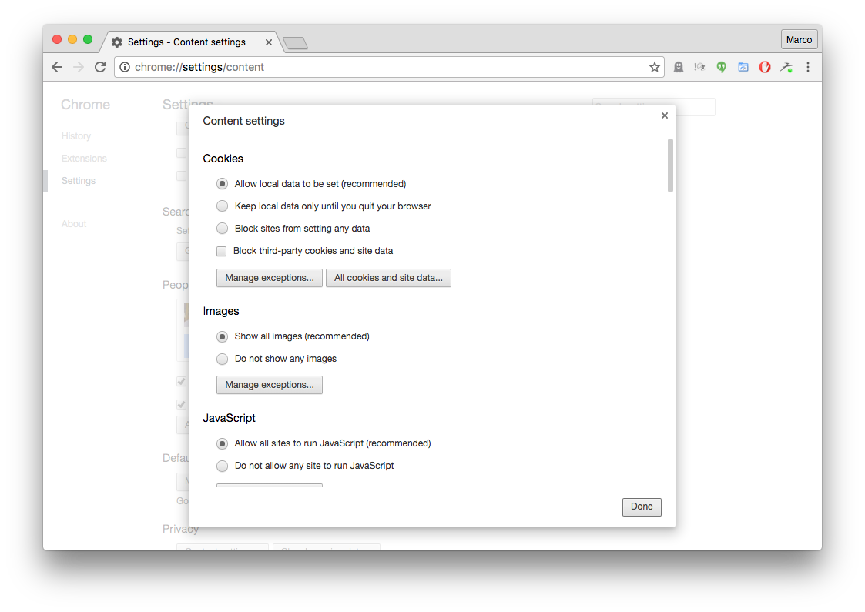
Finding Cookies in Your Chrome Browser
Browsers store their cookies in their own format and files.
In Chrome
  Customize/Control > Settings > Show advanced settings >
  Privacy - Content settings > Cookies -> All cookies and site data...
Here are the
Chrome settings
for handling
cookies
Copyright 2012-2016 Ellis Horowitz

Slide 9
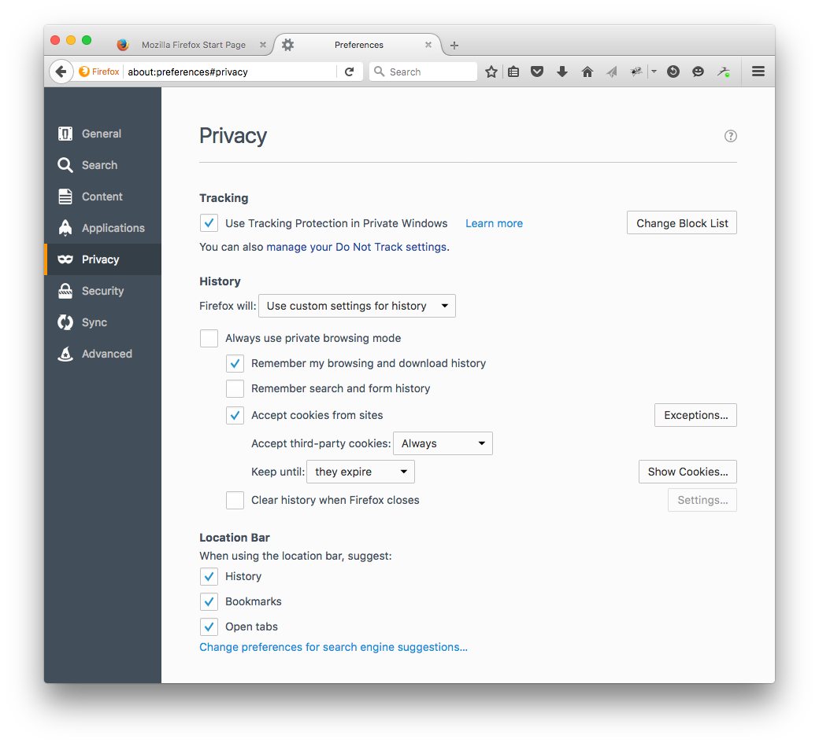
Finding Cookies in Your Firefox Browser
In Firefox
  Open menu > Preferences > Privacy > Show Cookies
Here are the
Firefox settings
for handling
cookies
Show all cookies
Copyright 2012-2016 Ellis Horowitz

Slide 10
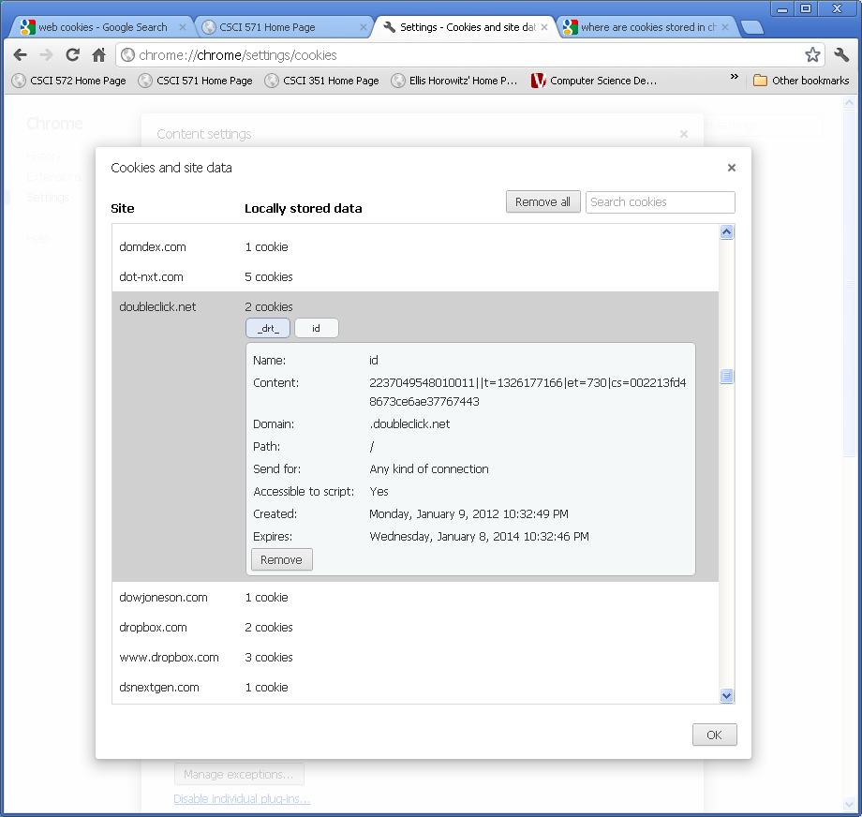
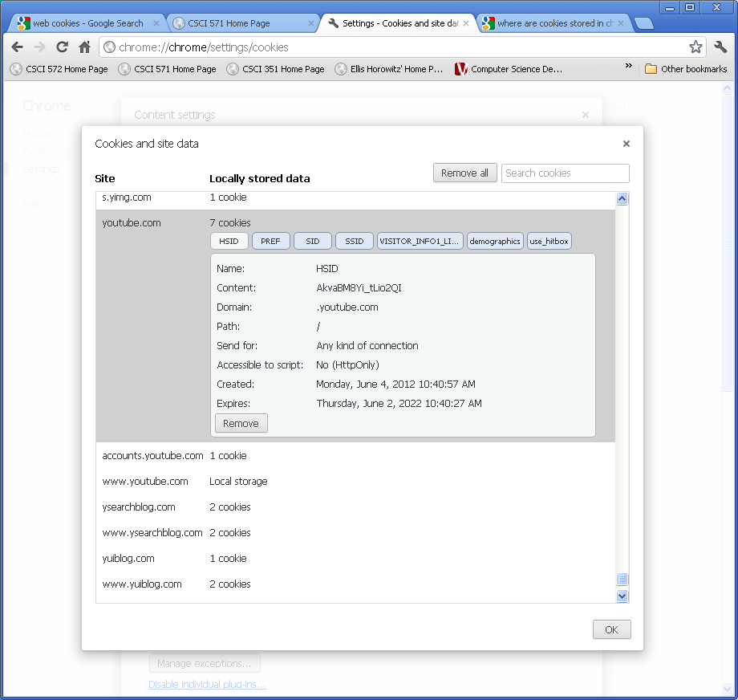
Other Google Property Cookies
Doubleclick Cookies
YouTube cookies
Doubleclick and YouTube are two companies owned and operated by
Google; Doubleclick cookies are referred to as 3rd party because the
user never actually visits the Doubleclick site
Copyright 2012-2016 Ellis Horowitz

Slide 11
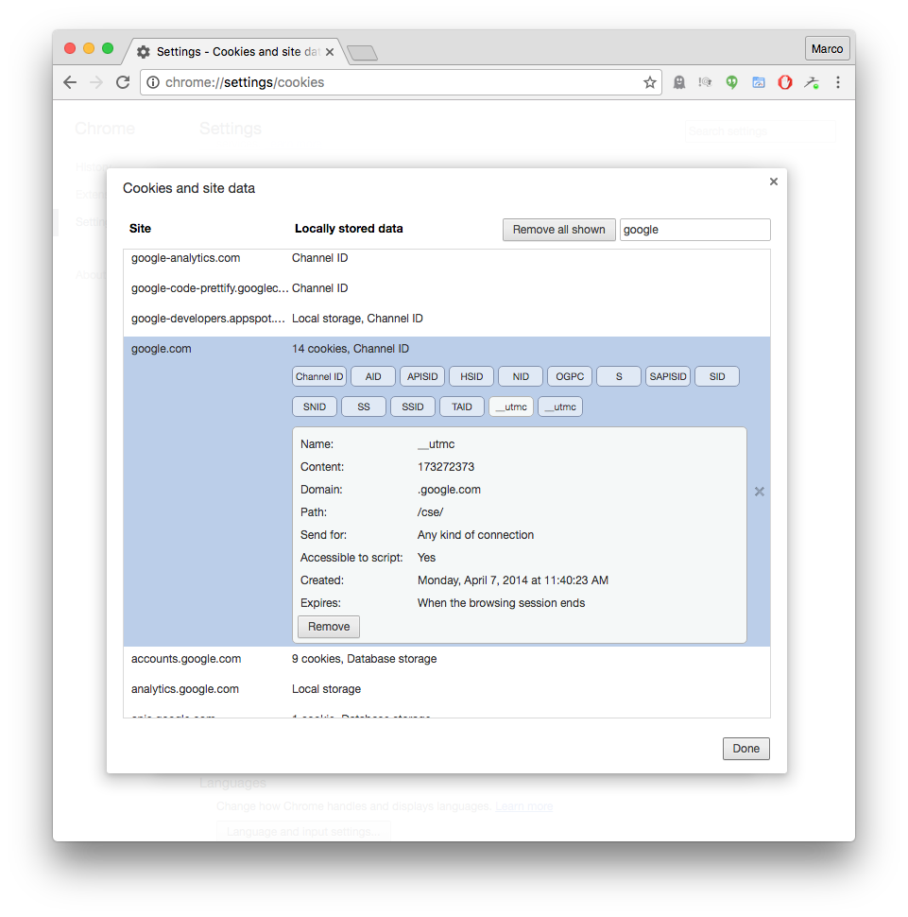
Sample Chrome Cookie Storage
For example, google.com has
stored many cookies on this
browser:
plus.google.com 2 cookies
plusone.google.com 2
productformums.google.com 6
research.google.com 2
support.google.com 31
talkgadget.google.com 4
wallet.google.com 16
www.google.com 5
For a total of 68 cookies
Copyright 2012-2016 Ellis Horowitz

Slide 12
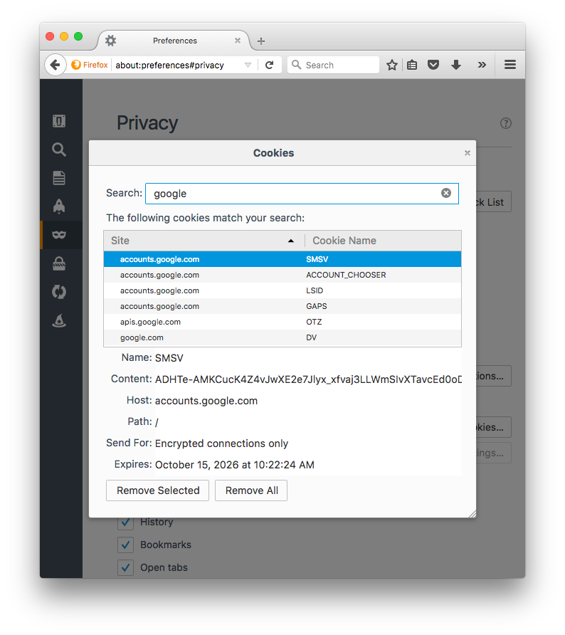
Sample Firefox Cookie Storage
For example, google.com has
stored many cookies on this
browser:
accounts.google.com 9 cookies
google.com 8
mail.google.com 9
plus.google.com 1
plusone.google.com 1
For a total of 28 cookies
Copyright 2012-2016 Ellis Horowitz

Slide 13
Cookie Types and Taxonomy
By Lifespan
- Session Cookies (stored in RAM)
- Persistent Cookies (stored on disk)
By Read-Write Mechanism
- Server-Side Cookies (included in HTTP Headers)
- Client-Side Cookies (manipulated with JavaScript)
By Structure
- Simple Cookies
- Array Cookies
Session cookies exist only while the user is reading and navigating the website; browsers normally delete session cookies when the user exits the browser
Persistent cookies, also known as tracking cookies have an expiration date
Secure cookies have the secure attribute enabled and are only used via https, so the cookie is always encrypted
Copyright 2012-2016 Ellis Horowitz

Slide 14
Third Party Cookies
Third party cookies are cookies set with a different domain (or subdomain) than the one in the browser’s address bar
  These cookies may be placed by an advertisement on the page or an image on the page
  RFC 6265 allows browsers to implement whatever policy they wish regarding third party cookies
    https://tools.ietf.org/html/rfc6265
  Advertisers use third party cookies to track a user across multiple sites
    E.g. a user visits www.company1.com which sets a cookie with domain ad.adtracking.com; later the same user visits www.company2.com which also sets a cookie with domain ad.adtracking.com; Eventually both cookies will be sent to the advertiser who will know the two sites visited
Wikipedia has a nice description of cookies, see
http://en.wikipedia.org/wiki/HTTP_cookie
Copyright 2012-2016 Ellis Horowitz

Slide 15
Cookie Processing Algorithm
A URL is requested, (either by entering one into the address field or clicking on a link)
The browser scans its Cookie database for any cookies whose domain and path matches the requested URL
If any are found, all the cookies are sent along with the request as part of the HTTP headers (value of Cookie)
The server-side programs may/may not make use of any cookies from the client to determine what page to return
The server-side program may generate one (or more) cookies and send them along with the requested page; cookies are included in the HTTP headers returned to the browser (value of Set-Cookie)
The browser stores any new cookies into its database; cookies can be accessed on the client using the document.cookie object in JavaScript
Copyright 2012-2016 Ellis Horowitz

Slide 16
Cookie Processing Example
https://www.google.com/?gws_rd=ssl
GET /?gws_rd=ssl HTTP/1.1
Host: www.google.com
User-Agent: Mozilla/5.0 (Macintosh; Intel Mac OS X 10.11; rv:43.0) Gecko/20100101 Firefox/43.0
Accept: text/html,application/xhtml+xml,application/xml;q=0.9,*/*;q=0.8
Connection: keep-alive
Cache-Control: max-age=0
HTTP/2.0 200 OK
Date: Mon, 29 Feb 2016 22:02:31 GMT
Content-Type: text/html; charset=UTF-8
Content-Encoding: gzip
Server: gws
Set-Cookie: NID=77=AITJ83oyT_0OAB8c4ogH1JKOxUwf3w9SMg5tcZUjnqq_3mKK1AQTMPPIET1Q2FL1jaKpK-NFJ_v-HT469S0DKl5SYn6Ct_1bGdn0xbbU-dLABnqUDneClbdgsG1iFcKqZdfur3w9nN3VyQ; expires=Tue, 30-Aug-2016 22:02:31 GMT; path=/; domain=.google.com; HttpOnly
----------------------------------------------------------
https://www.google.com/images/hpp/ic_wahlberg_product_core_48.png8.png
GET /images/hpp/ic_wahlberg_product_core_48.png8.png HTTP/1.1
Host: www.google.com
User-Agent: Mozilla/5.0 (Macintosh; Intel Mac OS X 10.11; rv:43.0) Gecko/20100101 Firefox/43.0
Accept: image/png,image/*;q=0.8,*/*;q=0.5
Accept-Encoding: gzip, deflate
Cookie: NID=77=AITJ83oyT_0OAB8c4ogH1JKOxUwf3w9SMg5tcZUjnqq_3mKK1AQTMPPIET1Q2FL1jaKpK-NFJ_v-HT469S0DKl5SYn6Ct_1bGdn0xbbU-dLABnqUDneClbdgsG1iFcKqZdfur3w9nN3VyQ
Connection: keep-alive
If-Modified-Since: Wed, 09 Sep 2015 23:04:49 GMT
HTTP/2.0 304 Not Modified
Date: Mon, 29 Feb 2016 22:02:32 GMT
Expires: Mon, 29 Feb 2016 22:02:32 GMT
Last-Modified: Wed, 09 Sep 2015 23:04:49 GMT
Server: sffe
Notes:
http-only: you cannot read from JavaScript;

Slide 17
Additional Facts About Cookies
Scope: by default, cookie scope is limited to all URLs on the current host name. Scope may be limited with the path= parameter to specify a specific path prefix to which the cookie should be sent, or broadened to a group of DNS names, rather than single host only, with domain=.
Time to live: by default, each cookie has a lifetime limited to the duration of the current browser session. Alternatively, an expires= parameter may be included to specify the date at which the cookie should be dropped
Overwriting cookies: if a new cookie with the same NAME, domain, and path as an existing cookie is encountered, the old cookie is discarded
Deleting cookies: There is no specific mechanism for deleting cookies, although a common hack is to overwrite a cookie with a bogus value as outlined above, plus a backdated or short-lived expires=
"Protected" cookies: as a security feature, some cookies set may be marked with a special secure keyword, which causes them to be sent over HTTPS only
Copyright 2012-2016 Ellis Horowitz

Slide 18
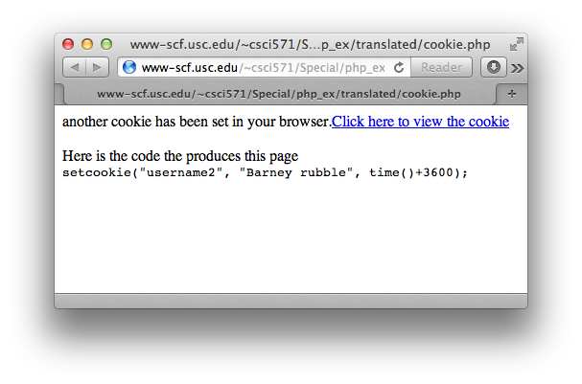
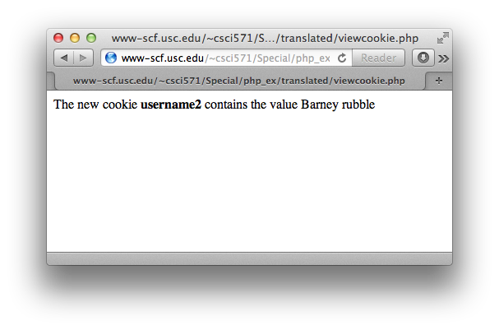
Server-Side Cookie example in PHP
Set cookie:
<?php
setcookie("username2", "Barney rubble", time()+3600);
echo "another cookie has been set in your browser.";
?>
<a href="viewcookie.php">Click here to view the cookie</a><br/><br/>
Here is the code the produces this page<br>
<?php highlight_string('setcookie("username2", "Barney rubble", time()+3600);'); ?>
View cookie:
<?php
if(isset($_COOKIE["username2"])) {
echo "The new cookie <b>username2</b> contains the value " . $_COOKIE["username2"];
}
?>
Copyright 2012-2016 Ellis Horowitz

Slide 19
Client-Side Cookies
JavaScript has a property of the document object named cookie:
document.cookie
This is a string variable that can be read and written using the JavaScript string functions
• A cookie can be removed from the cookie database either because it expires or because the cookie file gets too large
browsers need not store more than 300 cookies, nor more than 20 cookies per web server, nor more than 4K per cookie
Setting document.cookie creates a new cookie for the web page
Reading
Copyright 2012-2016 Ellis Horowitz

Slide 20
Creating a Cookie in JavaScript
var today = new Date();
var expiry = new Date(today.getTime() + 30 * 24 * 3600 * 1000); // plus 30 days
function setCookie(name, value, expiry)
{
document.cookie=name + "=" + escape(value) + "; path=/; expires=" + expiry.toGMTString();
}
produces a cookie that looks like
name= value; path=/; expires= date;
toGMTString() produces a date in the correct format
Copyright 2012-2016 Ellis Horowitz

Slide 21
escape(s) and unescape(s)
Cookie ‘values’ should not contain white space, brackets, parentheses, equals signs, commas, double quotes, slashes, question marks, at signs, colons, and semicolons
  Cookie values are encoded into their hex equivalents
escape() and unescape are not methods of any object
escape(s) returns a new version of string s that is encoded
  all spaces, punctuation, accented characters, and other non-ASCII letters or numbers are converted to %xx format (ISO-8859-1)
  https://developer.mozilla.org/en-US/docs/Web/JavaScript/Reference/Global_Objects/escape
unescape(s) returns a new version of string s that is decoded
  all %xx are replaced by their character equivalent
  https://developer.mozilla.org/en-US/docs/Web/JavaScript/Reference/Global_Objects/unescape
Copyright 2012-2016 Ellis Horowitz

Slide 22
Test of escape( ), unescape( )
<html><head><title>testing escape</title>
<script language=javascript>
function printout(x) {
document.write("<PRE>")
document.write("Original input = " + x + "<BR>")
document.write("escape() of input = " + escape(x) + "<BR>")
document.write("unescape() of input = " + unescape(x) + "<BR>")
document.write("</PRE></BODY></HTML>" )}
</script>
</head><body><H1>Testing Escape in JavaScript</h1>
<form name="myform"> <input name="sample"><br>
<input type="button" value="Go" onClick="printout(myform.sample.value)">
</form></body></html>
Copyright 2012-2016 Ellis Horowitz

Slide 23
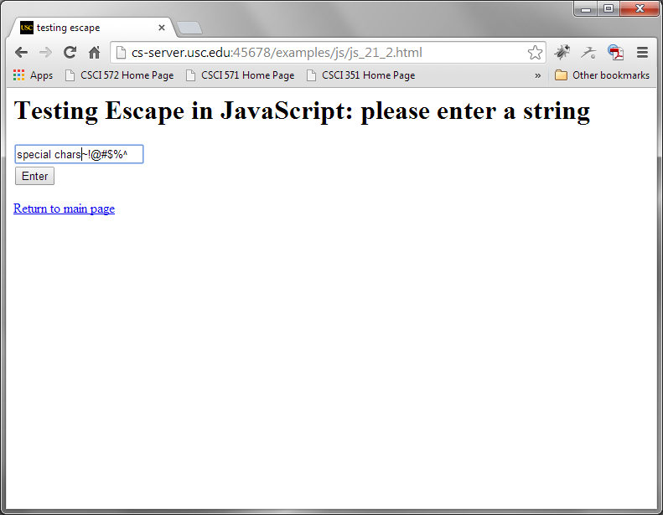
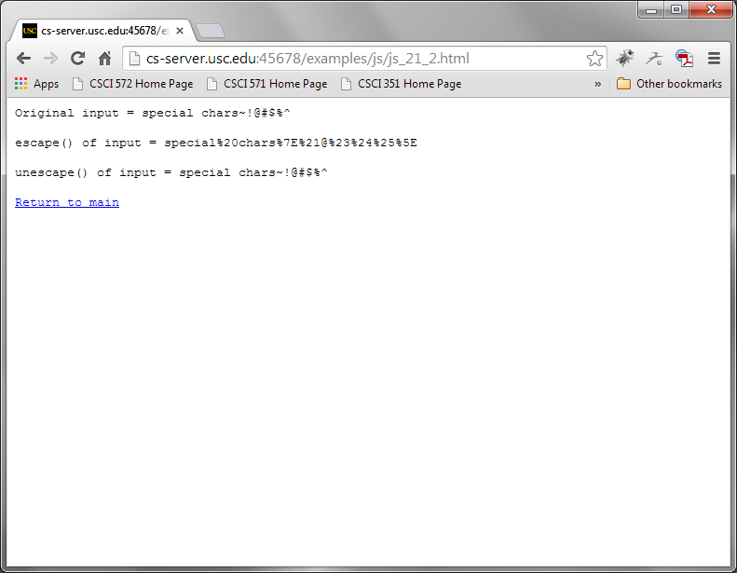
Browser Output Showing Use of Escape(), Unescape()
http://cs-server.usc.edu:45678/examples/js/js_21_2.html
Copyright 2012-2016 Ellis Horowitz

Slide 24
Setting a cookie
function setCookie(cname, cvalue, exdays) {
//Create a cookie Example. Suppose we want to create a cookie variable "username" whose value is "John Smith"
//document.cookie="username=John Smith; expires=Thu, 18 Dec 2018 12:00:00 UTC; path=/";
var d = new Date();
d.setTime(d.getTime() + (exdays*24*60*60*1000));
var expires = "expires=“ + d.toUTCString();
document.cookie = cname + "=" + cvalue + "; " + expires;
}
Copyright 2012-2016 Ellis Horowitz

Slide 25
Retrieving a cookie
// Original JavaScript code by Chirp Internet: www.chirp.com.au
// http://www.the-art-of-web.com/javascript/getcookie/
// Please acknowledge use of this code by including this header.
function getCookie(name)
{
var re = new RegExp(name + "=([^;]+)");
var value = re.exec(document.cookie);
return (value != null) ? unescape(value[1]) : null;
}
Copyright 2012-2016 Ellis Horowitz

Slide 26
Removing a cookie
Var today = new Date();
var expired = new Date(today.getTime() - 24 * 3600 * 1000); // less 24 hours
Function removeCookie(name)
{
document.cookie=name + "=null; path=/; expires=" + expired.toGMTString();
}
  creates an early date (24 hour early);
  attaches it to the expires directive and
  assigns the name to the null string
Copyright 2012-2016 Ellis Horowitz

Slide 27
JavaScript Cookie Libraries
We have defined three JavaScript functions for handling cookies
  setCookie( name, value, expireDate )
  getCookie( name )
  removeCookie( name )
Instead of including them in every html page that manipulates cookies, one can save them in a file, e.g. cookies.js and include the line
<SCRIPT language=JavaScript src=cookies.js>
. . .
</SCRIPT>
Copyright 2012-2016 Ellis Horowitz

Slide 28
Complete JavaScript Example
<HTML><HEAD><TITLE>Set Cookies</TITLE>
<SCRIPT language=JavaScript src=cookies.js></SCRIPT>
<SCRIPT language=JavaScript>
//cname: cookie name
//cvalue: cookie value
//expdays: the cookie expires after a certain number of days
See Next Slide
</SCRIPT></HEAD>
<BODY>
<h2>Full Cookie Example</h2>
<FORM method="GET" name="myform">
What is your name: <input name="yourname" type="text" /><BR>
Choose your background:<br>
<input type=radio name="backg" value="green">green<br>
<input type=radio name="backg" value="red">red<br>
<input type="button" value="submit" onclick="saveCookies()">
</FORM>
<a href="http://cs-server.usc.edu:45678/examples.html#cookies">
Return to main page</a>
<noscript></BODY></HTML>

Slide 29
Complete JavaScript Example (2) - saveCookies
function saveCookies()
{
// Remove any previous cookies
//To delete a cookie, just set the expires parameter to a passed date:
document.cookie = "personColor=; expires=Thu, 01 Jan 1970 00:00:00 UTC";
document.cookie = "personName=; expires=Thu, 01 Jan 1970 00:00:00 UTC";
var hisName = document.myform.yourname.value;
var hisColor;
if (document.myform.backg[0].checked)
{
hisColor=document.myform.backg[0].value;
}
else if (document.myform.backg[1].checked)
{
hisColor=document.myform.backg[1].value;
}
setCookie('personName', hisName, 30);
setCookie('personColor', hisColor, 30);
alert("personName =" + hisName + "\npersonColor = " + hisColor);
window.location="js_21_5.html";
} </SCRIPT>
Copyright 2012-2016 Ellis Horowitz

Slide 30
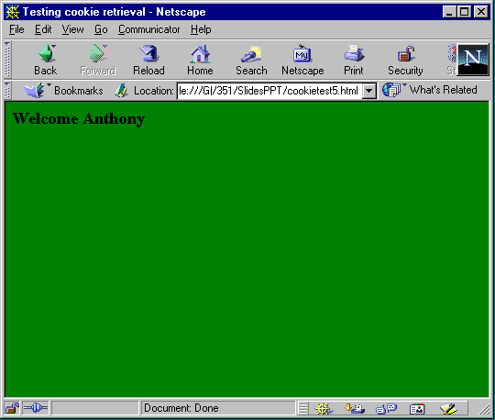
Browser Output
http://cs-server.usc.edu:45678/examples/js/js_21_4.html
Copyright 2012-2016 Ellis Horowitz

Slide 31
Another Example: Site Visit
A cookie can maintain a count of the number of times a client has visited your site
<HTML><HEAD><TITLE>Testing cookie counter</TITLE>
<script language=javascript src=cookies.js></script>
</head><body>
<script language=javascript>
var expire = new Date(21,12,31);
var numHits = getCookie("hits");
if (numHits) {//numHits is defined
numHits = parseInt(numHits) + 1;
document.write("You have visited this site " + numHits + " times"); }
else { numHits = 1;
document.write("Welcome, this is your first visit");}
setCookie("hits", numHits, expire); </script> </BODY> </HTML>
Copyright 2012-2016 Ellis Horowitz

Slide 32
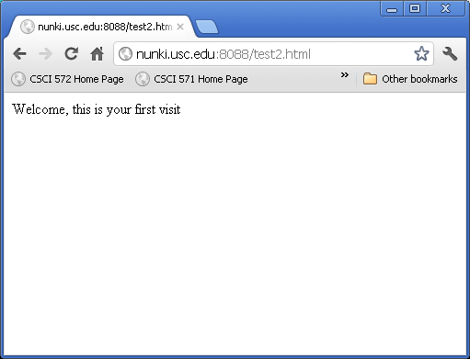

Browser Output
http://cs-server.usc.edu:45678/examples/js/js_21_6.html
Copyright 2012-2016 Ellis Horowitz

Slide 33
How Advertising on the Web Works
An online advertising network or ad network is a company that connects advertisers to web sites that want to host advertisements.
  The key function of an Ad Network is to place advertisements on the web sites of web publishers who wish to sell advertising space.
There are four key players involved in an Ad Network’s delivery of ads to users.
  First, there are the advertisers that wish to place the ads.
  Second, there are the website owners who wish to make money by selling ad space on their websites.
  Third, there is the Ad Network that signs up advertisers and places their ads on the web pages of website owners.
  Fourth, there are the visitors who view the web pages that contain the ads.
    When a visitor requests a web page, the Ad Network is notified and it supplies one ad from its inventory to appear on the web page that was requested. The advertiser will pay the Ad Network for placing its ads and the Ad Network will return a portion of that fee to the website owner.
Notes:
Website owners: show ad(cheap) / click through(costly);

Slide 34
Cookie-based Marketing
What is it?
A user customized online advertising and marketing system that uses cookies and databases to create, maintain and utilize consumer profiles and monitor their activity
How does it work?
Ad serving companies make agreements with website owners; website owners agree to send cookies from ad serving companies to their clients
When a user visits another such site, it sends data placed in your cookies to the Ad Serving company which retrieves marketing information about you from their database enabling them to customize the resulting ad
Result: One person may see ads for sporting goods and another for baby clothes

Slide 35

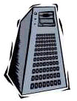

Cookie-based Marketing - Schema
Web Server
Ad Server
2. SEND – website sends the User ad server id and IP address to the Ad Server
3. GET – Ad Server returns the Consumer profile and/or Targeted banner ad
4. SEND
- website returns the Regular page content including Targeted advertising
1. GET
- user requests a page
and sends Cookie based info
including its User ad server id
and IP address
User Computer
Copyright 2012-2016 Ellis Horowitz

Slide 36
How Doubleclick Works
Doubleclick is an Ad Network; it was purchased by Google for $3.1 billion in 2007
How Doubleclick works:
  When a user invokes Web page, a tag on the page signals Doubleclick's server to delve into its inventory of advertisements to find one that matches the marketer's needs with the user's profile.
  Here is an example of a Doubleclick tag http://ad.doubleclick.net/ABC/publisher/zone;topic=abc;sbtpc=def;cat=ghi;kw=xyz;tile=1;slot=728x90.1;sz=728x90;ord=7268140825331981?
  How to interpret the fields of a Doubleclick tag can be found here http://www.adopsinsider.com/ad-ops-basics/how-to-read-doubleclick-ad-tags-and-ad-tag-variables/
Doubleclick will read multiple criteria including:
  User location, embedded in a user's Internet address,
  time of day,
  cookies previously placed on the user's disk, which can further refine the target by telling Doubleclick whether someone is a repeat visitor , or has already seen a specific ad.
Copyright 2012-2016 Ellis Horowitz

Slide 37
Doubleclick Ad Tag (Expanded)
http://ad.doubleclick.net/ADJ/publisher/zone;topic=abc;sbtpc=def;cat=ghi;kw=xyz;tile=1;slot=728x90.1;sz=728x90;ord=7268140825331981?
http://ad.doubleclick.net/ - host address for the ad server
ADJ/ - defines the Ad type which can be {images, XML, scripts}
publisher/ - identifies the website publisher, e.g. www.nytimes.com
zone; - identifies the landing page at the publisher's site
topic=abc; - identifies whatever topic is being talked about
sbtpc=def; - subtopic level
kw=xyz; - keyword level
tile=1; - there may be multiple ads on the same page, each has a tile number
slot=728x90.1; - defines the size of the ad (728 x 90) for tile 1
ord=7268140825331981? - a random number that prevents the page from being cached
Copyright 2012-2016 Ellis Horowitz

Slide 38
How does Google use the DoubleClick cookie to serve ads?
Google uses the DoubleClick cookies to collect information that includes:
time: 06/Aug/2011 12:01:32
ad_placement_id: 105
ad_id: 1003
userid: 0000000000000001
client_ip: 123.45.67.89
referral_url: "http://youtube.com/categories"
  The “time” field reflects the time the ad was displayed.
  The “ad placement id” and “ad id” identify the advertising campaign and the specific ad served.
  The “userid” is the display ad cookie that identifies the browser.
  The “client IP” reflects the user’s Internet Protocol (IP) address.
  A “referral URL” indicates the URL of the page where the ad was served. the logs also record whether a user’s browser clicks or interacts with an ad.
Opting Out
  Anyone who prefers not to see ads with this level of relevance can opt out. This opt-out will be specific only to the browser that you are using when you click the “Opt out” button.
  For more details see http://www.google.com/policies/privacy/ads/ and http://www.google.com/ads/preferences/plugin/
  Use browser add-ons, such as AdBlock ( getadblock.com)

Slide 39
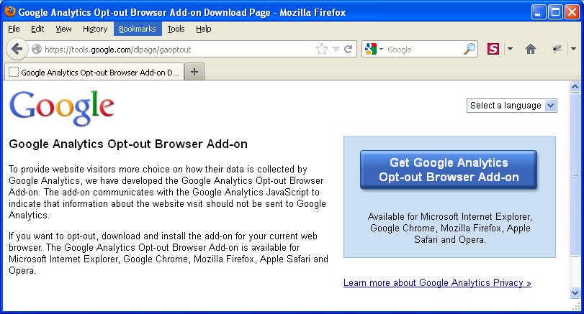
How does Google use Cookies for Google Analytics?
Google Analytics is Google’s free web analytics tool that helps website owners understand how their visitors engage with their website.
Google Analytics collects information anonymously, and reports website trends without identifying individual visitors.
Analytics uses its own set of cookies to track visitor interactions. These cookies are used to store information, such as time of current visit, previous visits, and referred site.
A different set of cookies is used for each website, and visitors are not tracked across sites.
Available for IE11, Chrome, Firefox, Safari and Opera.
To disable this cookie, you can install the Google Analytics Opt-out Add-on in your browser, which prevents Google Analytics from collecting information about your website visits. See:
https://tools.google.com/dlpage/gaoptout
Copyright 2012-2016 Ellis Horowitz

Slide 40
Google Uses Cookies for Conversion Tracking
Google uses cookies to help businesses that buy ads from Google determine how many people who click their ads end up purchasing their products.
The conversion tracking cookie is set on your browser only when you click an ad delivered by Google where the advertiser has opted in to conversion tracking.
These cookies expire within 30 days and do not contain information that can identify you personally. If this cookie has not yet expired when you visit certain pages of the advertiser’s website, Google and the advertiser will be able to tell that you clicked the ad and proceeded to that page.
Each advertiser gets a different cookie, so no cookie can be tracked across advertiser websites.
If you want to disable conversion tracking cookies, you can set your browser to block cookies from the googleadservices.com domain.
Copyright 2012-2016 Ellis Horowitz

Slide 41
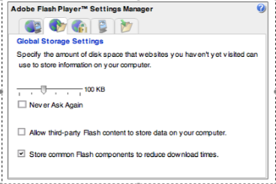
Adobe Flash Cookies
An Adobe Flash cookie or locally shared object is a bit of text that can be stored on a user’s machine
But unlike conventional cookies, Flash cookies can
  Store 100KB of data (much more than the cookie 4KB limit)
  Has no expiration date
  Are not controlled by browser settings, but by the Adobe Flash Player Settings Manager located on the Adobe Macromedia website
They are stored in a .sol file in a special directory
So Adobe Flash cookies are a way for companies to circumvent cookie deletion by the user
BetterPrivacy is a Firefox addon for removing Flash cookies
  https://addons.mozilla.org/en-US/firefox/addon/betterprivacy/
A screenshot of the Flash Player
Menu Global Storage settings
With 3rd Party flash content being
Prevented as box is NOT checked
Copyright 2012-2016 Ellis Horowitz

Slide 42
Other Types of Cookies
Evercookie is a JavaScript API that produces extremely persistent cookies in a browser
When creating a new cookie, it uses the following storage mechanisms when available:
  Standard HTTP Cookies
  Local Shared Objects (Flash Cookies)
  Silverlight Isolated Storage
  Storing cookies in RGB values of auto-generated, force-cached PNGs using HTML5 Canvas tag to read pixels (cookies) back out
  Storing cookies in Web History
  Storing cookies in HTTP ETags
  Storing cookies in Web cache
  window.name caching
  Internet Explorer userData storage
  HTML5 Session Storage, HTML5 Local Storage, HTML5 Global Storage, HTML5 Database Storage via SQLite
See http://samy.pl/evercookie/
Copyright 2012-2016 Ellis Horowitz

Slide 43
Six Ways to Opt Out of cookies
Select “do not track” in your browser Settings. This setting is available Firefox 9+, Chrome, Safari 5.1+, Internet Explorer 9/10. See “Web Tracking Protection” submission:
http://www.w3.org/Submission/2011/SUBM-web-tracking-protection-20110224/#dnt-uas
Download opt-out cookies. This is a process that usually involves clicking on a button to download the opt-out cookie.
  you go to the marketer's web site, find the privacy policy, then find the "opt out" information. The cookie your computer will get tells the company not to track you anymore.
Use the cookie management tools in your web browser. In most web browsers, you can set your browser to accept only session cookies, or to turn all cookies into session cookies. Session cookies are generally harmless.
  For Macintosh Safari users, you can tell the browser to only accept cookies from "the site you are navigating to." This means that you will not accept third party cookies.
View current cookies and delete what you don't need. Most web browsers allow you to see what cookies you already have stored.
  Some cookies, such as registration cookies for web sites you visit frequently, are useful to keep around. But other cookies, like tracking cookies from atdmt.com, doubleclick.net, 2o7.net, atwola.com, and other advertisers aren't necessarily helpful to you.
Check your account preferences on registration sites. Some sites, such as eBay, require registration and the use of cookies. On eBay, for example, if you do not opt-out of advertising tracking, information about your eBay activities can be used by other sites and advertisers outside of eBay.
Use browser Add-ons. Free browser extensions are available for most browsers to control tracking, such as Ghostery (www.ghostery.com)
Copyright 2012-2016 Ellis Horowitz

Slide 44
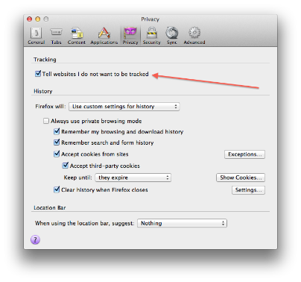
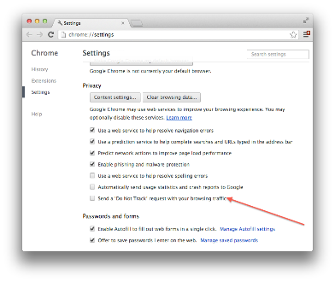
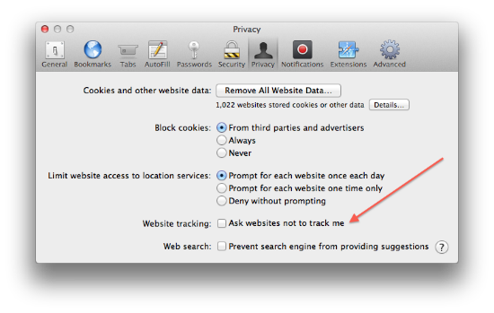
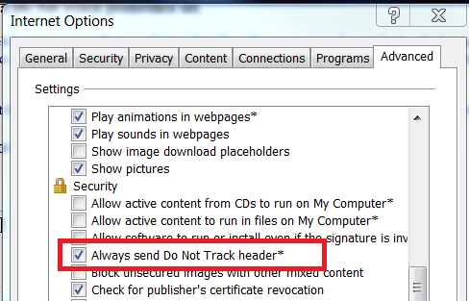
Opt-Out’s Do Not Track
In Firefox: Preferences -> Privacy -> check “ Tell web sites I do not want to be tracked”
In Chrome: Preferences -> Settings -> Show advanced settings… -> Privacy-> check “Send a ‘Do Not Track’ request with your browsing traffic”
In Safari: Preferences -> Privacy -> check “Ask websites not to track me”
In IE 10: Internet options -> Advanced -> Settings -> Always send Do Not Track header
Copyright 2012-2016 Ellis Horowitz

Slide 45
Supercookie
A "supercookie" is a cookie with an origin of a Top-Level Domain (TLD).
  But even .co.uk or k12.ca.us are considered Top-Level even though they are multiple levels deep.
  These domains are referred to as Public Suffixes and are not open for reservation by end-users.
Most browsers, by default, allow first-party cookies—a cookie with domain to be the same or sub-domain of the requesting host.
  For example, a user visiting www.example.com can have a cookie set with domain www.example.com or .example.com.
  A so-called "supercookie" is a cookie originating from a Public Suffix or Top-Level Domain such as .com. It is important that these cookies are blocked by browsers otherwise, an attacker in control of malicious website with domain .com could set a "supercookie" and potentially disrupt or impersonate legitimate user requests to example.com.
  Why? Because a supercookie can take advantage of the fact that .com can set valid cookies for sub-domain example.com.
The Public Suffix List (http://publicsuffix.org/learn/) is a cross-vendor initiative to provide an accurate list of domain name suffixes changing. Older versions of browsers may not have the most up-to-date list, and will therefore be vulnerable to supercookies from certain domains.
Verizon tracks customer habits on smartphone sand tablets using a “supercookie”. Just allowed users to opt-out:
http://computermagazine.com/syndicated/good-news-verizon-will-finally-let-you-turn-off-tracking-supercookie/
Copyright 2012-2016 Ellis Horowitz

Slide 46
Canvas Fingerprinting
Canvas fingerprinting is one of a number of browser fingerprinting techniques for tracking online users that allows websites to uniquely identify and track visitors without the use of browser cookies
Primarily it makes use of the Canvas API of HTML5;
  it relies on the fact that the drawing of the text will contain subtle differences that arise from font rasterization, anti-aliasing, pixel smoothing, related to the browser, etc.
  See https://developer.mozilla.org/en-US/docs/Web/API/HTMLCanvasElement
Here is the 4 step process that is followed:
user visits a page
fingerprinting script draws text with specific font and size and adds background colors
the script calls Canvas API's ToDataURL method to get the canvas pixel data in dataURL format (Base64 encoded representation of binary pixel data)
the script takes the hash of the text-encoded pixel data and uses that as the fingerprint
While not sufficient to uniquely identify users by itself, this fingerprint is usually combined with other sources of information, e.g. browser plugins, to provide a unique identifier
see the paper The Web never forgets, at https://securehomes.esat.kuleuven.be/~gacar/persistent/the_web_never_forgets.pdf
Copyright 2012-2016 Ellis Horowitz

Slide 47
Some References
Articles on Cookies
  www.cookiecentral.com
  www.echoecho.com
  www.wmlpulse.com
  www.epic.org
  www.ciac.org
  www.howstuffworks.com
  www.webmonkey.com
  www.ozemail.com.au
Articles on Online Advertising
  http://en.wikipedia.org/wiki/Doubleclick
  http://computer.howstuffworks.com/web-advertising.htm
  http://en.wikipedia.org/wiki/Online_advertising
Copyright 2012-2016 Ellis Horowitz

