Slide 1
Lecture
The HTTP Protocol
Copyright © Ellis Horowitz & Marco Papa 1999-2016

Slide 2
What Does the WWW Server Do?
Enables browser requests
Mainly provides
  – Support for retrieving hypertext documents
  – Manages access to the Web site
  – Provides several mechanisms for executing server-side scripts
    Common Gateway Interface (CGI)
    Application Programmers Interface (API)
  – produces log files and usage statistics
Copyright © Ellis Horowitz & Marco Papa 1999-2016

Slide 3
How Does a Web Server Communicate?
Web browsers and servers communicate using the HyperText Transfer Protocol (HTTP) protocol
HTTP is a lightweight protocol
  different from the ftp protocol
    ftp sessions are long lived and there are two connections, one for control, one for data
Current HTTP protocol is version 1.1
W3C updates to HTTP:
  http://www.w3.org/Protocols/
HTTP 2.0 under the IETF httpbis Working Group
  http://datatracker.ietf.org/wg/httpbis/charter/
HTTP/2 Home page:
  https://http2.github.io/
Copyright © Ellis Horowitz & Marco Papa 1999-2016
Notes:
FTP: one channel for data, one for control;

Slide 4
HTTP History
The Hypertext Transfer Protocol (HTTP) is an application-level protocol for distributed, collaborative, hypermedia information systems.
The first version of HTTP, HTTP/0.9, was a simple protocol for raw data transfer across the Internet.
HTTP/1.0, is defined by RFC 1945, see
  http://www.w3.org/Protocols/rfc1945/rfc1945
HTTP/1.0 allows messages to be in the format of MIME-like messages, containing meta-information about the data transferred and modifiers on the request/response semantics.
HTTP/1.1, is defined by RFCs 7230-7237 (supersede RFC 2616) , see
  http://tools.ietf.org/html/
  HTTP/1.1 extends the protocol to handle:
  the effects of hierarchical proxies
  caching
  the need for persistent connections
  virtual hosts
Copyright © Ellis Horowitz & Marco Papa 1999-2016

Slide 5
HTTP History (cont’d)
HTTP/2 is being worked on by IETF Working Groups:
  http://tools.ietf.org/wg/httpbis/
HTTP/2 started as a copy of Google SPDY (“SPeeDY”).
HTTP/2 designed to speed up websites far larger than 10 years ago, using hundreds of requests/connections.
One major feature of HTTP/2 is header compression:
  http://httpwg.github.io/specs/rfc7541.html
Google is dropping SPDY from Chrome and adopting HTTP/2:
  http://techcrunch.com/2015/02/09/google-starts-fading-out-spdy-support-in-favor-of-http2-standard/
See also:
  https://en.wikipedia.org/wiki/HTTP/2
Seen RFC 7540 (HTTP/2) & 7541 (HPACK):
  https://httpwg.github.io/specs/rfc7540.html
  https://httpwg.github.io/specs/rfc7541.html
Several implemenations already available:
  https:// github.com/http2/http2-spec/wiki/Implementations
Copyright © Ellis Horowitz & Marco Papa 1999-2016

Slide 6
MIME MEDIA TYPES
HTTP tags all data that it sends with its MIME type
HTTP sends the MIME type of the file using the line Content-Type: mime type header
For example here are 2 MIME type messages
Content-type: image/jpeg
Content-length: 1598
Some important MIME types are
  text/plain, text/html
  image/gif, image/jpeg
  audio/basic, audio/wav, audio/x-pn-realaudio
  model/vrml
  video/mpeg, video/quicktime, video/vnd.rn-realmedia, video/x-ms-wmv
  application/*, application-specific data that does not fall under any other MIME category, e.g. application/vnd.ms-powerpoint
Copyright © Ellis Horowitz & Marco Papa 1999-2016
Notes:
No type: ERROR 500(server crash)

Slide 7
Multipurpose Internet Mail Extensions
MIME is an Internet standard for electronic mail
  Traditional e-mail was limited to ASCII text, limited line length, and limited size
MIME has extended Internet e-mail to include
  Unlimited text line and message length
  Messages with multiple body parts or objects enclosed
  Messages that point to files on another server and are automatically retrievable
  International character sets in addition to US-ASCII
  Formatted text including multiple font styles
  Images
  Video clips
  Audio messages
  Application-specific binary data
It was formalized in RFC 2046
Copyright © Ellis Horowitz & Marco Papa 1999-2016
Notes:
MIME: allows you to generate

Slide 8
Facts About MIME
MIME converts data that uses all eight bits into 7-bit ASCII, sends it, and reconverts it at the other end
MIME headers at the front of the file define the type of data the message includes, e.g. here are a set of MIME types describing an attachment at an ftp site
Content-type: Message/External-Body
  name="classnotes.ps"
  site="ftp.usc.edu"
  access-type=anon-ftp
  directory="pub/cs665"
  mode="image"
  permission="read"
  expiration="Wed, 15 Mar 2009 07:00:00 -0400 (PST)"
Copyright © Ellis Horowitz & Marco Papa 1999-2016

Slide 9
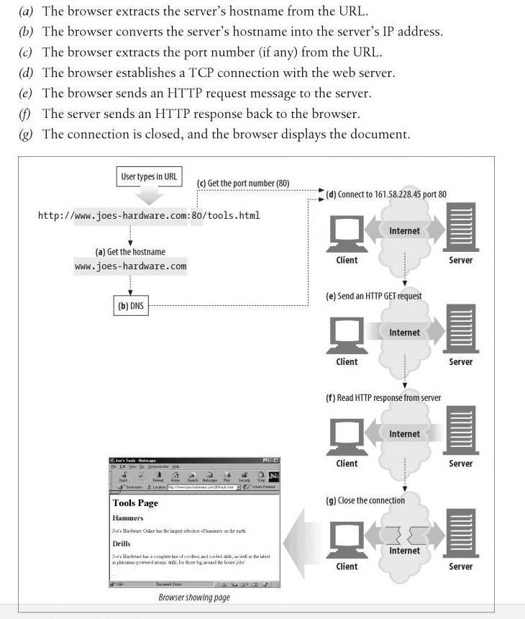
Description of a
Browser Server Interaction
Copyright © Ellis Horowitz & Marco Papa 1999-2016
Notes:
http -- No state maintained;

Slide 10
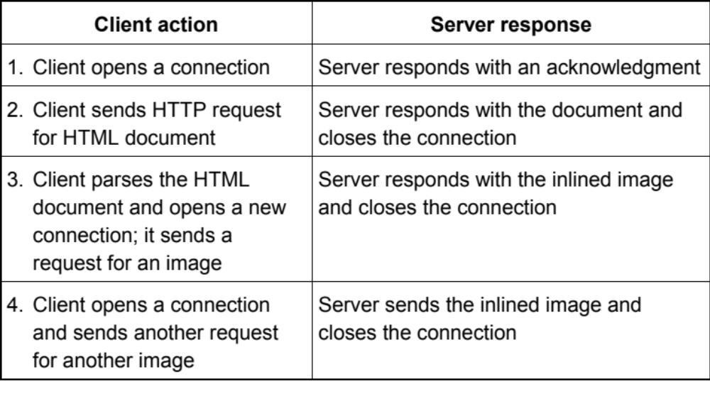
An HTTP Scenario
Communication takes place over a TCP/IP connection, generally on port 80
Copyright © Ellis Horowitz & Marco Papa 1999-2016

Slide 11
A More Complicated HTTP Scenario
Actually, communication between a browser and a web server can be much more complicated; communication can go between one or more intermediaries.
There are three common forms of intermediary: proxy, gateway, and tunnel.
  A proxy is a forwarding agent, receiving requests for a URI in its absolute form, rewriting all or part of the message, and forwarding the reformatted request toward the server identified by the URI.
  A gateway is a receiving agent, acting as a layer above some other server(s) and, if necessary, translating the requests to the underlying server’s protocol.
  A tunnel acts as a relay point between two connections without changing the messages; tunnels are used when the communication needs to pass through an intermediary (such as a firewall) even when the intermediary cannot understand the contents of the messages.
Copyright © Ellis Horowitz & Marco Papa 1999-2016

Slide 12
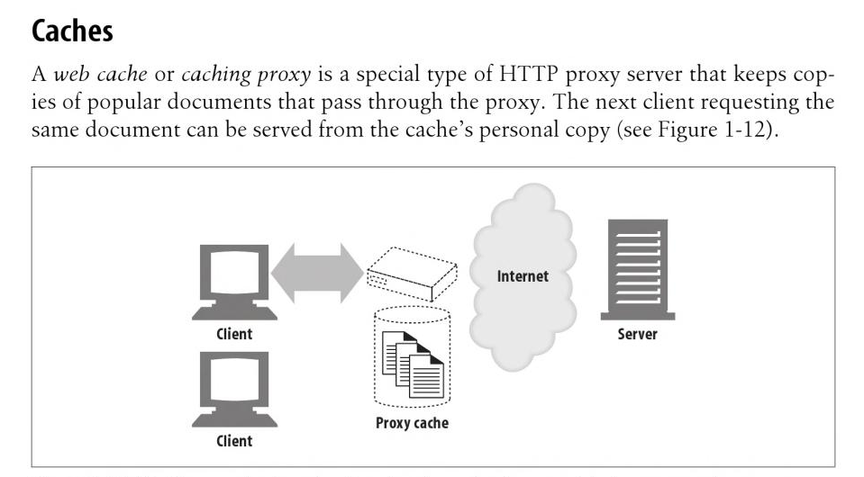
Proxy Cache
A web cache or caching proxy is a special type
of HTTP proxy server that keep copies of popular
documents that pass through the proxy. The next
client requesting the same document can be served
from the cache's personal copy.
Copyright © Ellis Horowitz & Marco Papa 1999-2016
Notes:
Filter on client side/ cache on server side.
Frequently visited

Slide 13
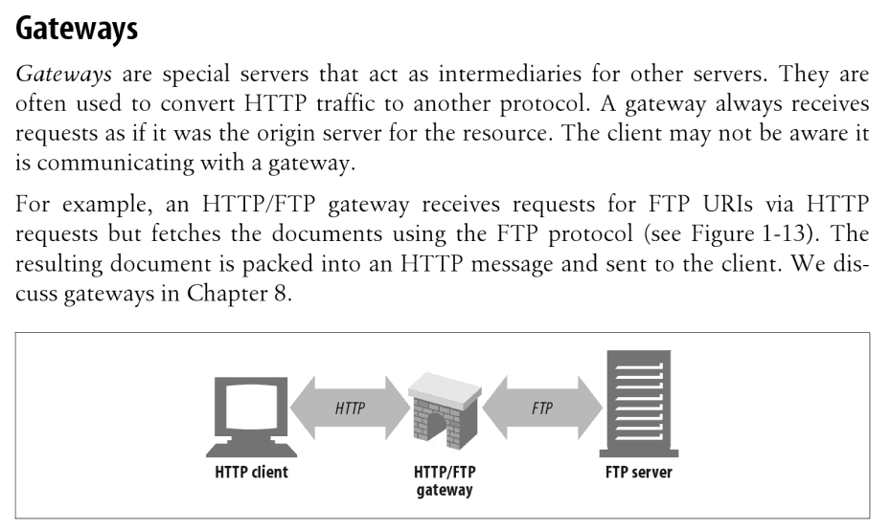
Gateways
Gateways are special servers that act as intermediaries for other servers.
They are often used to convert HTTP traffic to another protocol. A gateway always receives requests as if it was the origin server for the resource. The client
may not be aware it is communicating with a gateway.
For example, an HTTP/FTP gateway receives requests for FTP URIs via HTTP requests but fetches the documents using the FTP protocol. The resulting document is packed into an HTTP message and sent to the client.
Copyright © Ellis Horowitz & Marco Papa 1999-2016

Slide 14
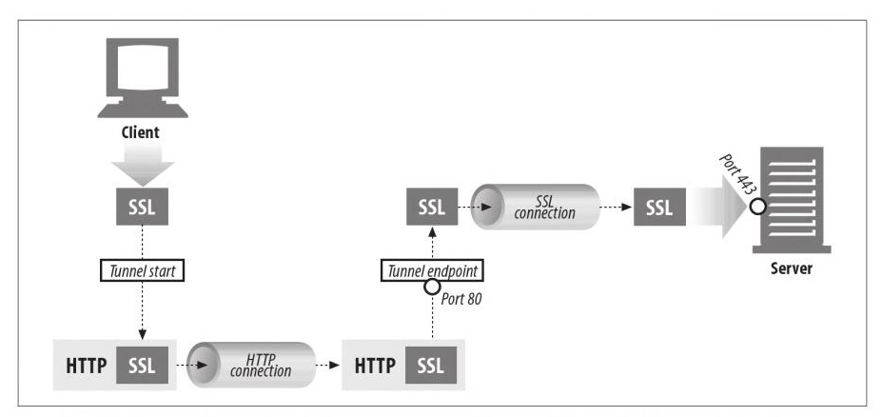
Tunnels
Tunnels are HTTP applications that, after setup, blindly relay raw data between two connections. HTTP tunnels are often used to transport non-HTTP data over one or more HTTP connections, without looking at the data.
Copyright © Ellis Horowitz & Marco Papa 1999-2016

Slide 15
The Most General HTTP Scenario
Communication between browser and server should be regarded as a request chain goes left to right ----->
UA ---v--- A ---v--- B ---v--- C ---v--- O
<----- and a response chain goes right to left
A, B, and C are three intermediaries between the user agent and origin server. A request or response message that travels the whole chain will pass through four separate connections.
UA stands for User Agent, typically a browser
O stands for the origin server; the server that actually delivers the document
Copyright © Ellis Horowitz & Marco Papa 1999-2016

Slide 16
Persistent Connections
In the original HTTP protocol each request was made over a new connection
  so an HTML page with n distinct graphic elements produced n+1 requests
TCP uses a three-way handshake when establishing a connection, so there is significant latency in establishing a connection
  client sends SYN, server replies ACK/SYN, client responds with ACK
HTTP1.0 introduced a keep-alive feature
  the connection between client and server is maintained for a period of time allowing for multiple requests and responses
Copyright © Ellis Horowitz & Marco Papa 1999-2016

Slide 17
HTTP/1.0 Keep Alive Connections
client
server
Open connection
Send 1st request
Receive 1st response
Send 2nd request
Receive 2nd response
etc
Close connection
Acknowledge connection
Receive request
send response
receive request
send response
etc
Close connection
Copyright © Ellis Horowitz & Marco Papa 1999-2016

Slide 18
HTTP/1.1 Keep Alive Extensions
Persistent connections are now the default
client and server must explicitly say they do NOT want persistence using the header
Connection: close
HTTP also permits multiple connections in parallel, e.g.
1. client requests a page and server responds
2. client parses the page and initiates 3 new connections, each requesting a different image file
the above scheme is NOT always faster, as multiple connections may compete for available bandwidth
Generally browsers severely limit multiple connections and servers do as well
Copyright © Ellis Horowitz & Marco Papa 1999-2016

Slide 19
Example of a GET Request
Clicking on a link in a web page or entering a URL in the address field of the browser causes the browser to issue a GET request, e.g.
Suppose the user clicks on the link below:
<A HREF="http://pollux.usc.edu/html/file.html">click here </A>
The request from the client may contain the following lines
  GET /html/file.html HTTP/1.1
  Accept: text/html,application/xhtml+xml,application/xml;q=0.9,*/*;q=0.8
  User-Agent: Mozilla/5.0 (Windows NT 5.1; rv:15.0) Gecko/20100101 Firefox/15.0.1
  Referer: http://pollux.usc.edu/html/prevfile.html
  If-Modified-Since: Wed, 11 Feb 2009 13:14:15 GMT
  {there is a blank line here which terminates the input}
Copyright © Ellis Horowitz & Marco Papa 1999-2016

Slide 20
Response of the Server to GET
In response to the previous client request, the server responds with the following
  HTTP/1.1 200 OK
  Date: Monday, 29-May-09 12:02:12 GMT
  Server: Apache/2.0
  MIME-version: 1.0
  Content-Type: text/html
  Last-modified: Sun, 28-May-09 15:36:13 GMT
  Content-Length: 145
  {a blank line goes here }
  {the contents of file.html goes here }
Copyright © Ellis Horowitz & Marco Papa 1999-2016

Slide 21
Client HTTP Requests
The general form of an HTTP request has four fields:
HTTP_method, identifier, HTTP_version, Body
  HTTP_Method says what is to be done to the object specified in the URL; some possibilities include GET, HEAD, and POST
  identifier is the URL of the resource or the body // can be folder name;
  HTTP_version is the current HTTP version, e.g. HTTP/1.1
  Body is optional text
Copyright © Ellis Horowitz & Marco Papa 1999-2016

Slide 22
HTTP Request Methods
Most common HTTP request methods are
  GET, retrieve whatever information is identified by the request URL
  HEAD, identical to GET, except the server does not return the body in the response
  POST, instructs the server that the request includes a block of data in the message body, which is typically used as input to a server-side application
  PUT, used to modify existing resources or create new ones, contained in the message body
  DELETE, used to remove existing resources
  TRACE, traces the requests in a chain of web proxy servers; used primarily for diagnostics
  OPTIONS, allows requests for info about the server’s capabilities
Copyright © Ellis Horowitz & Marco Papa 1999-2016
Notes:
GET: “NAME = VALUE”;
POST: no “value” in URL

Slide 23
HTTP Headers
HTTP/1.1 divides headers into four categories:
  general, present in requests or responses
  request, present only in requests
  response, present only in responses
  entity, describe the content of a body
  extension, new headers not already defined
Each header consists of a name followed by a colon, followed by the value of the field, e.g.
  Date: Tue, 3 Oct 2009 02:16:03 GMT
  Content-length: 12345
  Content-type: image/gif
  Accept: image/gif, image/jpeg, text/html
Copyright © Ellis Horowitz & Marco Papa 1999-2016

Slide 24
Examples of HTTP Headers - Request
Accept: text/html, image/*
indicates what media types are acceptable
Accept-Charset: iso-8859-5
indicates acceptable character sets. By default all are acceptable
Accept-Encoding: compress, gzip
indicates acceptable encodings
Accept-Language: en, fr=0.5
indicates language preferences, English preferred, but French also accepted
Authorization:
used to pass user’s credentials to the server
Copyright © Ellis Horowitz & Marco Papa 1999-2016

Slide 25
Examples of HTTP Headers - Request
From: name@site.com
requesting user’s email address, rarely present
Host: www.usc.edu:8080
hostname and port of the requesting URL
Referer: http://www.usc.edu/index.html
the URL of the document that contains the reference to the requested URL
User-Agent: Mozilla/5.0 (Macintosh; Intel Mac OS X 10.8; rv:18.0) Gecko/20100101 Firefox/18.0
reports the client software name and version and possibly platform, see
http://www.javascriptkit.com/javatutors/navigator.shtml
Copyright © Ellis Horowitz & Marco Papa 1999-2016

Slide 26
Byte Range Headers
Requests
  If-Range: "entity-tag"
used with byte range requests to guarantee that any new byte range responses are generated from the same source object. The entity-tag is quoted
  Range: bytes=0-512, 2048-4096
used to request a byte range
Responses
  Accept-ranges: bytes
indicates the server can respond to range requests
Entity
  Content-Range: 0-399/2000
response to byte range request giving the byte ranges actually returned, e.g. the first 400 bytes of a 2000 byte document
Copyright © Ellis Horowitz & Marco Papa 1999-2016

Slide 27
Examples of HTTP Headers - Response
Age: 1246
age in seconds since response was generated
Location: http://www.myco.com/page.html
indicates that re-direction is desired
Public: GET, HEAD, POST, OPTIONS, PUT
methods supported by this web server
Server: Apache/1.3.1
identifies the server
WWW-AUTHENTICATE:
sent with 401 Unauthorized status code, it includes authorization parameters
Retry-after: 240
used with Service Unavailable status, indicates requested data will be available in 4 minutes
Copyright © Ellis Horowitz & Marco Papa 1999-2016

Slide 28
Examples of HTTP Headers - Response
A URL may point to a document with multiple representations: languages, formats (html, pdf), or html features based upon user-agent
if a French version is requested and cached, then a new request may fail to retrieve the English version
HTTP/1.1 introduces Vary: accept-language, user-agent
the header specifies acceptable languages and browsers,
e.g. the request is
GET http://www.myco.com/ HTTP/1.1
User-agent: Mozilla/4.5
Accept-language: en
the response is
HTTP/1.1 200 OK
Vary: Accept-language
Content-type: text/html
Content-language: en
The proxy must store
the fact that this
doc has variants and
when requested, get
the proper variant
Copyright © Ellis Horowitz & Marco Papa 1999-2016

Slide 29
Examples of HTTP Headers - Response
Warning: 10 proxy-id “Revalidation failed”
messages indicating status information of the resource; HTTP/1.1 defines the following status codes
Code Meaning
10 Response is stale
11 Revalidation failed
12 Disconnected operation
13 Heuristic expiration
14 Transformation applied
99 Miscellaneous warning
Copyright © Ellis Horowitz & Marco Papa 1999-2016

Slide 30
Entity Tags
An ETag or entity tag.
  one of several mechanisms that HTTP provides for web cache validation, and which allows a client to make conditional requests.
  This allows caches to be more efficient, and saves bandwidth, as a web server does not need to send a full response if the content has not changed.
An ETag is an opaque identifier assigned by a web server to a specific version of a resource found at a URL.
  If the resource content at that URL ever changes, a new and different ETag is assigned.
  ETags are similar to fingerprints, and they can be quickly compared to determine if two versions of a resource are the same or not.
An ETag is a serial number or a checksum that uniquely identifies the file
  caches use the If-None-Match condition header to get a new copy if the entity tag has changed
  if the tags match, then a 304 Not Modified is returned
Copyright © Ellis Horowitz & Marco Papa 1999-2016

Slide 31
Examples of HTTP Headers - Entity
Allow: GET, HEAD, PUT
lists methods supported by the URL
Content-Base: http://www.usc.edu/somedir
all relative references are taken wrt the base
Content-Encoding: gzip
indicates the encoding of the entity body; content-type indicates the media after encoding
Content-Language: en
identifies the language of the entity
Content-Length: 7890
specifies the length of the entity in bytes
Content-Location: http://www.usc.edu/myfile.htm
specifies the URL of the accessed resource
Copyright © Ellis Horowitz & Marco Papa 1999-2016

Slide 32
Examples of HTTP Headers - Entity
Content-MD5: base-64 encoded MD5 signature
contains the MD5 signature of the body as created by the web server
Content-type:text/html
indicates the MIME type of the object
Etag: "doc-id-2441"
specifies the entity tag for the object, which can be used for re-validation; tags are unique ids determined by the server; this line is normally sent as a response
Expires: Wed, 30 Dec 2002 03:43:21 GMT
specifies the expiration date/time of the object; a cached copy should not be used beyond; Expires 0/now is immediate
Last-Modified: Wed, 30 Dec 2002 01:20:34 GMT
specifies the creation or last modification time of the object on the web server
Copyright © Ellis Horowitz & Marco Papa 1999-2016

Slide 33
HTTP Status Codes - Informational
After receiving and interpreting a request message, a server responds with an HTTP response message.
Syntax of response is
Status-Line
*( general-header | response-header | entity-header ) CRLF [ message-body ]
where the Status line is composed of
Status-Line = HTTP-Version Status-Code Reason-Phrase CRLF
Copyright © Ellis Horowitz & Marco Papa 1999-2016

Slide 34
HTTP Status Codes - Informational
Code meaning
100 Continue, the client may continue with its request; used for a PUT before a large document is sent
101 Switching Protocols, switching either the version or the actual protocol
Copyright © Ellis Horowitz & Marco Papa 1999-2016

Slide 35
HTTP Status Codes - Successful
Code meaning
200 OK, request succeeded
201 Created, result is newly created
202 Accepted, the resource will be created later
203 Non-authoritative information, info returned is from a cached copy and may be wrong
204 No content, response is intentionally blank, so client should not change the page
205 Reset Content, notifies the client to reset the current document, e.g. clear a form field
206 Partial content, e.g. a byte range response
Copyright © Ellis Horowitz & Marco Papa 1999-2016

Slide 36
HTTP Status Codes - Redirection
Code meaning
300 Multiple choices, the document has multiple representations
301 Moved permanently, new location is specified in Location: header
302 Moved temporarily: similar to above
303 See Other: used to automatically redirect the client to a different URL
304 Not Modified: the client or proxy copy is still up-to-date
305 Use Proxy: make the request via the proxy
306 Proxy Redirection: a proposed extension to HTTP/1.1 still not specified
307 Temporary Redirect
Copyright © Ellis Horowitz & Marco Papa 1999-2016

Slide 37
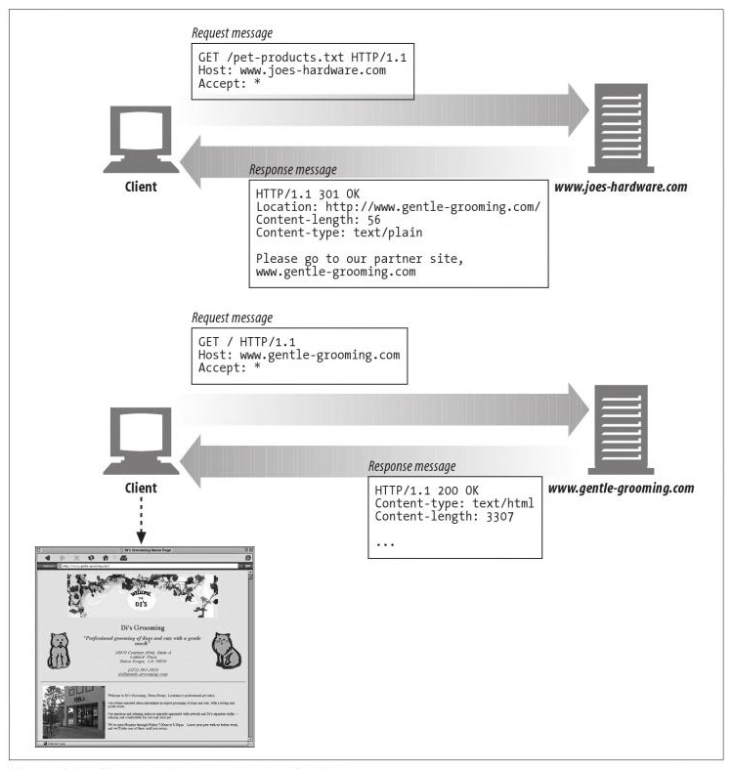
Redirection Example
Copyright © Ellis Horowitz & Marco Papa 1999-2016

Slide 38
HTTP Status Codes - Client Error
Code meaning
400 Bad request, server could not understand
401 unauthorized, authorization challenge
402 Payment Required, reserved for future use
403 forbidden, server refuses to fulfill request; e.g. check protections
404 Not found, document does not exist
405 Method not allowed, request method is not allowed for this URL
406 Not Acceptable, none of the available representations are acceptable to the client
407 Proxy Authentication Required, authentication is being challenged
408 Request Timeout, client did not send a request within a time given by server
Copyright © Ellis Horowitz & Marco Papa 1999-2016

Slide 39
HTTP Status Codes - Client Error (cont’d)
Code meaning
409 conflict, the requested action cannot be performed
410 Gone, requested resource is no longer available
411 Length Required, Content-length header is missing
412 Precondition failed, a precondition for the request has failed, so request is canceled
413 request entity too large, entity is too large for server
414 Request URI too large, the request URL is too large
415 Unsupported media type, request entity is of an unsupported type
Copyright © Ellis Horowitz & Marco Papa 1999-2016

Slide 40
HTTP Status Codes - Server Error
Code meaning
500 Internal server error, generic error code for the server
501 Not implemented, request could not be serviced because server does not support it
502 Bad gateway, intermediate proxy server received a bad response
503 Service unavailable, due to high load or maintenance on the server
504 Gateway timeout, intermediate proxy server timed out waiting for response from another server
505 HTTP version not supported
Copyright © Ellis Horowitz & Marco Papa 1999-2016

Slide 41
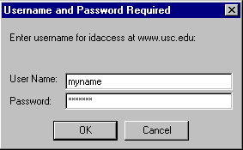
HTTP Authentication
The web server can maintain secure directories and request authentication when someone tries to access them
Procedure
  web server receives a request without proper authorization
  web server responds with
  401 Authentication Required
  client prompts for username and password and returns the information to the web server
we will show how to cause an authentication request when we discuss the web server features
Copyright © Ellis Horowitz & Marco Papa 1999-2016

Slide 42
Example HTTP Basic Authentication
Client makes a request on a secure page
GET /secure/mypage.html HTTP/1.0
server responds with
HTTP/1.0 401 Unauthorized
Server: Apache 2.0
Date: Wed, 23 Dec 2002 15:42:00 GMT
WWW-Authenticate: Basic realm="notes server"
client prompts for username and password and uses base-64 printable encoding; it re-issues its request, e.g.
GET /secure/mypage.html HTTP/1.0
User-agent: Mozilla/4.5
Accept: text/html, image/gif, image/jpeg
Authorization: Basic MQDadmverWPUsvd=
Copyright © Ellis Horowitz & Marco Papa 1999-2016
Notes:
Basic Authenticate: username and password;

Slide 43
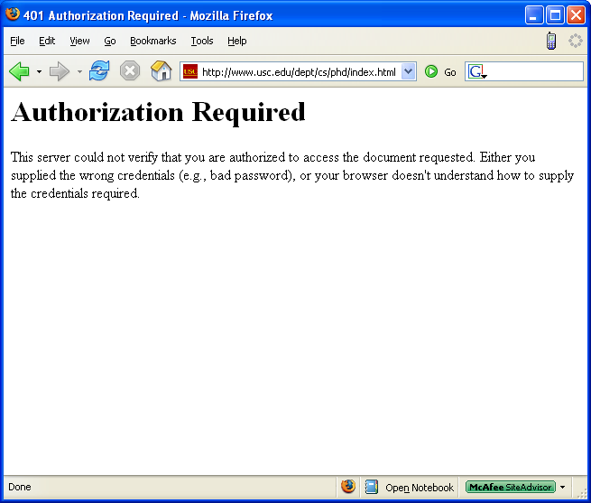
Authorization Denied
Copyright © Ellis Horowitz & Marco Papa 1999-2016

Slide 44
META HTTP-EQUIV
This is a mechanism for authors of HTML documents to set HTTP headers, in particular HTTP responses
two common uses are
  to set the expiration time of a document
  to cause a refresh of a document
E.g. here is an HTTP response header which causes the current page to be replaced by another page in 5 seconds
Refresh: 5; http://xyz.com/htdocs/mynewpage.html
this is equivalent to the following HTML
<META HTTP-EQUIV="Refresh" CONTENT=5,
http://www-scf.usc.edu/~csci571/index.html”>
</HEAD><BODY> This page will be replaced by the csci571 home page in 5 seconds.
Copyright © Ellis Horowitz & Marco Papa 1999-2016

Slide 45
X-Frame-Options: SAMEORIGIN
Provides Clickjacking protection. Values: deny - no rendering within a frame, sameorigin - no rendering if origin mismatch, allow-from: DOMAIN - allow rendering if framed by frame loaded from DOMAIN
The X-Frame-Options HTTP response header can be used to indicate whether or not a browser should be allowed to render a page in a <frame> or <iframe>. Sites can use this to avoid clickjacking attacks, by ensuring that their content is not embedded into other sites; options include:
DENY
  The page cannot be displayed in a frame, regardless of the site attempting to do so.
SAMEORIGIN
  The page can only be displayed in a frame on the same origin as the page itself.
ALLOW-FROM uri
  The page can only be displayed in a frame on the specified origin.
  See:
  https://tools.ietf.org/html/rfc7034
  https://developer.mozilla.org/en-US/docs/Web/HTTP/X-Frame-Options
Copyright © Ellis Horowitz & Marco Papa 1999-2016

Slide 46
HTTP Strict-Transport-Security (HSTS)
HSTS is a security feature that lets a web site tell browsers that it should only be communicated with using HTTPS, instead of using HTTP.
The HSTS feature lets a web site inform the browser that it should never load the site using HTTP, and should automatically convert all attempts to access the site using HTTP to HTTPS requests instead. HSTS is supported by all browsers, (IE 12 only).
Enabling this feature for your site is as simple as returning the Strict-Transport-Security HTTP header when your site is accessed over HTTPS:
Strict-Transport-Security: max-age=expireTime [; includeSubdomains]
expireTime
  The time, in seconds, that the browser should remember that this site is only to be accessed using HTTPS.
includeSubdomains (Optional)
  If this optional parameter is specified, this rule applies to all of the site's subdomains as well.
See:
  https://developer.mozilla.org/en-US/docs/Web/Security/HTTP_strict_transport_securityHTTP_strict_transport_securityHTTP_Strict_Transport_Security
  http://news.cnet.com/8301-1009_3-57524915-83/web-security-protocol-hsts-wins-proposed-standard-status/
Copyright © Ellis Horowitz & Marco Papa 1999-2016

Slide 47
Cross-origin resource sharing (CORS)
Cross-origin resource sharing (CORS) allows many resources (e.g, fonts, JavaScript, etc.) on a web page to be requested across domains.
In particular, AJAX calls can use XMLHttpRequest across domains. Such “cross-domain” requests would otherwise be forbidden by web browsers.
The CORS standard adds new HTTP headers. To initiate a CORS request, a browser sends the request with an “Origin” HTTP header. Suppose a page from http://www.social-network.com attempts to access user data from online-personal-calendar.com. If the browser supports CORS, this header is sent:
Origin: http://www.social-network.com
If the server at online-personal-calendar.com allows the request, it sends an Access-Control-Allow-Origin (ACAO) header in the response. The value of the header indicates what origin sites are allowed (* = all sites). For example:
Access-Control-Allow-Origin: http://www.social-network.com
If the server does not allow the CORS request, the browser will deliver an error instead of the online-personal-calendar.com response.
Firefox 3.5+, Safari 4+, Chrome3+, IE 10+, Opera 12+ support CORS. See:
https://developer.mozilla.org/en-US/docs/Web/HTTP/Access_control_CORS
http://enable-cors.org/server_apache.html
Copyright © Ellis Horowitz & Marco Papa 1999-2016

Slide 48
Exercises to Examine the HTTP Protocol
Simple Proxy Server
Live HTTP Headers
WireShark
Copyright © Ellis Horowitz & Marco Papa 1999-2016

Slide 49
Simple Proxy Server
On the class web page there is a simple proxy server built by Dan Boneh of Stanford
See More >> Additional Resources >> Web Servers, “Installing A Simple Proxy Server”
Start the proxy server on a specific port, e.g. 5678
Point your browser to the proxy server
  in IE select Tools, Internet Options, Connections, LAN Settings, Proxy server, Advanced)
  In Firefox select Tools, Options (Firefox, Preferences on Mac), Advanced, Network, Connection Settings…
telnet to the proxy server
Ussue commands to your browser and watch as the proxy server prints out the request/response messages
Copyright © Ellis Horowitz & Marco Papa 1999-2016

Slide 50
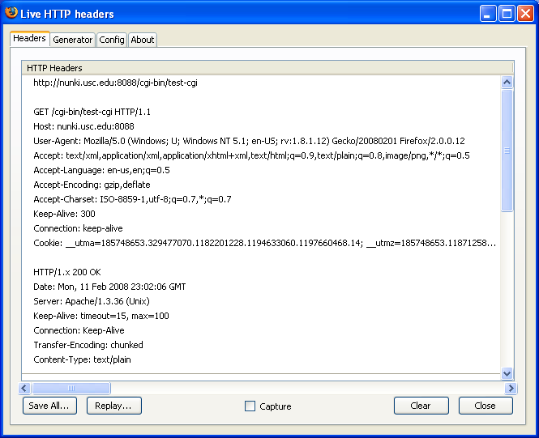
Firefox Live HTTP Headers add-on
Download at
  https://addons.mozilla.org/en-US/firefox/addon/live-http-headers/
Copyright © Ellis Horowitz & Marco Papa 1999-2016

Slide 51
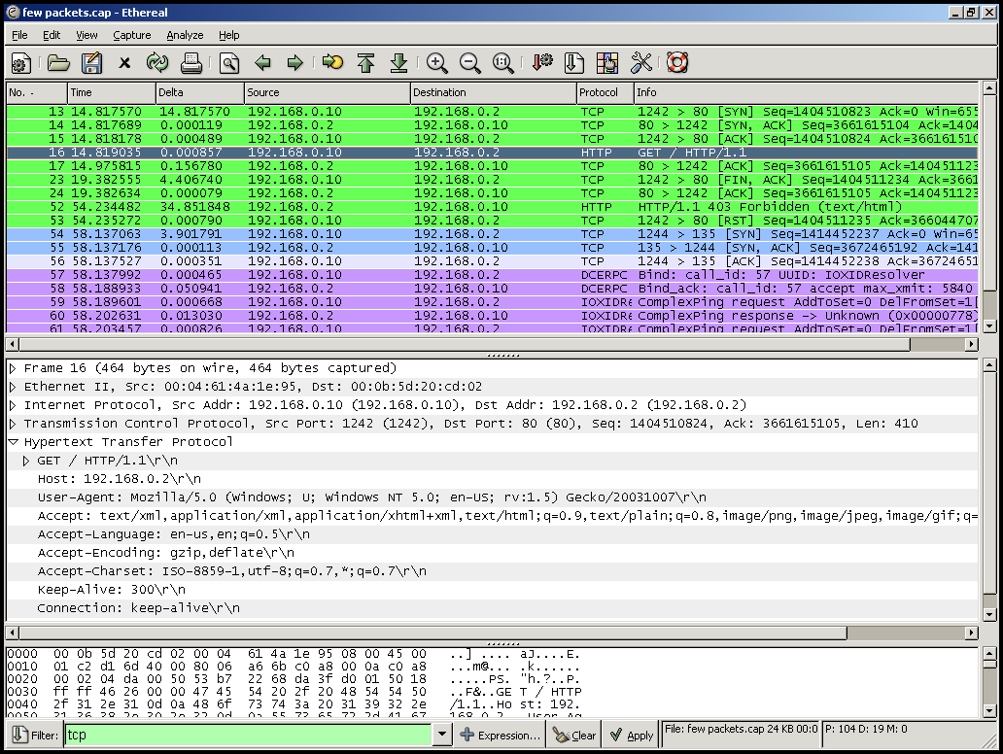
Protocol Analyzer
Install a protocol analyzer (a.k.a. a “sniffer”), such as WireShark (formerly Ethereal), available at
  http://www.wireshark.org/
Captured network data can be browsed via a GUI
Supports 1300+ protocols
Copyright © Ellis Horowitz & Marco Papa 1999-2016

Slide 52
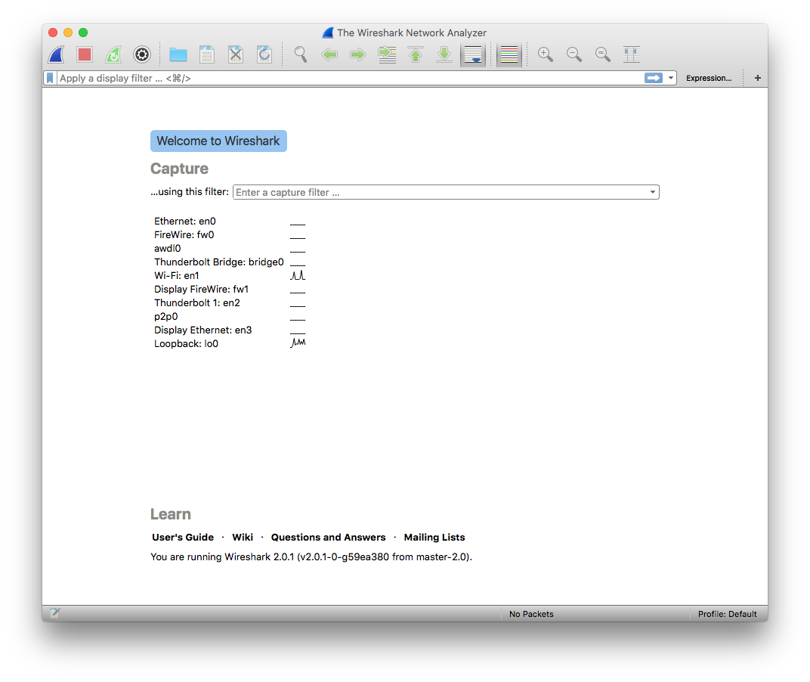
www.wireshark.org
Download the latest “stable” copy of WireShark (currently 2.0.4)
Initial Screen (new interface)
Copyright © Ellis Horowitz & Marco Papa 1999-2016

Slide 53
Filter HTTP requests
In your browser open up the page
http://cs-server.usc.edu:45678/resources/web_servers/proxy.html
In WireShark
  Click on Expression on the right hand side of the third row
  Select HTTP and click on OK
  Click on Apply on the third row at the right hand end
In WireShark
  Click on Capture | Interfaces and then click the Start button that is on the line related to your wired/wireless connection to the Internet
  A window appears as shown on the next slide
Copyright © Ellis Horowitz & Marco Papa 1999-2016

Slide 54
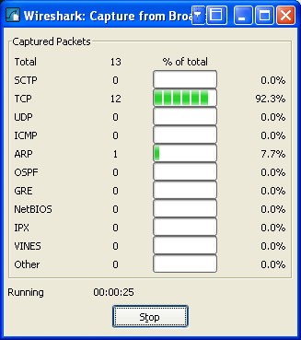
Start up the web Traffic
Return to the browser and paste the first test URL into the address field
http://www-scf.usc.edu/~csci571/Special/HTTP/simple1.html
Once the requested page appears in the browser return to the window that is shown on the right and click on the Stop button
A new WireShark screen appears as shown on the next slide
Copyright © Ellis Horowitz & Marco Papa 1999-2016

Slide 55
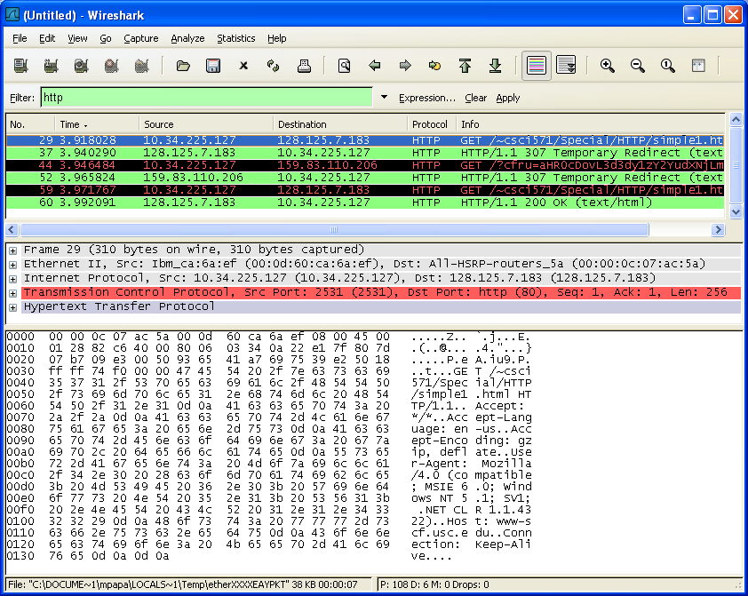
WireShark Output
Scroll the green window until a line with HTTP GET appears;
Click on the line;
Then, in the middle window expand the line labeled Hypertext Transfer Protocol
Copyright © Ellis Horowitz & Marco Papa 1999-2016

Slide 56
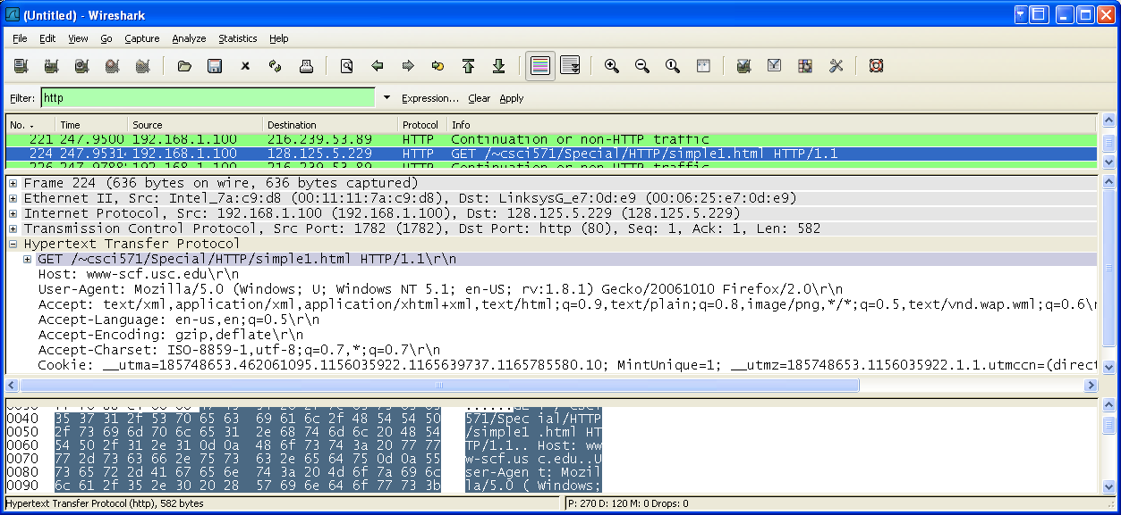
Expansion of HTTP request
Notice the:
- GET request
- Host
- User-Agent
- Accepts
- Cookie
Copyright © Ellis Horowitz & Marco Papa 1999-2016

Slide 57
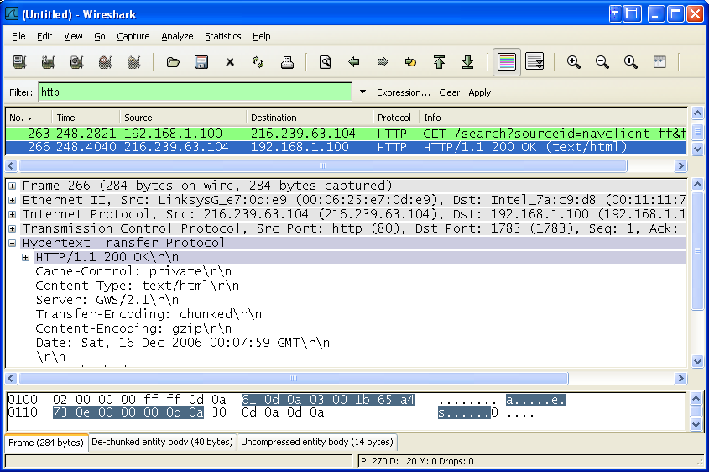
Expansion of HTTP response
Scroll down again in the upper window and click on the HTTP/1.1 200 OK line, as shown to the right
Notice the additional
lines that are sent including
- Cache-Control
- Content-Type
- Server
Etc.
Copyright © Ellis Horowitz & Marco Papa 1999-2016

Slide 58
Repeat the Exercise
Using the remaining links on
http://www-scf.usc.edu/~csci571/Special/HTTP/proxy.html
do the following:
In WireShark, select the Capture Start menu
Click on the button “Continue without Saving”
Enter the new URL into the browser
Once the requested page appears click on Stop in the WireShark Capture window
Examine the result in the main WireShark window
Remember to note the HTTP commands, request, response and general commands
Copyright © Ellis Horowitz & Marco Papa 1999-2016

