Slide 1

What is Firebug?
Firebug is an extension for the Mozilla Firefox browser that allows you to debug and inspect HTML, CSS, the Document Object Model (DOM) and JavaScript.
INTRODUCTION

Slide 2
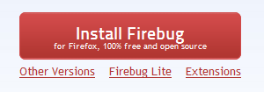
Installation of Firebug for Mozilla Firefox Browser
To install Firebug for Firefox, go to http://www.getfirebug.com
(click on Install Firebug)
INTRODUCTION

Slide 3
There are 2 Ways to Launch Firebug
With the Mozilla Firefox browser open…
1) Press F12 on the keyboard
(By default, body HTMLElement is selected)*
OR
2) Press the Firebug button on the toolbar
(By default, body HTMLElement is selected)*
INTRODUCTION

Slide 4
Firebug Toolbar
PANELS
Console: Brings up a Interactive JavaScript Console
HTML: Brings up the HTML View (see previous)
CSS: Brings up the CSS View
Script: Brings up the JavaScript Debugger (used later)
DOM: A list of all the DOM Properties (defaults to window object)
Net: Displays requests made from the browser
Cookies: Displays sessions & cookies from the browser
Click on Firebug, and then click on each of the menu commands
HTML, CSS, SCRIPT, DOM, NET, COOKIES;
make sure that each screen is enabled;
FIREBUG TOOLBAR

Slide 5
Firebug Button Brings Up a Menu
Firebug Rectangle Allows Inspection of Elements
The Firebug Button
  Hide Firebug (hides the panel)
  Deactivate Firebug (turns off Firebug)
  Firebug UI Location…
    Detached
    Left/Right
    Top/Bottom
  Open with Editor
  Text Size
  Options
  Firebug Online
  Visible Panels
  Customize Shortcuts
  About
1
2
3
4
2. Click on the Firebug button to view the menu
shown to the right
3. Click on the Firebug rectangle (circled 2) and then
hover the cursor across different sections of
the web page and examine how Firebug
displays the properties of each section;
FIREBUG TOOLBAR

Slide 6
Firebug Toolbar – Arrows, Quick Console, Show Hide Panels
3. Back/Forward – Switches between Panels
4. Quick Console – Interactive JavaScript console
1
2
3
4
4. Click on Back/Forward arrows to show how the
console switches from HTML to CSS to Script view, etc.
FIREBUG TOOLBAR

Slide 7

Inspecting HTML/CSS Elements and their Properties
5. Go to
http://cs-server.usc.edu:45678/examples/firebug/lesson1.html
We are given the following element:
Find out the attributes & DOM properties of the element
Find out the computed CSS properties
Draw the box model for the element.
When hovering the element, determine the CSS properties.

Slide 8
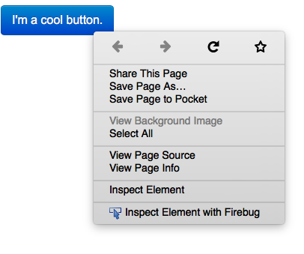
Finding the Attributes & DOM properties of the Element
6) Use the Inspect Element feature in Firebug. (Right click on the element, and click on Inspect Element)
Note: We can also use this
button and click on the
element

Slide 9
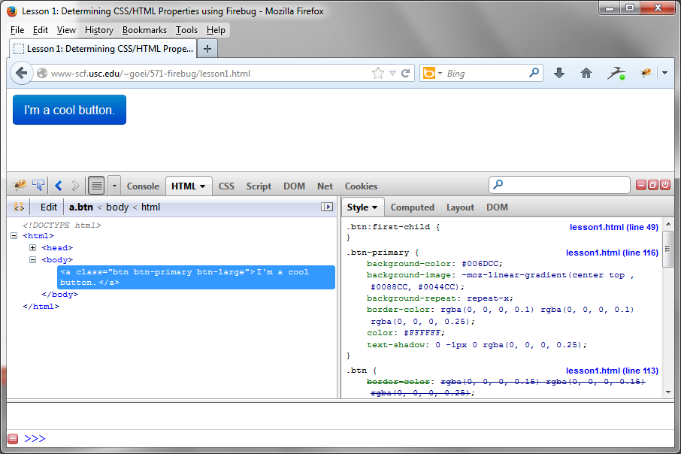
Finding the Attributes & DOM properties of the Element
The HTML Panel is displayed with the element selected.
From the highlighted area, we know the following about the element:
<a class=“btn btn-primary btn-large”>I’m a cool button.</a>

Slide 10
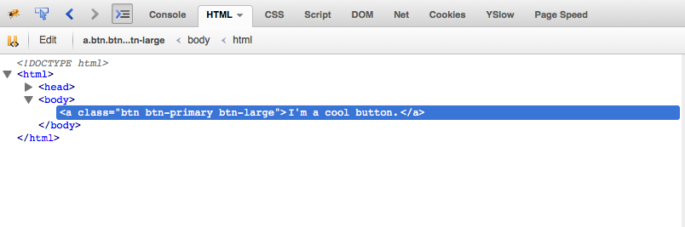
Finding the Attributes & DOM properties of the Element
BREADCRUMB
From the highlighted area & the breadcrumb we know the following about the element:
<a class=“btn btn-primary btn-large”>I’m a cool button.</a>
The element is an anchor
The element has a class attribute btn btn-primary btn-large
The element has a TextNode with TextContent “I’m a cool button”
The element’s parent node is body (whose parent node is html)
(Click on DOM in the right pane, and scroll to firstChild and parentNode)

Slide 11
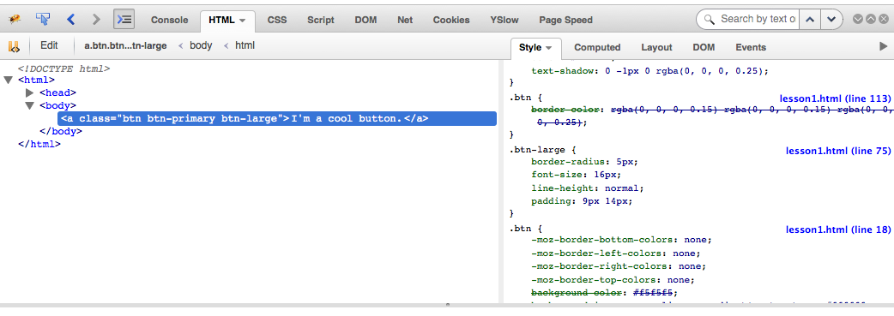
Finding the Attributes & DOM properties of the Element
7) To the right of a.btn < body < html there are a list of menu items
Style, Computed, Layout, DOM
Click on each of the 4 menu items to see the information they contain

Slide 12
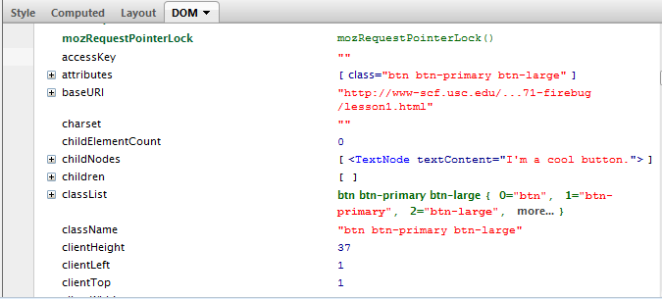
Finding the Attributes & DOM properties of the Element
A list of all DOM properties are displayed for the current element selected.
Notice: We have an attributes member variable, which has an array of attributes.
This is another way to determine the attributes for the selected element.

Slide 13
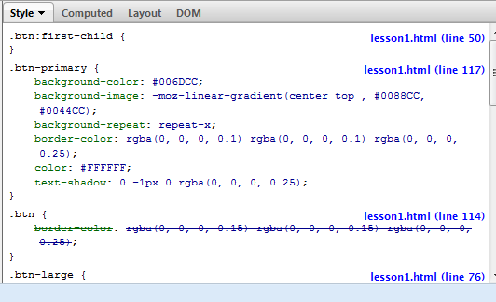
Find the Computed CSS Properties for that Element
What we know from the diagram:
List of CSS properties
  crossed out – It means the style was cascaded
Where it is located in the server
  Which file,
  What line number does the CSS property start
  Clicking on lesson1.html (line 50) brings up the file in the CSS panel.
1) Click on Style in the right hand column.
A list of CSS properties are shown, from most relevant to least.
2
1
1A

Slide 14
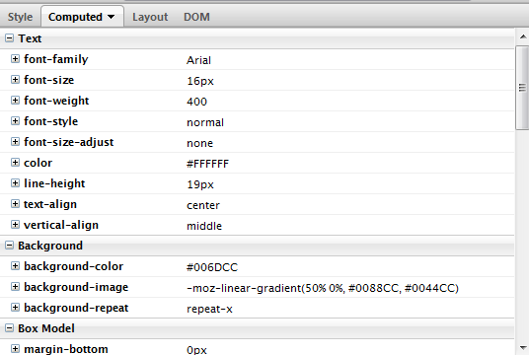

Find the Computed CSS Properties for that Element
2) Click on Computed
A list of Computed CSS properties are displayed.
Tip: Clicking on the +/- (or arrow) displays the computation for the CSS property (Cascaded properties are crossed out). Open (+) background-color.
Next objective, finding the box
model of the element

Slide 15
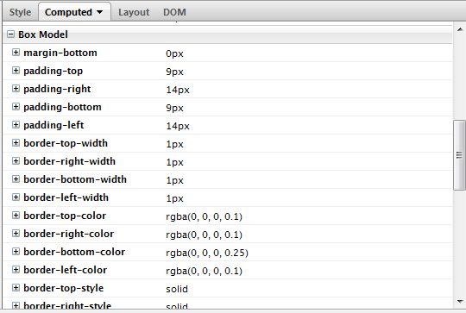
Find the Computed CSS Properties for that Element
1) Stay on the Computed panel and scroll to box model.
A list of Box Model CSS properties are shown..
We need to draw out the
box model, however…

Slide 16
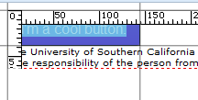
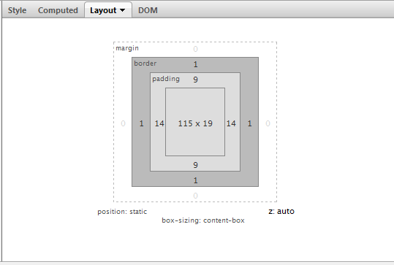

Find the Computed CSS Properties for that Element
2) Click on Layout
The Box Model is drawn out. When highlighting over an area, the browser highlights the selected element’s box property & displays a ruler
Purple highlight: Padding
Yellow highlight: Margin

Slide 17

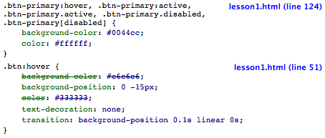
Determining Hover CSS Properties of the Element
Hover over the element.
The Style Panel will change accordingly.
Added CSS properties caused by the psuedo-class hover:

Slide 18



Tutorial 1 Summary
TUTORIAL OBJECTIVES
Find out the attributes & DOM properties of the element
Solution: In the HTML Panel, click DOM on the right side pane.
Find out the computed CSS properties
Solution: In the HTML Panel, click DOM on the right side pane
Draw the box model for the element.
Solution: In the HTML Panel, click on Layout

Slide 19

Tutorial 1 Summary
TUTORIAL OBJECTIVES
4) Determining CSS Hover Properties of the element
Solution: Hover over the element, watch the Style pane in HTML View
HOW IS THIS USEFUL?
Can visualize how an element is formed in CSS/HTML/JavaScript
Example – A client of yours likes a button at Google+. The client wants that same exact button in their web application. Time to use Firebug.

Slide 20
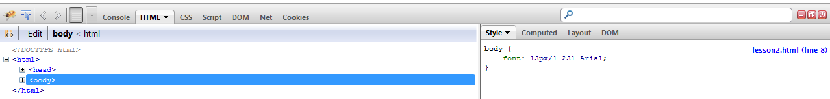
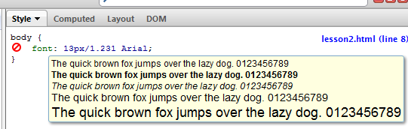
Modifying the DOM of an Element in Real Time
Go to http://cs-server.usc.edu:45678/examples/firebug/lesson2.html
Method 1: Using the HTML View & Style Pane
Launch Firebug and under the HTML View inspect the body element.
  - Easy way to do this: F12, click on the body tag. It is highlighted.
1a) If we hover over on Arial in: font: 13px/1.231 Arial;
Hovering over the element does
2 things:
shows an info box about the
property (if available)
2) Clicking on will hide the
selected property.

Slide 21

Modifying the DOM of an Element in Real Time
Method 1: Using the HTML View & Style Pane
2) Double-Click on the braces { } of the CSS element declaration.
Firebug will allow you to add a new css property.
color: white;
background: black;
3) Add the following properties:
Result… but we are not done yet
MODIFYING THE DOM OF AN ELEMENT
IN REAL TIME

Slide 22
Modifying the DOM of an Element in Real Time
Method 1: Using the HTML View & Style Pane
4) Inspect the paragraph element, I am a paragraph element with black text and a white background
5) Double click on the innerText of the element, and modify accordingly.

Slide 23

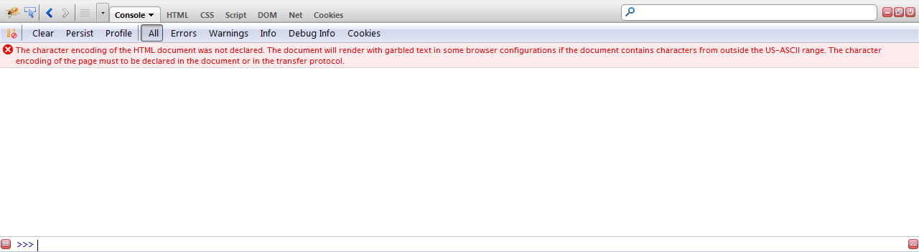
Modifying the DOM of an Element in Real Time
Method 2: Using the Interactive JavaScript Console
Click on Console. Click on drop-down.
Toggle Show Command Editor (single-line mode editor appears at bottom)
CONSOLE PANEL

Slide 24
Modifying the DOM of an Element in Real Time
Method 2: Using the Interactive JavaScript Console
CONSOLE PANEL
3
1
2
The Interactive JavaScript Console. All console messages (console.log),
output of execution is displayed here.
2. Write commands here. As long the JavaScript is valid, any command here
will be executed in real time.
3. Filtering. We can filter messages by their type. Clicking will cause the console
to break on all errors.

Slide 25
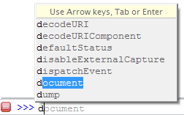

Modifying the DOM of an Element in Real Time
Method 2: Using the Interactive JavaScript Console
Execute the following JavaScript line:
(To execute JavaScript code, type the line starting at >
and hit Enter
document.body.style.color = "white";
Neat! Firebug has
autocomplete when
typing in JavaScript
commands
Result:
What did we just do? We just set the text color of the body element to white, so currently we have white text on a white background (the border is there just to emphasize there is nothing)
2. Execute the following lines of JavaScript:
document.body.style.backgroundColor = "black";
document.body.children[0].innerHTML = "I am a paragraph with WHITE text and a BLACK background”;
Result:
MODIFYING THE DOM OF AN ELEMENT
IN REAL TIME

Slide 26
Modifying the DOM of an Element in Real Time
TUTORIAL OBJECTIVES
Transform this page:
http://cs-server.usc.edu:45678/examples/firebug/lesson2.html
TO
HOW WE ACCOMPLISHED THE OBJECTIVE WITH FIREBUG WITH 2 METHODS:
Method 1: Changing HTML/CSS Properties using the HTML Panel and the CSS Pane
  Solution: Use the CSS Pane to change the background to black and the text-color, to white
  Solution: Use the HTML pane to change the text content of the element
2. Method 2: Use the Interactive JavaScript Console
  Solution: Write JavaScript DOM object code in the Console (document.body.style.color….)

Slide 27
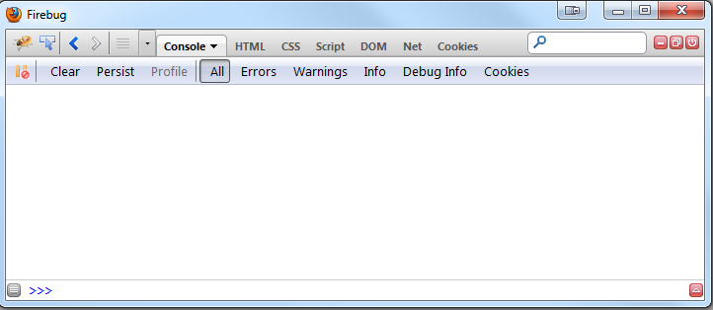
Side Note: Executing a Block of JavaScript Code
If you have a block of JavaScript code you would like to execute, such as the following:
var array = ["Ellis", "Horowitz", "CSCI", "571"];
for(var i = 0; i < array.length; i++) {
console.log(array[i]);
}
Instead of writing line by line, we can the entire block in the console. Here’s how:
1. Press the button in the Console tab. – OR – Console – Show Command Editor
MODIFYING THE DOM OF AN ELEMENT
IN REAL TIME

Slide 28
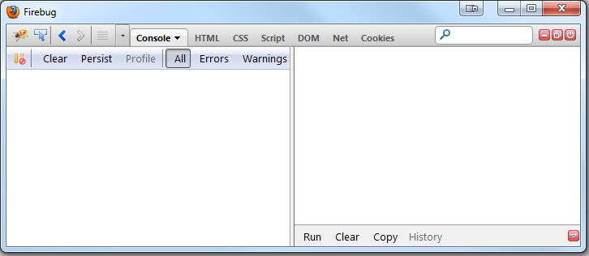
Side Note: Executing a Block of JavaScript Code
The Console Panel should now be the following:
2. Type or paste the
code here.
3. Click Run.
MODIFYING THE DOM OF AN ELEMENT
IN REAL TIME

Slide 29
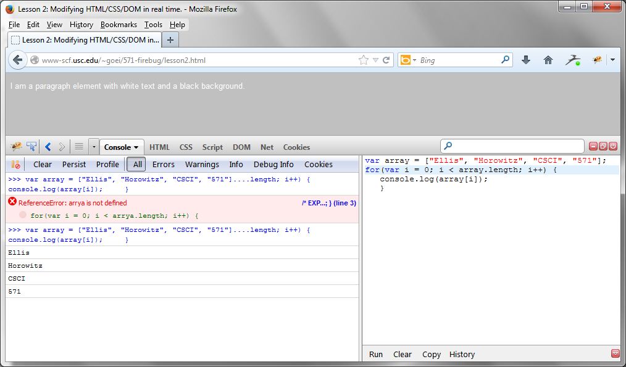
Side Note: Executing a Block of JavaScript Code
Result:
Note: To go back to single-line mode, click on A Also Clear the Console Command Editor.
WHY IS THIS USEFUL?
To write good JavaScript code, you have to test it frequently. We can write functions,
test it, and ensure validity through the console. This practice is known as test-driven development.

Slide 30
Understanding Behavior of JavaScript Code & Detecting Errors with Firebug
TUTORIAL OBJECTIVES
http://cs-server.usc.edu:45678/examples/firebug/lesson3.html
Step through the behavior of the JavaScript code
Understand what happens in the console when JavaScript hits an error
We will be analyzing the following JavaScript:
WHAT THE CODE DOES
var array = [1,2,3,4,5,6,7,8, "9"];
for(var i = 0; i < array.length; i++) {
array[i] = array[i] + 1;
}
console.log(array);
setTimeout(function() { x=z; }, 5000);
Given an array, add 1
to each element.
2. In 5 seconds, a function
will do an illegal operation
in JavaScript.
UNDERSTANDING BEHAVIOR OF JAVASCRIPT CODE & DETECTING ERRORS WITH FIREBUG

Slide 31

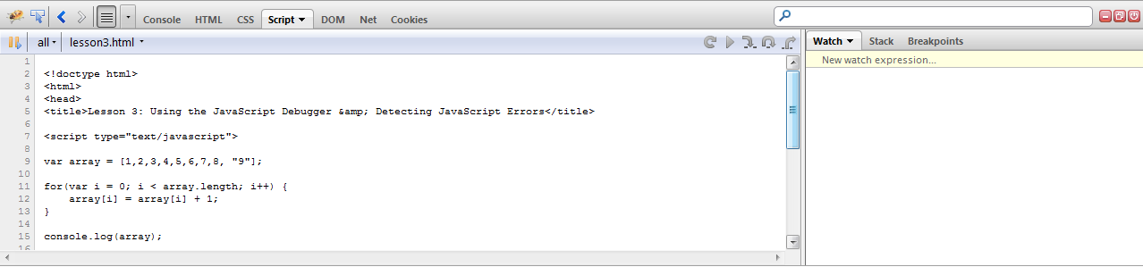
Understanding Behavior of JavaScript Code & Detecting Errors with Firebug
1) Go to http://www-scf.usc.edu/~goei/571-firebug/lesson3.html
2) Go to the Console. You should see the following (and a ReferenceError):
QUESTION: Why did the last element become 91?
We will analyze this by stepping through the code.
3) Click on Script
UNDERSTANDING BEHAVIOR OF JAVASCRIPT CODE & DETECTING ERRORS WITH FIREBUG

Slide 32
Firebug - SCRIPT PANEL
2
1
The Script Panel View
Actions when JavaScript has hit a breakpoint
  Rerun – Shift + F8 (not available in some version of Firebug)
  Continue – F8
  Step Into – F11
  Step Over – F10
  Step Out – Shift F11
UNDERSTANDING BEHAVIOR OF JAVASCRIPT CODE & DETECTING ERRORS WITH FIREBUG

Slide 33
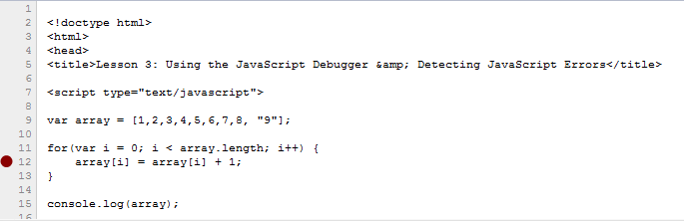
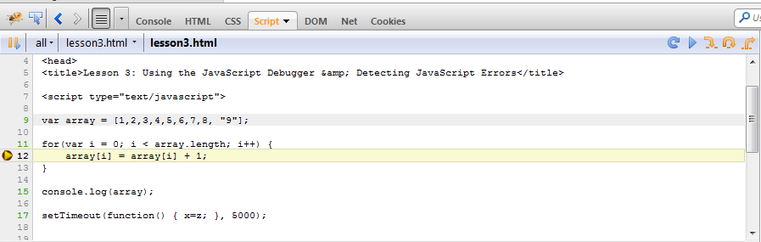
Stepping Through JavaScript
4) Create a breakpoint on line number 11 to analyze the problem. Refresh the page.
(To create a breakpoint, click on the line number. A red circle will appear.)
5) JavaScript has
stopped on the
breakpoint. A Yellow arrow appears.
Notice: The page is still
loading because the
body element is not loaded.

Slide 34
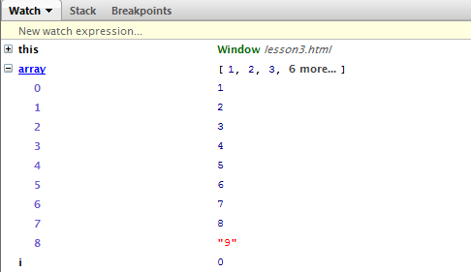


When Firebug Hits a Breakpoint, what else can we see?
Global elements & local elements
(click on Watch, then open “this”)
The stack (useful for recursive functions)
(click on Stack)
Breakpoints
(click on Breakpoints)
UNDERSTANDING BEHAVIOR OF JAVASCRIPT CODE & DETECTING ERRORS WITH FIREBUG

Slide 35
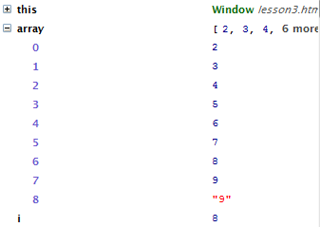
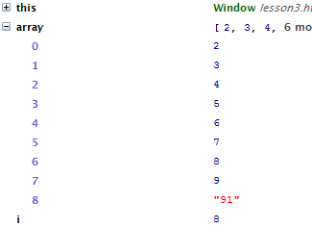

Analyzing the Array using the Watch Pane
4) Step through 8 times the dynamic execution trace by clicking on Step Into…
5) Step through once. The 8th element should be now “91”
After pressing Step Into 8 times…
Stepping in once after 8
6) We can execute JavaScript code while JavaScript is still in the breakpoint.
Hit
UNDERSTANDING BEHAVIOR OF JAVASCRIPT CODE & DETECTING ERRORS WITH FIREBUG

Slide 36

Analyzing the Array using the Watch Pane
6) Execute the following JavaScript inside “New watch expression…”. (after typing, hit enter)
typeof array[8]
QUESTION: Why did the last element become 91?
It’s because the last element is a string, hence it will do concatenation.
WHY IS STEPPING THROUGH JAVASCRIPT USEFUL?
It detects logic errors in JavaScript code
Useful when interpreting data via AJAX, as numbers may be interpreted
as strings, and when we do number manipulation, it will cause a similar
error as was described.
Speaking of errors, what does Firebug do when it executes the following illegal code?
setTimeout(function() { x=z; console.log(“Hello there!”); }, 5000);
UNDERSTANDING BEHAVIOR OF JAVASCRIPT CODE & DETECTING ERRORS WITH FIREBUG

Slide 37
Errors in the Console
setTimeout(function() { x=z; console.log(“Hello there!”); }, 5000);
How to detect JavaScript Syntax/Undefined errors the easy way:
Launch Firebug. Click on Console in the Firebug toolbar.
Due to the nature of the top code, the error will not appear until 5 seconds have
passed. Then the following should show:
WHY IS THIS USEFUL?
By default, JavaScript code stops executing from the line an error occurs.
If we didn’t have Firebug, we would expect Hello there! to appear in the console, but it didn’t, and we would debug manually by using alert() or
document.write()
UNDERSTANDING BEHAVIOR OF JAVASCRIPT CODE & DETECTING ERRORS WITH FIREBUG

Slide 38
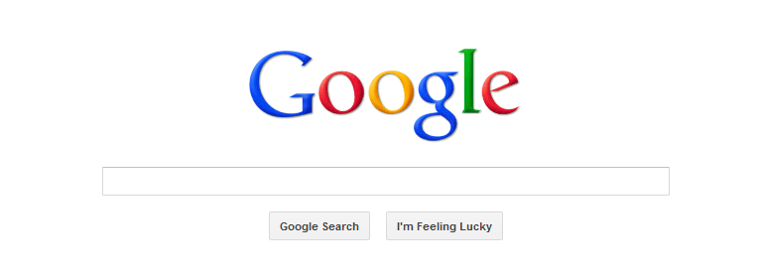
Detecting Web Performance Using Firebug
TUTORIAL OBJECTIVE
We will use http://www.google.com for this tutorial.
Determine what requests are made when going to http://www.google.com and how fast was each request.
DETECTING WEB PERFORMANCE USING FIREBUG

Slide 39
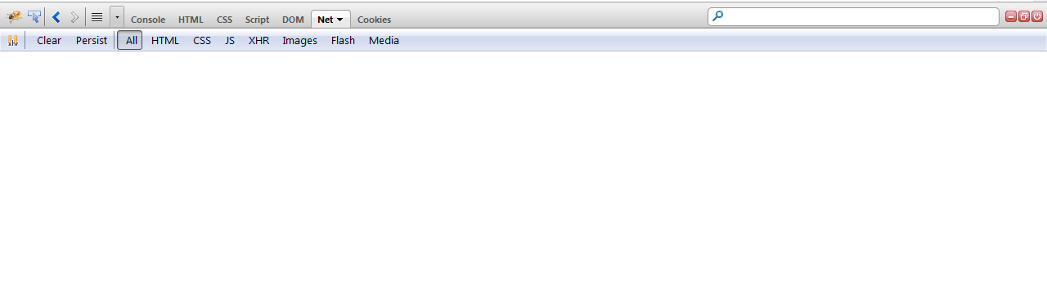
Detecting Web Performance Using Firebug
Go to http://www.google.com better to try www.amazon.com
Launch Firebug and click on Net
2
1
The requests made
Filtering
3. Refresh the page.
DETECTING WEB PERFORMANCE USING FIREBUG

Slide 40
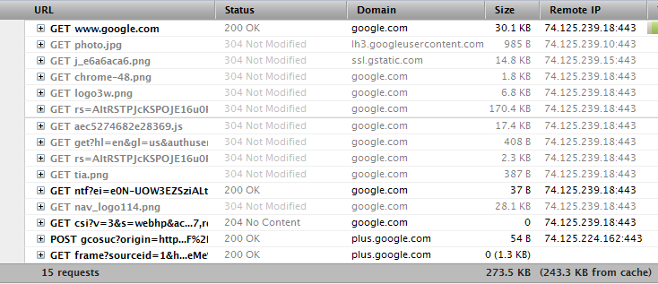
Detecting Web Performance Using Firebug
After refreshing, something like the above should appear.
Here’s what we can say about the performance of http://www.google.com:
There were 13 requests, 273.5 KB in total size, 243.3 KB from cache.
The remote IP is 74.125.239.180: 443 and 74.125.224.167:443 for one req.
The status of each request, and what type it was
(the sizes and IP addresses may change daily)
DETECTING WEB PERFORMANCE USING FIREBUG

Slide 41
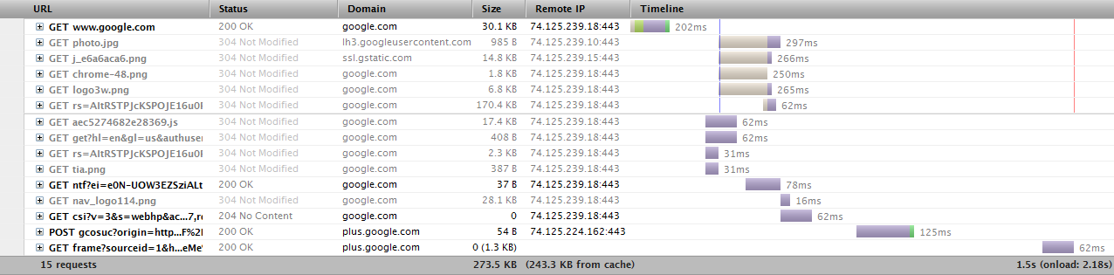
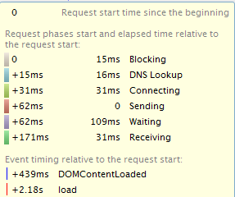
Detecting Web Performance Using Firebug
4. The longest request is 297 ms.
5. We also know the timeline of each request
6. The legend on the right indicates what each
request was doing
DETECTING WEB PERFORMANCE USING FIREBUG

Slide 42


Analyzing a Request using Firebug
TIP: Hovering over an image will show an info box of the image
1) Expand the request by clicking on +
DETECTING WEB PERFORMANCE USING FIREBUG

Slide 43
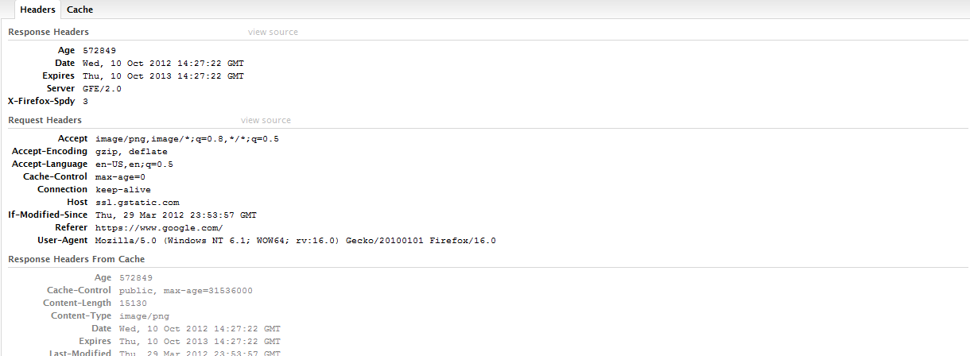
Analyzing a Request using Firebug
2) We can see the details of the request in the Headers Tab (HTML -> open URL)
DETECTING WEB PERFORMANCE USING FIREBUG

Slide 44
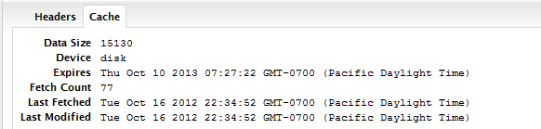
Analyzing a Request using Firebug
3) We can see what was loaded in the cache from the cache tab
WHY IS ANALYZING PERFORMANCE WITH FIREBUG USEFUL?
We can detect how large a request is, and where the website is really slow
- which is how we can improve performance for a site
DETECTING WEB PERFORMANCE USING FIREBUG

Slide 45
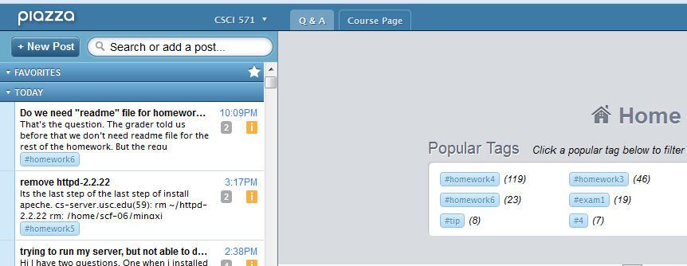
Tracking Cookies and Sessions with Firebug
TUTORIAL OBJECTIVE
Track the cookies and sessions created by a website.
1) We will use http://www.piazza.com for this example.
2) Launch Firebug and click on the cookies panel.
TRACKING COOKIES AND SESSIONS WITH FIREBUG

Slide 46
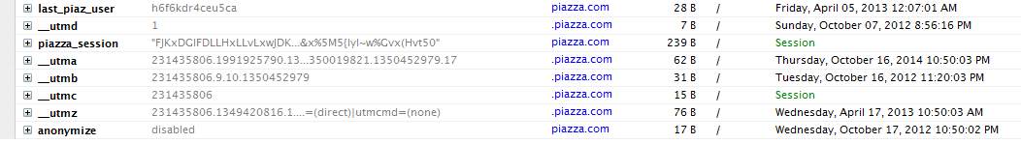
Tracking Cookies and Sessions with Firebug
1
2
3
4
5
Name and Expand button.
Expanding the cookie only reveals the full value of the value attribute.
2. Value of the cookie
3. Domain of the cookie
4. The size
5. The path
6. When it expires / or whether it is a session
TRACKING COOKIES AND SESSIONS WITH FIREBUG

Slide 47
Sources
Smashing Magazine - “15 Helpful In-Browser Web Development Tools”
http://www.smashingmagazine.com/2008/11/18/15-helpful-in-browser-web-development-tools/
(Used for Introduction)
SitePoint – “Firebug CSS Active Hover States” - http://www.sitepoint.com/firebug-css-active-hover-states/ - Tip for :hover
Firebug - https://getfirebug.com/ (Images, and Firebug Console)
Tutorials were made from scratch, based on my real-life scenarios as a web developer:
  Tutorial 1: Client: I really like this button from http://www.google.com . I want that same button on my website.
  Tutorial 2: Client: Can we compare how the website looks with white text and black background, black background & white text?
  Tutorial 3: When I was developing a canvas application for USC Viterbi, I was adding numbers like the following: 2 + 2. I expected 4, but the result turned out to be 22.
  Tutorial 4: When I had the lecture in CSCI 571 about Web Performance, I played with Firebug
  Tutorial 5: Internship made me deal with cookies/sessions

