Slide 1
jQuery Tutorial

Slide 2

What is jQuery?
A framework for client-side JavaScript.
Frameworks provide useful alternatives for common programming tasks.
An open source project at jquery.com
It simplifies
HTML document traversing
Event Handling
Animating
AJAX interactions

Slide 3
What is available with jQuery?
Cross browser support and detection
AJAX functions
CSS functions
DOM manipulation
DOM transversal
Attribute manipulation
Event detection and handling
JavaScript animation
Hundreds of plugins for pre-built user interfaces, advanced animations, form validation, etc
Expandable functionality using custom plugins
Small foot print

Slide 4
Downloading jQuery
Installation – You just download the latest jquery-x.y.z.js file and put it in your website folder
http://jquery.com/download
jQuery is lightweight: 30KB (Minified and Gzipped)‏

Slide 5
So How Does jQuery Change How You Write JavaScript?
jQuery adds a JavaScript object called $ or jQuery to your JavaScript code.
Through manipulation of this JavaScript code, it abstracts away commonly used JavaScript objects into $ and jQuery, such as the DOM (document), XMLHTTPRequest, and JSON
Example: Instead of var myButton = document.getElementById("myButton");
In jQuery, it’s just
$("#myButton");

Slide 6
jQuery Basic Selectors
These are examples of “Basic” selectors, based on CSS1:
All Selector (“*”): selects all elements, sets css properties and returns the number of elements found
var elementCount = $("*").css("border", "3px solid red" ).length;
Class Selector (“.class”): selects all elements with a given class and sets css properties
$(".myClass").css("border", "3px solid red");
Element selector (“element”): selects all elements with the given tag name, e.g. div, and sets css properties
$("div").css("border", "9px solid red");
ID selector (“#id”): selects a single element with the given id attribute
$("#myDiv").css("border", "3px solid red");
Multiple selector (“selector1, selector2, selectorN"): selects a combined result of all the specified selectors
$("div, span, p.myClass").css("border", "3px solid red");
For more examples see: http://api.jquery.com/category/selectors/basic-css-selectors/

Slide 7
Other jQuery Selector Categories
JQuery borrows notation from CSS1-3 “selectors”, as a tool to match a set of elements. Here are some examples of what one can do:
Attribute: selects elements that have the specified attribute and changes the associated text
$("input[value='Hot Fuzz'] "). text( "Hot Fuzz" ) ;
Basic Filter, e.g. selects all elements that are h1, h2, h3, etc and assigns css properties
$(":header").css({ background: "#ccc", color: "blue" });
Child Filter, e.g. finds the first span in each div and underlines the text
$("div span:first-child").css( "text-decoration", "underline" )
Content Filter, e.g. finds all div containing “John” and underlines them
$("div:contains('John’)").css( "text-decoration", "underline" );
Form, e.g. finds all buttons and adds the css class “marked” to their properties
var input = $(":button").addClass( "marked" );
For more examples see: http://api.jquery.com/category/selectors

Slide 8
jQuery Functions
Either attached to the jQuery object or chained off of a selector statement.
E.g. Run a function when the page is fully loaded
$( window ).load(function() {
//run code
} );
Most functions return the jQuery object they were originally passed, so you can perform many actions in a single line.
E.g. Add the class bigImg to all images with height > 100 once the image is loaded
$("img.userIcon" ).load(function() {
if ( $( this ).height() > 100 {
$( this ).addClass("bigImg");
}
});
The same function can perform an entirely different action based on the number and type of parameters.

Slide 9
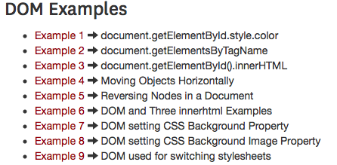
More jQuery Examples
Remember these examples?
http://cs-server.usc.edu:45678/examples.html#dom
We’ll revisit the examples, but with jQuery instead!

Slide 10

Example 1: document.getElementById.style.color
JavaScript w/o jQuery
hex=255 // Initial color value.
function fadetext() {
if(hex>0) { //If color is not black yet
hex -= 11; // increase color darkness
document.getElementById("sample").style.color="rgb("+hex+","+hex+","+hex+")";
setTimeout("fadetext()",20); }
else hex=255 //reset hex value
}
http://cs-server.usc.edu:45678/examples/dom/ex1.html

Slide 11
Example 1: $.fadeOut(), $.delay(), $.fadeIn()
JavaScript with jQuery
$(function() { // when document is ready
$("#fadeText").click(function() { // set a onClick handler on fadeText
$("h3").fadeOut(125).delay().fadeIn(125);
// fadeOut the h3 for 125 ms, delay, then fadeIn
});
});
http://cs-server.usc.edu:45678/examples/jquery/dom/ex1.html

Slide 12
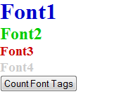
Example 2: document.getElementsByTagName
JavaScript w/o jQuery
function handleAllTags()
{ var arrayOfDocFonts;
if (document.all || document.getElementById)
{ arrayOfDocFonts = document.getElementsByTagName("font"); }
else { document.write("Unrecognized Browser Detected"); }
alert("Number of font tags in this document are " + arrayOfDocFonts.length + ".");
}
JavaScript w/ jQuery
$(function() { // when the doc is loaded,
$("#countTags").click(function() { // when countTags is clicked,
alert("Number of font tags in this document are " + $("font").length);
// alert the number of font tags in the HTML
});
});
http://cs-server.usc.edu:45678/examples/dom/ex2.html
http://cs-server.usc.edu:45678/examples/jquery/dom/ex2.html

Slide 13

Example 3: document.getElementById().innerHTML
JavaScript w/o jQuery
var hits = 0;
function updateMessage() {
hits += 1;
document.getElementById("counter").innerHTML = "Number of clicks = " + hits; }
JavaScript w/ jQuery
$(function() {
var hits = 0;
$("#updateMessage").click(function() {
$("#counter").html("Number of clicks = " + ++hits);
});
});
http://cs-server.usc.edu:45678/examples/dom/ex3.html
http://cs-server.usc.edu:45678/examples/jquery/dom/ex3.html

Slide 14
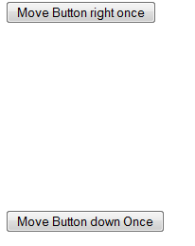
Example 4: document.getElementById().style.left
JavaScript and HTML w/o jQuery
<FORM>
<INPUT ID="counter1" STYLE="position:relative;
left:0px" TYPE="button" VALUE="Move Button right once"
onclick="document.getElementById('counter1').style.left = '500px';">
</FORM>
<br><br><br><br><br><br><br><br><br>
<FORM> <INPUT ID="counter2" STYLE="position:relative;
top:0px" TYPE="button" VALUE="Move Button down Once"
onclick="document.getElementById('counter2').style.top = '15px';">
</FORM>
http://cs-server.usc.edu:45678/examples/dom/ex4.html

Slide 15
Example 4: $.css();
JavaScript and HTML w/ jQuery
<FORM>
<INPUT ID="counter1" STYLE="position:relative;
left:0px" TYPE="button" VALUE="Move Button right once"
onclick="$('#counter1').css('left', '500px');">
</FORM>
<br><br><br><br><br><br><br><br><br>
<FORM> <INPUT ID="counter2" STYLE="position:relative;
top:0px" TYPE="button" VALUE="Move Button down Once"
onclick="$('#counter2').css('top', '15px');">
</FORM>
http://cs-server.usc.edu:45678/examples/jquery/dom/ex4.html

Slide 16

Example 5: document.getElementById(), parseint()
JavaScript w/o jQuery
var obj = document.getElementById(‘counter1’);
var xlocation = parseInt(obj.style.left);
function handleClick( ) {
xlocation += 50;
document.getElementById(‘counter1’).style.left = xlocation + “px”;}
JavaScript w/ jQuery
$(function() {
$(“#counter1”).css(“left”,(parseInt($(“#counter1”).css(“left”))+50)+”px”);
});
});
http://cs-server.usc.edu:45678/examples/dom/ex5.html
http://cs-server.usc.edu:45678/examples/jquery/dom/ex5.html

Slide 17
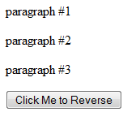
Example 6: Uses childNodes, removechild, appendChild
JavaScript w/o jQuery
function reverse(n)
{ // Reverse the order of the children of Node n
var kids = n.childNodes; // Get the list of children
var numkids = kids.length; // Figure out how many children there are
for(var i = numkids-1; i >= 0; i--) { // Loop backward through the children
var c = n.removeChild(kids[i]); // Remove a child
n.appendChild(c); // Put it back at its new position
} }
http://cs-server.usc.edu:45678/examples/dom/ex6.html

Slide 18
Example 6: $.children(), $.remove(), $.append();
JavaScript w/ jQuery
var onReady = function() {
$(".reverse").on("click", function() {
var kids = $("body").children();
for(var i = kids.length - 1; i >= 0; i--) {
var c = $(kids[i]).remove();
$("body").append(c);
}
onReady();
});
}
$(onReady);
http://cs-server.usc.edu:45678/examples/jquery/dom/ex6.html

Slide 19
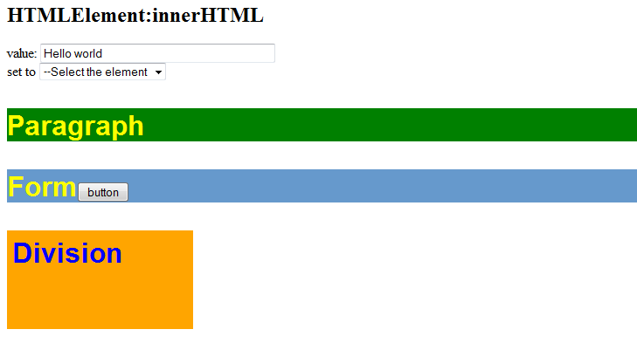
Example 7: Uses innerHTML
JavaScript w/o jQuery
function setInnerHTML(nm, value) {
if (nm == '') return;
var element=document.getElementById?document.getElementById(nm):(document.all?document.all(nm):null)
if (element) {
if(element.innerHTML) {
element.innerHTML=value;
}
else notSupported( );
}
else NotSupported( );
}
http://cs-server.usc.edu:45678/examples/dom/domtest.html

Slide 20
Example 7: $.change() and $.html();
JavaScript w/ jQuery
$(function() {
$("#sel").change(function() {
var selector = "#" + $("#sel").val();
$(selector).html($("input[name='t']").val());
});
});
http://cs-server.usc.edu:45678/examples/jquery/dom/domtest.html

Slide 21
jQuery & AJAX
jQuery has a series of functions which provide a common interface for AJAX, no matter what browser you are using.
Most of the upper level AJAX functions have a common layout:
$.func(url[,params][,callback]), [ ] optional
url: string representing server target
params: names and values to send to server
callback: function executed on successful communication.

Slide 22
jQuery AJAX load method
The load() method loads data from a server and puts the returned data into the selected element.
$(selector).load(URL,data,callback);
The selector is a usually a reference to div or span tag
The required URL parameter specifies the URL you wish to load.
The optional data parameter specifies a set of querystring key/value pairs to send along with the request.
The optional callback parameter is the name of a function to be executed after the load() method is completed.
For examples see
http://cs-server.usc.edu:45678/ajaxexamples/simple/simpleajaxexjquery.html

Slide 23
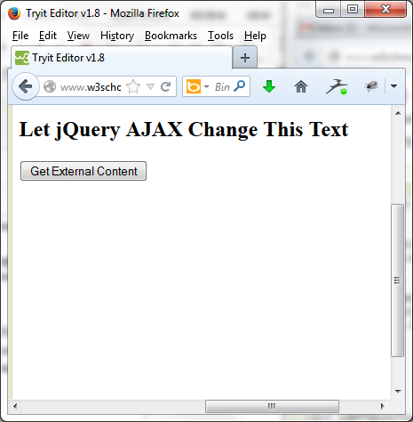
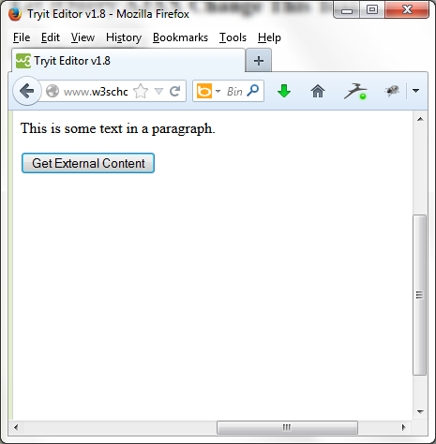
AJAX Example 1
<!DOCTYPE html><html><head>
<script src="http://ajax.googleapis.com/ajax/libs/jquery/1.10.2/jquery.min.js">
</script>
<script>
$(document).ready(function(){
$("button").click(function(){
$("#div1").load("demo_test.txt #p1");
});
});
</script>
</head><body>
<div id="div1"><h2>Let jQuery AJAX Change This Text</h2></div>
<button>Get External Content</button>
</body></html>

Slide 24
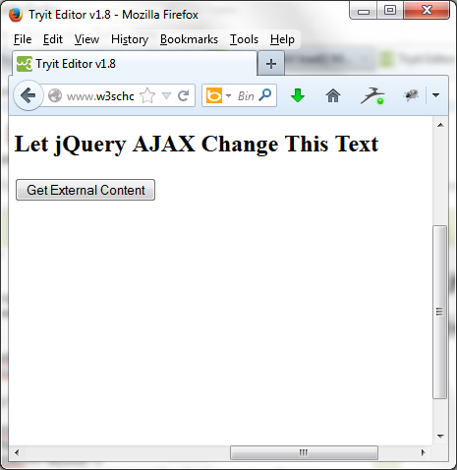
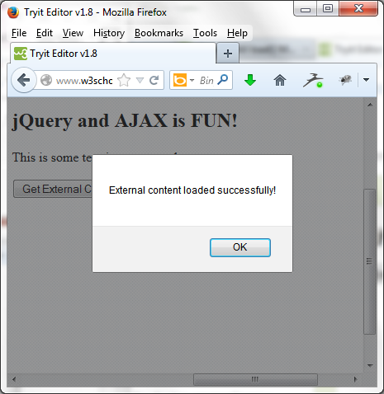
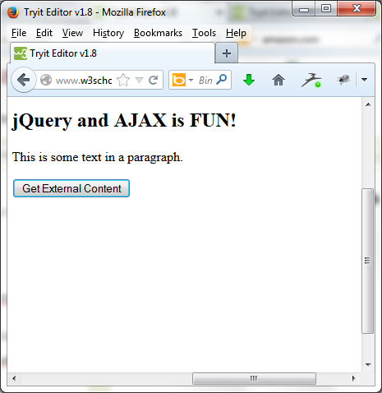
AJAX Example 2
<!DOCTYPE html><html><head>
<script src="http://ajax.googleapis.com/ajax/libs/jquery/1.10.2/jquery.min.js">
</script><script>
$(document).ready(function(){
$("button").click(function(){
$("#div1").load("demo_test.txt",function(responseTxt,statusTxt,xhr){
if(statusTxt=="success")
alert("External content loaded successfully!");
if(statusTxt=="error")
alert("Error: "+xhr.status+": "+xhr.statusText); }); }); });
</script></head><body>
<div id="div1"><h2>Let jQuery AJAX Change This Text</h2></div>
<button>Get External Content</button></body></html>

Slide 25
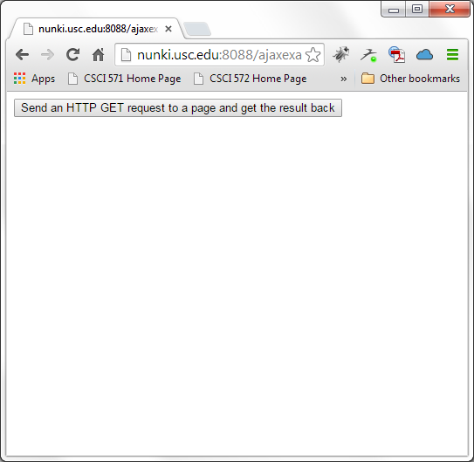
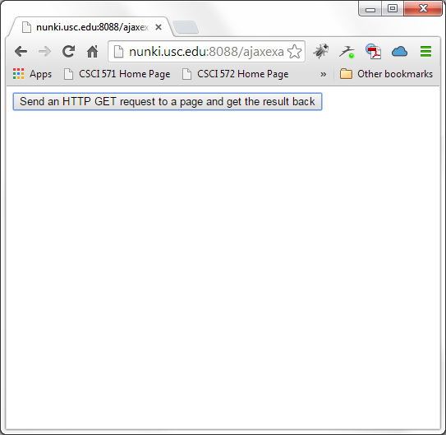
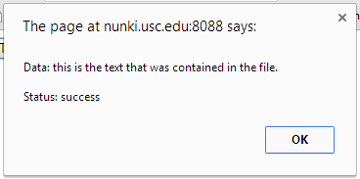
AJAX Example 3 – GET Method
<!DOCTYPE html><html><head>
<script src="http://ajax.googleapis.com/ajax/libs/jquery/1.10.2/jquery.min.js">
</script><script>
$(document).ready(function(){
$("button").click(function(){
$.get("demo_test3.test",function(data,status){
alert("Data: " + data + "\nStatus: " + status);
});
});
});
</script></head><body>
<button>Send an HTTP GET request to a page and get the result back</button>
</body></html>
The $.get() method requests data from the server
with an HTTP GET request.
The required URL parameter specifies the URL you wish to request.
The optional callback parameter is the name of a function to be executed if the request succeeds.
The following example uses the $.get() method to retrieve data from a file on the server

Slide 26
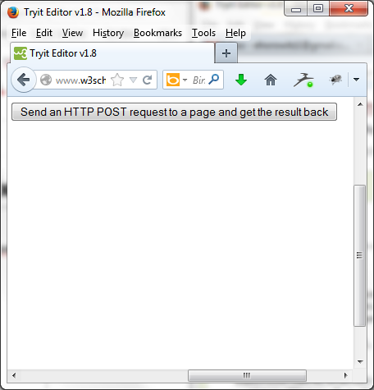
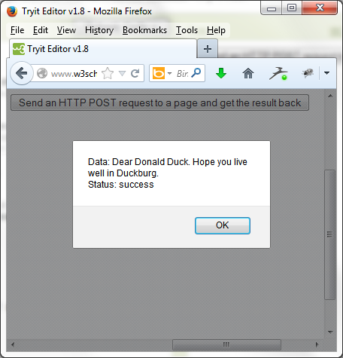
AJAX Example 4 – POST Method
<!DOCTYPE html><html><head>
<script src="http://ajax.googleapis.com/ajax/libs/jquery/1.10.2/jquery.min.js">
</script><script>
$(document).ready(function(){
$("button").click(function(){
$.post("demo_test_post.php",
{
name:"Donald Duck",
city:"Duckburg"
},
function(data,status){
alert("Data: " + data + "\nStatus: " + status);
});
});
});
</script></head><body>
<button>Send an HTTP POST request to a page and get the result back</button>
</body></html>

Slide 27
Summary jQuery AJAX Functions
$.func(url[,params][,callback])
$.get
$.getJSON
$.getIfModified
$.getScript
$.post
$(selector), inject HTML
load
loadIfModified
$(selector), ajaxSetup alts
ajaxComplete
ajaxError
ajaxSend
ajaxStart
ajaxStop
ajaxSuccess
$.ajax, $.ajaxSetup
async
beforeSend
complete
contentType
data
dataType
error
global
ifModified
processData
success
timeout
type
url

Slide 28
jQuery Usage Example (1)
jQuery way of a mouseover event that shows a submenu when menu is selected:
$(‘#menu’).mouseover(function() { // Anonymous function
$(‘#submenu’).show();
});

Slide 29
jQuery Usage Example (2)
Stopping a normal event action: Suppose we want to stop the action of following a URL when a link is clicked. The action is part of the event object. We can reference the event object and call .preventDefault();
$(‘#menu’).click(function(evt){
//JS code here
evt.preventDefault();
}

Slide 30
jQuery Usage Example (3)
Selecting all form elements of a certain type:
$(‘:text’) It selects all text fields.
Use with :input ( all form elements), :password, :radio, :checkbox, :submit, :image, :reset, :button, :file, :hidden
Set the value of a form element
Var fieldvalue = $(‘#total’).val(Yourvalue);

Slide 31
jQuery Usage Example (4)
Determining if checkbox is checked
If ($(‘#total’).attr(‘checked’)) {
//Do whatever you want if box is checked
}
else {
//Do whatever you want if box is not checked
}

Slide 32
jQuery Usage Example (5)
Form Events such as submit:
$(document).ready(function() {
$(‘#signup’).submit(function() {
if ($(‘#username’).val() ==‘’) {
alert (‘Please supply name to name field’);
return false;
}
})
});

Slide 33
jQuery Usage Example (6)
Focus Example: Auto erases default text in a field when it gets the focus
<input name=“username” type=“text” id=“username” value=“Please type your user name”>
$(‘#username’).focus(function() {
var field = $(this);
if(field.val()==field.attr(‘defaultValue’)) {
field.val(‘’);
}
});

Slide 34
jQuery Usage Example (7)
Click: If any radio button is clicked
$(‘:radio’).click(function() {
//do stuff
});
Add focus to the first element of the form:
$(‘username’).focus;

Slide 35
jQuery Snippet that Detects Browser Width
<html><head><link rel="stylesheet" href="style.css" type="text/css" />
<script type="text/javascript" src="http://ajax.googleapis.com/ajax/libs/jquery/1.4.4/jquery.min.js">
</script></head><body>
<h2>Text that will be red if screen width is less than 800px, mobile.css is used,
and text will be green if screen width is greater than 800px, style.css is used, and black if no style sheet is specified</h2>
<div id="browserInfo" style="padding:8px; border:1px solid blue; width:300px;"></div>
<script type="text/javascript">
$(document).ready(function(){ resizeWindow();
$(window).bind('resize', resizeWindow);
getBrowserInfo(); });
function resizeWindow(){$('#browserInfo').text('Browser (Width : ' + $(window).width() +
' , Height :' + $(window).height() + ' )');
var newWindowWidth = $(window).width();
// If window width is below 800px, switch to the mobile stylesheet
if(newWindowWidth < 800){ $("link[rel=stylesheet]").attr({href : "mobile.css"}); }
// Else if width is above 800px, switch to the large stylesheet
else //if(newWindowWidth >= 800)
{ $("link[rel=stylesheet]").attr({href : "style.css"});
} }
function getBrowserInfo(){
$('#browserInfo').text('Browser (Width : ' + $(window).width() +
' , Height :' + $(window).height() + ' )'); }
</script><noscript></body></html>

Slide 36
Is jQuery Worth It?
Yes | No
Good use of the jQuery library will make it worthwhile in your code; will make JavaScript more readable and understandable | Bad use of jQuery library adds extra overhead. Why even add jQuery? Remember you need to add: <script src="//ajax.googleapis.com/ajax/libs/jquery/1.8.3/jquery.min.js"></script>
If web application requires a lot of DOM manipulation, hiding elements, fading out elements, etc | Doesn’t even need DOM manipulation; could be done with CSS
Cross Browser Support – no need extra code for browser compatibility | Audience only uses Firefox – no need cross browser support only

Slide 37
jQuery
It’s a useful library when used wisely.
It will allow you to write JavaScript differently
Write less, do more.
Remember: jQuery is just JavaScript
What you can do with jQuery, you can always do without jQuery but with more code.

Slide 38
jQuery Resources
Project website
http://www.jquery.com
Learning Center
http://docs.jquery.com/Tutorials
http://www.learningjquery.com/
http://15daysofjquery.com/
Support
http://docs.jquery.com/Discussion
http://www.nabble.com/JQuery-f15494.html mailing list archive
irc.freenode.net irc room: #jquery
Documentation
http://docs.jquery.com/Main_Page
http://www.visualjquery.com
http://jquery.bassistance.de/api-browser/
jQuery Success Stories
http://docs.jquery.com/Sites_Using_jQuery

