Slide 1
Lecture
JavaScript – Basics
Copyright © Ellis Horowitz 1999-2016

Slide 2
What is JavaScript
    JavaScript is a "simple", interpreted, programming language with elementary object-oriented capabilities
    JavaScript has two distinct systems
      client-side JavaScript runs on Web browsers
      server-side JavaScript runs on Web servers
    JavaScript syntax resembles C, C++, and Java
    JavaScript was developed in 10 days by Brendan Eich at Netscape in May 1995 (now at Mozilla)
    The original name was Mocha, chosen by Marc Andreessen, founder of Netscape
    Was renamed as LiveScript, then JavaScript
    See ”A Short History of JavaScript”:
    https://www.w3.org/community/webed/wiki/A_Short_History_of_JavaScript
Copyright © Ellis Horowitz 1999-2016

Slide 3
JavaScript is Embedded in HTML
In the <body>
<HTML>
<HEAD>
</HEAD>
<BODY>
<SCRIPT LANGUAGE="JavaScript">
//the Javascript here produces content for the BODY on loading
</SCRIPT>
</BODY>
</HTML>
or in the <head> as a deferred script
<HTML>
<HEAD>
<SCRIPT LANGUAGE="JavaScript">
//the Javascript here creates functions for later use
</SCRIPT>
</HEAD>
<BODY>
</BODY></HTML>
Copyright © Ellis Horowitz 1999-2016

Slide 4
A Simple Example
<HTML>
<HEAD>
<TITLE>Simple Javascript</TITLE>
</HEAD>
<BODY>
<H1>First Example of JavaScript</H1>
<SCRIPT LANGUAGE="JavaScript">
document.write("Last updated on " + document.lastModified + ". ")
</SCRIPT>
</BODY>
</HTML>
JavaScript has:
objects
properties
methods
strings
concatenation
Copyright © Ellis Horowitz 1999-2016

Slide 5
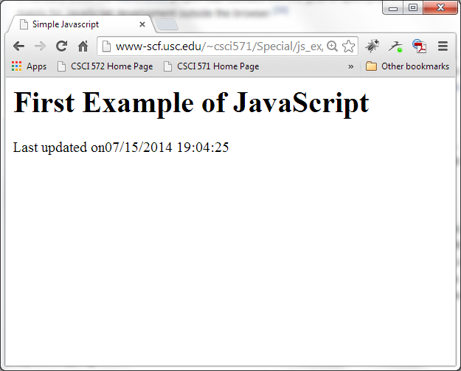
Example 1: Browser Output
Copyright © Ellis Horowitz 1999-2016

Slide 6
Another Example
<HTML>
<HEAD><TITLE>Computing Factorials</TITLE></HEAD>
<BODY>
<H1>Another Example of JavaScript</H1>
<SCRIPT LANGUAGE="JavaScript">
document.write("<H1>Factorial Table</H1>");
for ( i = 1, fact = 1; i < 10; i++, fact = fact * i) {
document.write(i + "! = " + fact);
document.write("<BR>");
}
</SCRIPT>
</BODY>
</HTML>
Classical C for statement
Copyright © Ellis Horowitz 1999-2016

Slide 7
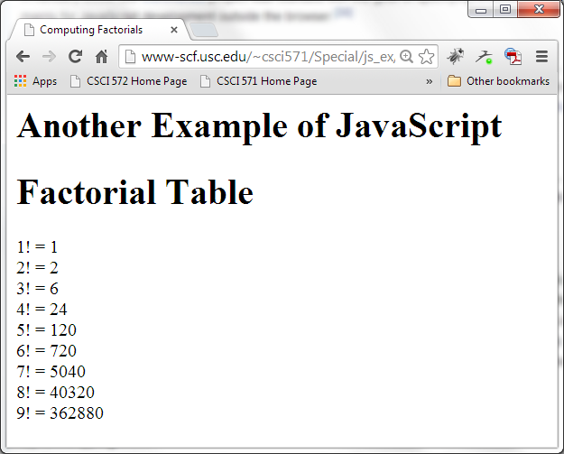
Example 2: Browser Output
Copyright © Ellis Horowitz 1999-2016

Slide 8
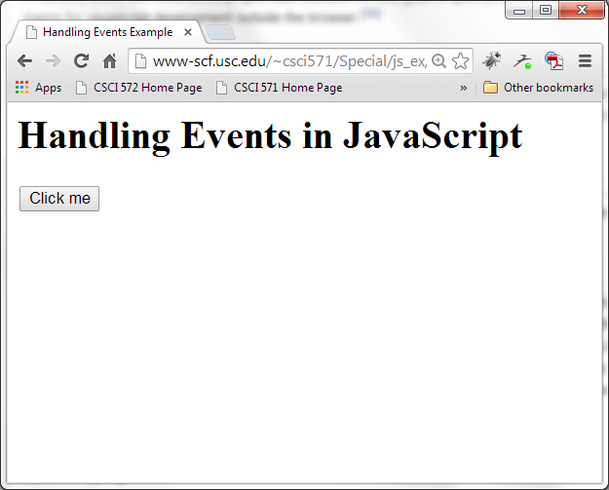
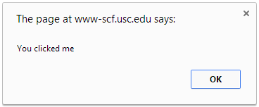
JavaScript has Event Handlers
<HTML>
<HEAD><TITLE>Handling Events Example</TITLE></HEAD>
<BODY>
<H1>Handling Events in JavaScript</H1>
<INPUT TYPE="button" VALUE="Click me"
onClick="alert(‘You clicked me’)" >
</BODY>
</HTML>
Copyright © Ellis Horowitz 1999-2016

Slide 9
Some Common Events
Mouse Events
  onclick user clicks an HTML element
  ondblclick user double-clicks an element
  onmouseover user moves the mouse over an HTML element
  onmouseout user moves the mouse away from an HTML element
Keyboard Events
  onkeydown user presses a key
  onkeyup user releases a key
Object Events
  onload browser has finished loading the page
  onunload a page has unloaded
  onresize a document view is resized
  onscroll a document view is scrolled
Copyright © Ellis Horowitz 1999-2016

Slide 10
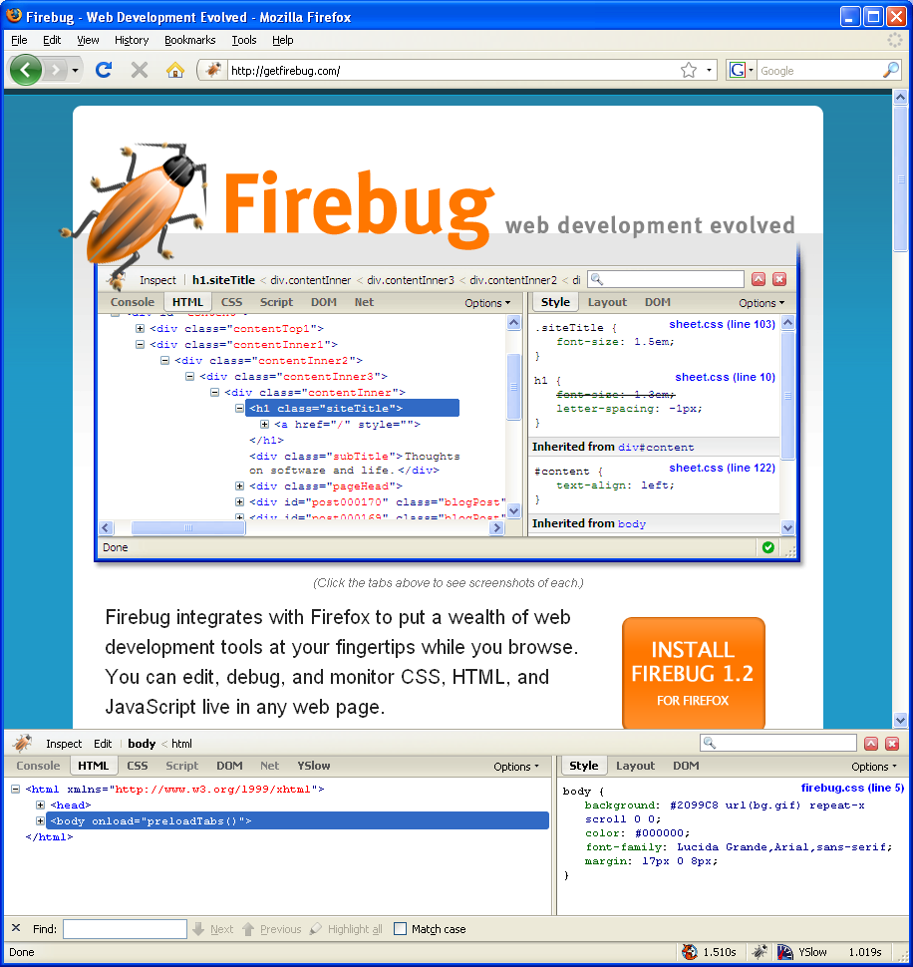
Debugging JavaScript
Firefox Developer Tools
Firebug is a Firefox AddOn that is designed to help people debug their web pages
To get Firebug, in Firefox, go to:
http://getfirebug.com
download and install the software
Excellent tutorials on Firebug can be found on the Resources page of the course website, see “Firebug Tutorials” at:
http://cs-server.usc.edu:45678/resources.html
Copyright © Ellis Horowitz 1999-2016

Slide 11
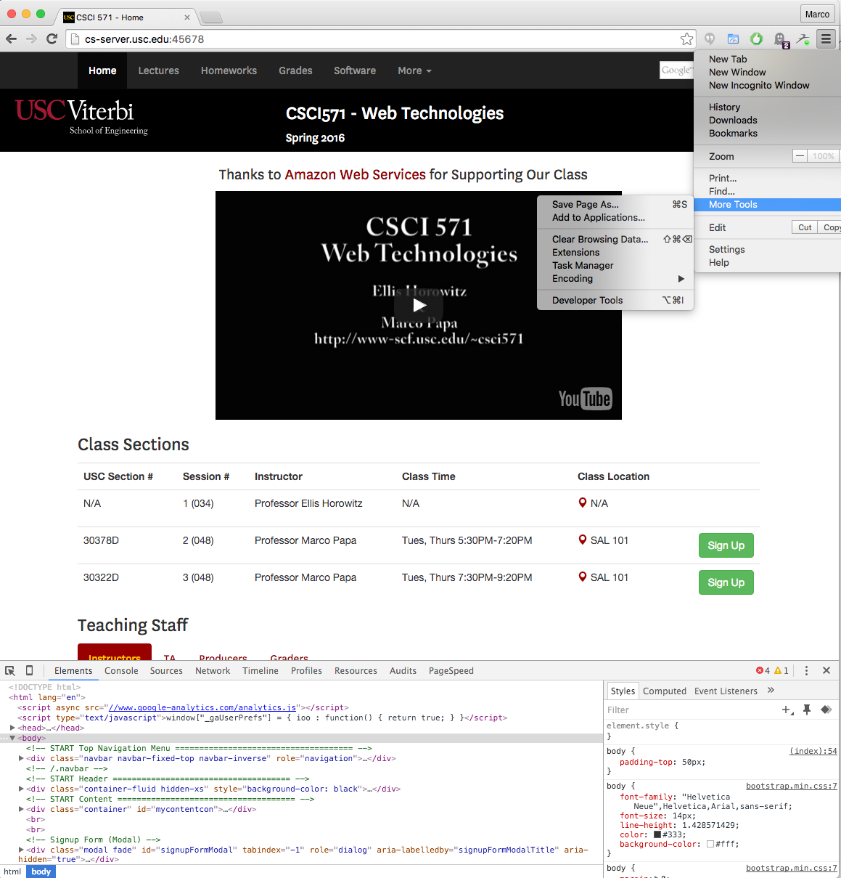
Debugging JavaScript
Chrome Developer Tools
The Chrome Developer Tools
are built into Google Chrome.
They provide deep access into
the internals of the browser and
their web application.
Use the DevTools to
track down layout issues
set JavaScript breakpoints
get insights for code optimization.
Got to Tools > More Tools > Developer Tools
Copyright © Ellis Horowitz 1999-2016

Slide 12
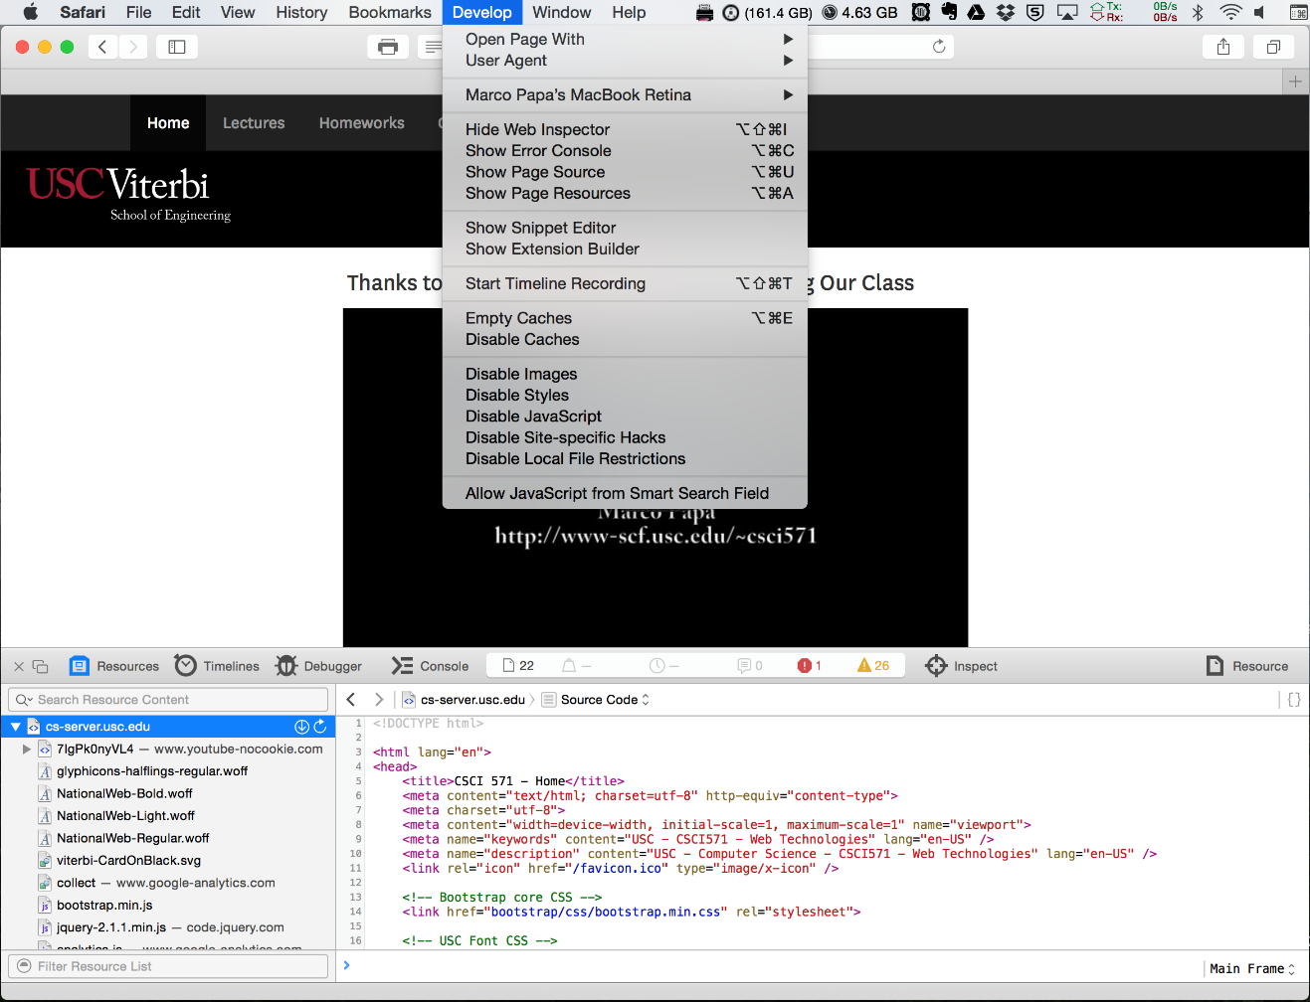
Debugging JavaScript
Safari Developer Tools
The Safari Developer Tools are built into Safari.
Developer Tools include
  Web Inspector
  Error Console
  Page Source
  Page Resources
  Snippet Editor
  Extension Builder
  Debugger
  Timelines
  Timeline recording
Turn on Develop menu: Preferences > Advanced > check “Show Develop menu in menu bar”
Copyright © Ellis Horowitz 1999-2016

Slide 13
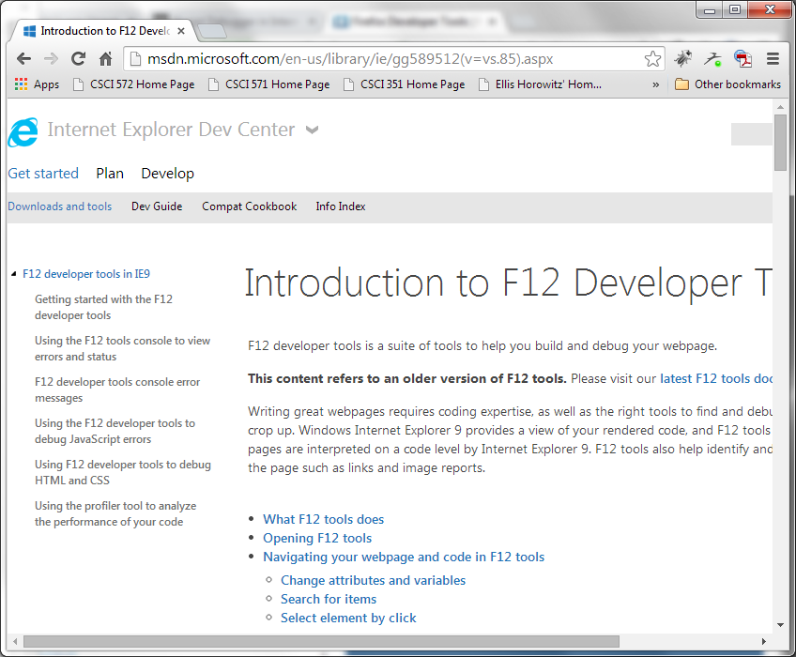
JavaScript Debugging
Internet Explorer F12 Developer Tools
A similar set
of capabilities
as Firebug and
Chrome Developer
Tools.
Available in IE9, IE10 and IE11.
Copyright © Ellis Horowitz 1999-2016

Slide 14
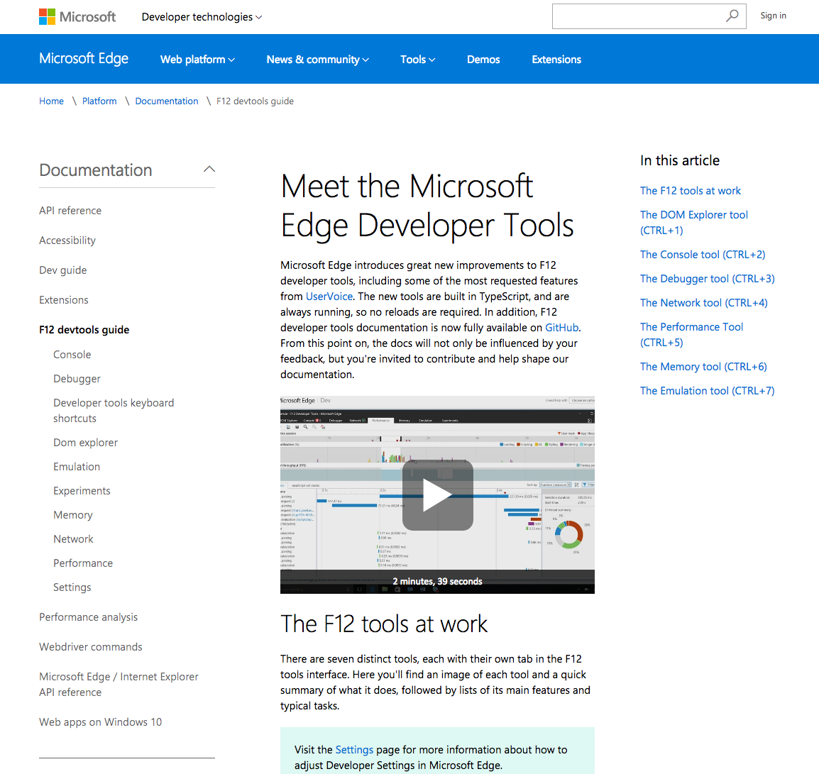
JavaScript Debugging
Edge F12 Developer Tools
Includes seven tools:
DOM Explorer tool
Console tool
Debugger tool
Network tool
Performance tool
Memory tool
Emulation tool
Documentation available at: https://developer.microsoft.com/en-us/microsoft-edge/platform/documentation/f12-devtools-guide/
Copyright © Ellis Horowitz 1999-2016

Slide 15
What JavaScript Programs Can Do
    Write programs to perform any computation; it is equivalent in power to a general purpose programming language
    But it is specifically designed for manipulating web pages
      Control Web page appearance and content (this is its intended use)
      Control the Web browser, open windows, test for browser properties
      Interact with document content
      Retrieve and manipulate all hyperlinks
      Interact with the user, sensing mouse clicks, mouse moves, keyboard actions
      Read/write client state with cookies
Copyright © Ellis Horowitz 1999-2016

Slide 16
Limitations of Client-Side JavaScript
[Was] Extremely difficult to explicitly draw graphics.
  This has been dramatically improved in the latest versions
No access to the underlying file system or operating system
Unable to open and use arbitrary network connections
No support for multithreading
[Was] Not suitable for computationally intensive applications
  This has been dramatically improved in the latest versions
Copyright © Ellis Horowitz 1999-2016
Notes:
Cannot write to/from file systems; single threaded;
Fast graphics(GPU)s && mathematics computations ---(compiled languages; CPU faster)

Slide 17
JavaScript – Basics of the Language
JavaScript is case-sensitive
  sum, SUM and Sum are 3 different identifiers
  HTML is NOT case-sensitive
JavaScript ignores spaces, tabs, newlines
  So it can be minified
Semicolon is optional
  but multiple statements on a line require a semicolon
i = 1; j = 2
C and C++ style comments are supported
//comment to end of line
/* this can be a
multiple line comment */
Copyright © Ellis Horowitz 1999-2016

Slide 18
JavaScript Literals
Literals are fixed values, (not variables) that you literally provide in your script
  numbers, 42, -5, 3.14159, -7.5E6
    All numbers are treated as floating point
    Octal (begin with a zero), 01234
    Hexadecimal (begin with zero and x), 0xFF
  Boolean, true, false, (also null and undefined)
  strings, any sequence of zero or more characters enclosed within single or double quotes
    Examples
      ‘a single quoted string’
      "a double quoted string"
      ""
      "alert(‘Please Click OK’)"
Copyright © Ellis Horowitz 1999-2016

Slide 19
JavaScript Strings
Strings are immutable, once created they can never be changed
You can search a string and extract substrings, but you cannot modify a string
“immutable” means that once you instantiate the object, you can't change its properties.
So, when calling methods on a string, JavaScript will return the modified string, but it won't change the initial string
Now this doesn't mean that you can't assign a new string object to the str variable. You just can't change the current object that str references.
One generally builds a string through concatenation
var newWebPage = ""
newWebPage += "<HTML><HEAD>"
newWebPage += "<TITLE>A Sample Page</TITLE></HEAD>"
newWebPage += "<BODY>My Home Page</BODY>"
newWebPage += "</HTML>"
Copyright © Ellis Horowitz 1999-2016

Slide 20
Properties of Strings
    Strings have a length property
"Lincoln".length // result = 7
"Four score".length //result = 10
"One\ntwo".length // result = 7
"".length // result = 0
    Some String methods
    string.tolowerCase(); string.toupperCase()
    string.indexOf(searchstring [, startindex]) //returns index value
    of char within string where searchString begins
    string.charAt(index) //returns the one char at position index
    string.substring(indexA, indexB) //returns characters of string
    between indexA and indexB
Copyright © Ellis Horowitz 1999-2016

Slide 21
JavaScript Escape Notation
Escape sequences are used to embed special characters in a string
\b backspace \t tab
\f form feed \’ single quote
\n newline \" double quote
\r carriage return \\ backslash
Example of escape characters in strings
msg = ‘You\’re using an embedded single quote here.’
msg = "This is on the first line \n and this is on the second line."
msg = document.title + "\n" + document.links.length + "links present"
Copyright © Ellis Horowitz 1999-2016

Slide 22
JavaScript Reserved Words
JavaScript identifiers start with a letter, $, or underscore followed by
zero or more letters or digits;
JavaScript reserved words; you cannot use these reserved words
as variables, labels, or function names
abstract | arguments | boolean | break | byte
case | catch | char | class* | const
continue | debugger | default | delete | do
double | else | enum* | eval | export*
extends* | false | final | finally | float
for | function | goto | if | implements
import* | in | instanceof | int | interface
let | long | native | new | null
package | private | protected | public | return
short | static | super* | switch | synchronized
this | throw | throws | transient | true
try | typeof | var | void | volatile
while | with | yield
Copyright © Ellis Horowitz 1999-2016

Slide 23
More JavaScript Words to Avoid
You should also avoid using the name of JavaScript built-in
objects, properties, and methods including:
Array | Date | eval | function | hasOwnProperty
Infinity | isFinite | isNaN | isPrototypeOf | length
Math | NaN | name | Number | Object
prototype | String | toString | undefined | valueOf
Some notes:
1. The NaN property represents "Not-a-Number" value.
This property indicates that a value is not a legal number
2. Infinity is a numeric value that represents positive infinity.
-Infinity is a numeric value that represents negative infinity.
3. The valueOf() method returns the primitive value of the specified object.
Copyright © Ellis Horowitz 1999-2016

Slide 24
JavaScript Variables
    Variables should be declared, but not their type
    var i, sum; //declaration
    var zero = 0; //declaration and initialization
    var myName = "Ellis"
    The type of value a variable can hold during execution may change.
    Scope
      Any variable outside a function is a global variable and can be referenced by any statement in the document
      Variables declared in a function are local to the function
      if var is omitted, the variable becomes global
    In a multi-frame or multi-window set up of the browser, scripts can access global variables from any other document currently loaded
Copyright © Ellis Horowitz 1999-2016
Notes:
Loosely typed language;

Slide 25
JavaScript Data Types
JavaScript has a limited set, with some notable ones lacking, e.g. integer, and some notable ones not usually found in programming languages, e.g. function
Type Example Description
String "a string" A series of characters inside quote marks
Number 123.45 Any number not inside quote marks
Boolean true A logical true and false
Null null Completely devoid of any value, not
a number, not a string, different
than 0 in C/C++
Object All properties and methods belonging
to the object
Function A function
Copyright © Ellis Horowitz 1999-2016

Slide 26
JavaScript Arrays
    though not an official data type, arrays are included in the language using a traditional array notation, i.e. square brackets
    However they differ from conventional arrays in many ways
    array properties
      one dimensional, indexed from zero
      array elements can contain any type of data including references to other arrays, to objects, to functions
      array elements can have different types
    An array literal is a list of zero or more expressions, each of which represents an array element, enclosed in square brackets ([]), e.g.
      var coffees = [“French Roast”, “Columbian”, “Kona”];
      var fish = [“Tuna", , “Cod"]; (one empty element)
      var myArray = [“Richard”, 10, getPhoto()]; (string, number, function)
      var items = [[1,2],[3,4],[5,6]]; (two-D array, items[0][0] is 1)
Copyright © Ellis Horowitz 1999-2016

Slide 27
More on Arrays
Every array has a length property
The length property is the largest integer property name in the array plus one
var myArray = []; // name an array with no elements;
myArray.length //0
myArray[100000] = true; //size of the array became 100000 + 1;
myArray.length //100001
Arrays are sparse, in the above example only one index is allocated
JavaScript does NOT provide a way to declare the size (dimension) of an array, but we can add one
Array.dim = function (dimension, initial) {
var a = [], i;
for (i = 0; i < dimension; i += 1) {
a[i] = initial; }
return a; };
var myArray = Array.dim(10,0); //makes an array of ten zeros
Copyright © Ellis Horowitz 1999-2016

Slide 28
More on Arrays
There are many ways to iterate over an array
  for loop; for (i=0; i < len; i++) {. . . }
  forin loop; for (x in person) { . . . }
  while loop; while (condition) {. . . }
There are many built-in methods for working with arrays, here are just a few:
  concat(), joins two or more arrays
  indexOf(), search the array for an element and return its position
  pop(), remove the last element
  push() add a new element at the end
  reverse(), reverses the order of elements
See also
https://developer.mozilla.org/en-US/docs/Web/JavaScript/Guide/Predefined_Core_Objects
or
http://www.w3schools.com/jsref/jsref_obj_array.asp
Copyright © Ellis Horowitz 1999-2016

Slide 29
Arrays and Objects are Semantically Identical
    The typeof() function returns a string which is the type of its argument ("number", "string", "boolean", "object", "function", "undefined")
    In JavaScript objects and arrays are really identical, typeof(array) = typeof(object) = object
    JavaScript does NOT support associative arrays, e.g.
    var person = new Array();
    person["firstname"] = "John";
    person["lastName"] = "Doe";
    person["age"] = 41;
    alert(person["age"]);
    alert(person.length); person[“firstName”] returns “John”, but person[0] returns undefined and person.length returns 0
    The ‘dot’ operator can be used with arrays
    arr[1] is identical to arr.1
    but if i = 1, arr[1] is not equivalent to arr.i since property names are not evaluated (i is a property name)

Slide 30
Objects
    An object literal is a list of zero or more pairs of property names and associated values of an object, enclosed in curly braces ({}), e.g.
      var person = {firstName:"John",
      lastName:"Doe",
      age:50,
      eyeColor:"blue"};
      the “dot” operator is used to access the value of an object’s property or to assign it a value, e.g.
      lname = person.lastName // returns “Doe”
      person.lastName = “Smith”;
    Objects can be nested within objects, e.g.
    var myHonda = {color: "red",
    wheels: 4,
    engine: {cylinders: 4,
    size: 2.2}
    };

Slide 31
Object Constructors
It is often useful to define an “object type” that can be used multiple times to create object instances having the same structure
To do this one creates an object constructor, which is a JavaScript function that is called with the new operator, e.g.
function cat(name, meow) {
this.name = name;
this.talk = function() {
alert (this.name + " say " + meow)
}
}
cat1 = new cat("felix", "purr");
cat1.talk();
cat2 = new cat("ginger", "hisss");
cat2.talk();
cat() is an object constructor with properties and methods declared inside

Slide 32
Predefined JavaScript Objects
There are a set of predefined objects that include:
  Array object, we have already seen
  Boolean object, a wrapper around the primitive Boolean data type,
    var booleanObject = new Boolean(value);
    var booleanObject = new Boolean(false); alert(booleanObject); // false;
    var booleanObject = new Boolean("false");alert(booleanObject); //true;
    Any object whose value is not (undefined, null, 0, Nan or the empty string, including a Boolean object whose value is false), evaluates to true
  Date Object, like Java it stores dates as the number of milliseconds since Jan. 1, 1970, 00:00:00
    var Xmas95 = new Date("December 25, 1995");
    Xmas95.getMonth() returns 11, Xmas95.getFullYear() returns 1995
  Function object
    Var functionObjectName = new Function([arg1, ..., argn], functionbody);
  Math object includes properties and methods for mathematical constants, e.g. sin(), cos(), ceil(), floor()
  RegExp object (discussed later)
  String object (discussed later)

Slide 33
Example Using Date Object
<HTML>
<HEAD>
<TITLE>Example using new</TITLE>
<SCRIPT LANGUAGE=JavaScript>
function outputDate() {
var d = new Date(); //creates today’s date and time
document.write(d.toLocaleString()); }
// converts a date to a string
</SCRIPT></HEAD>
<BODY>
<H1>The date and time are</H1>
<SCRIPT LANGUAGE=JavaScript>
outputDate();
</SCRIPT>
</BODY>
</HTML>
Copyright © Ellis Horowitz 1999-2016

Slide 34
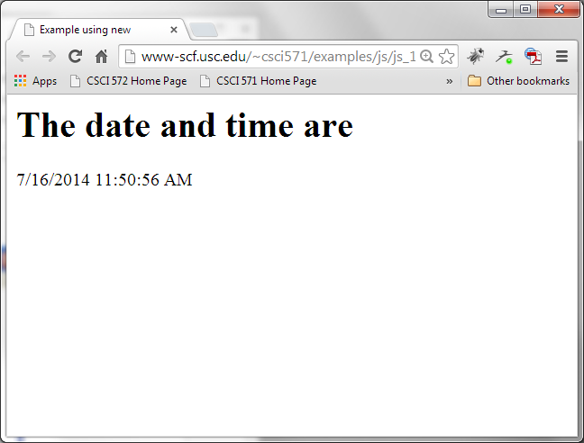
Example 4: Browser Output
Copyright © Ellis Horowitz 1999-2016

Slide 35
JavaScript Popup Boxes alert(), confirm(), and prompt()
<HTML><HEAD>
<TITLE>Example of alert, confirm, prompt</TITLE>
<SCRIPT LANGUAGE=JavaScript>
function alertUser() {
alert("An alert box contains an exclamation mark");}
function confirmUser() {
var msg = "\n please confirm that you want\n" +
"to test another button?";
if (confirm(msg))
document.write("<h2>You selected OK</h2>");
else document.write("<h2>You selected Cancel</h2>"); }
function promptUser() {
name1=prompt("What is your name? ", " ");
document.write("<h2>welcome to this page " + name1 + "</h2>"); }
</SCRIPT>
</HEAD>
Copyright © Ellis Horowitz 1999-2016

Slide 36
Using alert(), confirm(), and prompt()
<BODY>welcome to this page<br>
<FORM>
<INPUT TYPE=button VALUE="Click here to test alert()" onClick="alertUser()"><BR>
<INPUT TYPE=button VALUE="Click here to test confirm()" onClick="confirmUser()"><BR>
<INPUT TYPE=button VALUE="Click here to test prompt()" onClick="promptUser()">
</FORM>
</BODY>
</HTML>
Copyright © Ellis Horowitz 1999-2016

Slide 37
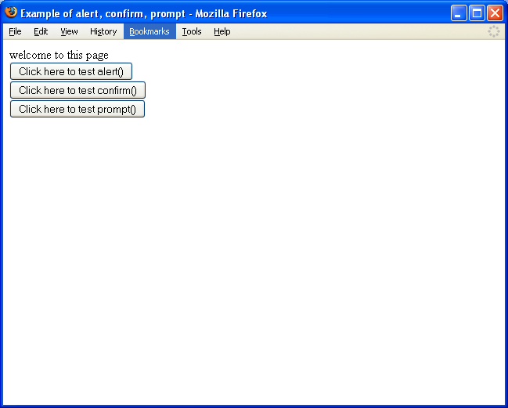
Example 5: Browser Output
Copyright © Ellis Horowitz 1999-2016

Slide 38
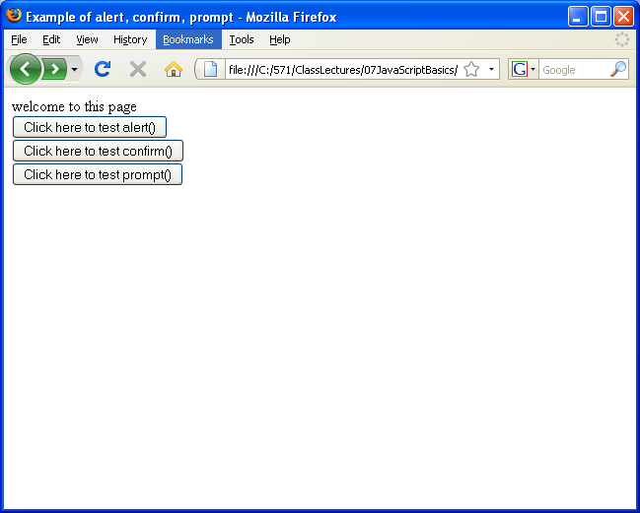
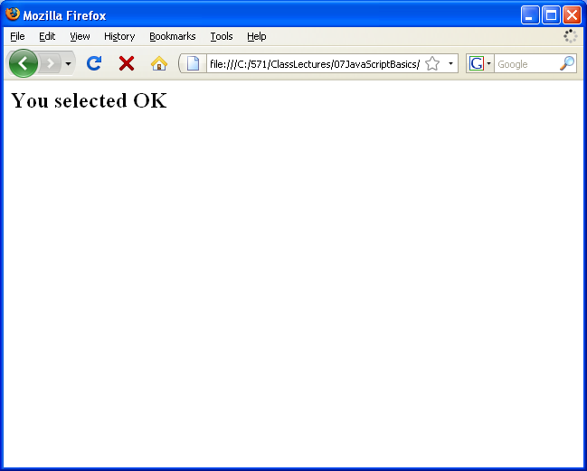
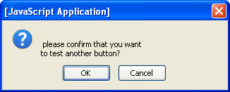
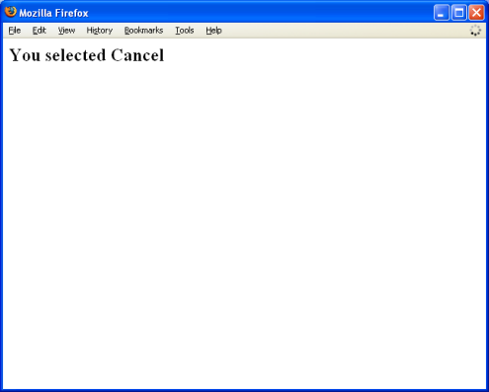
Clicking on confirm()
Copyright © Ellis Horowitz 1999-2016

Slide 39
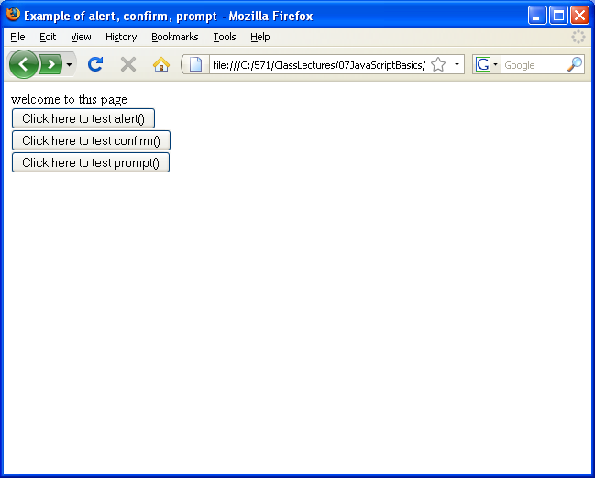
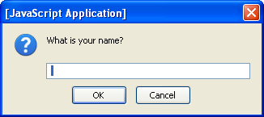
Clicking on prompt()
Copyright © Ellis Horowitz 1999-2016

Slide 40
Final Thoughts
Common Mistakes
Undefined may not be null
  In JavaScript something that has not been assigned to is not null, but undefined. Undefined is different from null when using !== but not when using the weaker != because JavaScript does some implicit casting in the later case
  For details see http://javascript.about.com/od/hintsandtips/a/Null-And-Undefined.htm
You cannot overload a function
  If you try to define two different functions with the same name but with different arguments, assuming the proper function will be called when the number of arguments match (this is overloading), then your assumption is incorrect. JavaScript will simply the latest-defined version of the function and call it;
  If a parameter is omitted it is undefined
Undeclared variables are global
  If a variable is NOT declared using var, then it is global. Two variables of the same name, both undeclared will create conflicts that are hard to debug
Copyright © Ellis Horowitz 1999-2016

Slide 41
Netscape JavaScript Versions
Netscape Browser | JavaScript Version | Comments
2.0 | 1.0 | a.k.a. LiveScript
3.0 | 1.1 | Adds images, arrays, applets, plug-ins
4.0-4.05 | 1.2 | More enhancements
4.06-4.7 | 1.3
 | 1.4 | Server only
6-7,Firefox 1.0-4 | 1.5 (1999) | ECMAScript-262 compliant
Firefox 1.5 | 1.6 | ECMAScript-262 Edition 3 compliant
Firefox 2.0 | 1.7 | Generators, iterators and let statement
Firefox 3.0-3.5 | 1.8-1.8.1 | Some ECMAScript 4 updates, JSON codec
Firefox 4.0-6.0 | 1.8.5 | ECMAScript 5 partial support
Firefox 17-47 | 1.8.6 | ECMAScript 5.1
Copyright © Ellis Horowitz 1999-2016

Slide 42
MSIE JavaScript Versions
MSIE Browser | JScript | Comments
3.X/1 | 1.0 | More or less compatible with NS JavaScript 1.0
3.X/2 | 2.0 | More or less compatible with NS JavaScript 1.1
4.0 | 3.0 | More or less compatible with NS JavaScript 1.2
5.0 | 5.0 | More or less compatible with NS JavaScript 1.5
5.1 | 5.1 | Minor update
5.5 | 5.5 | Minor update
6.0 | 5.6 | ECMA-262 3rd edition
7.0 | 5.7 | ECMA-262 3rd edition + ECMA-327
8.0 | 5.8 | ECMA-262 3rd edition + ECMA-327 + JSON (RFC 4627)
9.0-11.0 | 10.0 | Features from ECMA-262 5th edition (ES 5), .NET
Edge | 1.0 | ECMAScript 2015 (aka ES6)
Copyright © Ellis Horowitz 1999-2016

Slide 43
ECMAScript
JavaScript now controlled by the ECMA standard body
ECMA stands for European Computer Manufacturers Association
First language specification, ECMA-262, a.k.a. ECMAScript, approved in 1997, closely resembles Netscape JavaScript 1.1
Current language specification is ECMA-262, Edition 5.1 (June 2011)
ECMA-262 5th Ed. language specification found at:
  http://www.ecma-international.org/publications/files/ECMA-ST/Ecma-262.pdf
Microsoft Edge JavaScript now open source:
  https://blogs.windows.com/msedgedev/2016/01/13/chakracore-now-open/
JavaScript 1.8.x updates can be found at:
  https://developer.mozilla.org/en-US/docs/JavaScript/Reference
Mozilla JavaScript Docs
  https://developer.mozilla.org/en-US/docs/Web/JavaScript
Copyright © Ellis Horowitz 1999-2016

Slide 44
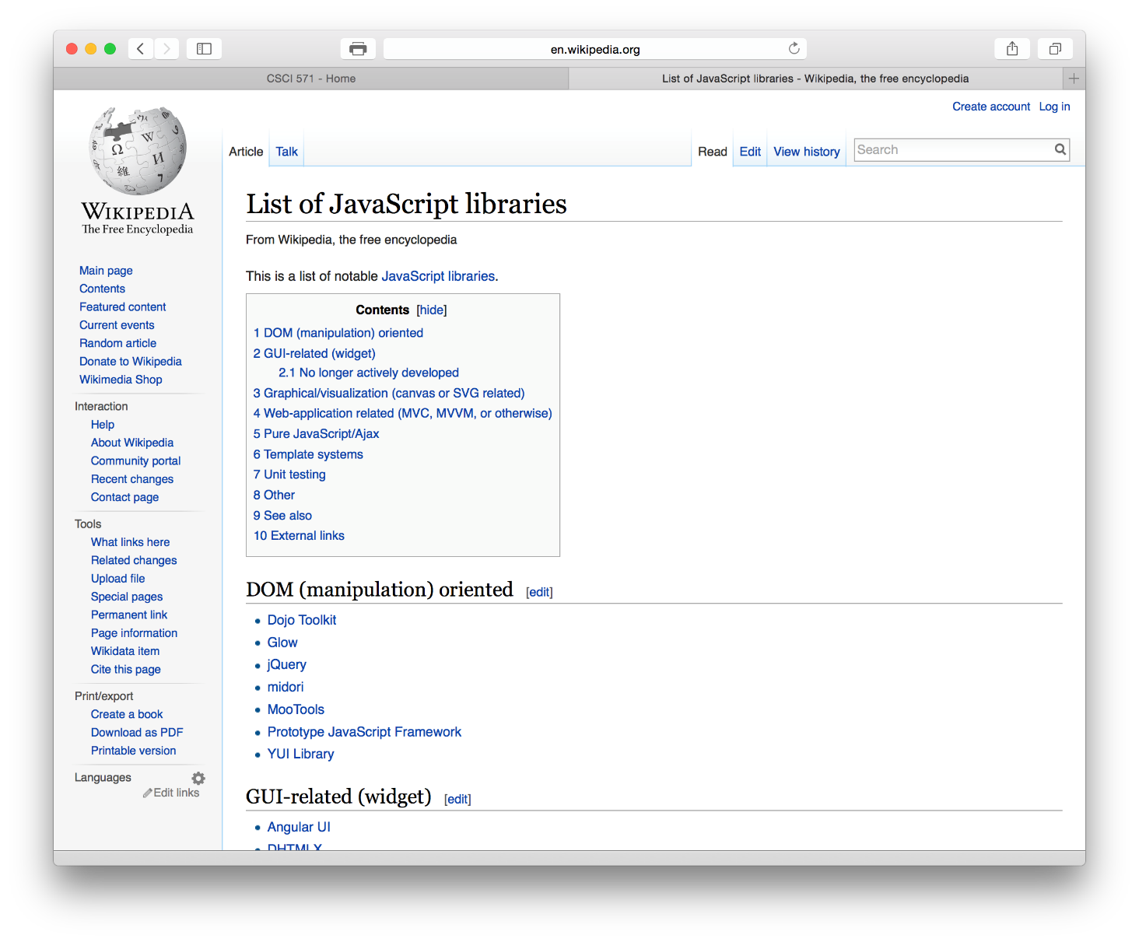
JavaScript Libraries
See http://en.wikipedia.org/wiki/List_of_JavaScript_libraries
where each library listed below includes a link to the respective home page
Copyright © Ellis Horowitz 1999-2016

