Slide 1


Scientific Machine Learning
Course Project for SciML
孟旭辉
数学与统计学院数学与应用学科交叉创新研究院
办公室：东32楼111室
Email：xuhui_meng@hust.edu.cn
https://github.com/XuhuiM/SciML-Course

Slide 2
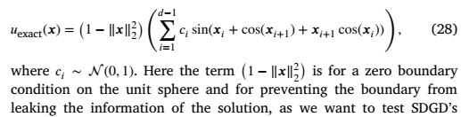
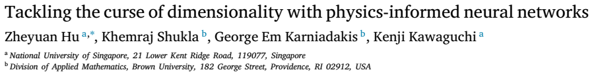
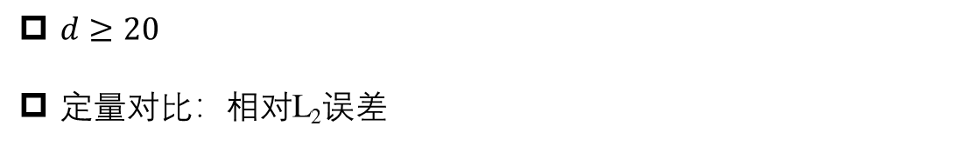
Project I: PINNs for solving high-dimensional PDE
Poisson equation
$$Δu\left(x\right)=g\left(x\right), x∈B^{d}$$
$d≥20$
定量对比：相对L₂误差

Slide 3
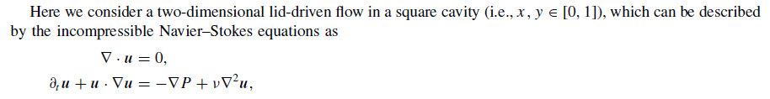

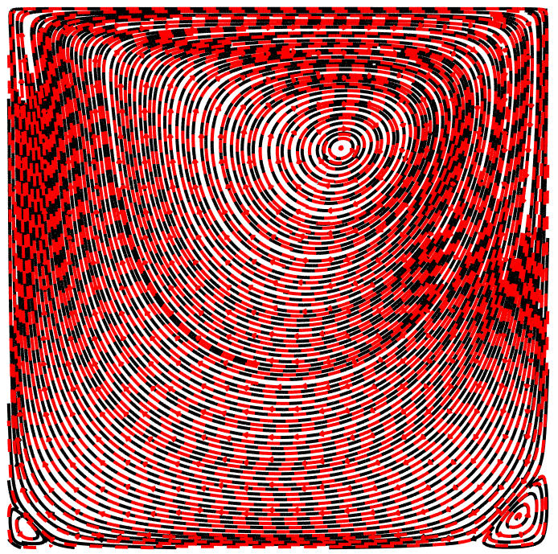
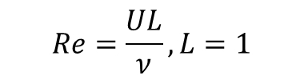
Project I: Cavity Flow
$$Re=\frac{UL}{ν}, L=1$$
Training data in github have been normalized using u/U, v/U
Re = 100

Slide 4
Project II: Cavity Flow
Forward problem: Solve NS equations given boundary conditions with Re=100
Flow field reconstruction:

Slide 5
Project III: Reaction-diffusion system in porous media

Slide 6
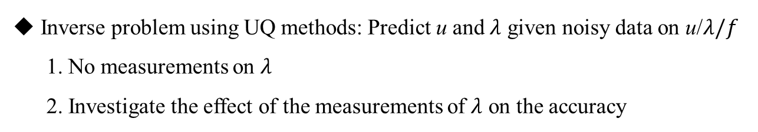
Project III: Reaction-diffusion system in porous media
Inverse problem using UQ methods: Predict u and $λ$ given noisy data on u/$λ/f$
1. No measurements on $λ$
2. Investigate the effect of the measurements of $λ$ on the accuracy

Slide 7


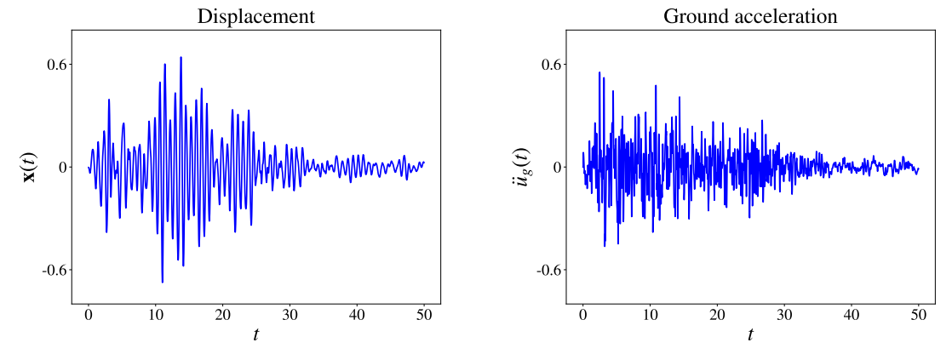

Project IV: Neural Operator for earthquake problem
x(t): displacement of the top floor for a building
: ground acceleration arising from the earthquake
Neural operator
Neural operator: DeepONet or FNO
﻿Pacific Earthquake Engineering Research Center database
https://peer.berkeley.edu/

Slide 8

Thank you for your attention!

