Slide 1


Scientific Machine Learning
Lecture 18: PINN for high-dimensional PDE problems
孟旭辉
数学与统计学院数学与应用学科交叉创新研究院
办公室：欣苑2栋111室
Email：xuhui_meng@hust.edu.cn
https://github.com/XuhuiM/SciML-Course

Slide 2

Monte Carlo physics-informed neural networks for multiscale heat conduction via phonon Boltzmann transport equation
Lin et al., arxiv, 2024

Slide 3
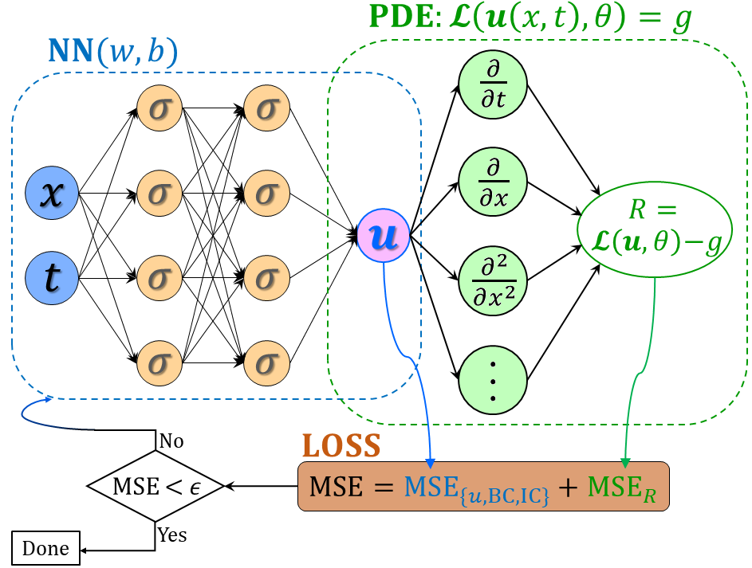


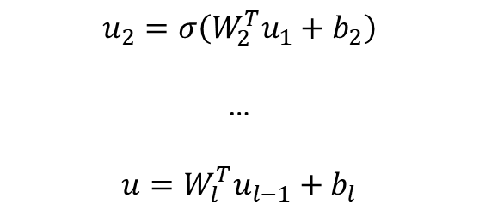

From DNNs to PINNs
$$u_{1}=σ(W_{1}^{T}X+b_{1})$$
(1)
$$u_{2}=σ\left(W_{2}^{T}u_{1}+b_{2}\right)$$
…
$$u=W_{l}^{T}u_{l−1}+b_{l}$$
(2) PDE part: Chain rule
$$∂_{t}u, ∂_{x}u, …$$
Loss function:
Forward problem:
$$L={\min_{θ}⁡(R^{2}+|u_{bc}^{∗}−u_{bc}|}^{2}+{\left|u_{ic}^{∗}−u_{ic}\right|}^{2})$$
Inverse problem:
$$L={\min_{θ,λ}⁡(R^{2}+|u_{bc}^{∗}−u_{bc}|}^{2}+{\left|u_{ic}^{∗}−u_{ic}\right|}^{2}+{\left|u^{∗}−u\right|}^{2})$$
Unified framework for forward and inverse PDE problems
No mesh for computations of derivatives
Raissi, et al, JCP, 2019
Meng, et al, CMAME, 2020

Slide 4
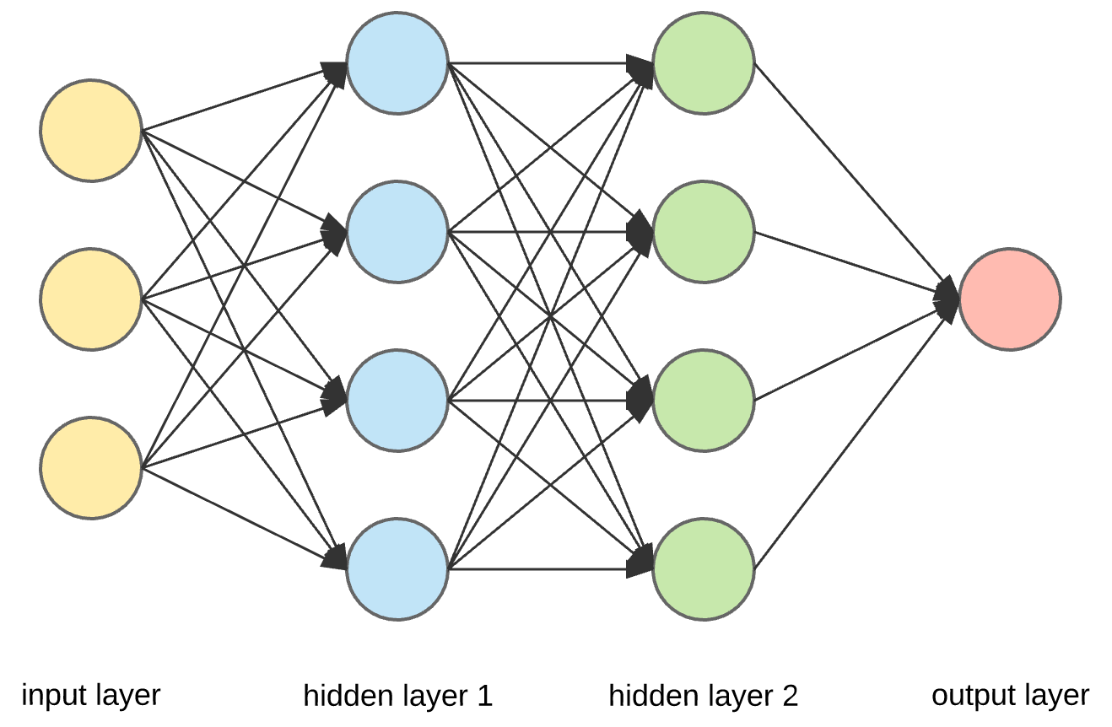


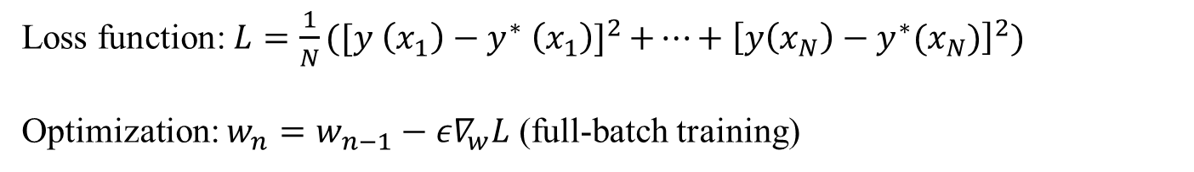









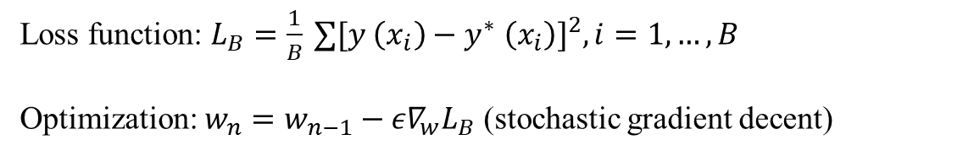
Mini-batch training – stochastic gradient descent
$$σ$$
$$σ$$
$$y_{1}=σ(W_{1}^{T}x+b_{1})$$
$$σ$$
$$σ$$
$$y_{2}=σ\left(W_{2}^{T}y_{1}+b_{2}\right)$$
…
$$y=W_{l}^{T}y_{l−1}+b_{l}$$
$$y$$
$$σ$$
$$σ$$
$$σ$$
$$σ$$
Loss function: $L=\frac{1}{N}{⁡([y \left(x_{1}\right)−y^{∗} \left(x_{1}\right)]}^{2}+…+{\left[y\left(x_{N}\right)−y^{∗}(x_{N})\right]}^{2})$
Optimization: $w_{n}=w_{n−1}−{ε∇}_{w}L$ (full-batch training)
Mini-batch training
Loss function: $L_{B}=\frac{1}{B}{⁡∑[y \left(x_{i}\right)−y^{∗} \left(x_{i}\right)]}^{2},i=1,…,B$
Optimization: $w_{n}=w_{n−1}−{ε∇}_{w}L_{B}$ (stochastic gradient decent)

Slide 5

Outline
Deep neural networks (DNNs): Universal Approximation Theorem
Monte Carlo PINNs for solving phonon Boltzmann equation
Numerical experiments
Summary

Slide 6
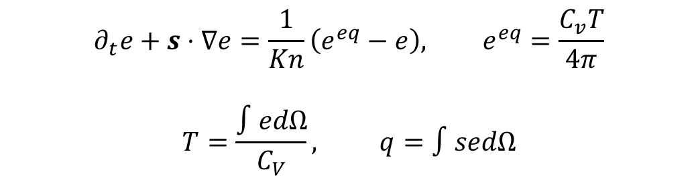
Phonon Boltzmann transport equation
$$∂_{t}e+s⋅∇e=\frac{1}{Kn}\left(e^{eq}−e\right), e^{eq}=\frac{C_{v}T}{4π}$$
$$T=\frac{∫edΩ}{C_{V}}, q=∫sedΩ$$
Stochastic method
Deterministic method
DSMC
Free of ray effect
DVM
Curse of dimensionality
Lin, et al. arxiv, 2024

Slide 7
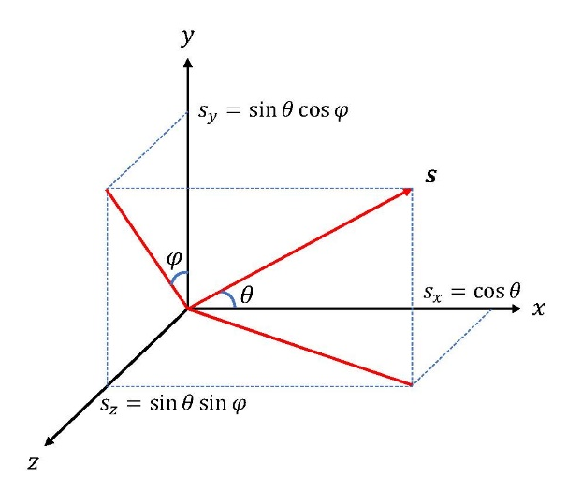
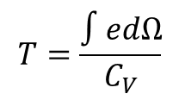
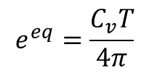

Monte Carlo PINNs for phonon BTE
${\left(t,x,s\right)}_{i}, i=1,…,N$
Popular sampling approach in PINNs: Randomly select B points at each step
$$e^{eq}=\frac{C_{v}T}{4π}$$
s
$$T=\frac{∫edΩ}{C_{V}}$$
x
Lin, et al. arxiv, 2024

Slide 8
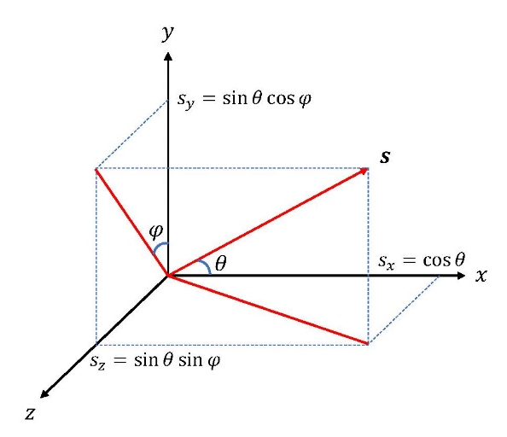
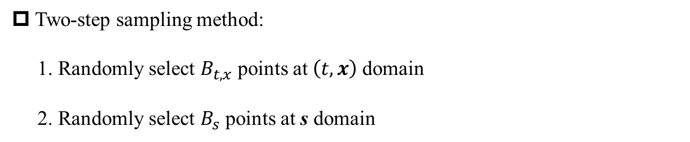
Two-step sampling method in MC-PINNs
Two-step sampling method:
1. Randomly select $B_{t,x}$ points at $\left(t,x\right)$domain
2. Randomly select $B_{s}$ points at s domain
$$e^{eq}=\frac{C_{v}T}{4π}$$
s
$$T=\frac{∫edΩ}{C_{V}}$$
x
Lin, et al. arxiv, 2024

Slide 9
Gradients unbiasedness and convergence
mini-batch
Garrigos, et al., arxiv, 2023
Lin, et al. arxiv, 2024

Slide 10
Outline
Deep neural networks (DNNs): Universal Approximation Theorem
Monte Carlo PINNs for solving phonon Boltzmann equation
Numerical experiments: Forward problems
Summary

Slide 11

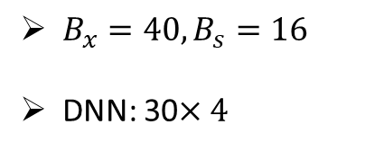
MC-PINNs for 1D steady multiscale heat conduction
$B_{x}=40, B_{s}=16$
DNN: 30$×4$
$$Kn=1 x=0, 0.5$$
Lin, et al. arxiv, 2024

Slide 12
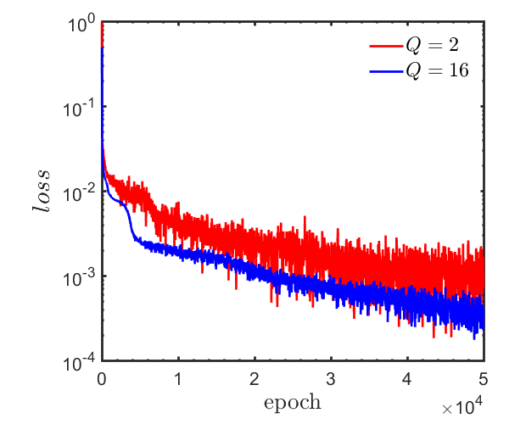
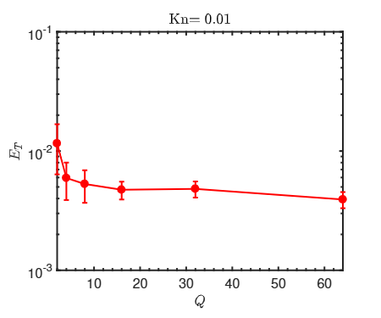
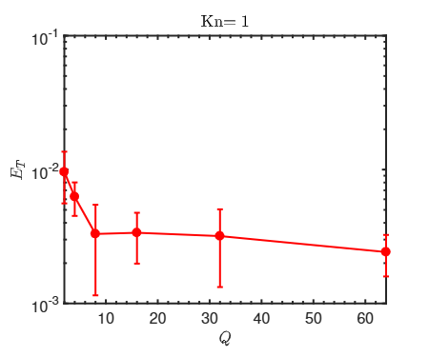
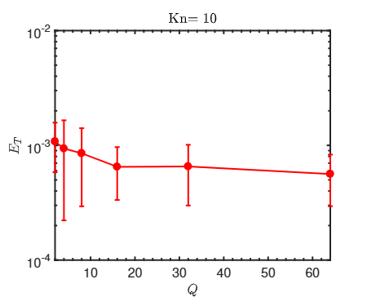
MC-PINNs: Effect of training points in angular space
Lin, et al. arxiv, 2024

Slide 13
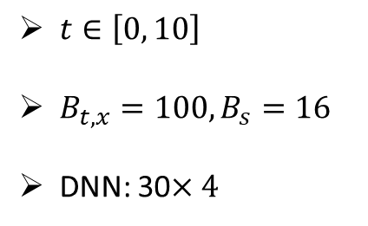



MC-PINNs for 1D unsteady multiscale heat conduction
$t∈\left[0, 10\right]$
$B_{t,x}=100, B_{s}=16$
DNN: 30$×4$
$$t=0.2$$
$$t=5$$
$$t=10$$
Lin, et al. arxiv, 2024

Slide 14
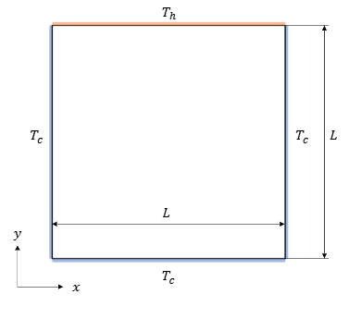
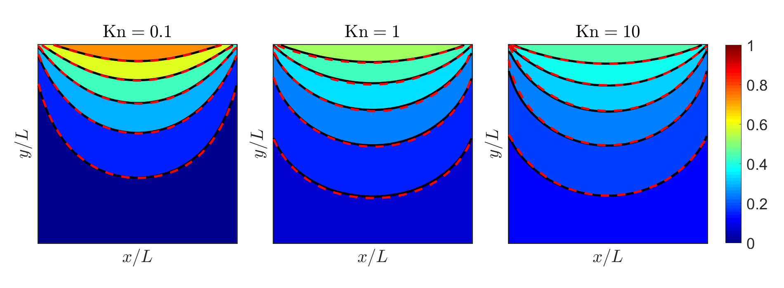
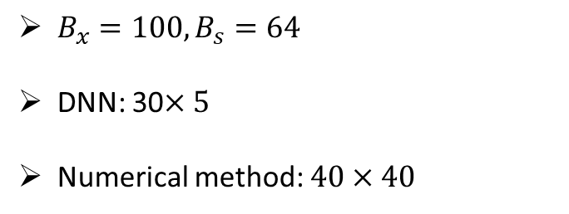
MC-PINNs for 2D multiscale heat conduction
$B_{x}=100, B_{s}=64$
DNN: 30$×5$
Numerical method: $40×40$
Lin, et al. arxiv, 2024

Slide 15
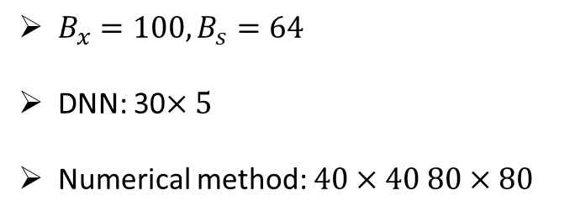
MC-PINNs for 3D multiscale heat conduction
$B_{x}=100, B_{s}=64$
DNN: 30$×5$
Numerical method: $40×40 80×80$
Lin, et al. arxiv, 2024

Slide 16
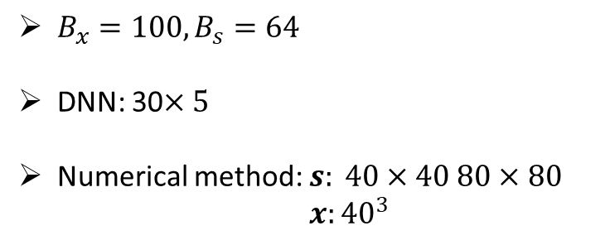
MC-PINNs for 3D multiscale heat conduction
$B_{x}=100, B_{s}=64$
DNN: 30$×5$
Numerical method: $s: 40×40 80×80$ $x:{40}^{3}$
Lin, et al. arxiv, 2024

Slide 17
Outline
Deep neural networks (DNNs): Universal Approximation Theorem
Monte Carlo PINNs for solving phonon Boltzmann equation
Numerical experiments: Inverse problems
Summary

Slide 18
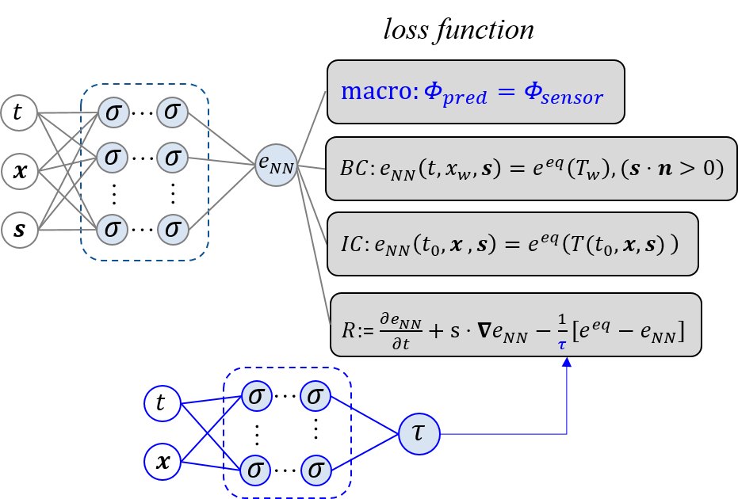

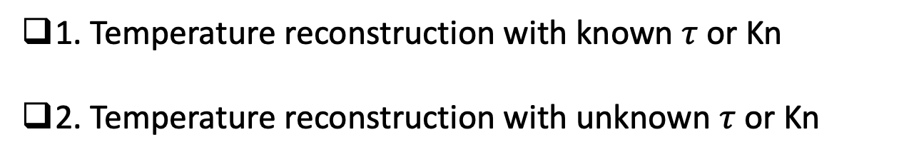
MC-PINNs for inverse multiscale heat conduction
1. Temperature reconstruction with known $τ$ or Kn
2. Temperature reconstruction with unknown $τ$ or Kn

Slide 19
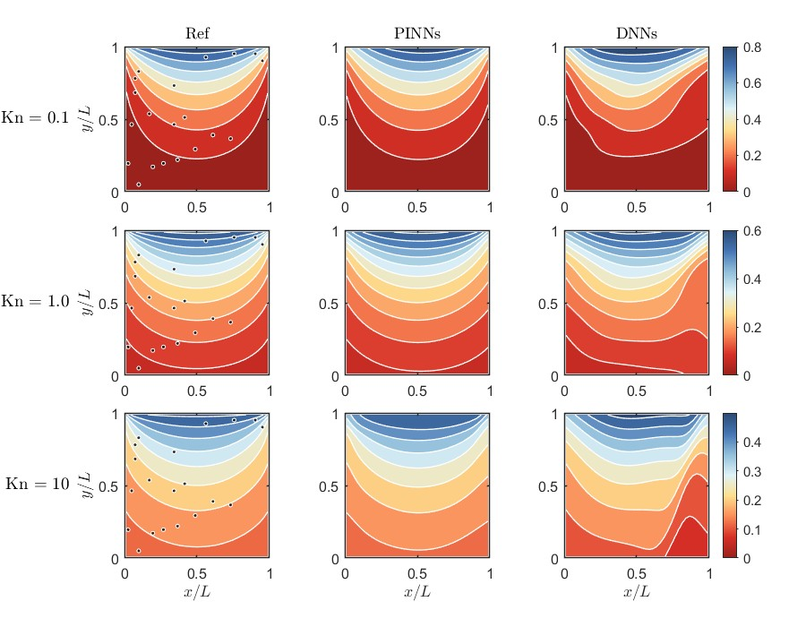
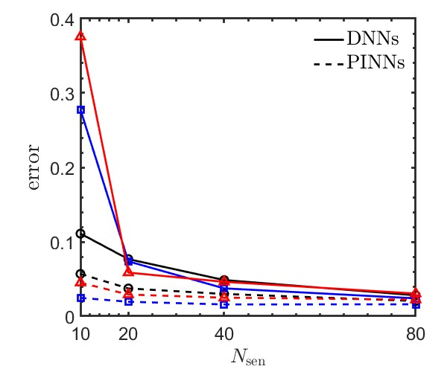

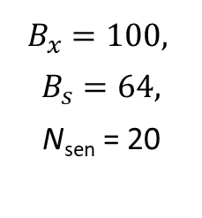
Temperature reconstruction with known $τ$ or Kn
$$B_{x}=100,$$
$$B_{s}=64,$$
$$\text{N}\text{sen}\text{ = 20}$$

Slide 20
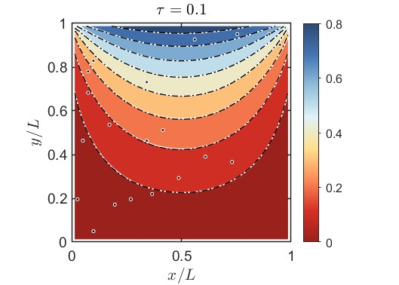
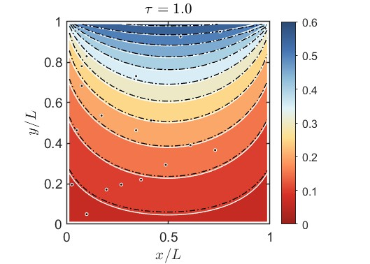
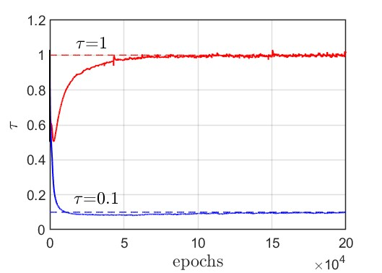
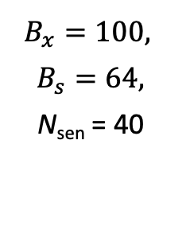
Temperature reconstruction with unknown $τ$ or Kn
$$B_{x}=100,$$
$$B_{s}=64,$$
$$\text{N}\text{sen}\text{ = }\text{4}\text{0}$$

Slide 21
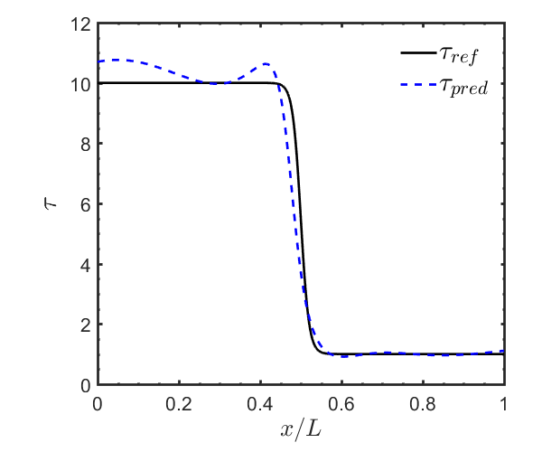
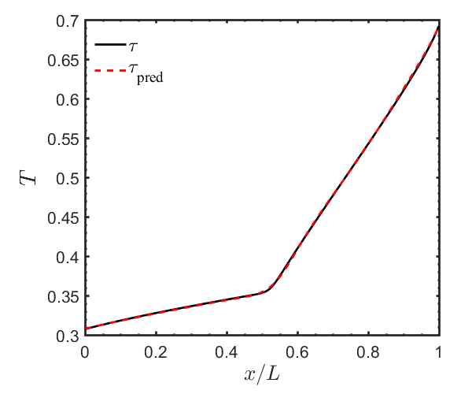
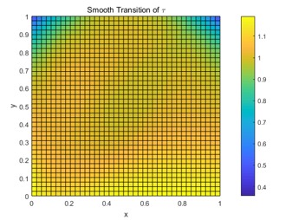
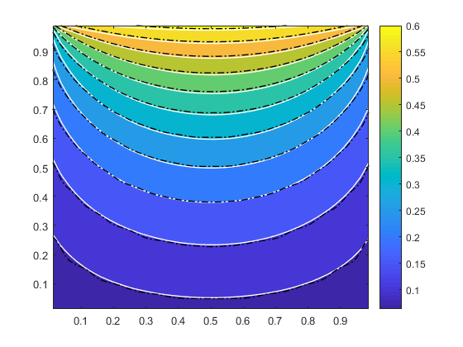
Temperature reconstruction with unknown $τ$ or Kn
Inverse
quasi-1D
problem
Inverse
quasi-2D
problem

Slide 22
From DNNs to PINNs
$$u_{1}=σ(W_{1}^{T}X+b_{1})$$
(1)
$$u_{2}=σ\left(W_{2}^{T}u_{1}+b_{2}\right)$$
…
$$u=W_{l}^{T}u_{l−1}+b_{l}$$
(2) PDE part: Chain rule
$$∂_{t}u, ∂_{x}u, …$$
Physics-informed neural networks (PINNs)
Loss function:
$$L={\min_{θ}⁡(R^{2}+|u_{bc}^{∗}−u_{bc}|}^{2}+{\left|u_{ic}^{∗}−u_{ic}\right|}^{2})$$
Raissi, et al, JCP, 2019
Meng, et al, CMAME, 2020

Slide 23
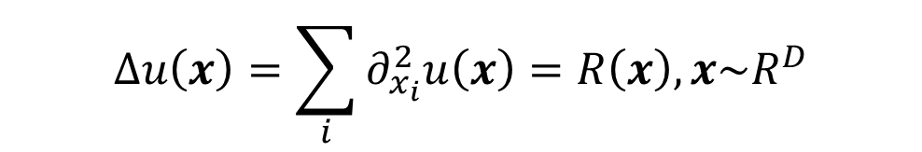
High-dimensional Poisson equation
$$Δu\left(x\right)=\sum_{i}{∂_{x_{i}}^{2}u\left(x\right)=R\left(x\right), x\sim R^{D}}$$
Memory usage:
The size of first layer ~ D
The number of second-order derivatives ~ D

Slide 24
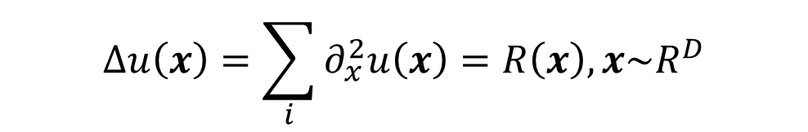
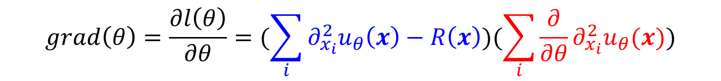
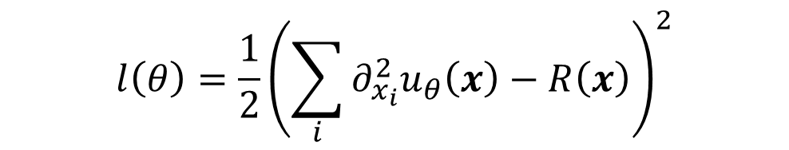
High-dimensional Poisson equation - Gradient descent
$$Δu\left(x\right)=\sum_{i}{∂_{x}^{2}u\left(x\right)=R\left(x\right), x\sim R^{D}}$$
$$l\left(θ\right)={\frac{1}{2}\left(\sum_{i}{∂_{x_{i}}^{2}u_{θ}\left(x\right)−R\left(x\right)}\right)}^{2}$$
$$grad\left(θ\right)=\frac{∂l\left(θ\right)}{∂θ}=(\sum_{i}{∂_{x_{i}}^{2}u_{θ}\left(x\right)−R\left(x\right)})(\sum_{i}{\frac{∂}{∂θ}∂_{x_{i}}^{2}u_{θ}(x)})$$

Slide 25
Tackling the curse of dimensionality with physics-informed neural networks
Neural Networks. (2024)
Zheyuan Hu, Khemraj Shukla, etc

Slide 26
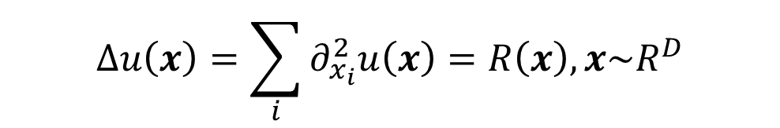
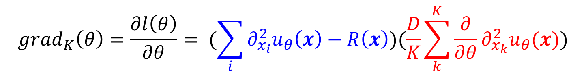
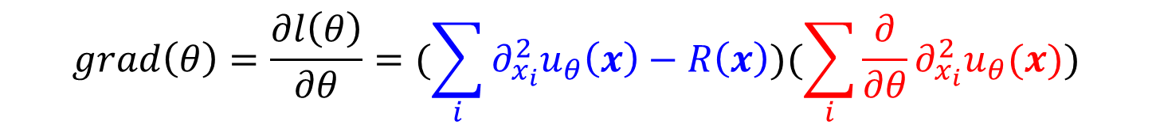
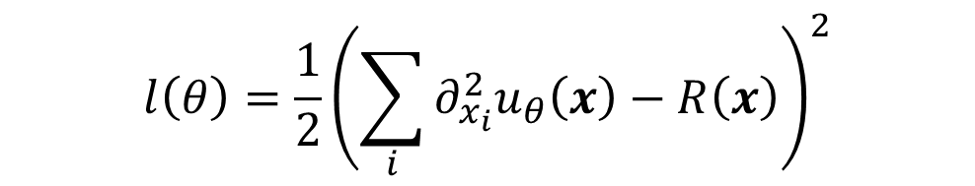
From SGD to SDGD
$$Δu\left(x\right)=\sum_{i}{∂_{x_{i}}^{2}u\left(x\right)=R\left(x\right), x\sim R^{D}}$$
$$l\left(θ\right)={\frac{1}{2}\left(\sum_{i}{∂_{x_{i}}^{2}u_{θ}\left(x\right)−R\left(x\right)}\right)}^{2}$$
$$grad\left(θ\right)=\frac{∂l\left(θ\right)}{∂θ}=(\sum_{i}{∂_{x_{i}}^{2}u_{θ}\left(x\right)−R\left(x\right)})(\sum_{i}{\frac{∂}{∂θ}∂_{x_{i}}^{2}u_{θ}(x)})$$
$$grad_{K}\left(θ\right)=\frac{∂l\left(θ\right)}{∂θ}= (\sum_{i}{∂_{x_{i}}^{2}u_{θ}\left(x\right)−R\left(x\right)})(\frac{D}{K}\sum_{k}^{K}{\frac{∂}{∂θ}∂_{x_{k}}^{2}u_{θ}(x}))$$

Slide 27
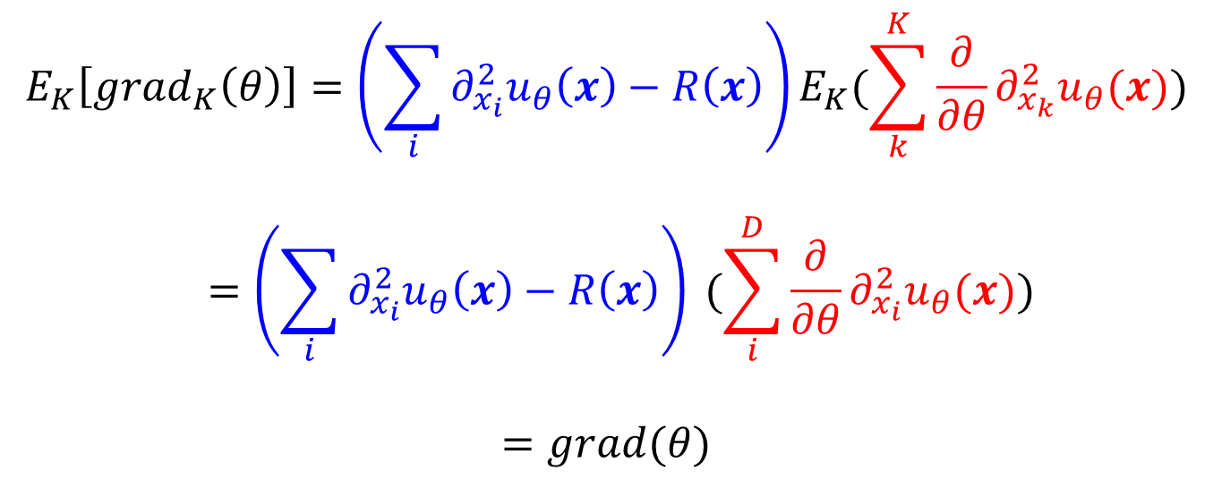

From SGD to SDGD
$$grad_{K}\left(θ\right)=\frac{∂l\left(θ\right)}{∂θ}= (\sum_{i}{∂_{x_{i}}^{2}u_{θ}\left(x\right)−R\left(x\right)})(\frac{D}{K}\sum_{k}^{K}{\frac{∂}{∂θ}∂_{x_{k}}^{2}u_{θ}(x}))$$
$$E_{K}\left[grad_{K}\left(θ\right)\right]=\left(\sum_{i}{∂_{x_{i}}^{2}u_{θ}\left(x\right)−R\left(x\right)}\right)E_{K}(\sum_{k}^{K}{\frac{∂}{∂θ}∂_{x_{k}}^{2}u_{θ}(x}))$$
$$=\left(\sum_{i}{∂_{x_{i}}^{2}u_{θ}\left(x\right)−R\left(x\right)}\right) (\sum_{i}^{D}{\frac{∂}{∂θ}∂_{x_{i}}^{2}u_{θ}(x}))$$
$$=grad(θ)$$

Slide 28
Numerical examples

Slide 29
Numerical examples

Slide 30

Thank you for your attention!

