Slide 1


Scientific Machine Learning
Course Project for SciML
孟旭辉
数学与统计学院数学与应用学科交叉创新研究院
办公室：欣苑2栋111室
Email：xuhui_meng@hust.edu.cn
https://github.com/XuhuiM/SciML-Course
6/7/2023

Slide 2
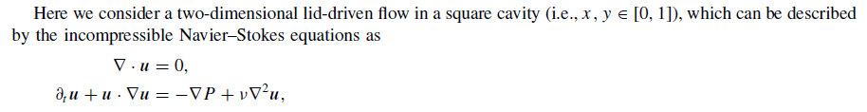

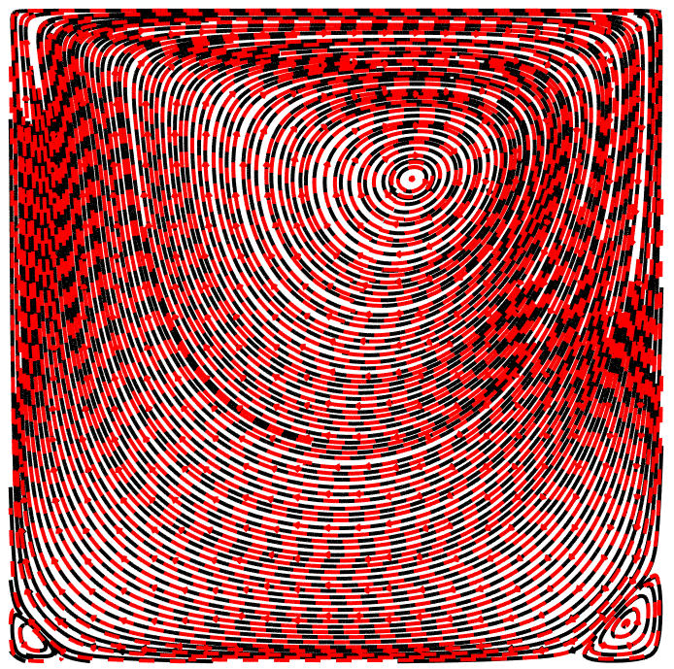
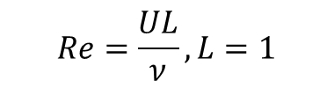
Project I: Cavity Flow
$$Re=\frac{UL}{ν}, L=1$$
Training data in github is normalized using u/U, v/U
Re = 100

Slide 3
Project I: Cavity Flow
Forward problem: Solve NS equations given boundary conditions with Re=100
Flow field reconstruction:

Slide 4
Project II: Reaction-diffusion system in porous media

Slide 5
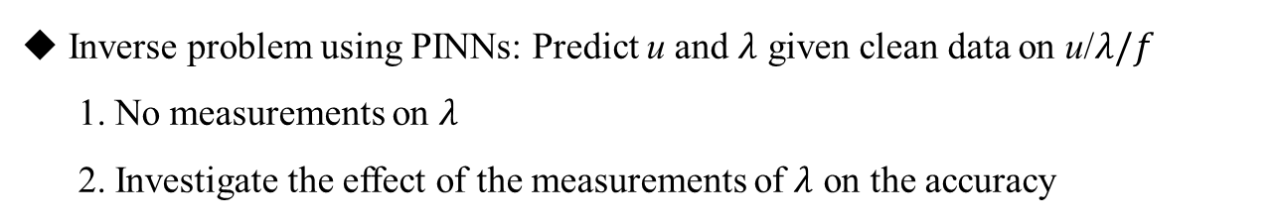
Project II: Reaction-diffusion system in porous media
Inverse problem using PINNs: Predict u and $λ$ given clean data on u/$λ/f$
1. No measurements on $λ$
2. Investigate the effect of the measurements of $λ$ on the accuracy

Slide 6
Project III: Reaction-diffusion system in porous media

Slide 7
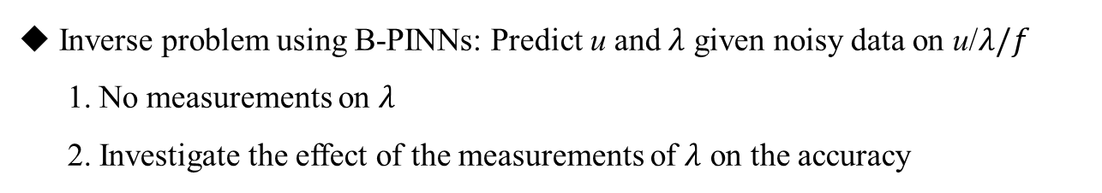
Project III: Reaction-diffusion system in porous media
Inverse problem using B-PINNs: Predict u and $λ$ given noisy data on u/$λ/f$
1. No measurements on $λ$
2. Investigate the effect of the measurements of $λ$ on the accuracy

Slide 8


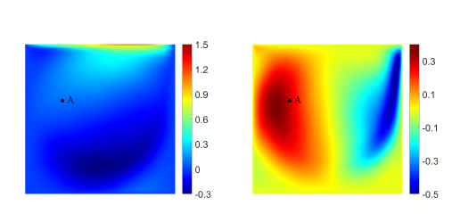

Project IV: Neural Operator for Cavity Flow
Cavity flow:
Re $→[100, 120, 140, …, 2080]$,
Input: Boundary condition at the upper wall
Output: Velocity field of the entire domain
Training: 90
Testing: 10

Slide 9
Project IV: Neural Operator for Cavity Flow
Comparison between two neural operators:
DeepONet/FNO
or
DeepONet/POD-DeepONet
or
POD-DeepONet

Slide 10

Thank you for your attention!

