Slide 1


Scientific Machine Learning
Lecture 2: On Universal Approximation Theorem
孟旭辉
数学与统计学院数学与应用学科交叉创新研究院
办公室：东32楼111室
Email：xuhui_meng@hust.edu.cn

Slide 2
Contents
Deep Neural Networks
ReLU NN with single hidden layer
On Universal Approximation Theorem

Slide 3
Contents
Deep Neural Networks
ReLU NN with single hidden layer
On Universal Approximation Theorem

Slide 4
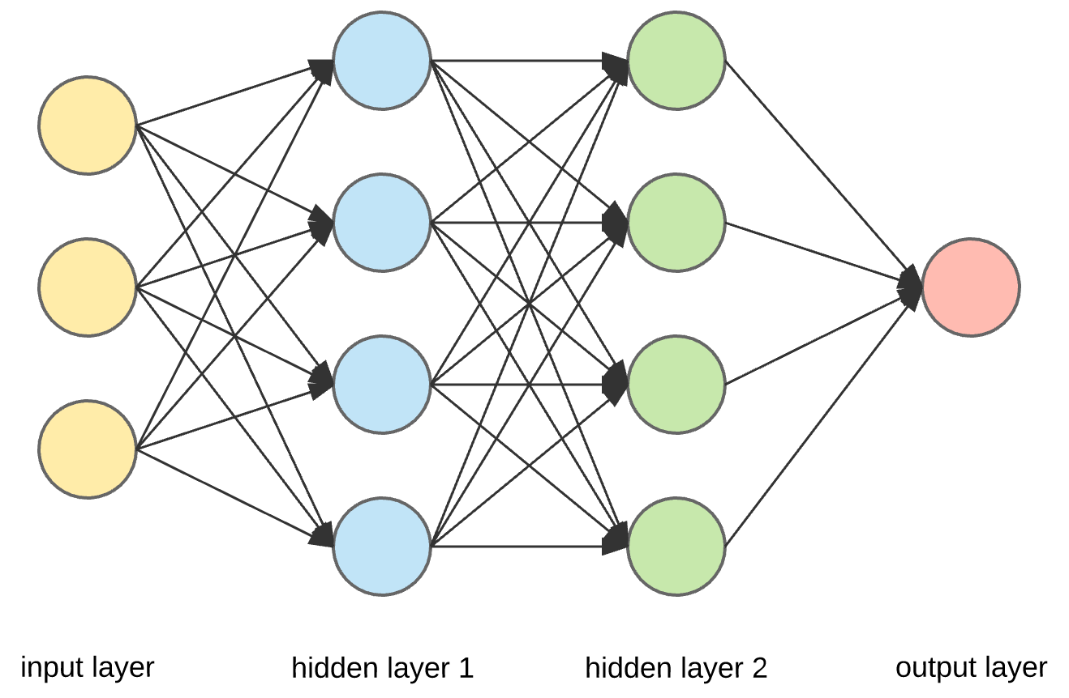














Deep Neural Networks (DNNs): Universal Approximation Theorem
$$w_{ij}$$
$$w_{ij}$$
$$σ$$
$$σ$$
$$y_{1}=σ(W_{1}^{T}x+b_{1})$$
$$w_{ij}$$
$$σ$$
$$σ$$
$$y_{2}=σ\left(W_{2}^{T}y_{1}+b_{2}\right)$$
…
$$y=W_{l}^{T}y_{l−1}+b_{l}$$
y
$$σ$$
$$σ$$
$$σ$$
$$σ$$
$$σ:sigmoid, tanh$$
Standard multilayer feedforward networks are capable of approximating any measurable function to any desired degree of accuracy
Convergence rate increases as the number of hidden units grows
K. Hornik, etc, Neural Networks, 1989

Slide 5
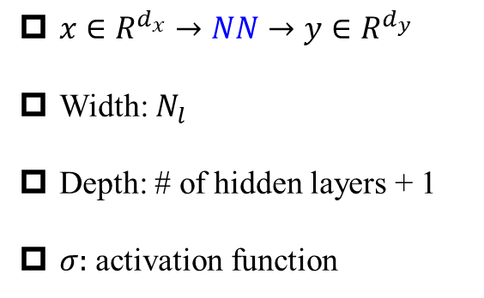
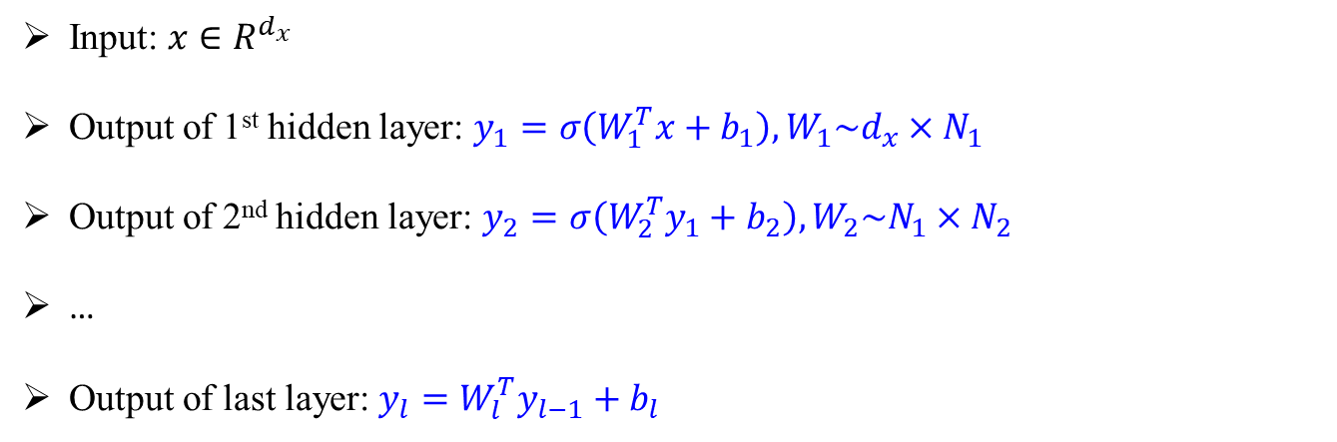
Deep Neural Networks (DNNs): Universal Approximation Theorem
$$w_{ij}$$
$$w_{ij}$$
$$σ$$
$$σ$$
$x∈R^{d_{x}}→NN→y∈R^{d_{y}}$
Width: $N_{l}$
Depth: # of hidden layers + 1
$σ:$ activation function
$$w_{ij}$$
$$σ$$
$$σ$$
y
$$σ$$
$$σ$$
$$σ$$
$$σ$$
Input: $x∈R^{d_{x}}$
Output of 1st hidden layer: $y_{1}=σ\left(W_{1}^{T}x+b_{1}\right), W_{1}\sim d_{x}×N_{1}$
Output of 2nd hidden layer: $y_{2}=σ\left(W_{2}^{T}y_{1}+b_{2}\right),W_{2}\sim N_{1}×N_{2}$
…
Output of last layer: $y_{l}=W_{l}^{T}y_{l−1}+b_{l}$
Hornik, et al, Neural Networks, 1989

Slide 6
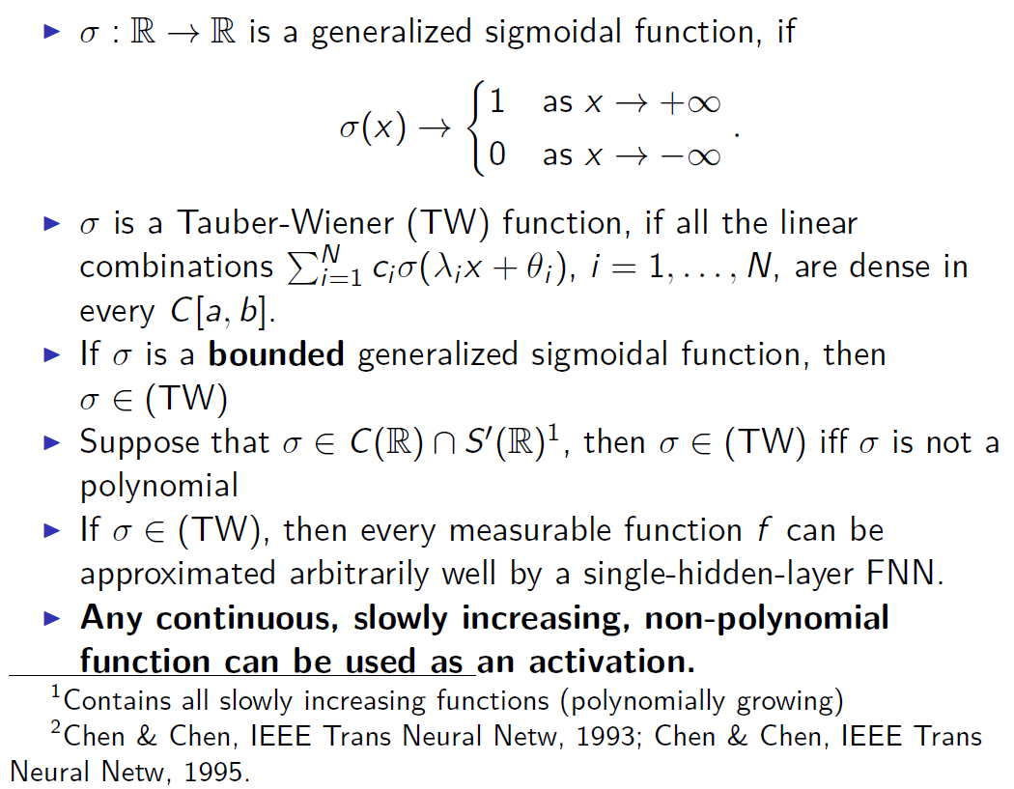
DNNs: About activation function

Slide 7
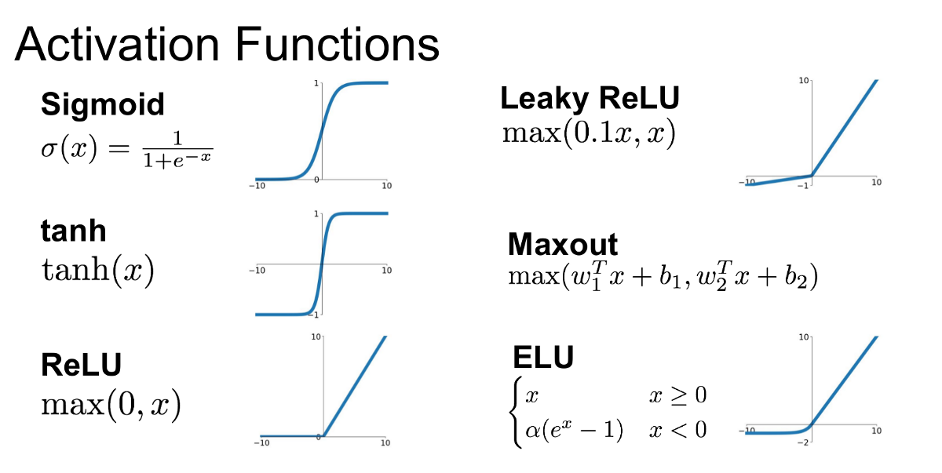
DNNs: About activation functions
Remarks:
First choice: tanh
For very deep NNs, try ReLU-type activation function first

Slide 8




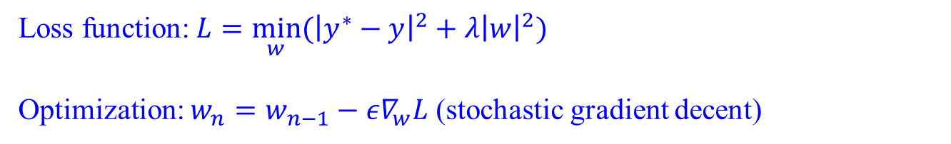
DNNs: Optimization
$$w_{ij}$$
$$w_{ij}$$
$$σ$$
$$σ$$
$$w_{ij}$$
$$y_{1}=σ(W_{1}^{T}x+b_{1})$$
$$σ$$
$$σ$$
$$y_{2}=σ\left(W_{2}^{T}y_{1}+b_{2}\right)$$
…
$$y=W_{l}^{T}y_{l−1}+b_{l}$$
y
$$σ$$
$$σ$$
$$σ$$
$$σ$$
$$σ:sigmoid, tanh$$
Standard multilayer feedforward networks are capable of approximating any measurable function to any desired degree of accuracy
Convergence rate increases as the number of hidden units grows
Loss function: $L={\min_{w}⁡(\left|y^{∗}−y\right|}^{2}+λ{\left|w\right|}^{2})$
Optimization: $w_{n}=w_{n−1}−{ε∇}_{w}L$ (stochastic gradient decent)
Hornik, et al, Neural Networks, 1989

Slide 9
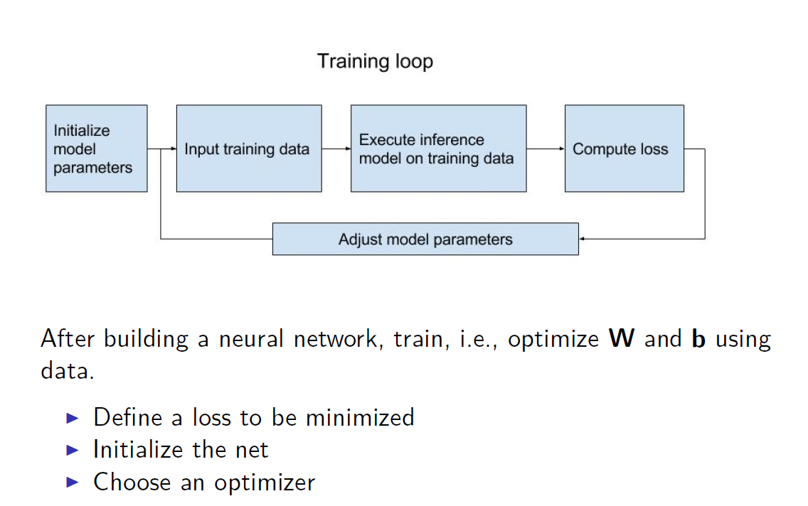
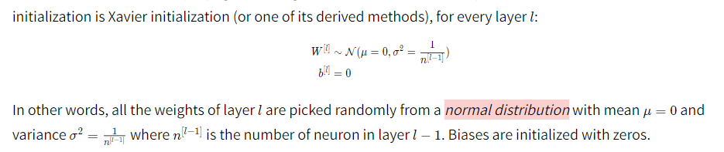
NN for regression problems
Adam

Slide 10
Contents
Deep Neural Networks
ReLU NN with single hidden layer
On Universal Approximation Theorem

Slide 11
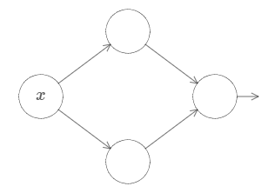
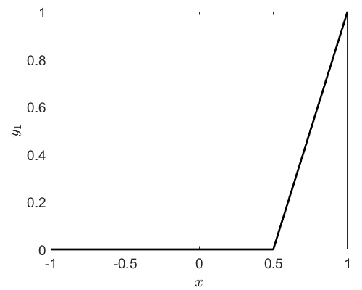
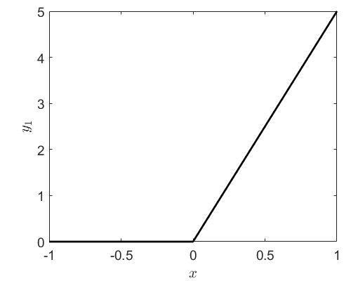





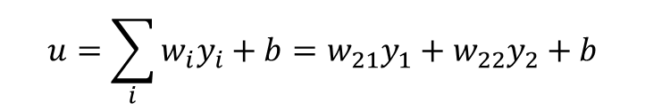



ReLU NN with a single hidden layer
$${y_{1}=ReLU(w}_{11}x+b_{11})$$
$$w_{11}x+b_{11}$$
$$w_{21}y_{1}$$
$$u=\sum_{i}{{w_{i}y}_{i}+b=w_{21}y_{1}+w_{22}y_{2}+b}$$
$$w_{12}x+b_{12}$$
$$w_{22}y_{1}$$
$${y_{2}=ReLU(w}_{12}x+b_{12})$$
$$w_{11}=2,b_{11}=−1$$
$$w_{12}=5,b_{12}=0$$

Slide 12
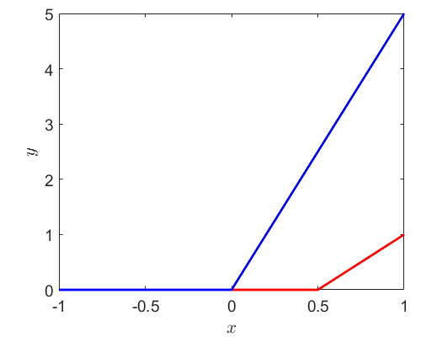
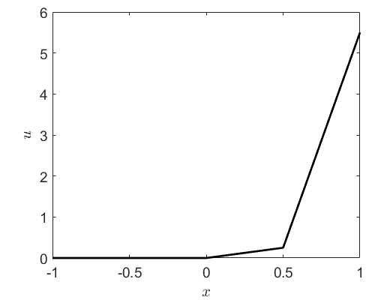



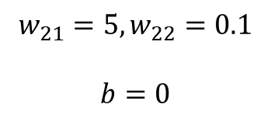

ReLU NN with a single hidden layer
$${y_{1}=ReLU(w}_{11}x+b_{11})$$
$$w_{11}x+b_{11}$$
$$w_{21}y_{1}$$
$$u=\sum_{i}{{w_{i}y}_{i}+b=w_{21}y_{1}+w_{22}y_{2}+b}$$
$$w_{12}x+b_{12}$$
$$w_{22}y_{1}$$
$${y_{2}=ReLU(w}_{12}x+b_{12})$$
$$w_{11}=2,b_{11}=−1$$
$$w_{12}=5,b_{12}=0$$
$$w_{21}=5,w_{22}=0.1$$
$$b=0$$
$$y_{2}$$
$$y_{1}$$

Slide 13
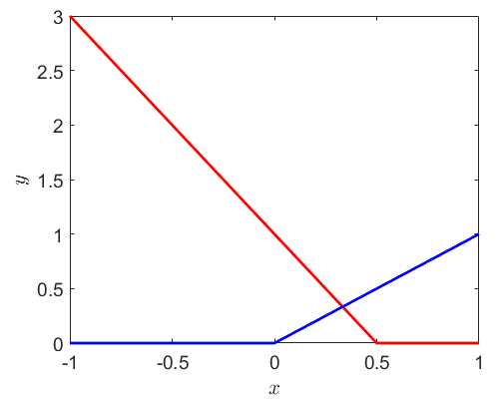
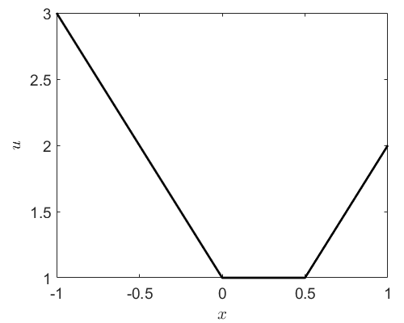
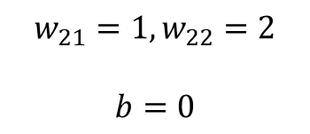


ReLU NN with a single hidden layer
$${y_{1}=ReLU(w}_{11}x+b_{11})$$
$$w_{11}x+b_{11}$$
$$w_{21}y_{1}$$
$$u=\sum_{i}{{w_{i}y}_{i}+b=w_{21}y_{1}+w_{22}y_{2}+b}$$
$$w_{12}x+b_{12}$$
$$w_{22}y_{1}$$
$${y_{2}=ReLU(w}_{12}x+b_{12})$$
$$w_{11}=−2,b_{11}=1$$
$$w_{21}=1,w_{22}=2$$
$$b=0$$
$$w_{12}=2,b_{12}=0$$

Slide 14
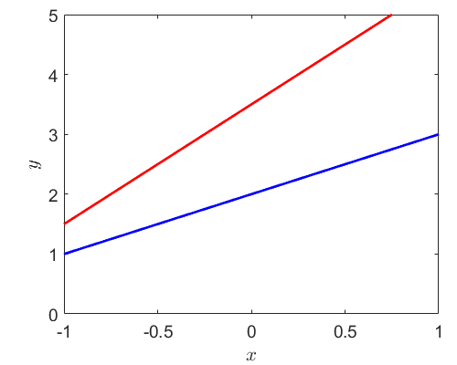
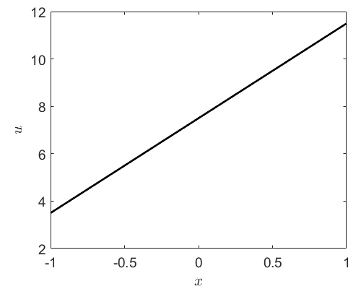



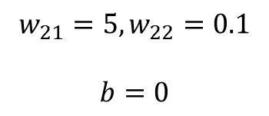

ReLU NN with a single hidden layer
$${y_{1}=ReLU(w}_{11}x+b_{11})$$
$$w_{11}x+b_{11}$$
$$w_{21}y_{1}$$
$$u=\sum_{i}{{w_{i}y}_{i}+b=w_{21}y_{1}+w_{22}y_{2}+b}$$
$$w_{12}x+b_{12}$$
$$w_{22}y_{1}$$
$${y_{2}=ReLU(w}_{12}x+b_{12})$$
$$w_{11}=2,b_{11}=3$$
$$y_{1}$$
$$w_{21}=5,w_{22}=0.1$$
$$b=0$$
$$y_{2}$$
$$w_{12}=1,b_{12}=2$$

Slide 15
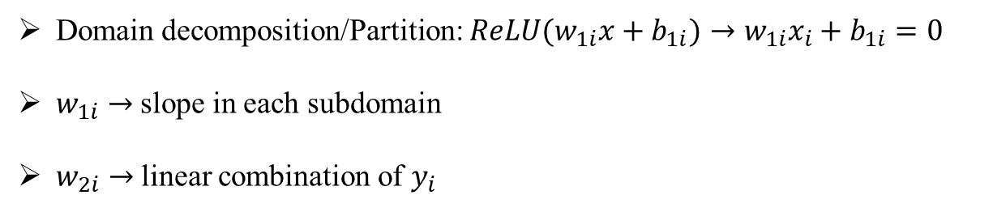
ReLU NN with a single hidden layer
$${y_{1}=ReLU(w}_{11}x+b_{11})$$
$$w_{11}x+b_{11}$$
$$w_{21}y_{1}$$
$$u=\sum_{i}{{w_{i}y}_{i}+b=w_{21}y_{1}+w_{22}y_{2}+b}$$
$$w_{12}x+b_{12}$$
$$w_{22}y_{1}$$
$${y_{2}=ReLU(w}_{12}x+b_{12})$$
Remarks:
Domain decomposition/Partition: ${ReLU(w}_{1i}x+b_{1i})→w_{1i}x_{i}+b_{1i}=0$
$w_{1i}→$ slope in each subdomain
$w_{2i}→$ linear combination of $y_{i}$

Slide 16
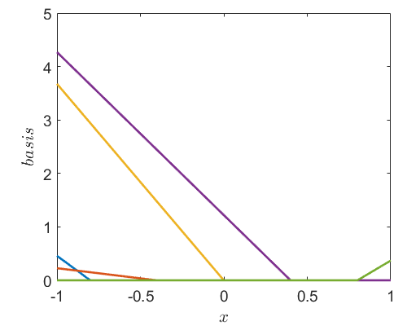




ReLU NN with a single hidden layer
$${y_{1}=ReLU(w}_{11}x+b_{11})$$
$$w_{11}x+b_{11}$$
…
$$w_{12}x+b_{12}$$
$${y_{n}=ReLU(w}_{1n}x+b_{1n})$$
3
4
5
6
1
2

Slide 17
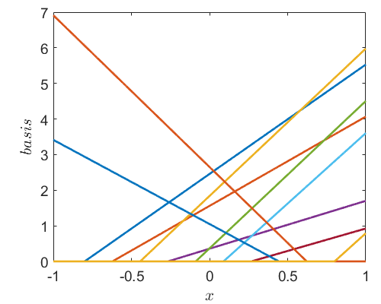
ReLU NN with a single hidden layer
$${y_{1}=ReLU(w}_{11}x+b_{11})$$
$$w_{11}x+b_{11}$$
…
$$w_{12}x+b_{12}$$
$${y_{n}=ReLU(w}_{1n}x+b_{1n})$$

Slide 18





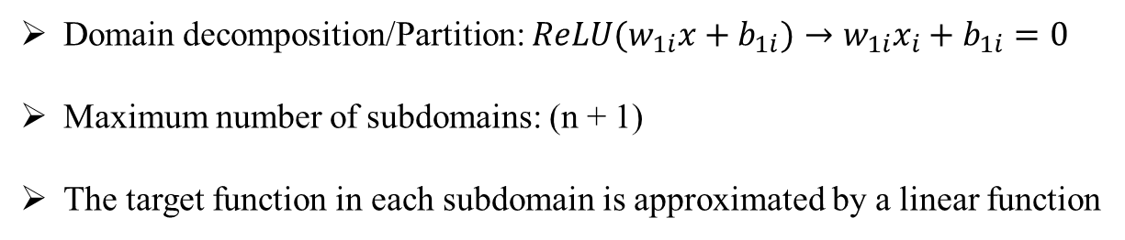
ReLU NN with a single hidden layer
$${y_{1}=ReLU(w}_{11}x+b_{11})$$
$$w_{11}x+b_{11}$$
…
$$u=\sum_{i}{{w_{i}y}_{i}+b}$$
$$w_{12}x+b_{12}$$
$${y_{n}=ReLU(w}_{1n}x+b_{1n})$$
Remarks:
Domain decomposition/Partition: ${ReLU(w}_{1i}x+b_{1i})→w_{1i}x_{i}+b_{1i}=0$
Maximum number of subdomains: (n + 1)
The target function in each subdomain is approximated by a linear function

Slide 19
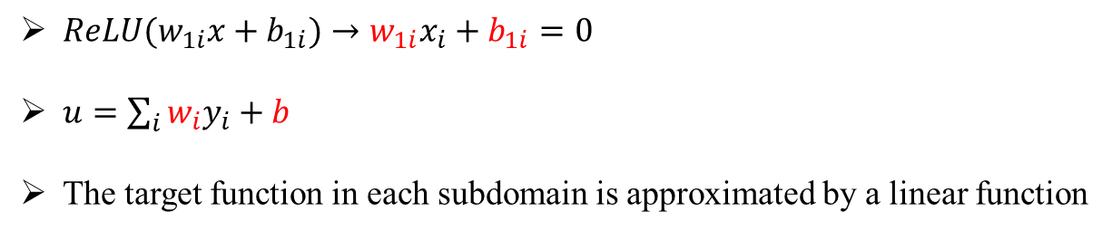
Training NNs is difficult
$${y_{1}=ReLU(w}_{11}x+b_{11})$$
$$w_{11}x+b_{11}$$
…
$$u=\sum_{i}{{w_{i}y}_{i}+b}$$
$$w_{12}x+b_{12}$$
$${y_{n}=ReLU(w}_{1n}x+b_{1n})$$
Training a neural networks:
${ReLU(w}_{1i}x+b_{1i})→w_{1i}x_{i}+b_{1i}=0$
$u=\sum_{i}{{w_{i}y}_{i}}+b$
The target function in each subdomain is approximated by a linear function

Slide 20
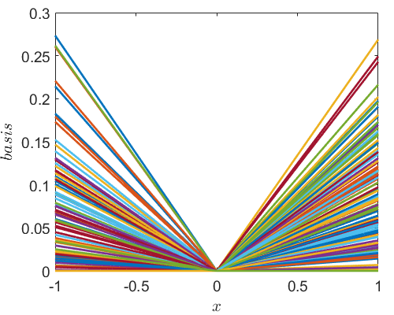
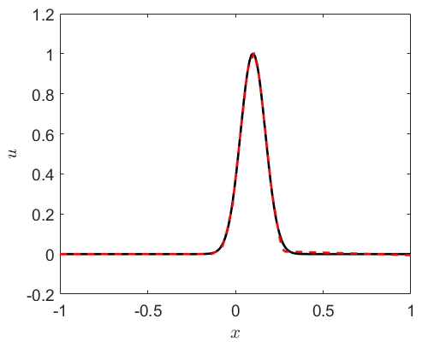
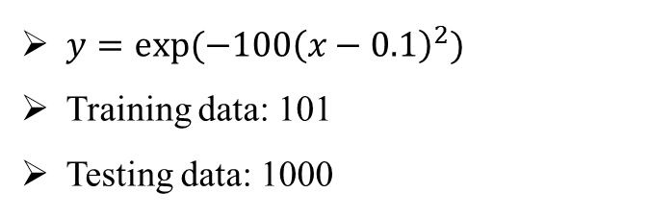
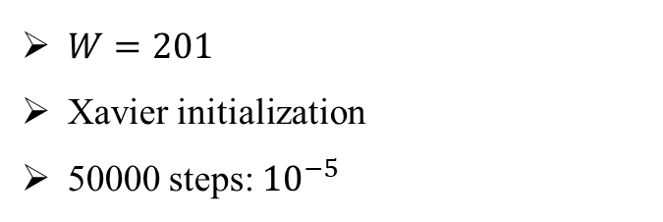
ReLU NN with a single hidden layer
$y=exp⁡(−100{\left(x−0.1\right)}^{2})$
Training data: 101
Testing data: 1000
$W=201$
Xavier initialization
50000 steps: ${10}^{−5}$

Slide 21
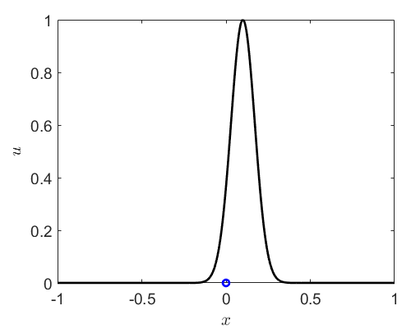
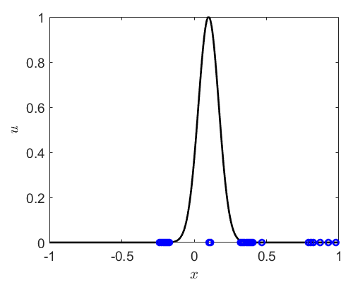
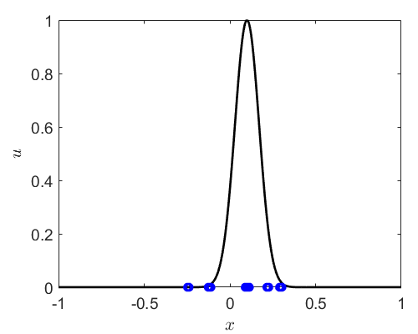
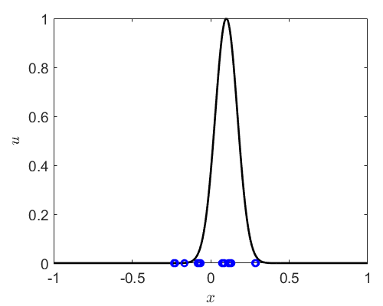
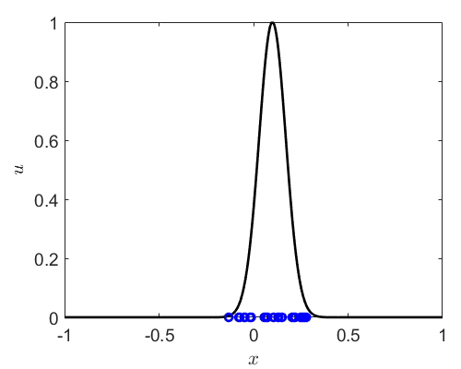

ReLU NN with a single hidden layer
$y=exp⁡(−100{\left(x−0.1\right)}^{2})$
Training data: 101
Testing data: 1000
$W=201$
step: 0
step: 100
step: 200
step: 300
step: 2000

Slide 22
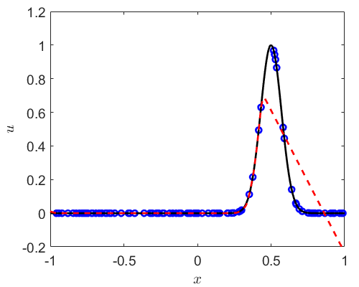
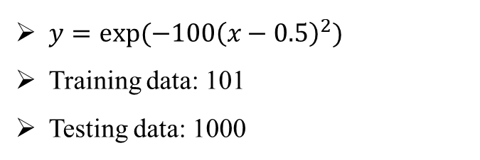
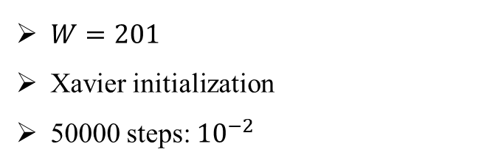
ReLU NN with a single hidden layer
$y=exp⁡(−100{\left(x−0.5\right)}^{2})$
Training data: 101
Testing data: 1000
$W=201$
Xavier initialization
50000 steps: ${10}^{−2}$

Slide 23
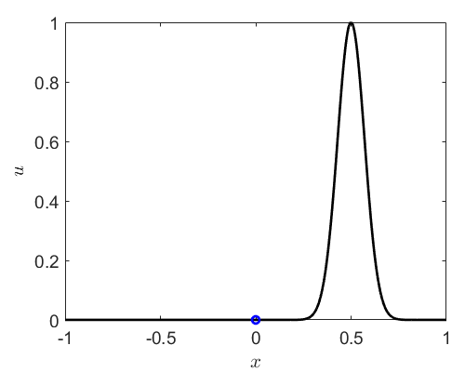
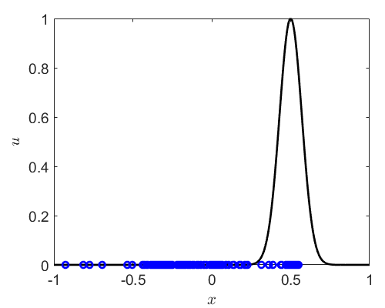
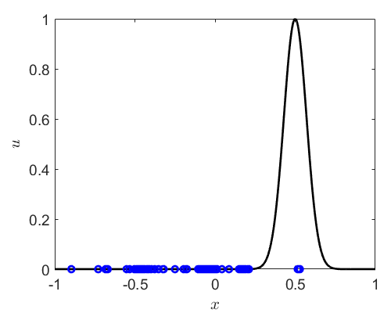
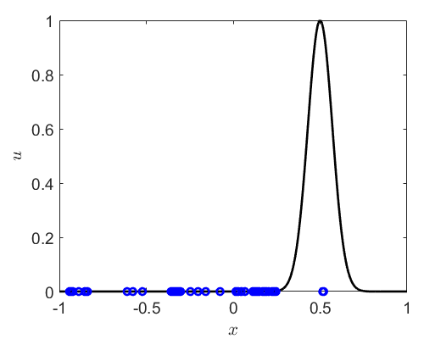
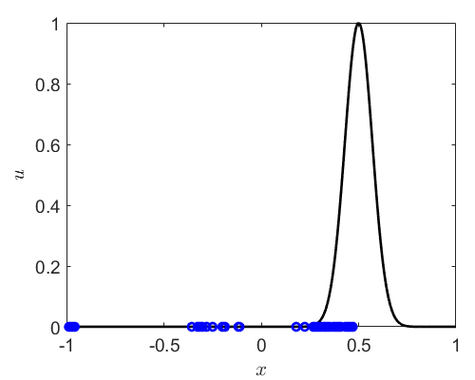
ReLU NN with a single hidden layer
$y=exp⁡(−100{\left(x−0.5\right)}^{2})$
Training data: 101
Testing data: 1000
$W=201$
step: 0
step: 100
step: 200
step: 300
step: 50000

Slide 24
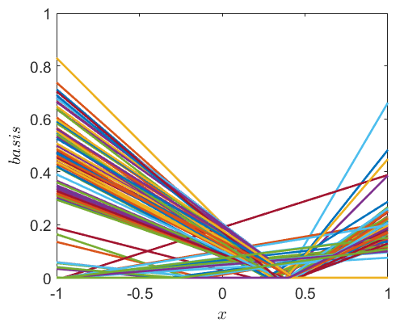
ReLU NN with a single hidden layer
$y=exp⁡(−100{\left(x−0.5\right)}^{2})$
Training data: 101
Testing data: 1000
$W=201$
step: 50000

Slide 25
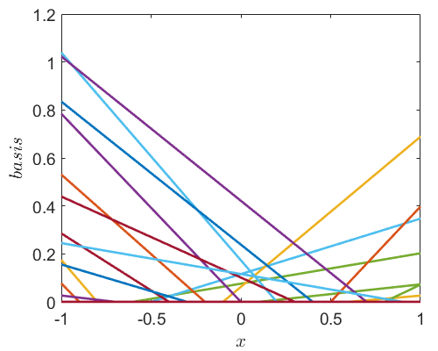
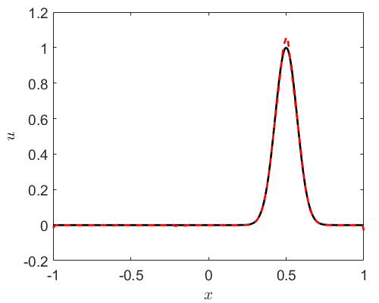
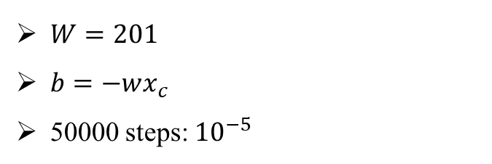
ReLU NN with a single hidden layer
$y=exp⁡(−100{\left(x−0.5\right)}^{2})$
Training data: 101
Testing data: 1000
$W=201$
$b=−wx_{c}$
50000 steps: ${10}^{−5}$

Slide 26
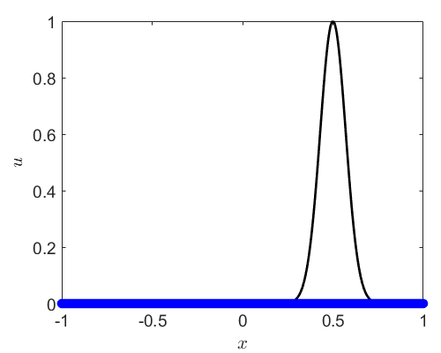




ReLU NN with a single hidden layer
$y=exp⁡(−100{\left(x−0.5\right)}^{2})$
Training data: 101
Testing data: 1000
$W=201$
step: 0
step: 100
step: 200
step: 300
step: 50000

Slide 27

ReLU NN with a single hidden layer
$y=exp⁡(−100{\left(x−0.5\right)}^{2})$
Training data: 101
Testing data: 1000
$W=201$
step: 50000

Slide 28



ReLU NN with a single hidden layer
$y=exp⁡(−100{\left(x−0.5\right)}^{2})$
Training data: 101
Testing data: 1000
$W=201$
$b=−wx_{c},x_{c}=0.5$

Slide 29






ReLU NN with a single hidden layer
$y=exp⁡(−100{\left(x−0.5\right)}^{2})$
Training data: 101
Testing data: 1000
$w=201$
step: 0
step: 100
step: 200
step: 300
step: 50000

Slide 30

ReLU NN with a single hidden layer
$y=exp⁡(−100{\left(x−0.5\right)}^{2})$
Training data: 101
Testing data: 1000
$w=201$
step: 50000

Slide 31





ReLU NN with a single hidden layer
$y=exp⁡(−100{\left(x−0.5\right)}^{2})$
Training data: 101
Testing data: 1000
$W=201$
$wx_{c}+b=0$
$$wx_{c}+b=0$$
$$x_{c}=0$$
$$x_{c}=U[−1,1]$$
$$x_{c}=0.5$$

Slide 32



ReLU NN with 2 hidden layers
$y=exp⁡(−100{\left(x−0.5\right)}^{2})$
Training data: 101
Testing data: 1000
$W=\left[20\right]∗2$
Xavier initialization

Slide 33

ReLU NN with 2 hidden layers
$y=exp⁡(−100{\left(x−0.5\right)}^{2})$
Training data: 101
Testing data: 1000
$W=\left[20\right]∗2$
Xavier initialization

Slide 34



From 1D to nD
$$wx_{c}+b=0$$

Slide 35


On Universal Approximation Theorem
$wx_{c}+b=0$: Adaptive partition
Different activation functions

Slide 36

ReLU NN with a single hidden layer
$${y_{1}=ReLU(w}_{11}x+b_{11})$$
$$w_{11}x+b_{11}$$
…
$$u=\sum_{i}{{w_{i}y}_{i}+b}$$
$$w_{12}x+b_{12}$$
$${y_{n}=ReLU(w}_{1n}x+b_{1n})$$
Convergence rate:
$$f\left(x\right)=a_{0}+a_{1}x+a_{2}x^{2}+…$$
Taylor expansion:
$$f\left(x\right)=f\left(x_{0}\right)+f^{′}\left(x_{0}\right)Δx+\frac{1}{2}f^{′′}\left(x_{0}\right)Δx^{2}+…$$
$$=f\left(x_{0}\right)+f^{′}\left(x_{0}\right)Δx+O(Δx^{2})$$

Slide 37

Thank you for your attention!

