Slide 1
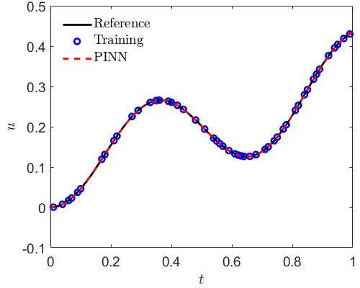
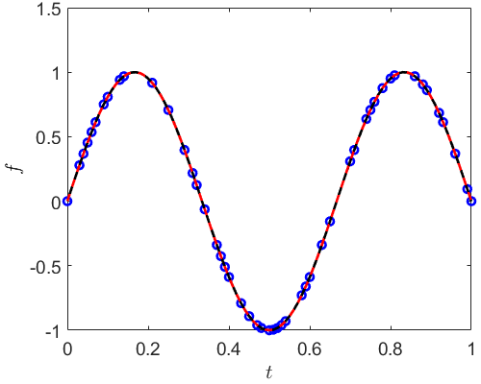
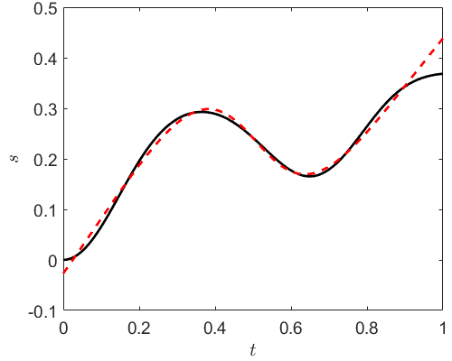

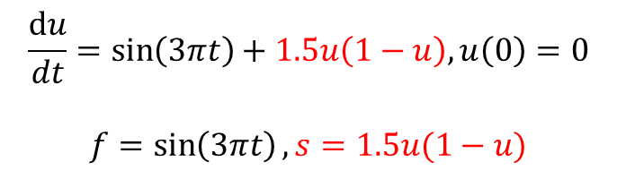
Identify the unknown source term using PINNs
$$\frac{du}{dt}=\sin\left(3πt\right)+1.5u\left(1−u\right), u\left(0\right)=0$$
$$f=\sin\left(3πt\right), s=1.5u(1−u)$$
$$u≈NN_{u}(t), s≈NN_{s}(t)$$
u: 50 measurements f: 50 measurements (clean data)

Slide 2
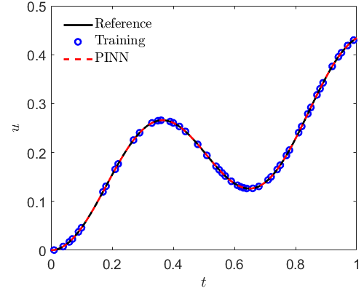
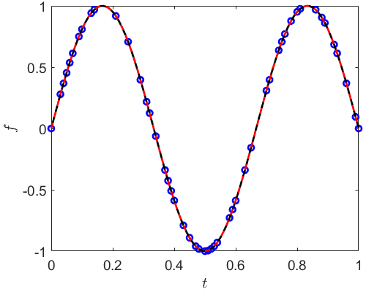
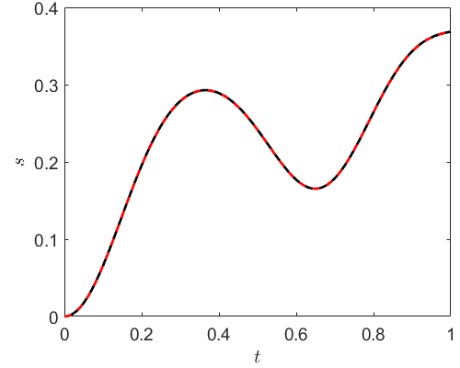

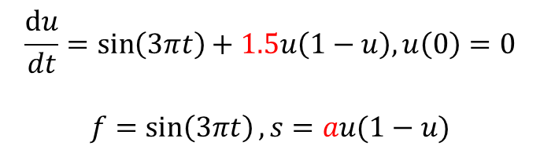
Identify the unknown source term using PINNs
$$\frac{du}{dt}=\sin\left(3πt\right)+1.5u\left(1−u\right), u\left(0\right)=0$$
$$f=\sin\left(3πt\right), s=au(1−u)$$
$$u≈NN_{u}(t)$$
u: 50 measurements f: 50 measurements (clean data)
$$a=1.4988$$

Slide 3
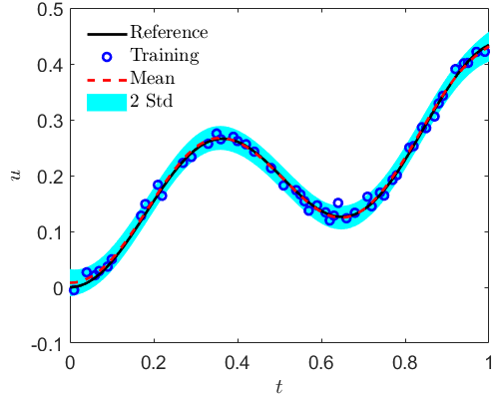
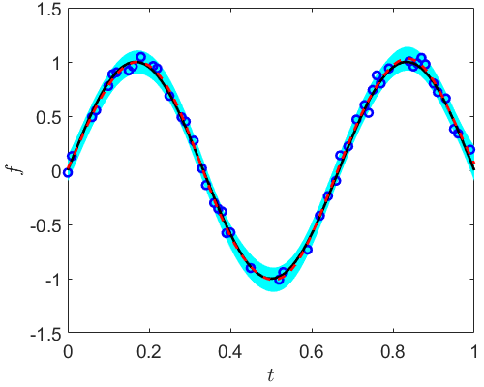
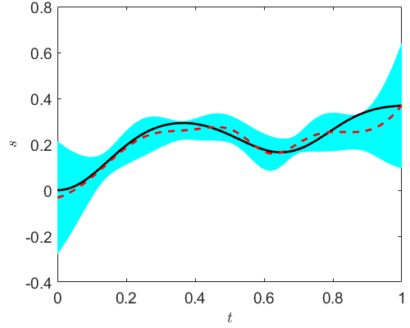

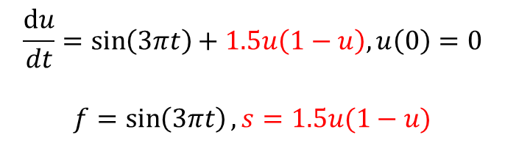
Identify the unknown source term using B-PINNs
$$\frac{du}{dt}=\sin\left(3πt\right)+1.5u\left(1−u\right), u\left(0\right)=0$$
$$f=\sin\left(3πt\right), s=1.5u(1−u)$$
$$u≈BNN_{u}(t), s≈BNN_{s}(t)$$
u: 50 measurements f: 50 measurements (noisy data)

Slide 4


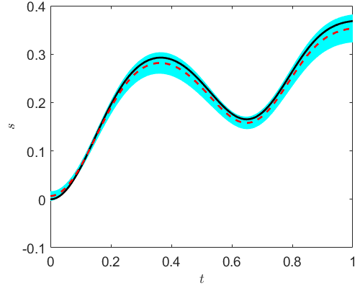



Identify the unknown source term using B-PINNs
$$\frac{du}{dt}=\sin\left(3πt\right)+1.5u\left(1−u\right), u\left(0\right)=0$$
$$f=\sin\left(3πt\right), s=au(1−u)$$
$$u≈BNN_{u}(t)$$
u: 50 measurements f: 50 measurements (noisy data)
$$a=1.437±0.057(mean±std)$$

Slide 5
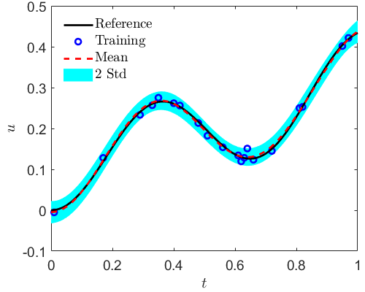
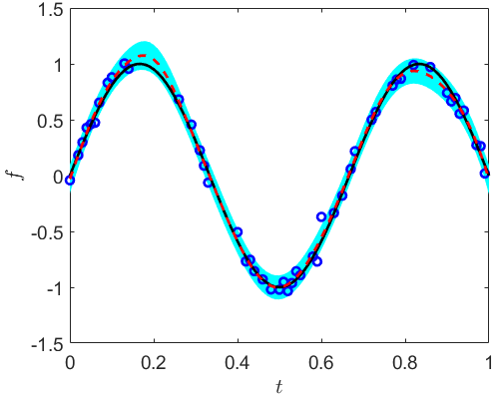
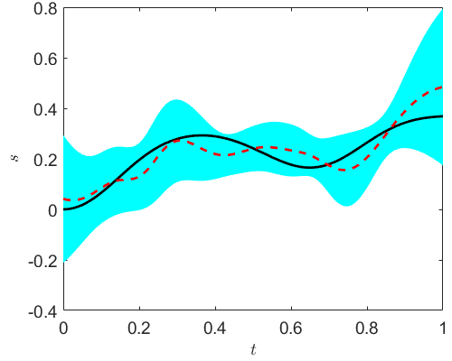
Identify the unknown source term using B-PINNs
$$\frac{du}{dt}=\sin\left(3πt\right)+1.5u\left(1−u\right), u\left(0\right)=0$$
$$f=\sin\left(3πt\right), s=1.5u(1−u)$$
$$u≈BNN_{u}(t), s≈BNN_{s}(t)$$
u: 20 measurements f: 50 measurements (noisy data)

