Slide 1


Scientific Machine Learning
Lecture 13: Neural Operator-Learning operators using neural networks
孟旭辉
数学与统计学院数学与应用学科交叉创新研究院
办公室：欣苑2栋111室
Email：xuhui_meng@hust.edu.cn
https://github.com/XuhuiM/SciML-Course

Slide 2
Contents
Neural Operator
DeepONet: Deep operator networks
FNO: Fourier Neural Operator
…

Slide 3
Contents
Neural Operator
DeepONet: Deep operator networks
FNO: Fourier Neural Operator
…

Slide 4
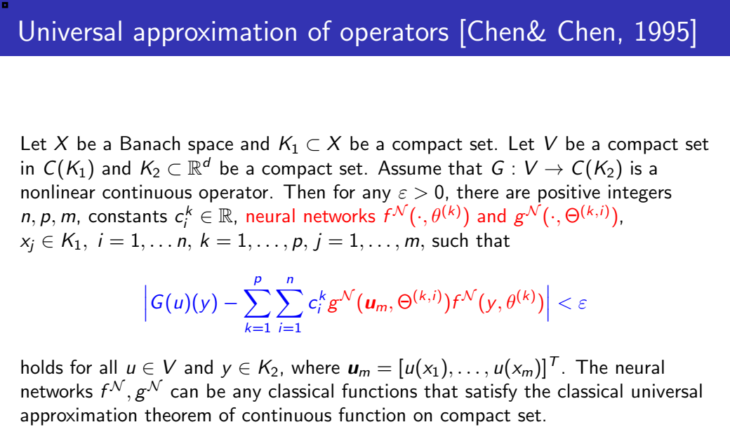
Deep Operator Networks (DeepONet)
Chen, et al., 1995

Slide 5
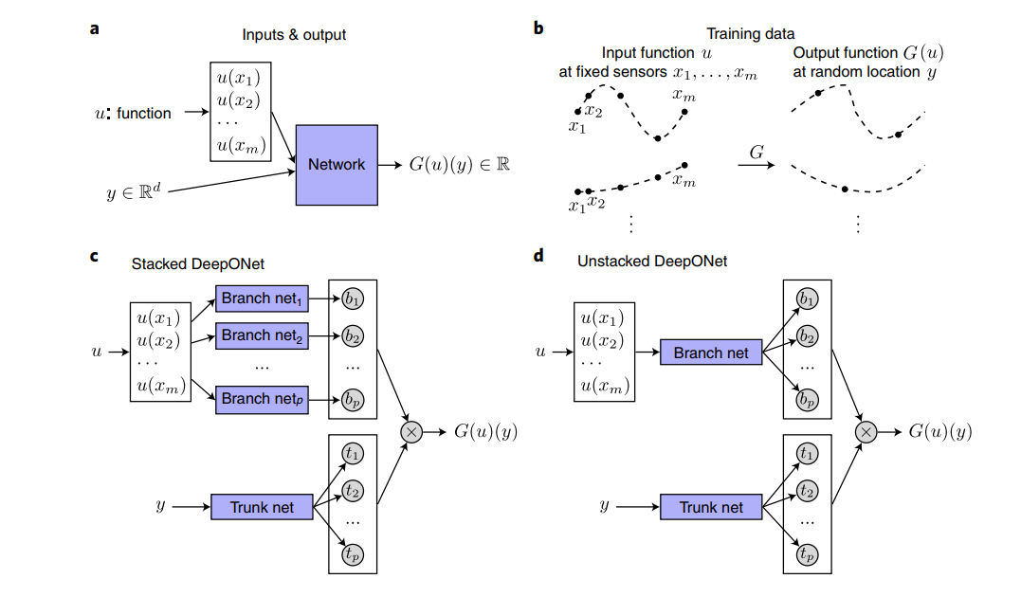
Deep Operator Networks (DeepONet)
Lu, et al., 2021

Slide 6
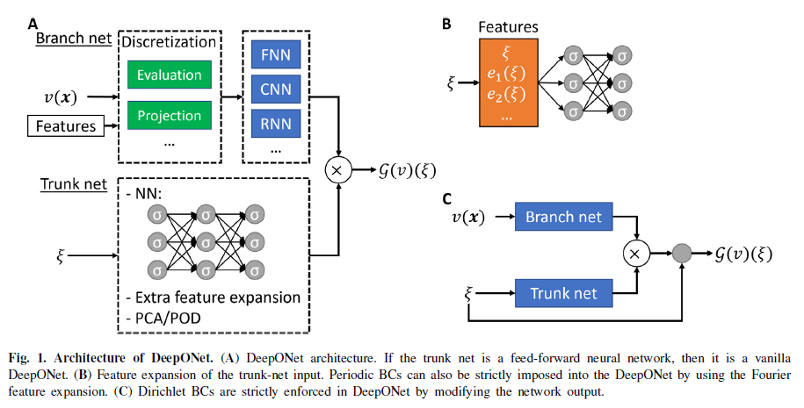
Extensions of DeepONet
Lu&Meng&Cai, et al., CMAME, 2022

Slide 7
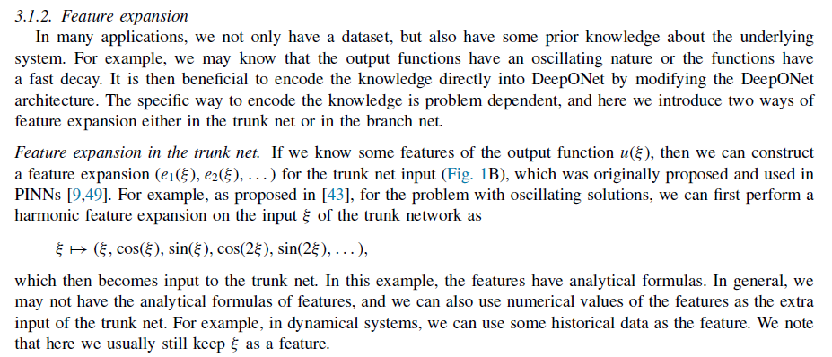
Extensions of DeepONet
Lu&Meng&Cai, et al., CMAME, 2022

Slide 8
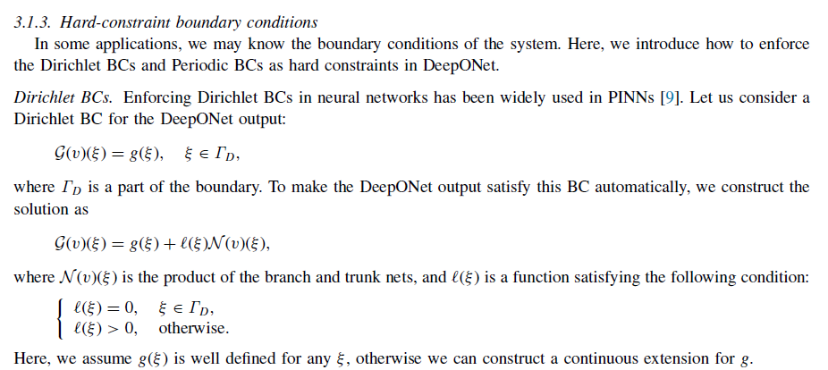
Extensions of DeepONet
Lu&Meng&Cai, et al., CMAME, 2022

Slide 9
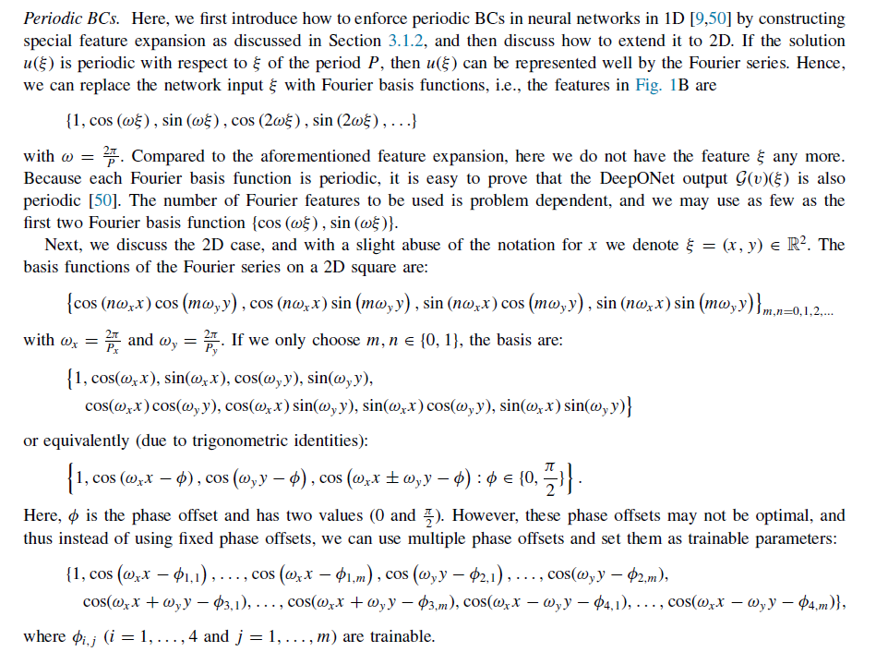
Extensions of DeepONet
Lu&Meng&Cai, et al., CMAME, 2022

Slide 10
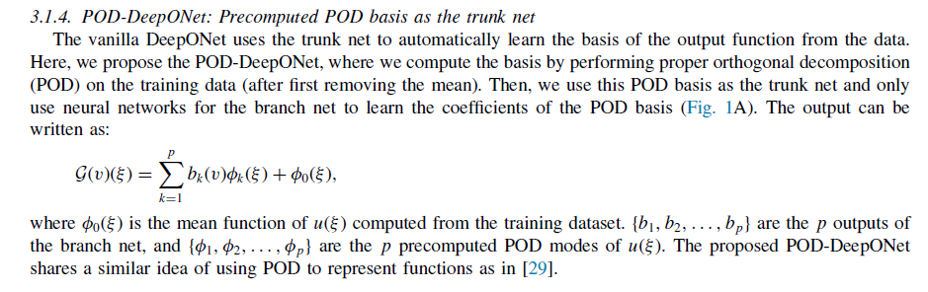
Extensions of DeepONet
Lu&Meng&Cai, et al., CMAME, 2022

Slide 11
Contents
Neural Operator
DeepONet: Deep operator networks
FNO: Fourier Neural Operator
…

Slide 12
Fourier Neural Operator
Z. Li, et al., ICLR, 2020

Slide 13
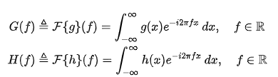

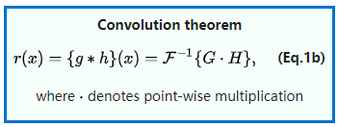
Convolution Theorem
From Wiki

Slide 14
Fourier Neural Operator
$$u\left(x\right)=∫G_{a}\left(x−y\right)f\left(y\right)dy$$
$$u\left(x\right)=∫G_{a}\left(x−y\right)f\left(y\right)dy=F^{−1}(G\left(\hat{f}\right)⋅f(\hat{f}))$$
Z. Li, et al., ICLR, 2021

Slide 15
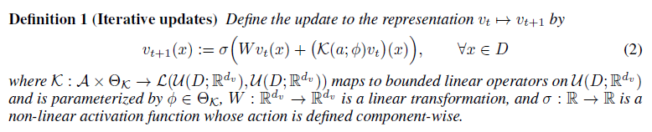

Fourier Neural Operator
$$v\left(x\right)→u(x)$$
Z. Li, et al., ICLR, 2021

Slide 16
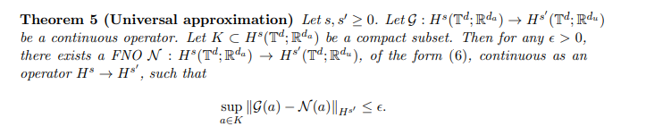
FNO: Universal Approximation
Kovichki, et al., JML, 2021

Slide 17
FNO: Universal Approximation
Kovichki, et al., JML, 2021

Slide 18
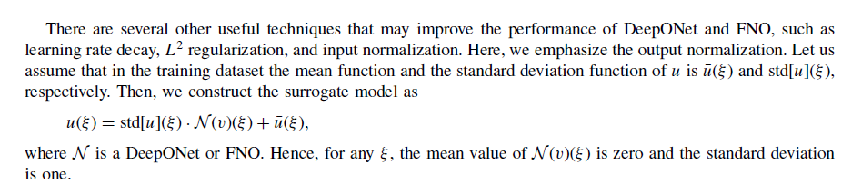
Normalization of training data

Slide 19

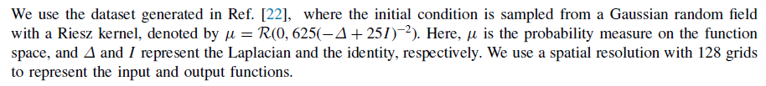
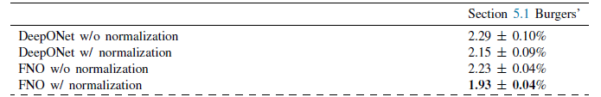
DeepONet vs FNO: Burgers equation
Lu&Meng&Cai, et al., CMAME, 2022

Slide 20
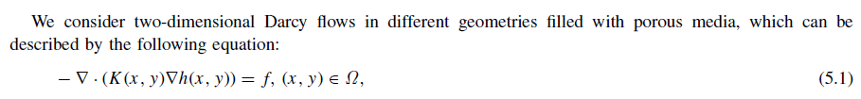
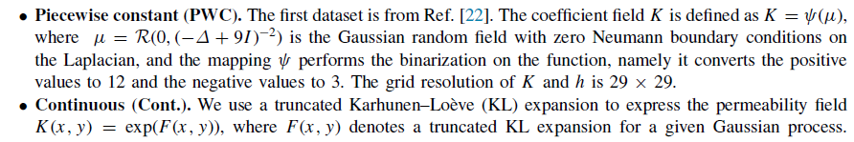
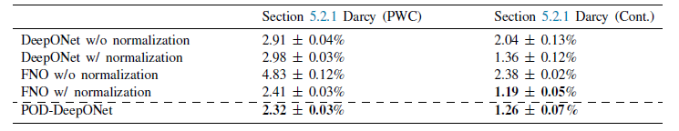
DeepONet vs FNO: Darcy Problem
$$G:K\left(x,y\right)→h(x,y)$$
Lu&Meng&Cai, et al., CMAME, 2022

Slide 21
DeepONet vs FNO: Darcy Problem
$$G:K\left(x,y\right)→h(x,y)$$
Lu&Meng&Cai, et al., CMAME, 2022

Slide 22
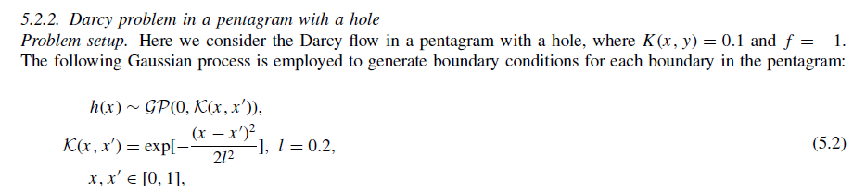
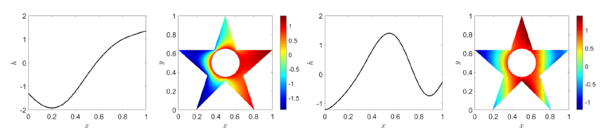
DeepONet vs FNO: Darcy Problem
Lu&Meng&Cai, et al., CMAME, 2022

Slide 23
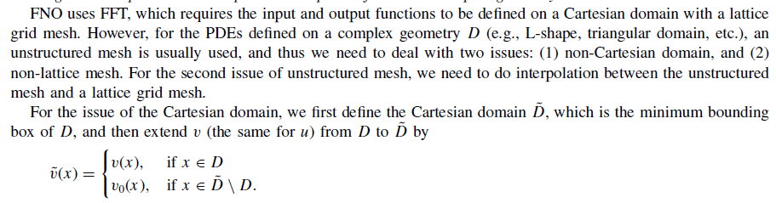
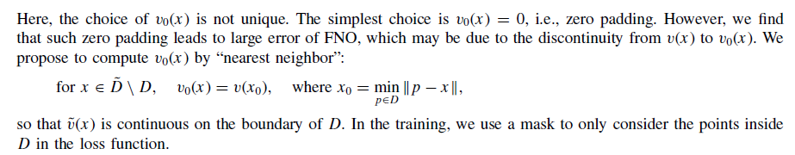
DeepONet vs FNO: Darcy Problem
Lu&Meng&Cai, et al., CMAME, 2022

Slide 24
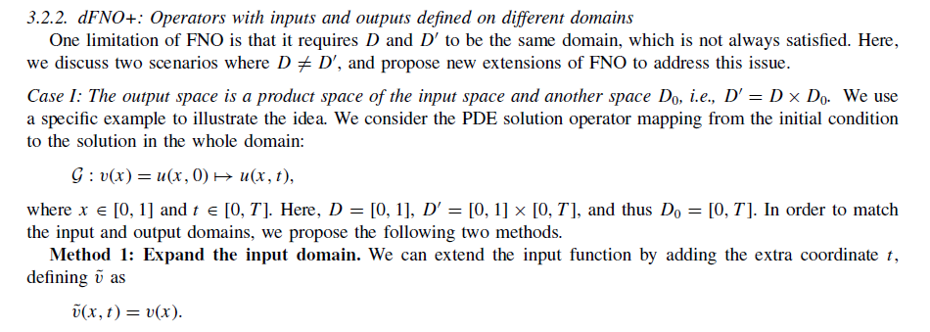
DeepONet vs FNO: Darcy Problem
Lu&Meng&Cai, et al., CMAME, 2022

Slide 25
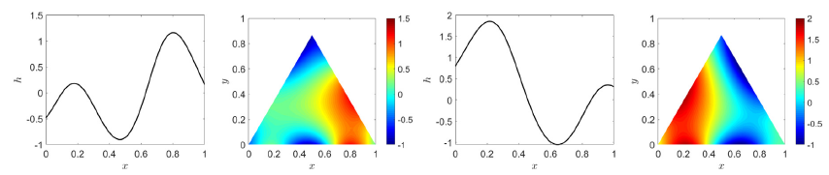
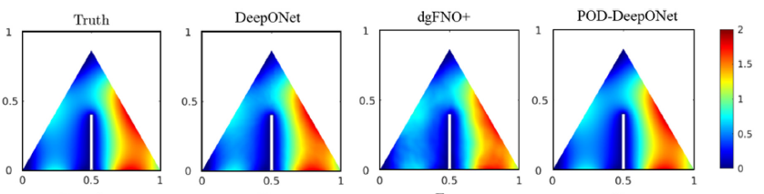
DeepONet vs FNO: Darcy Problem
Lu&Meng&Cai, et al., CMAME, 2022

Slide 26
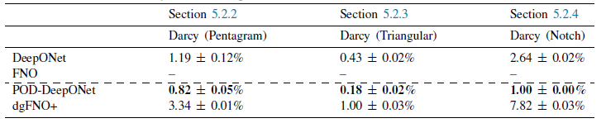
DeepONet vs FNO: Darcy Problem
Lu&Meng&Cai, et al., CMAME, 2022

Slide 27
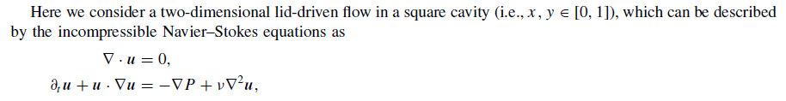


DeepONet vs FNO: Navier-Stokes equations
Lu&Meng&Cai, et al., CMAME, 2022

Slide 28
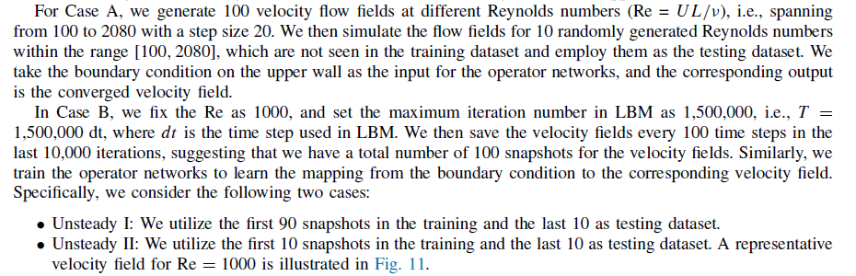
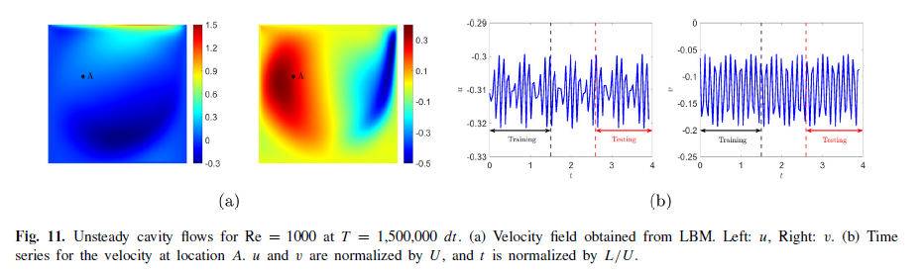
DeepONet vs FNO: Navier-Stokes equation
Lu&Meng&Cai, et al., CMAME, 2022

Slide 29
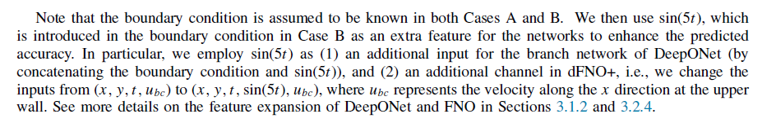
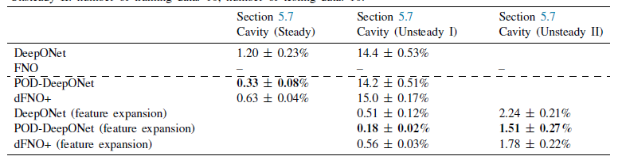
DeepONet vs FNO: Navier-Stokes equations
Lu&Meng&Cai, et al., CMAME, 2022

Slide 30

Thank you for your attention!

