Slide 1


Scientific Machine Learning
Lecture 14: Uncertainty Quantification in Scientific Machine Learning
孟旭辉
数学与统计学院数学与应用学科交叉创新研究院
办公室：欣苑2栋111室
Email：xuhui_meng@hust.edu.cn
https://github.com/XuhuiM/SciML-Course

Slide 2
Contents
Uncertainty quantification (UQ)
Introduction to UQ in SciML
…

Slide 3
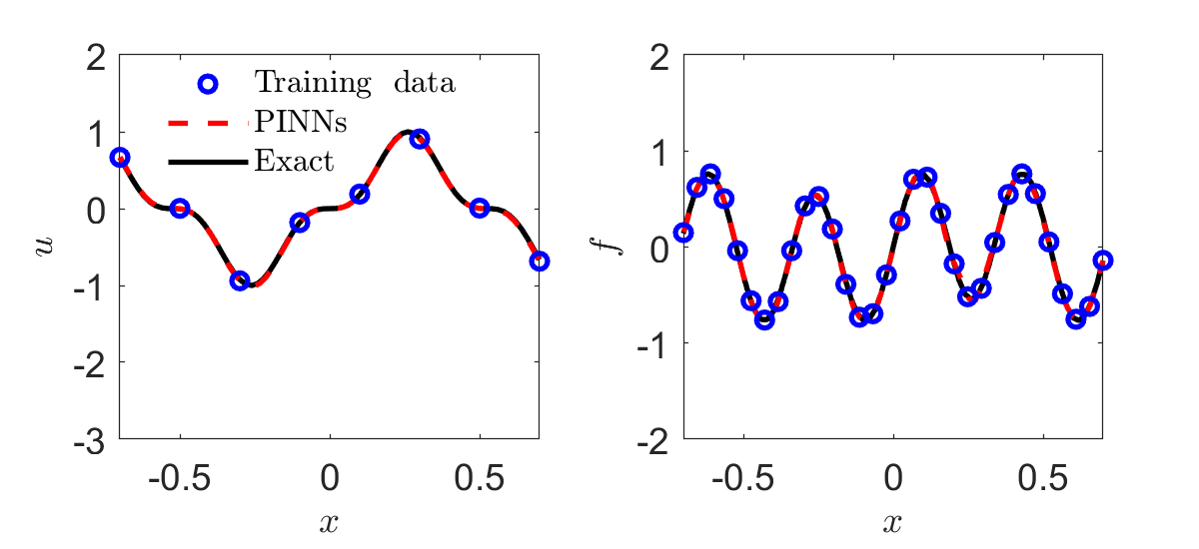
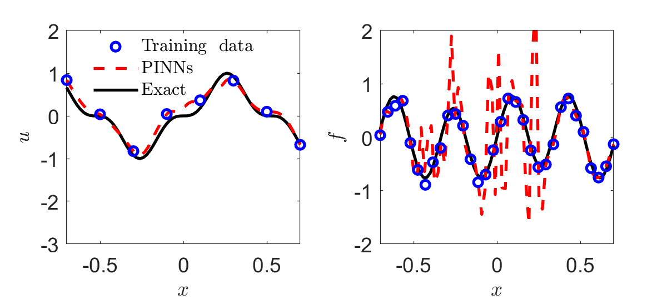





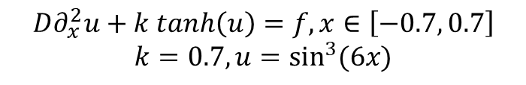
Why UQ?
1D inverse diffusion-reaction system:
$$D∂_{x}^{2}u+k tanh\left(u\right)=f, x∈\left[−0.7, 0.7\right]$$
$$k=0.7, u=\sin^{3}{(6x)}$$
NN: $2×50$
$$N(0, {0.01}^{2})$$
$$k=0.705$$
$$N(0, {0.1}^{2})$$
$$k=0.591$$
No uncertainty in predictions
Yang & Meng, et al., JCP, 2021

Slide 4
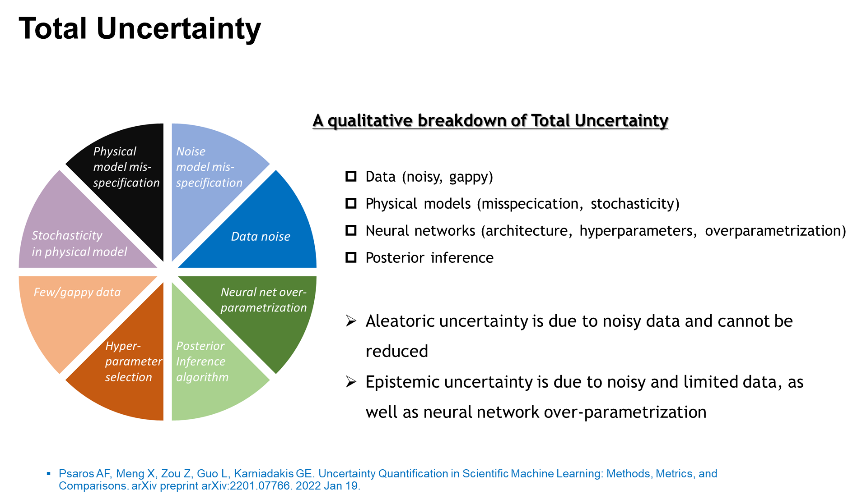
Why UQ?

Slide 5
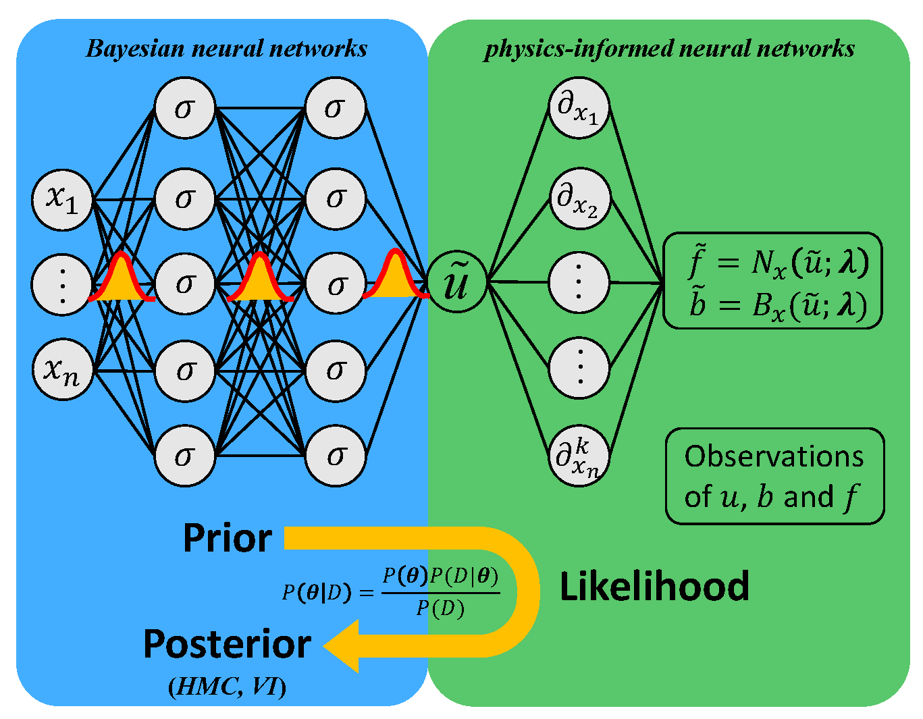
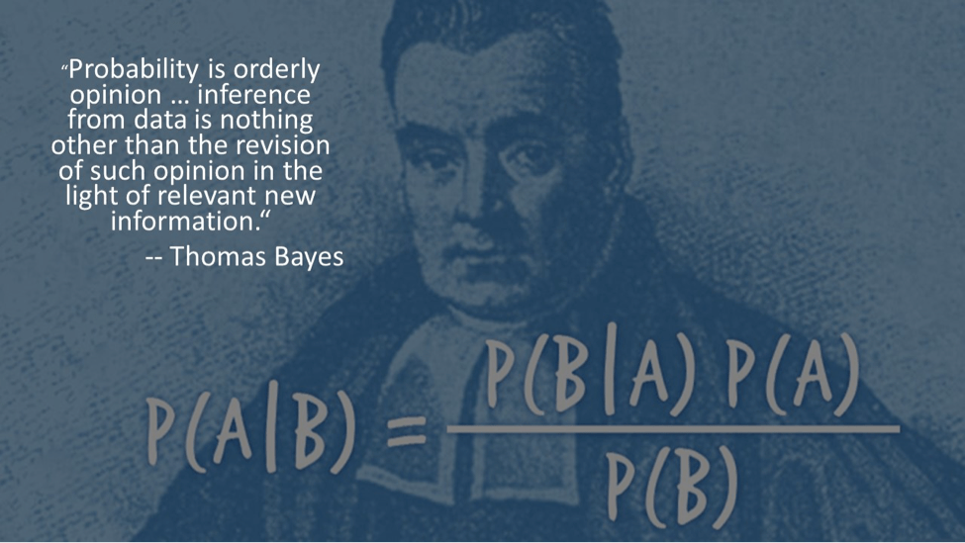
Bayesian PINNs (B-PINN): Uncertainty Quantification in PINNs
Prior
Data
Posterior
Bayes’ rule
Each weight/bias is a distribution rather than a point estimate
All data are noisy
Measurement errors are assumed to be Gaussian
Yang & Meng, et al., JCP, 2021

Slide 6
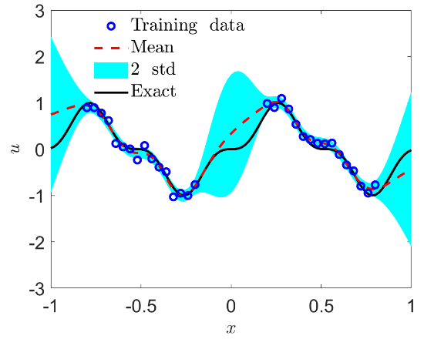
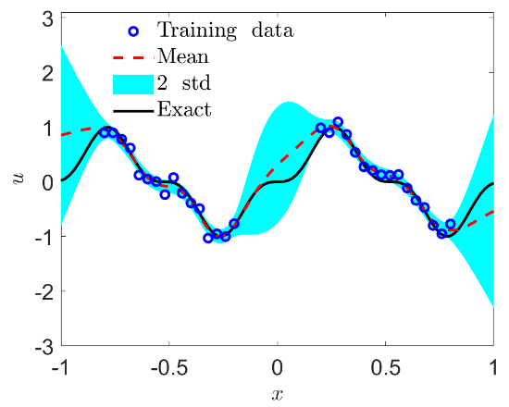
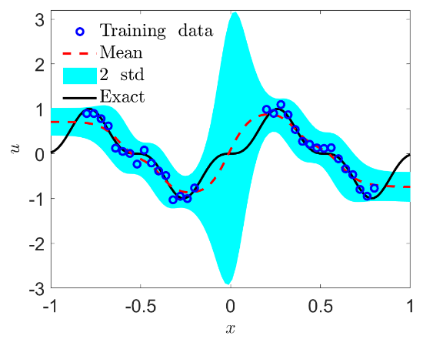
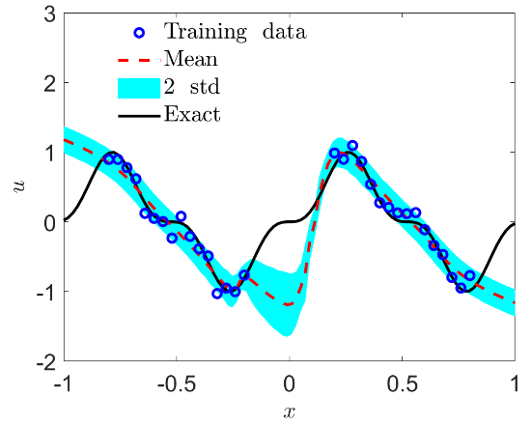
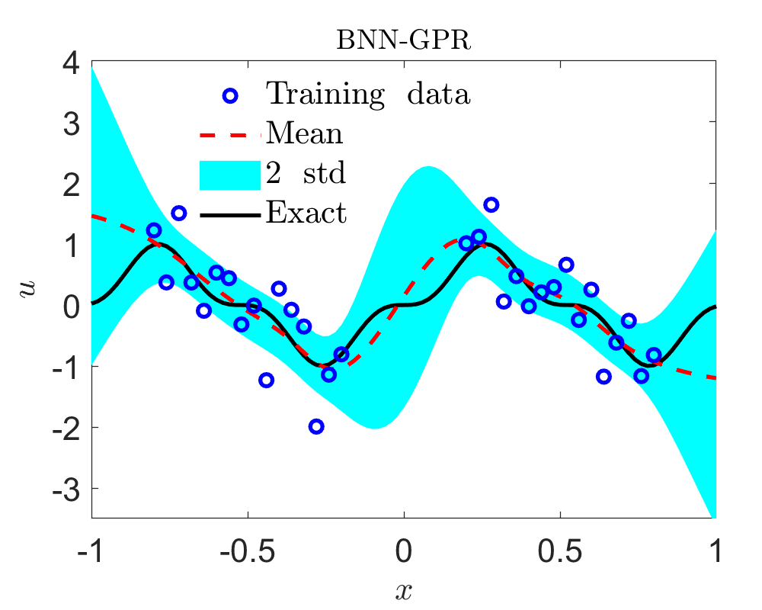
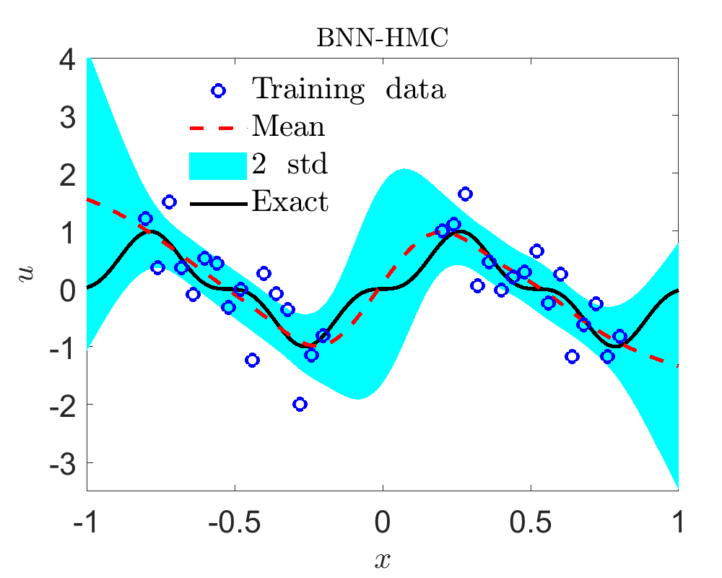




BNNs: Function Approximation
$$u=\sin^{3}{(6x)}, x∈[−1, 1]$$
32 noisy training data, $N(0, {0.1}^{2})$
BNNs: $2×50, tanh, θ\sim N\left(0, 1\right)$
Reference
BNNs+HMC
BNNs+MFVI
Dropout
$$N(0, {0.5}^{2})$$
Yang & Meng, et al., JCP, 2021

Slide 7
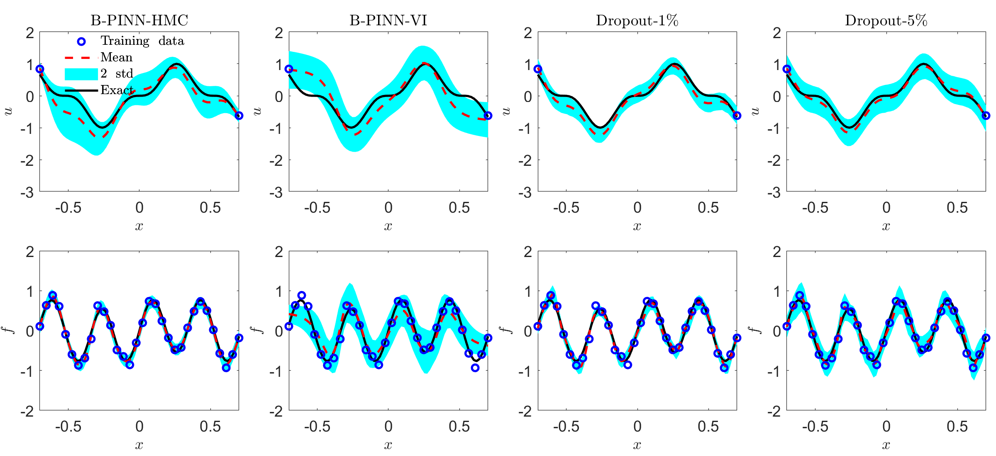



B-PINNs: Forward PDE Problems
1D nonlinear Poisson equation with noisy data:
$$λ∂_{x}^{2}u+k\tanh\left(u\right)=f, x∈[−0.7, 0.7]$$
$$λ=0.01, k=0.7$$
$$u=\sin^{3}{(6x)}$$
32 noisy data for f, 2 noisy boundary values for u
BNNs: $2×50, tanh, θ\sim N\left(0, 1\right)$
noise scale: $N(0, {0.1}^{2})$
Yang & Meng, et al., JCP, 2021

Slide 8
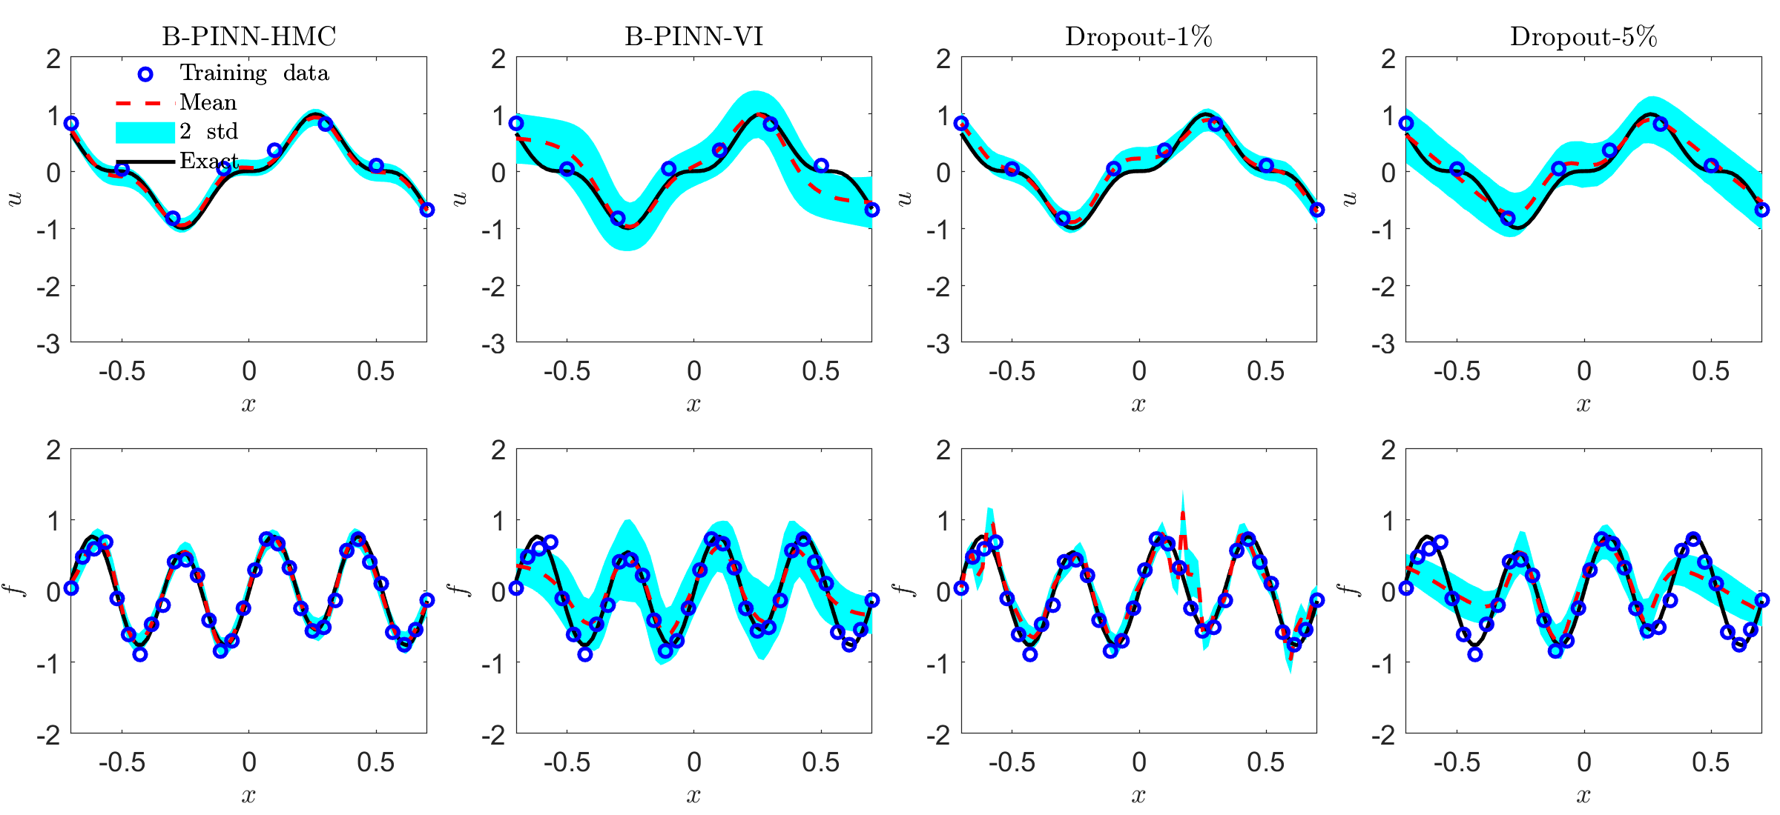
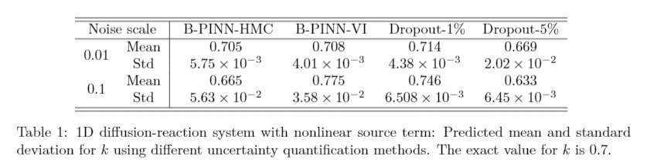

B-PINNs: Inverse PDE Problems (I)
1D nonlinear Poisson equation with noisy data:
$$λ∂_{x}^{2}u+k\tanh\left(u\right)=f, x∈[−0.7, 0.7]$$
$$λ=0.01, k=0.7$$
$$u=\sin^{3}{(6x)}$$
32 noisy data for f, 8 noisy boundary values for u
BNNs: $2×50, tanh, θ\sim N\left(0, 1\right)$
noise scale: $N(0, {0.1}^{2})$
Yang & Meng, et al., JCP, 2021

Slide 9
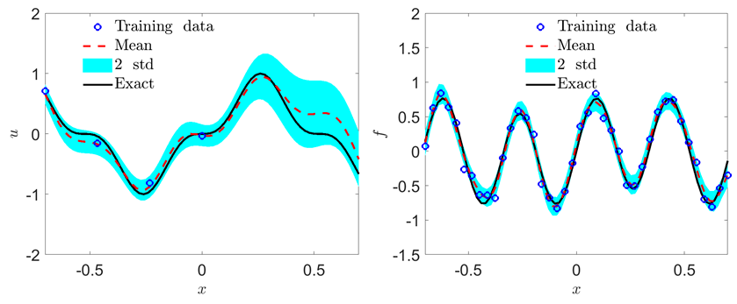

B-PINNs: Inverse PDE Problems (I)
1D nonlinear Poisson equation with noisy data:
$$λ∂_{x}^{2}u+k\tanh\left(u\right)=f, x∈[−0.7, 0.7]$$
$$λ=0.01, k=0.7$$
$$u=\sin^{3}{(6x)}$$
32 noisy data for f, 4 noisy boundary values for u
BNNs: $2×50, tanh, θ\sim N\left(0, 1\right)$
noise scale: $N(0, {0.1}^{2})$
Predicted k: $0.647±0.078$
Yang & Meng, et al., JCP, 2021

Slide 10
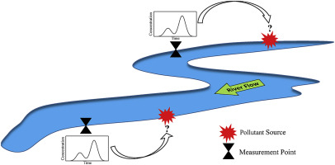

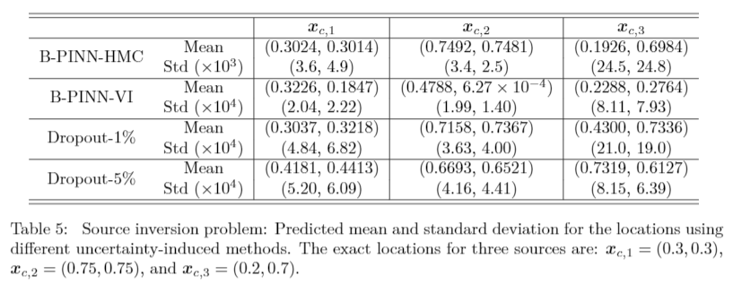
B-PINNs: Inverse PDE Problems (II)
2D contaminant source identification:
$$−λ\left(∂_{x}^{2}+∂_{y}^{2}\right)u−f_{2}=f_{1}, x, y∈[0, 1]$$
$$k=(2, −3, 0.5)$$
200 noisy data for f₁, 1000 noisy data for u
BNNs: $2×50, tanh, θ\sim N\left(0, 1\right)$
$$ε_{u}\sim N\left(0, {0.1}^{2}\right), ε_{f_{1}}\sim N(0, {0.01}^{2})$$
$$x_{c,1}=(0.3, 0.3)$$
$$x_{c,2}=(0.75, 0.75)$$
$$x_{c,3}=(0.2, 0.7)$$
Amiri, et al., 2019
Yang & Meng, et al., JCP, 2021

Slide 11
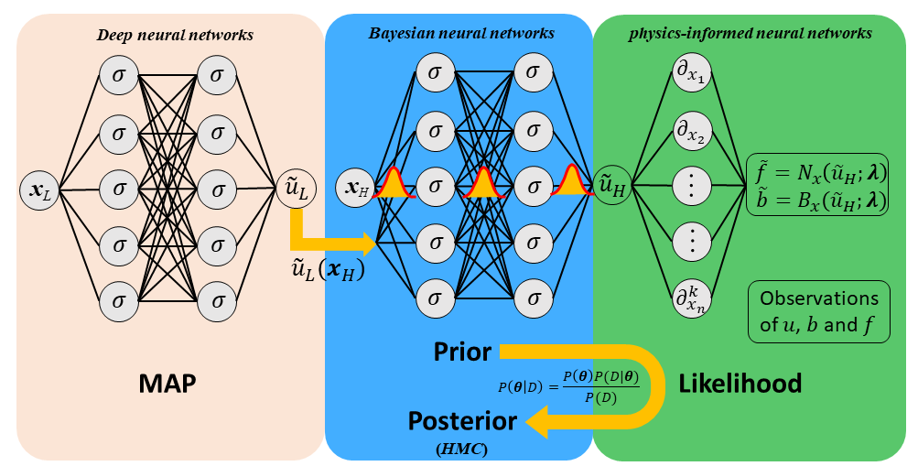



Multi-fidelity BNNs/B-PINNs
$$u_{H}=F(x,u_L)$$
Low-fidelity Training:
Maximum a posteriori probability
Posterior sampling
(Hamiltonian Monte Carlo)
High-fidelity Training:
All measurement errors are assumed to be Gaussian
Meng, et al., JCP, 2021

Slide 12
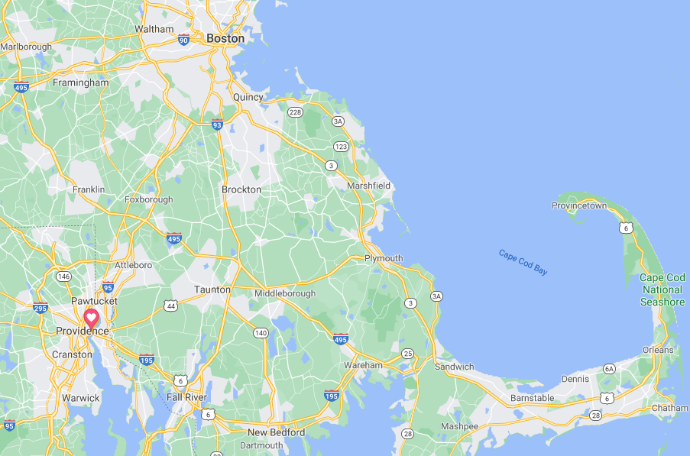
Sea Surface Temperature (Cape Cod Bay)

Slide 13
Sea Surface Temperature (Cape Cod Bay)
Low-fidelity NN: 2 hidden layers with 40 neurons per layer
BNNs: 1 hidden layer with 50 neurons
Meng, et al., JCP, 2021

Slide 14
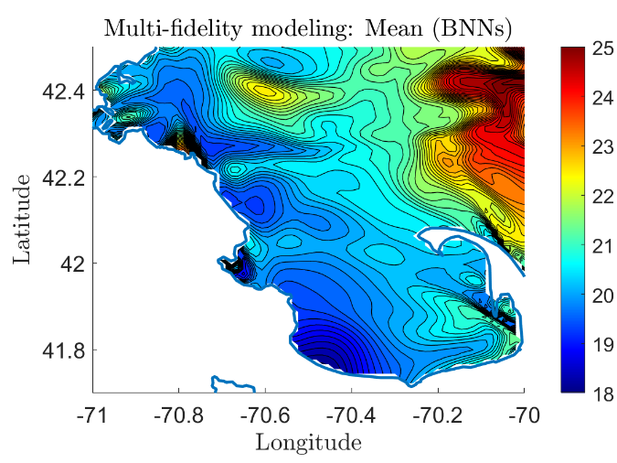
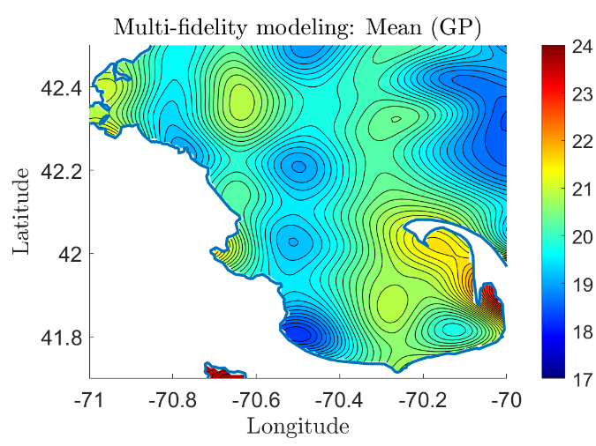
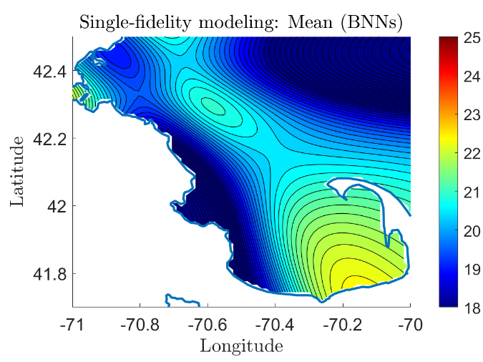
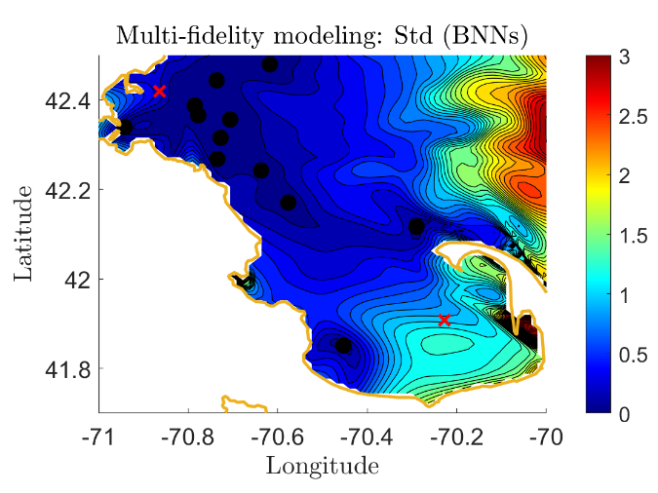
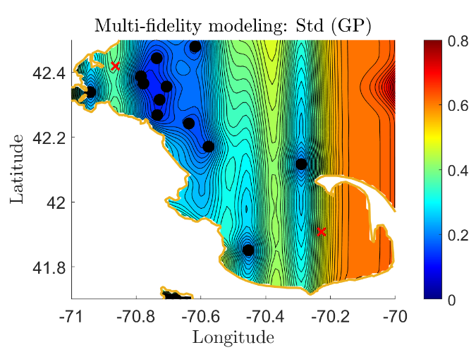
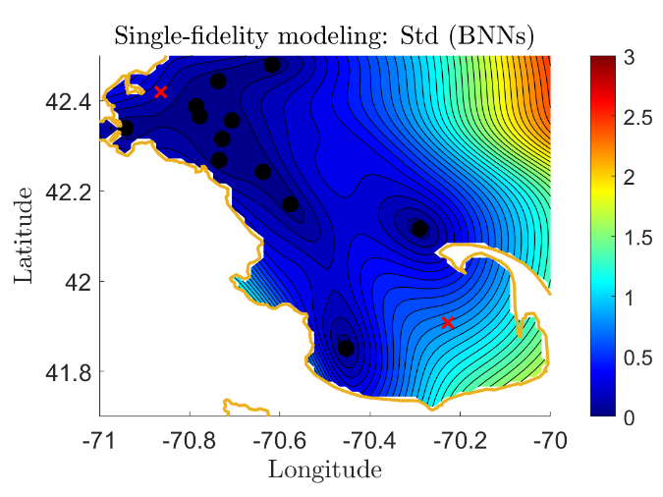
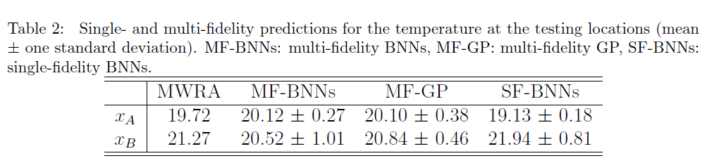
Sea Surface Temperature
Meng, et al., JCP, 2021

Slide 15
Inverse PDE Problem: Diffusion-reaction system (1D)
Diffusion-reaction system
Exact solution:
k = 1,
High-fidelity training data: 10 random high-fidelity noisy measurements for f
Low-fidelity training data:
100 randomly distributed data with noise
Objective: (1) Infer the reaction rate k
(2) Reconstruct u and f
Low-fidelity NN: 2 hidden layers with 20 neurons per layer
BNNs: 1 hidden layer with 50 neurons
Meng, et al., JCP, 2021

Slide 16
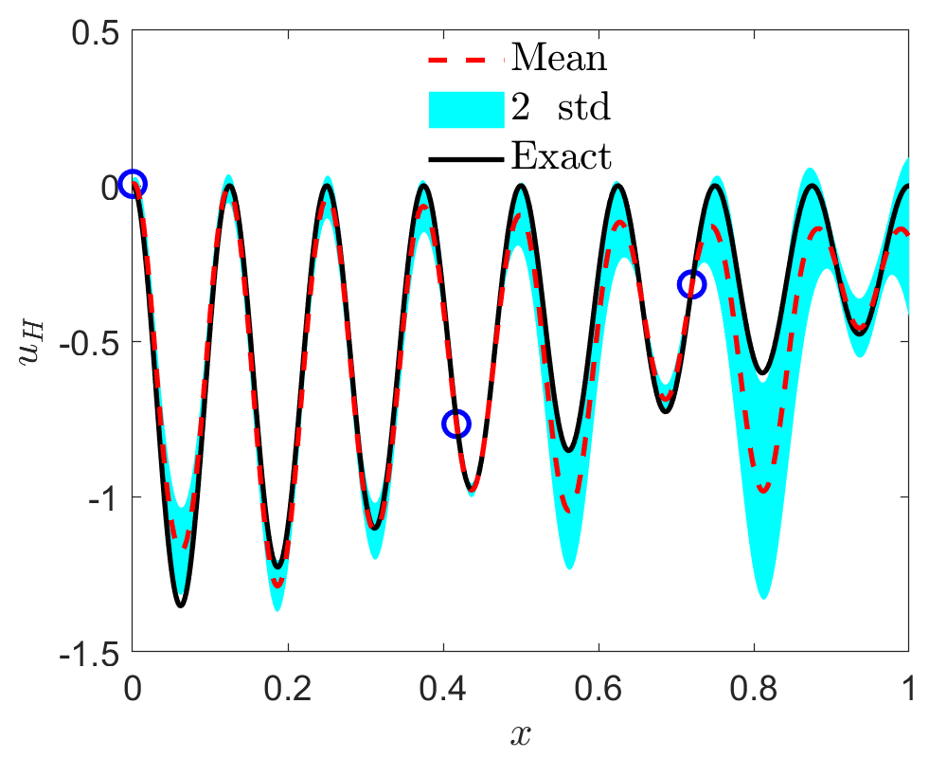
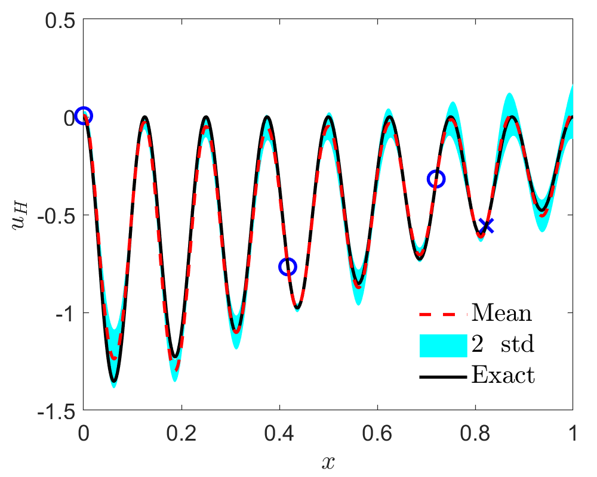
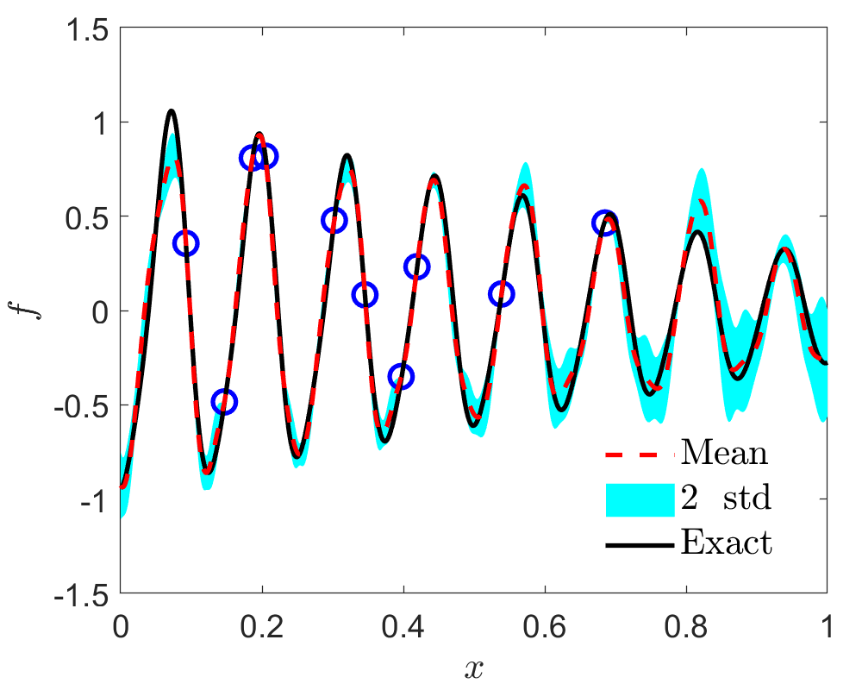
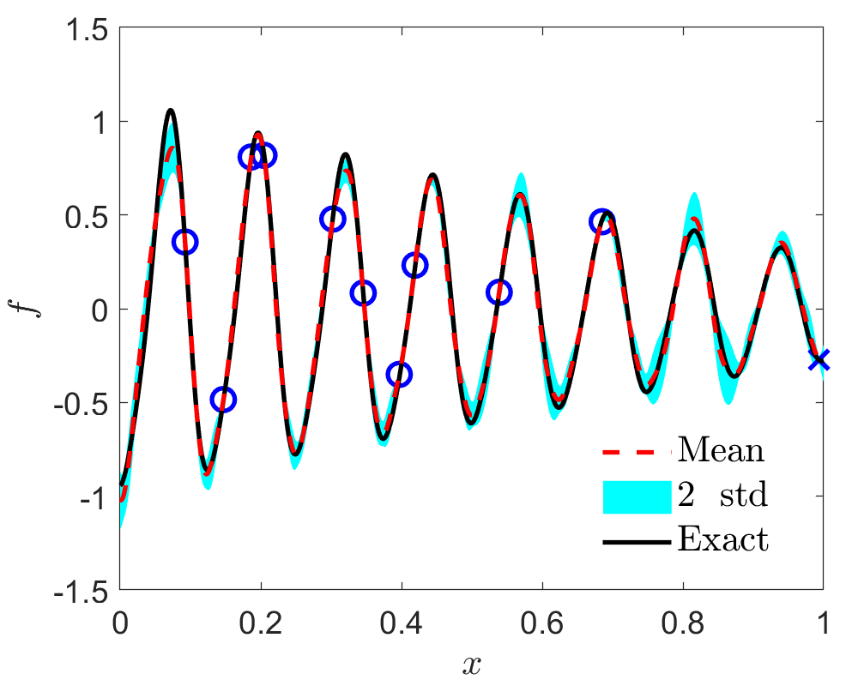
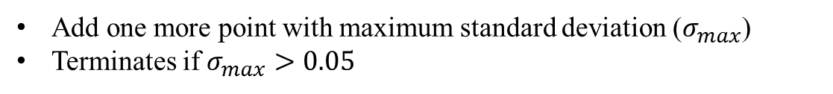
Active Learning: Inverse PDE Problem
Add one more point with maximum standard deviation ($σ_{max}$)
Terminates if $σ_{max}>0.05$

Slide 17
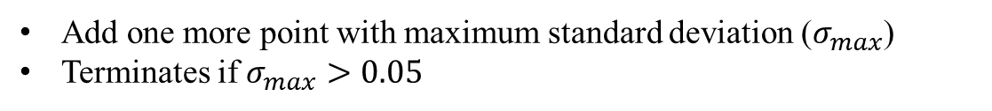
Active Learning: Inverse PDE Problem
Add one more point with maximum standard deviation ($σ_{max}$)
Terminates if $σ_{max}>0.05$

Slide 18

Thank you for your attention!

