Slide 1
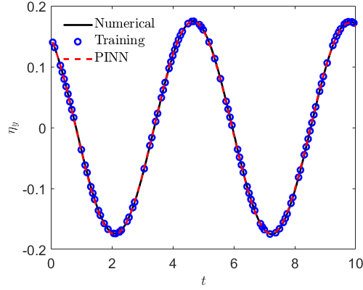
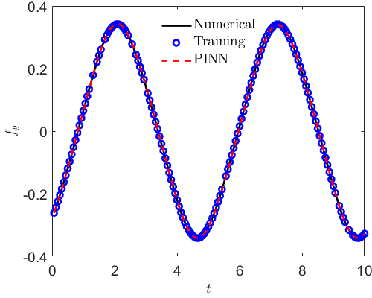


$$ρη_{tt}+λ_{1}η_{t}+λ_{2}η=f, ρ=2$$
 | $$λ_{1}$$ | $$λ_{2}$$
Exact | 0 | 1.09

