Slide 1
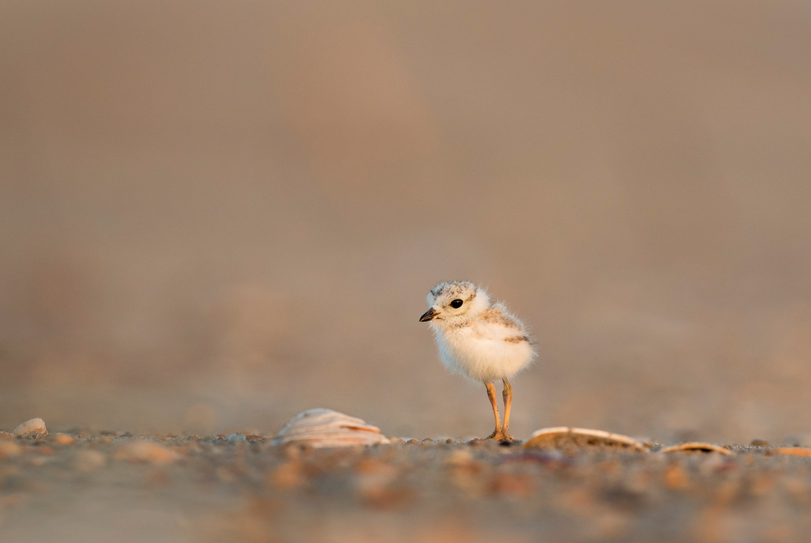

“
”
OUR VISION
To provide competitive user-centered access to avian knowledge
MARKET
$
Students
Scientists
Explorers
Interest Groups
Sponsors
In-line ads
Data Accumulation
Social Aspects
Research
Notes:
Anthony

