Slide 1
Develop Java web apps
¿What are Frameworks?
The Frameworks are code libraries, they help to write more clean code and better structured code.
The most used Frameworks are:

Slide 2
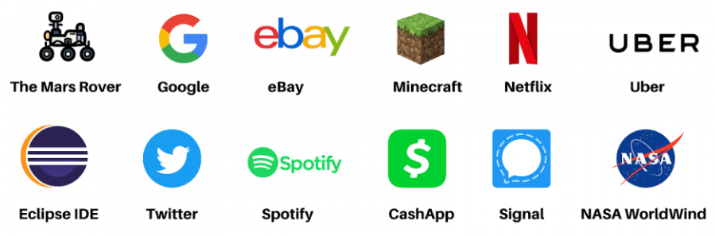
Develop applications more robust and scalable
Robust: Because Java memory management is very good, he know when to free memory and he do automatically, this makes Java very efficient.
Scalable: Java can control big aplications easily, is for it Java is used to big companies in her aplications

Slide 3
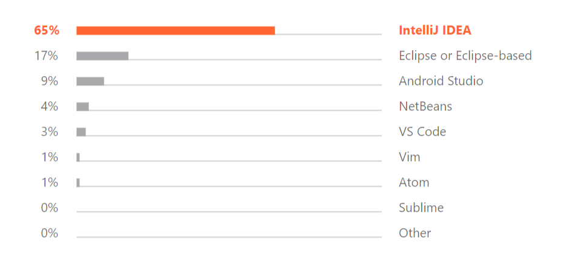



Tools and development environment
¿What is an IDE?
IDE significate is Integrated development environment, is a software use for devs for develop in different languages: Java – HTML – Python…
This tools help to write code more fast and detect errors in lines code, it also offers us suggestions on how to write our code to correct it.
Develop IDE most used

Slide 4
Java future and finaly conclusion
From my point of view, I think the future of Java will be very good and solid. For years, Java has proven to be a robust language, used in various applications. The continuous evolution of Java, with new versions and character updates, seeks a constant commitment to the demand for novelty and adaptability of software development.
Now, Java is still important for programming. People who use Java are active and helpful, supporting each other.
In short, looking at the past and what's happening now, Java could keep being a good choice for developers. It's good at adjusting to tech changes, and it's always getting better, so Java will likely stay important for making software.

