Slide 1
Testing with different learning rate and its decay function

Slide 2
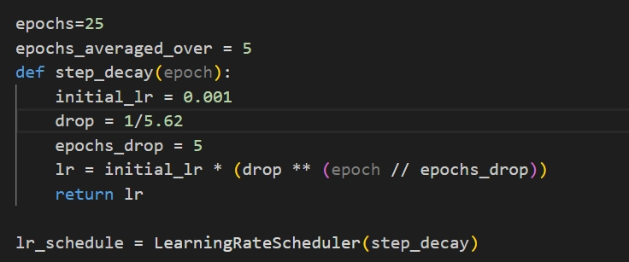
Step decay

Slide 3
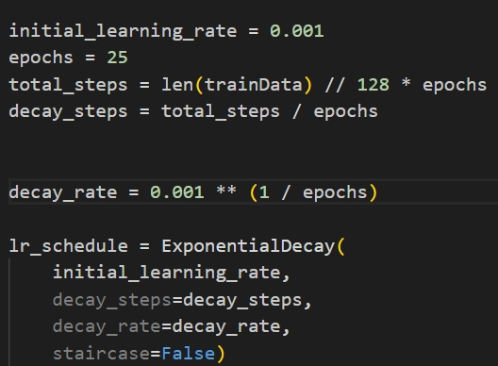
Exp decay

Slide 4
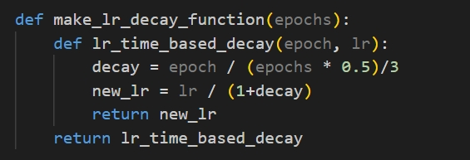
Custom Decay

Slide 5
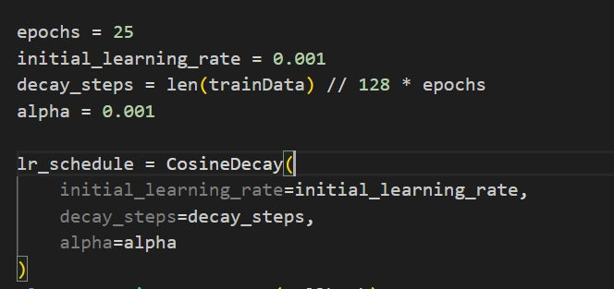
Cosine Decay

Slide 6
Starting lr=1e-3 Ending lr=1e-6 (1.28e-6 for Custom)
Tested with 4 kernels | Step_Decay | Exponential_Decay | Custom_Decay | Cosine_Decay
FMNIST | 88.14% | 88.03% | 88.38% | 88.44%
CIFAR | 45.85% | 45.8% | 45.90% | 45.73%
Tested with 4 CNNs | Step_Decay | Exponential_Decay | Custom_Decay | Cosine_Decay
FMNIST | 88.61% | 88.54% | 89.06% | 89.29%
CIFAR | 46.78% | 48.72% | 52.73% | 51.15%

Slide 7
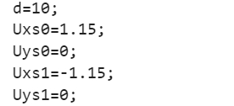
Testing different NA

Slide 8
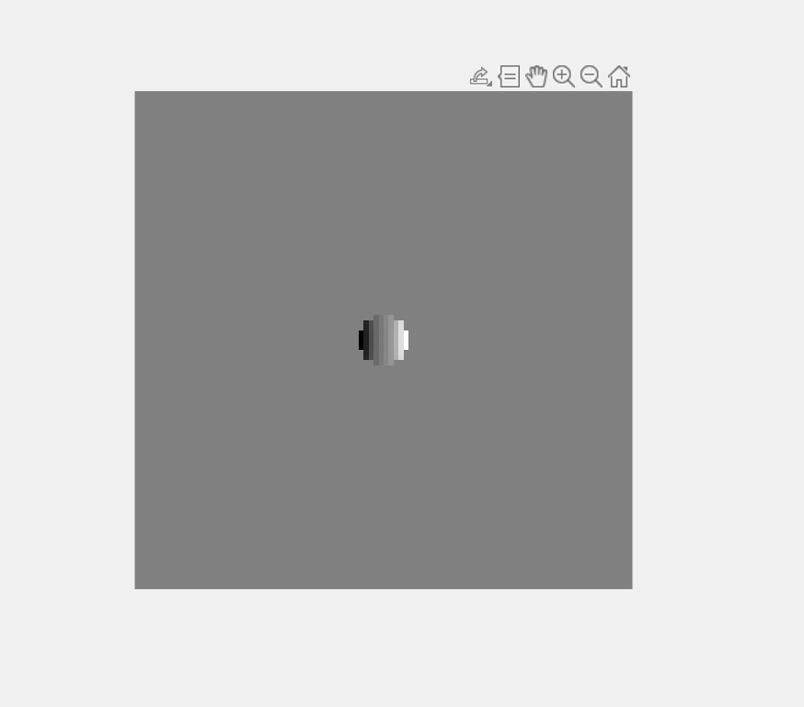
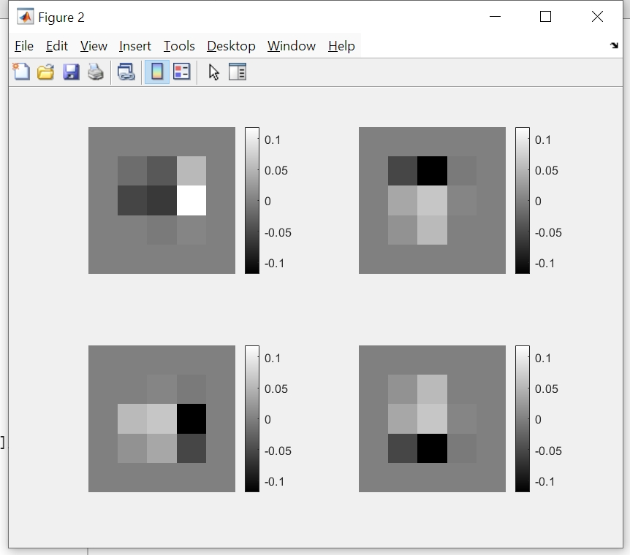
NA=0.1

Slide 9
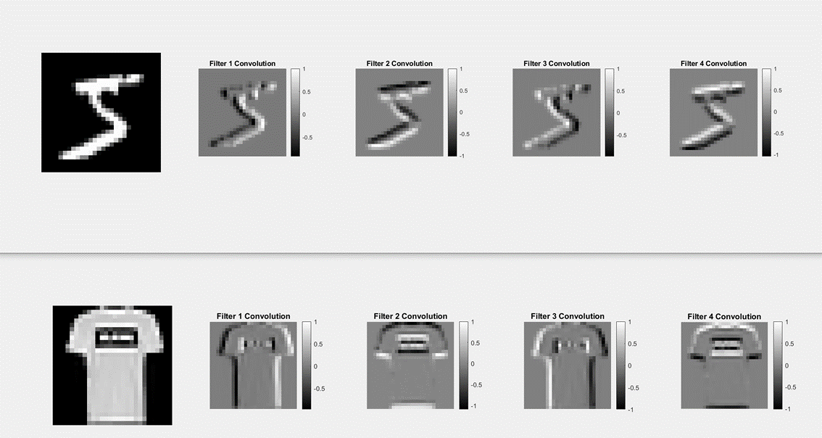

Slide 10
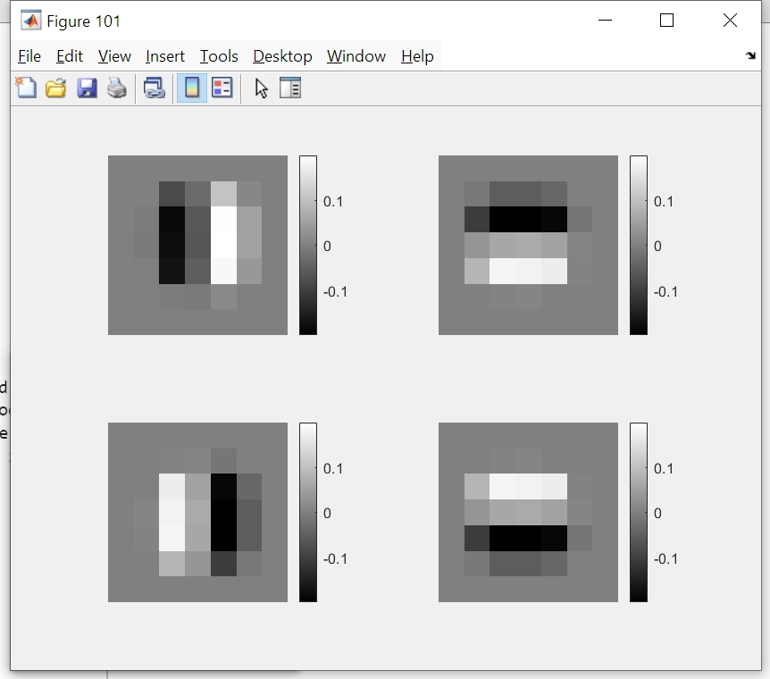
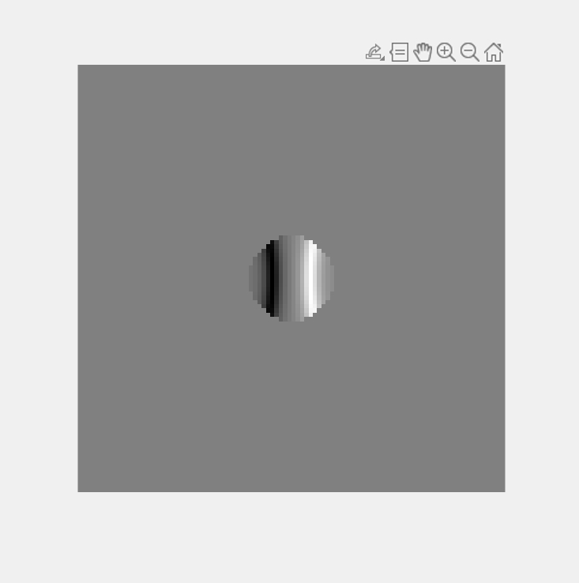
NA=0.2

Slide 11
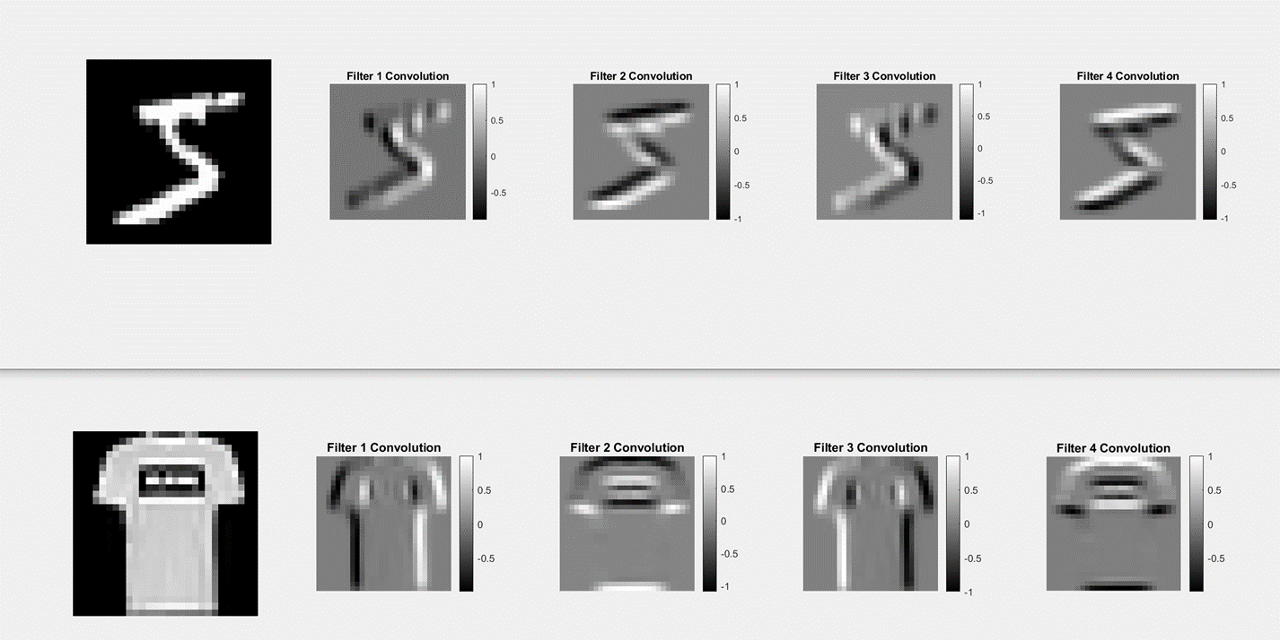

Slide 12
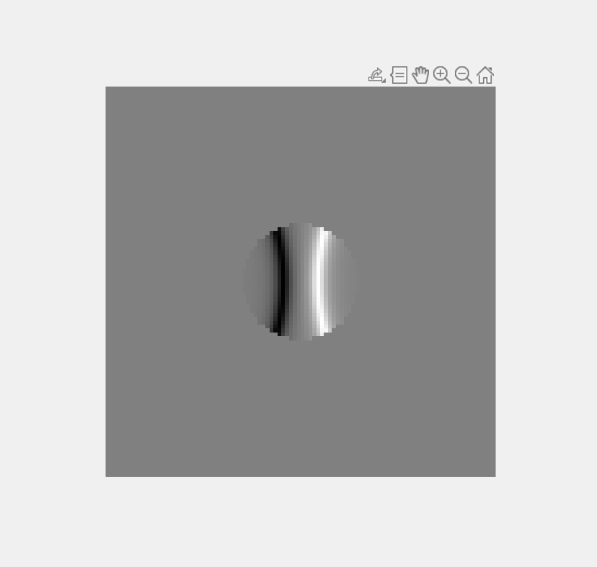
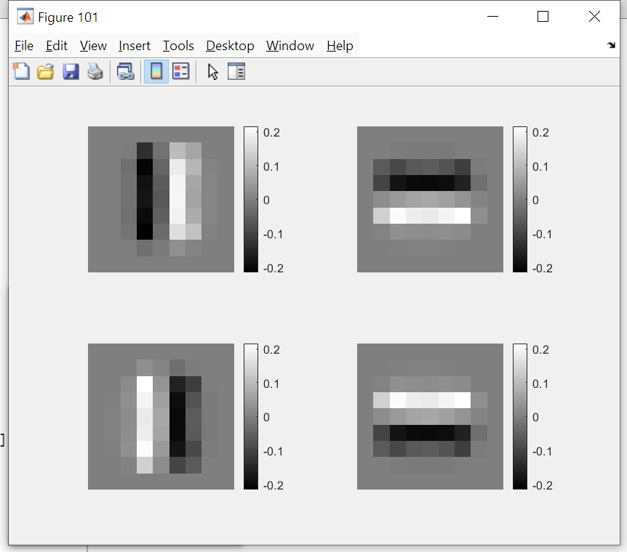
NA=0.3

Slide 13
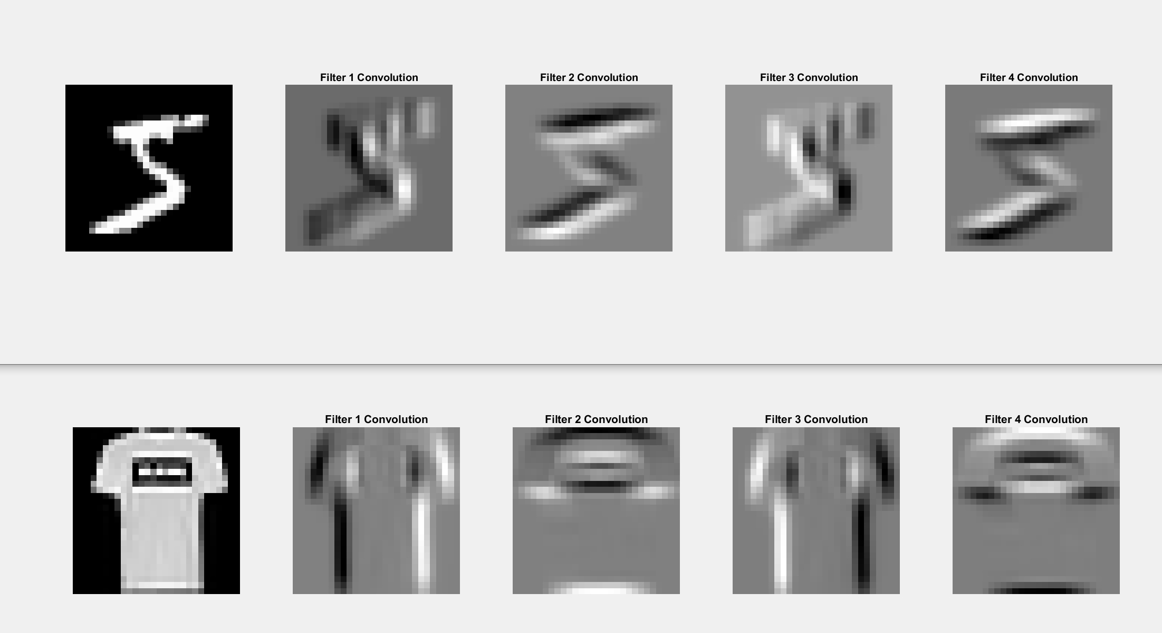

Slide 14
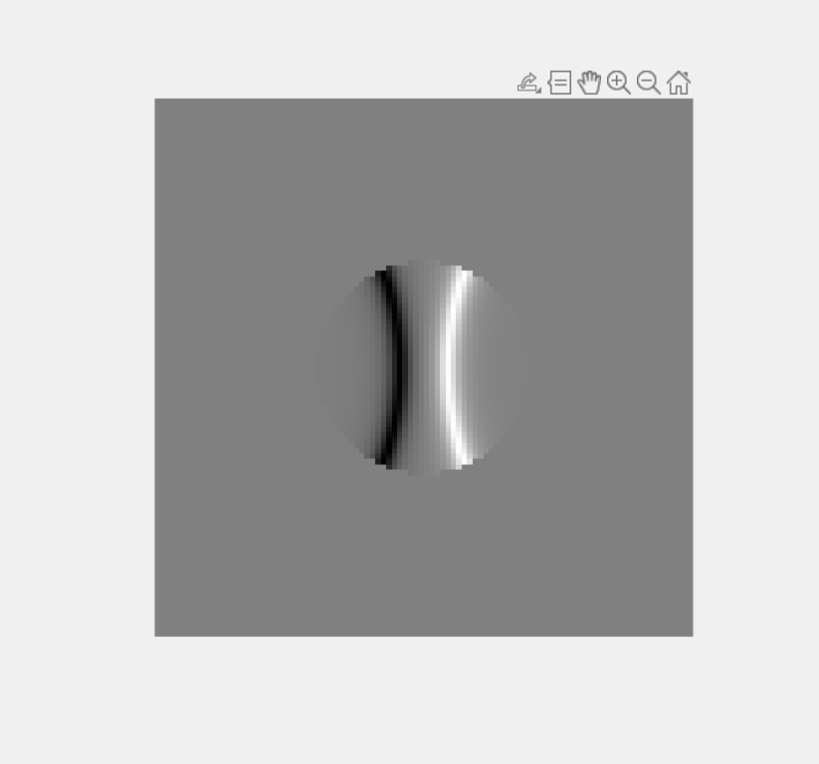
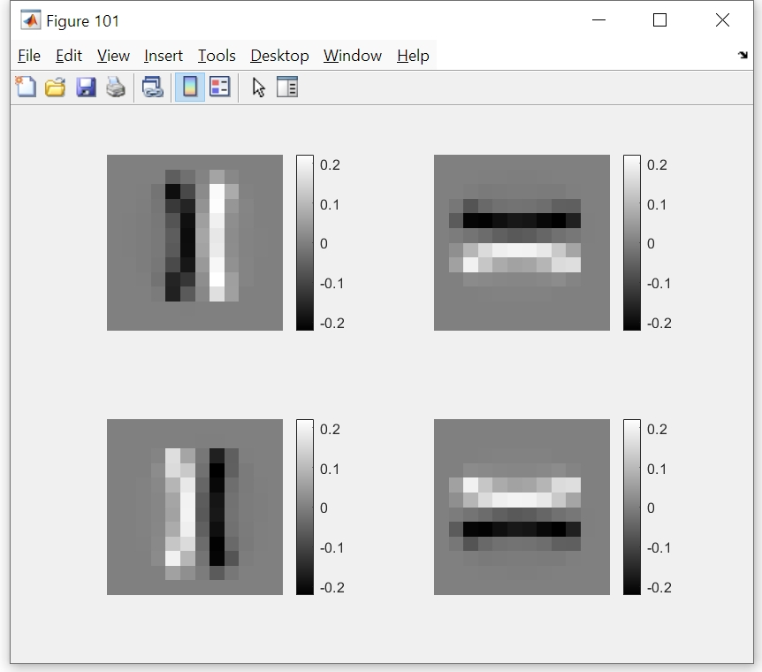
NA=0.4

Slide 15
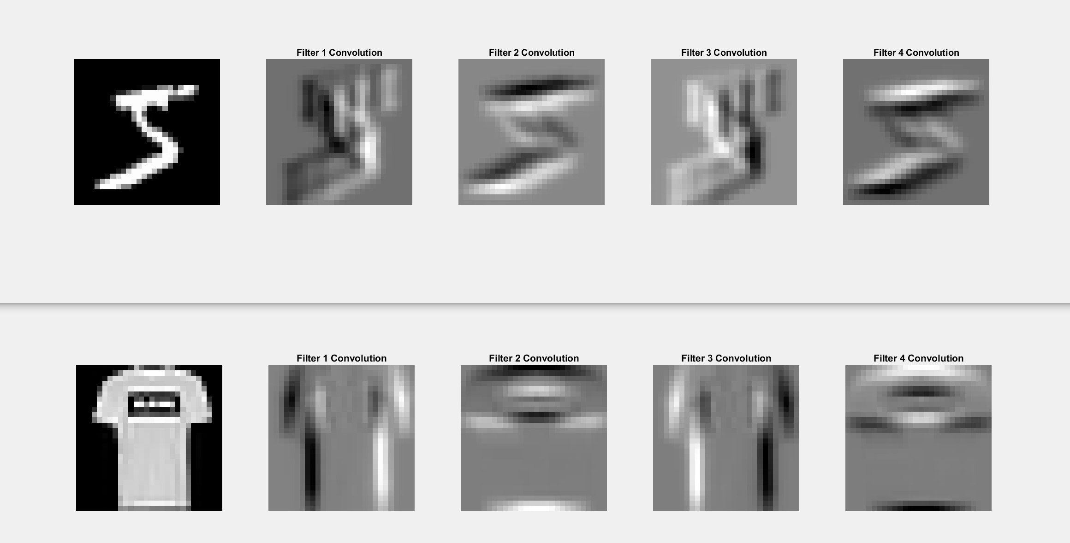

Slide 16
 | DMNIST | FMNIST | CIFAR
NA=0.1 | 97.18% | 88.42% | 46.88%
NA=0.2 | 97.38% | 88.55% | 46.69%
NA=0.3 | 97.48% | 88.32% | 45.82%
NA=0.4 | 97.67% | 87.9% | 45.19%

