Slide 1
Testing different parameters for R function

Slide 2
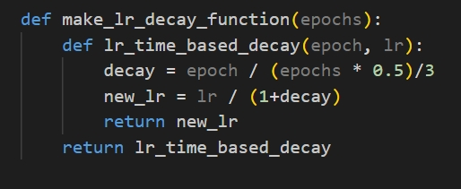
Accuracy here is based on the average of 3 runs where each run takes the average accuracy of last 5 epochs
Epochs=25 ,lr decays throughout training

Slide 3
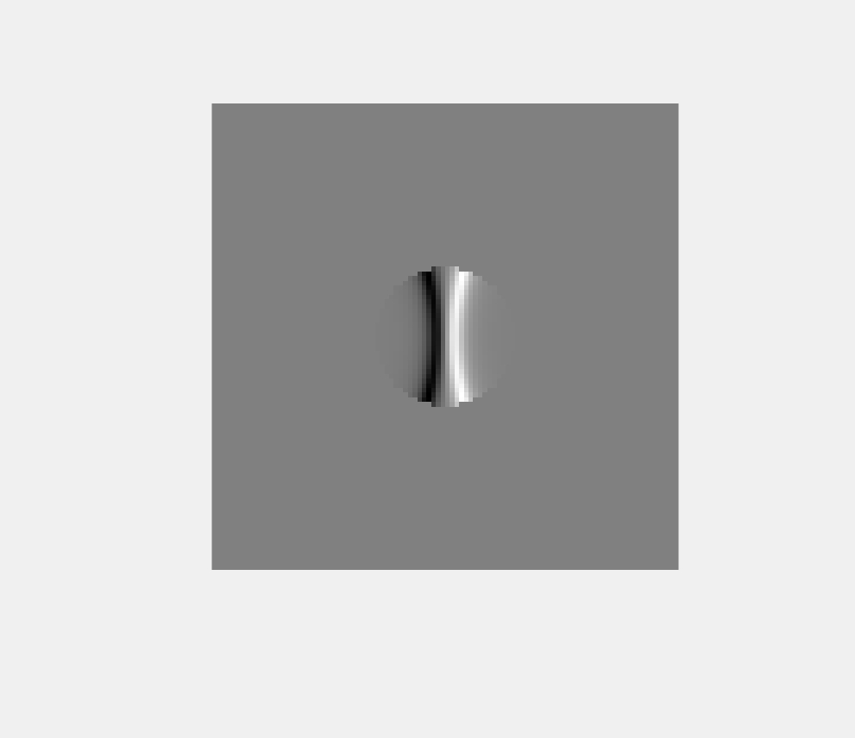
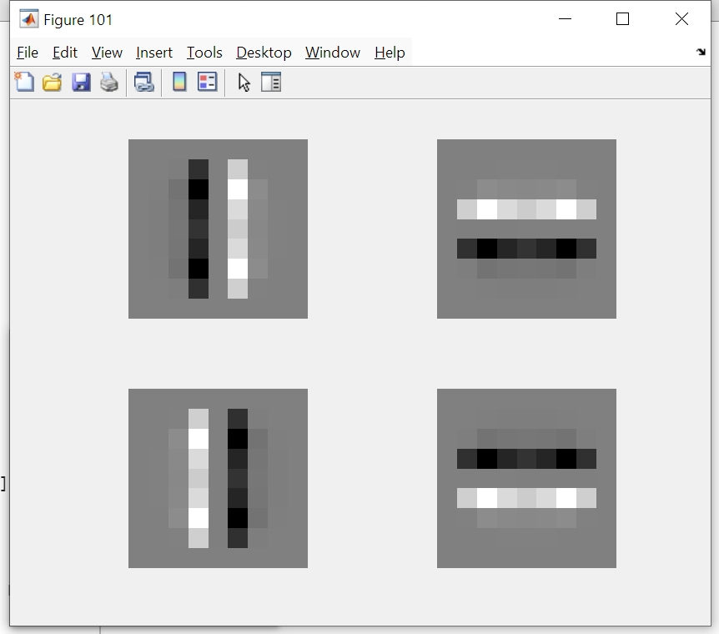
Spacing=0.08

Slide 4
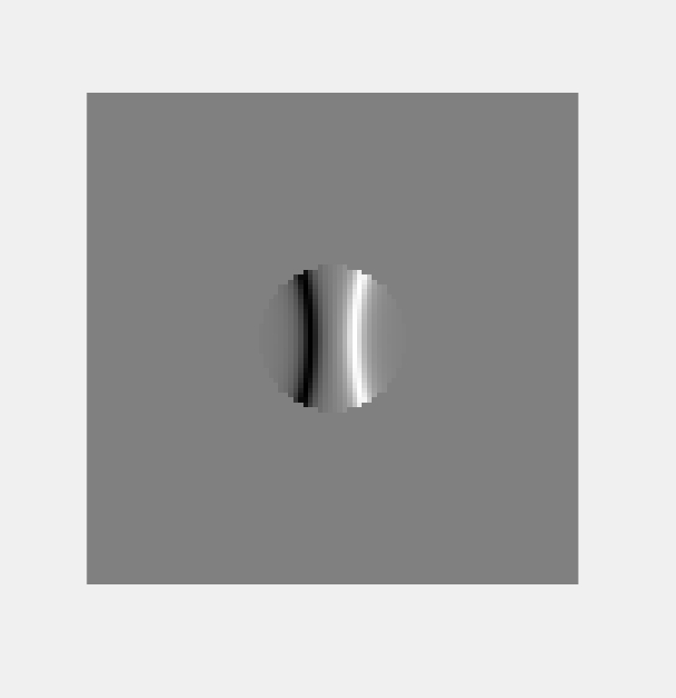
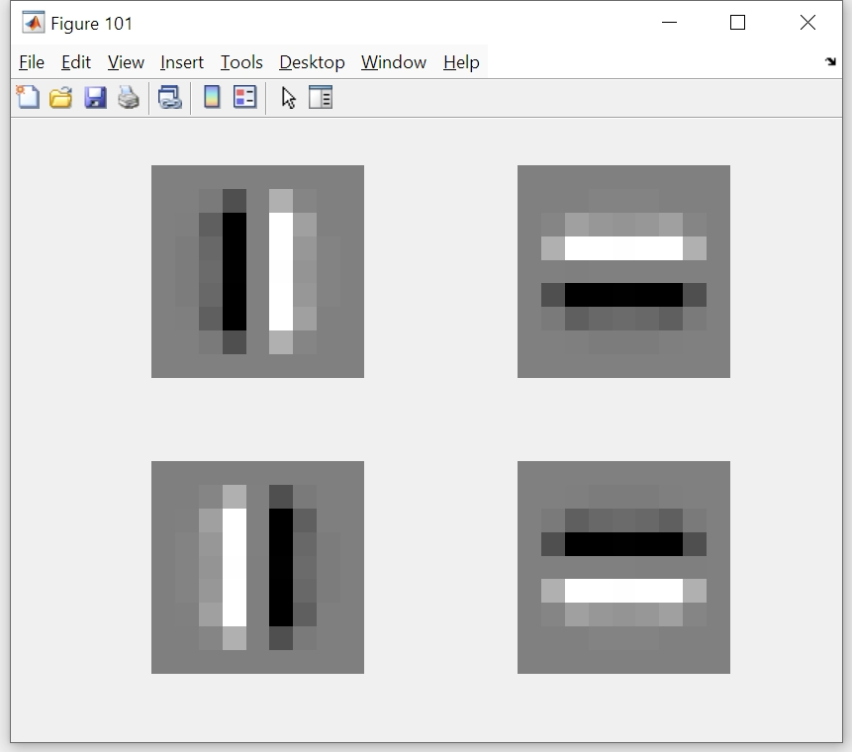
Spacing=0.18

Slide 5
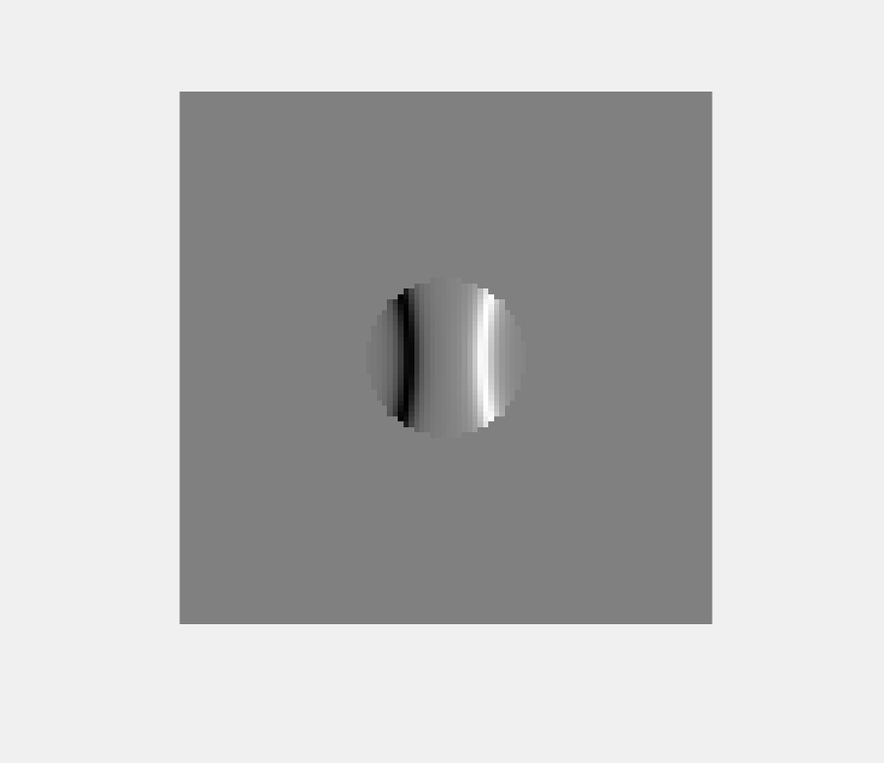
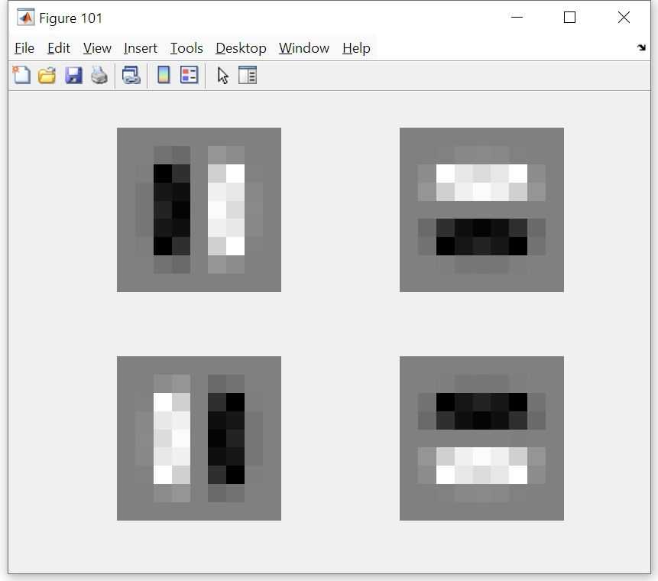
S=0.28

Slide 6
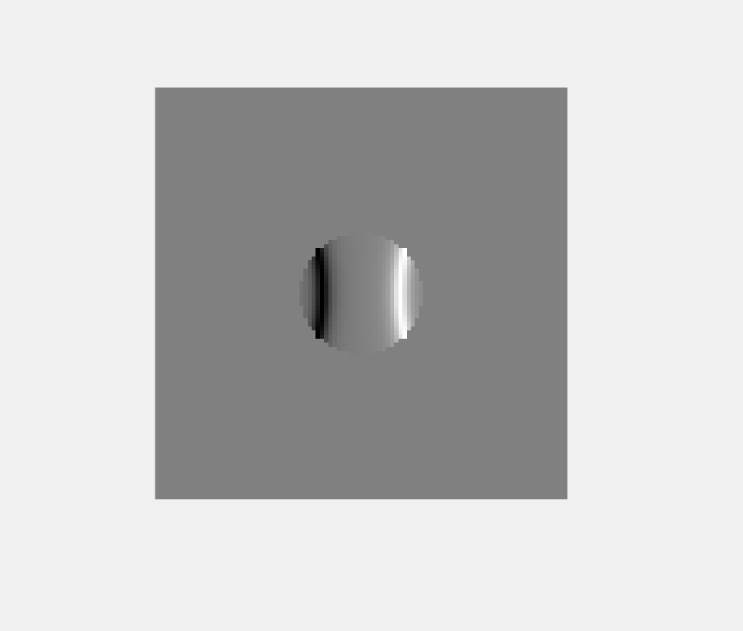

S=0.38

Slide 7
Spacing between curves
 | Digital Mnist | Fashion Mnist | Cifar
S=0.08 | 97.47% | 88.14% | 45.63%
S=0.18 | 97.48% | 88.12% | 46.04%
S=0.28 | 97.82% | 88.16% | 45.72%
S=0.38 | 97.59% | 88.16% | 45.15%

Slide 8
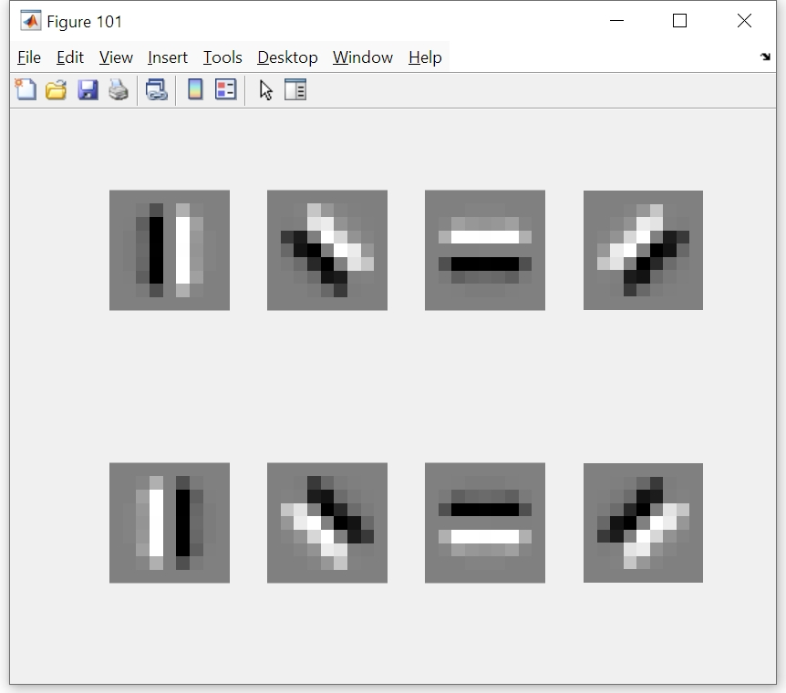

Slide 9
Rotation comparison with s=0.18
 | dmnist | fmnist | cifar
45 degree rotation 4 times | 98.15% | 88.1% | 49.23%
45 degree rotation 8 times | 98.54% | 89.43% | 53.18%
90 degree rotation | 97.48% | 88.12% | 46.04%
Comparing with CNN+FC
 | dmnist | fmnist | cifar
4 kernels 9x9 | 98.17% | 88.82% | 51.05%
8 kernels 9x9 | 98.8% | 90.08% | 57.94%

