Slide 1
Relational Calculus & ER Diagrams
CS 1270 Recitation 2

Slide 2
Tuple Relational Calculus (TRC)
Query language for describing queries
A TRC expression is of form: { t | P(t) }
Set notation: means all tuples t such that the expression P(t) is satisfied
P(t) is called a predicate
P(t) has a domain: set of possible tuples the result may take
Relational Calculus vs Relational algebra
Relational algebra is a Procedural language, describes how to obtain results
Relational calculus is a Declarative language, describes what results to obtain

Slide 3
Tuple Relational Calculus (TRC)
Examples:
a. { f | f ∈ Farmer }
→ represents all farmers in the set Farmer; domain is all tuples in Farmers
b. { f | f ∈ Farmer ^ f[name] = “Fred” }
→ set of all tuples in the set Farmer who are named Fred
Farmers
b. Farmers named Fred
f_id | name | age
0 | Fred | 55
1 | Bob | 36
2 | Max | 41
f_id | name | age
0 | Fred | 55

Slide 4
Tuple Relational Calculus (TRC)
Several tuple variables may appear in the P(t) formula
{f | f ∈ Farmer ^ ∃ g ∈ Grows( f[f_id] = g[f_id] ^ g[plant] = “Tomatoes” )}
tuples in Farmer
tuples in Grows with a f_id matching that of f
and plant field of “Tomatoes”
→ Represents farmers who grow tomatoes
Farmer
Grows
f_id | name | age
0 | Fred | 55
1 | Bob | 36
2 | Max | 41
f_id | plant
0 | Carrots
1 | Tomatoes
2 | Carrots
2 | Tomatoes
f_id | name | age
1 | Bob | 36
2 | Max | 41

Slide 5
Tuple Relational Calculus (TRC)
A tuple variable is said to be a free variable unless its quantified by a ∃ or a ∀, then it is said to be a bound variable.
The variable f that appears left of the “|” must be the only free variable in P(f)
{f | f ∈ Farmer ^ ∃ g ∈ Grows( f[f_id] = g[f_id] ^ g[plant] = “Tomatoes” )}
free variable
bound variable

Slide 6
Tuple Relational Calculus (TRC)
A formula is built of atoms. An atom is one of the following forms:
s∈R where s is a tuple and R is a relation
f ∈ Farmer
s[x] ? u[y] where s and u are tuple variables and x and y are attributes, and ? is a comparison operator (<, ≤, =, ≠, >, ≥)
f1[age] > f2[age]
p1[id] = p2[id]
s[x] ? c where c is a constant in the domain of attribute x
t[price] > 30
p[name] = “Fred”

Slide 7
Tuple Relational Calculus (TRC)
Formulae are built up from atoms using the following rules:
An atom is a formula
If P is a formula, then so are ¬P and (P)
If P1 and P2 are formulae then so are P1 ^ P2 and P1 ∨ P2
{ f | f ∈ Farmer ^ ¬ ( f[name] = “Fred” ) }
{ f | f ∈ Farmer ^ ( f[name] = “Fred” ∨ f[name] = “Bob” ) }

Slide 8
Practice Problem 1
Trees (tid, species, state)
Q. Find all trees in the state “Kansas”.

Slide 9
Practice Problem 1
Trees (tid, species, state)
Q. Find all trees in the state “Kansas”.
{ t | t ∈ Trees ^ t[state] = “Kansas” }

Slide 10
Practice Problem 2
Trees (tid, species, state)
Q. Find the tid of trees in Kansas that are Apple Trees.

Slide 11
Practice Problem 2
Trees (tid, species, state)
Q. Find the tid of trees in Kansas that are Apple Trees.
{ t | ∃ t1 ∈ Trees( t[tid] = t1[tid] ^ t1[state] = “Kansas” ^ t1[species] = “Apple Tree” ) }

Slide 12
Tuple Relational Calculus: Example
Student (sid, name, dept_no, hometown)
Course (cid, name)
Registration (sid, cid)
Q. Find the name of students, and their hometown, in dept_no 2 who’ve registered for cs127.

Slide 13
Tuple Relational Calculus: Example
Student (sid, name, dept_no, hometown)
Course (cid, name)
Registration (sid, cid)
Q. Find the name of students, and their hometown, in dept_no 2 who’ve registered for a course named “Database Management Systems”.
{s | ∃ s1 ∈ Student( s1[name] = s[name] ^ s1[hometown] = s[hometown] ^
s1[dept_no] = 2 ^
∃ r ∈ Registration(r[sid] = s1[sid] ^
∃ c ∈ Course(c[cid] = r[cid] ^ c[name] = “Database Management Systems”)))}

Slide 14
Safety of Expressions
An expression is safe if all resulting values are in the domain
dom(P): set of all values referenced by the tuple relational formula P
dom( t ∈ instructor ^ t[salary] > 80000 ) references the value 80000, and all instructors
dom( t ∈ Plants ^ t ∈ Trees) references the set of Plants and the set of Trees
dom( t ∈ Plants ^ ¬ (t ∈ Trees)) references the set of Plants and the set of Trees
Motivation for safety: A tuple-relational-calculus expression may generate an infinite relation, or results that are not in your database

Slide 15
Safety of Expressions
Example: { t | ￢( t ∈ Tree) }
Domain: the set of Trees, but the results will all not be in Trees. This example is considered unsafe
Example: { t | ￢( t ∈ Tree) ^ ￢( t ∈ Plant) }
Domain: the set of Trees and the set of Plants, but the results are not in Trees or Plants so it is unsafe
Example: { t | ￢( t ∈ Tree) ^ ( t ∈ Plant) }
Domain: the set of Trees and the set of Plants
Results are plants that are not trees, so they are in the domain. This expression is safe
Example: { t | ( t ∈ Tree) ^ ( t[height] > 30 ) }
Domain: the set containing Trees and the value 30
Results will be tuples in Tree height value > 30, so they are in the domain. Safe

Slide 16
ER Diagrams

Slide 17
The ER Data Model
Data Model:
Framework for organizing and interpreting data
Useful in mapping the meanings and interactions of real-world enterprises onto a conceptual schema
Employs three basic concepts:
entity sets
relationship sets
attributes

Slide 18
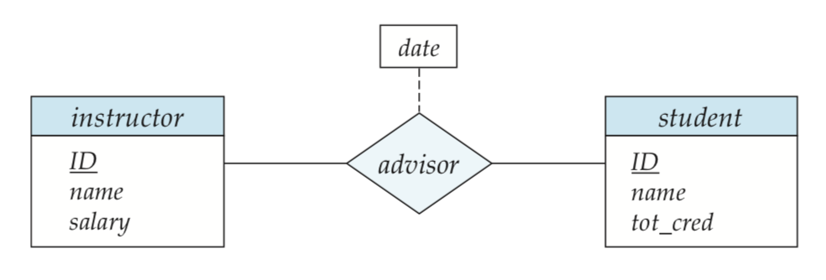
Entity Sets
Entity: An object in the real world, distinguishable from all other objects e.g. with a unique identifier such as an id
An entity set is a set of entities of the same type that share the same properties, or attributes
Instructor, Student, Plant, Farmer
ENTITY SET
ENTITY SET

Slide 19
Relationship Sets
Relationship - an association among (several) entities.
For example, we can define a relationship advisor that associates an instructor with a student.
Often a verb in a sentence indicates a relationship
Instructor advises a Student
Farmer grows Plants
Factory builds Products
Not always a verb:
Section is related to Course through a relationship we might call section-course

Slide 20
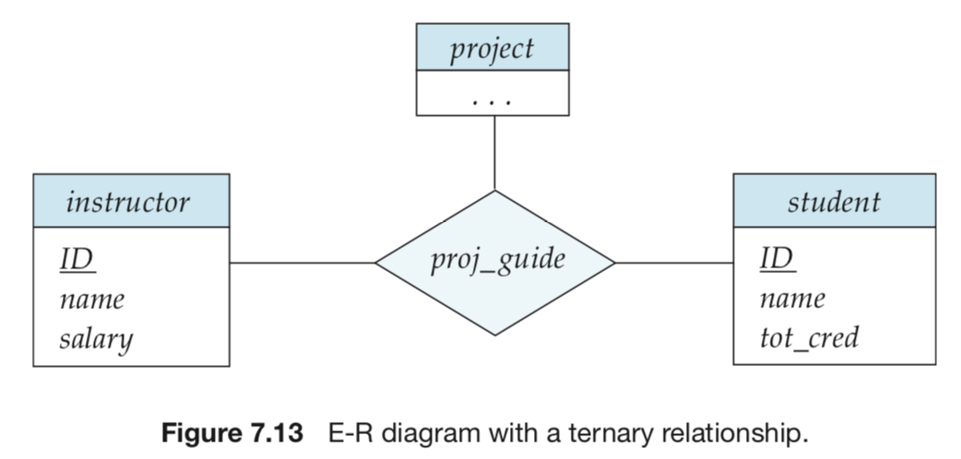
Relationship Sets
Relationship set - a set of relationships of the same type
Types of Relationship Sets
binary – involves 2 entity sets (most common)
n-ary – more than 2 entity sets
RELATIONSHIP SET (binary)
RELATIONSHIP SET (N-ary)

Slide 21
Attributes
Each entity has a set of properties.
These properties are referred to as attributes.
For example, a vegetable entity would be described by attributes such as price, color, seasonal, etc.
A primary key attribute is identified by an underline in the ER diagram.
Relationships may have attributes: date is relative to the advisor relationship

Slide 22
Attributes
Attributes may be..
Multivalued
Example: Students may have more than phone number
Composite
Example: Name may be composed of multiple parts: first name, middle name, last name; {name}
Derived
Example: Instructor may have a age field calculated from birth date; age()
{ }
birth_date
age()

Slide 23
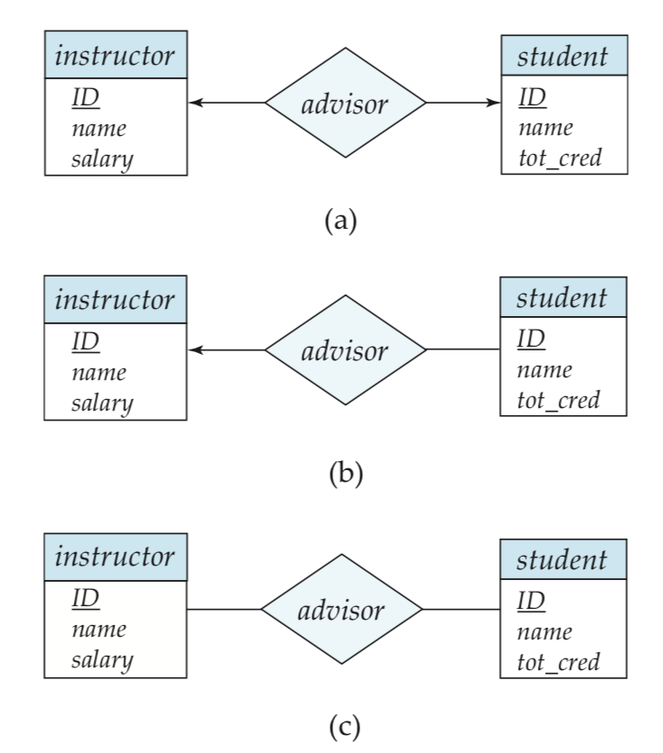
Cardinality of a Relationship
one-to-one (1:1): an entity related to exactly one type of another entity type
(a) Instructor advises at most 1 student, a student has at most 1 advisor
one-to-many (1:n) or vice versa: entity related to multiple entity types
(b) An Instructor may advise many students, but a student can have up to 1 advisor (or vice versa)
many-to-many (n:n):
(c) An instructor may advise many students, and students may have many advisors

Slide 24
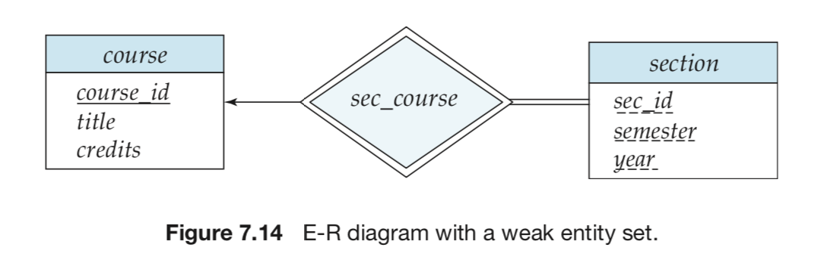
Existence Dependencies and Weak Entity Sets
Weak Entity Sets – their existence (identifying primary key) depends on a dominant set
sadas

Slide 25
Participation Constraints
Total - every entity in E participates in at least one relationship in R
Double line
Partial - only some entities in E participate in relationships in R

Slide 26
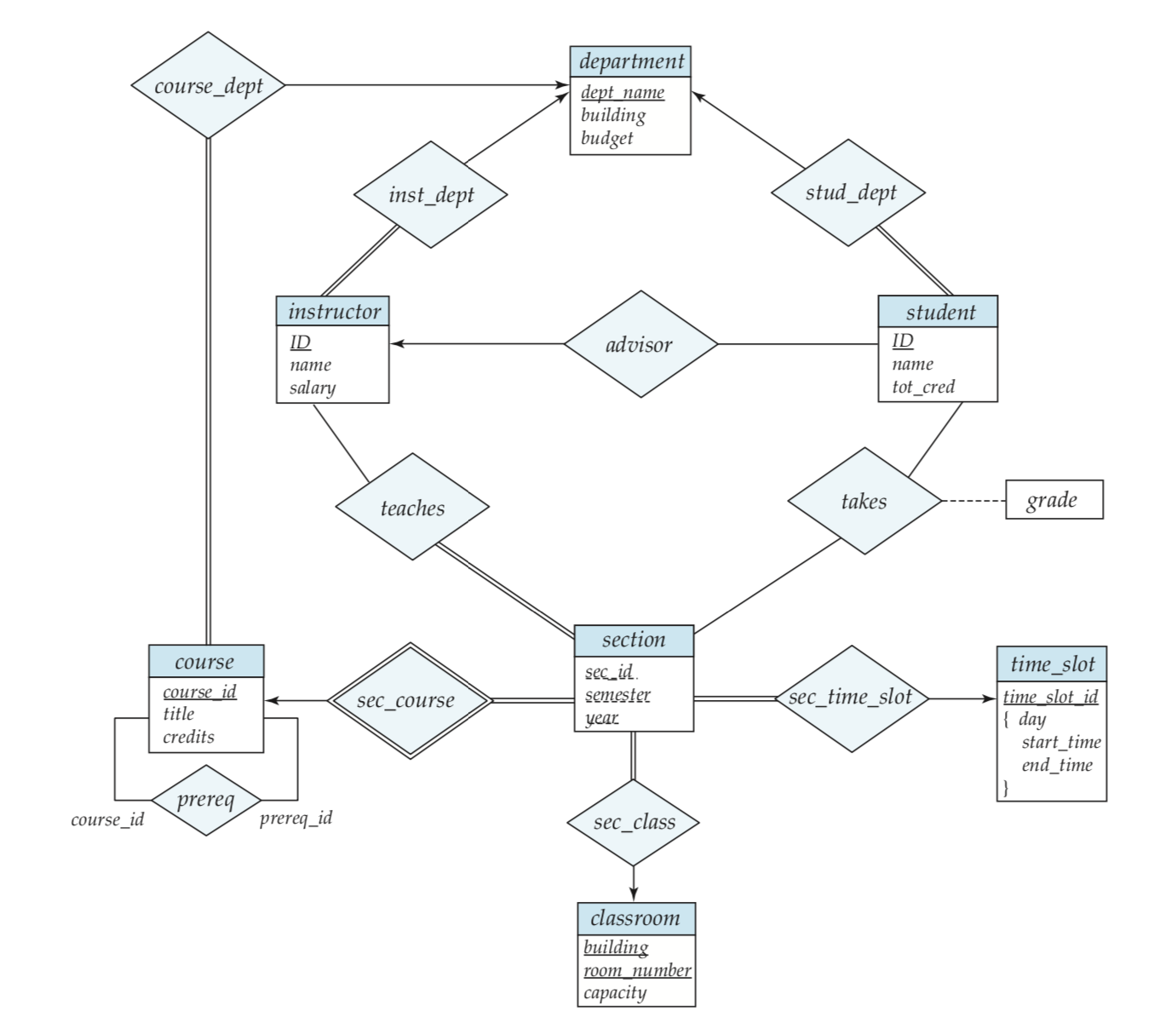
Textbook Example (p. 282)

Slide 27
Textbook Example (p. 282)
Entity sets are rectangles
Attributes inside
Primary key underlined
Relationship sets are diamonds

Slide 28
Textbook Example (p. 282)
Complex Attributes
time_slot consists of a primary key and a single other multivalued & composite attribute
multivalued: has curly brackets { }
composite: indented, in a group

Slide 29
Textbook Example (p. 282)
Cardinality: One to Many
An instructor may belong in at most one department, but a department can have many instructors
Similarly a student can have at most one advisor, but an instructor can advise many students
Directed arrow from the One going to the Many

Slide 30
Textbook Example (p. 282)
Cardinality: Many to Many
A student can be in many sections, and a section can have many students
An instructor can teach multiple sections, and a section can have multiple instructors
Undirected lines connecting the relationships!!

Slide 31
Textbook Example (p. 282)
Total Participation
Double lines
Every instructor belongs to a department
Every section is advised by an instructor
Every student belongs in a department
Every section belongs to a course and has time slots

Slide 32
Textbook Example (p. 282)
Partial Participation
Single lines
Not every instructor is an advisor to a student
Not every student has an advisor

Slide 33
Textbook Example (p. 282)
Weak/strong entity sets
Section depends on course to exist
Primary key of a weak entity set like Section uses the primary key of the strong set, plus its discriminator
Discriminator allows us to distinguish entities in the weak entity set from the strong entity
Discriminators have dashed underline
The relationship set connecting the two is a double diamond

Slide 34
Textbook Example (p. 282)
Building an ER Diagram
Group entities together, think about their relationships with each other
After you have your clusters, think about how these clusters are related

