Slide 1
Data Organization - B-trees

Slide 2
General Overview
Relational model - SQL
Formal & commercial query languages
Functional Dependencies
Normalization
Physical Design
Indexing
Query evaluation
Query optimization
….
Application
Oriented
Systems Oriented

Slide 3
Storage Media: Types
Cache – fastest and most costly form of storage; volatile; managed by the computer system hardware.
Main memory:
fast access (10s to 100s of nanoseconds; 1 nanosecond = 10^{–9} seconds)
generally too small (or too expensive) to store the entire database (but for some applications, this is changing)
Volatile — contents of main memory are usually lost if a power failure or system crash occurs.
But… CPU operates only on data in main memory

Slide 4
Storage Media: Types (cont.)
Disk
Primary medium for the long-term storage of data; typically stores entire database.
random-access – possible to read data on disk in any order, unlike magnetic tape
Non-volatile: data survive a power failure or a system crash, disk failure less likely than them
Flash Memory
no seeks
Cheap reads, expensive writes
experimental use for DB’s
NVM

Slide 5
Memory Hierarchy
cache
Main memory
Volatile
Lower price
Flash
Non-Volatile
Higher speed
disk
Optical storage
Traveling the hierarchy:
1. speed ( higher=faster)
2. cost (lower=cheaper)
3. volatility (between MM and Disk)
4. Data transfer (Main memory the “hub”)
5. Storage classes (P=primary, S=secondary,
T=tertiary)

Slide 6
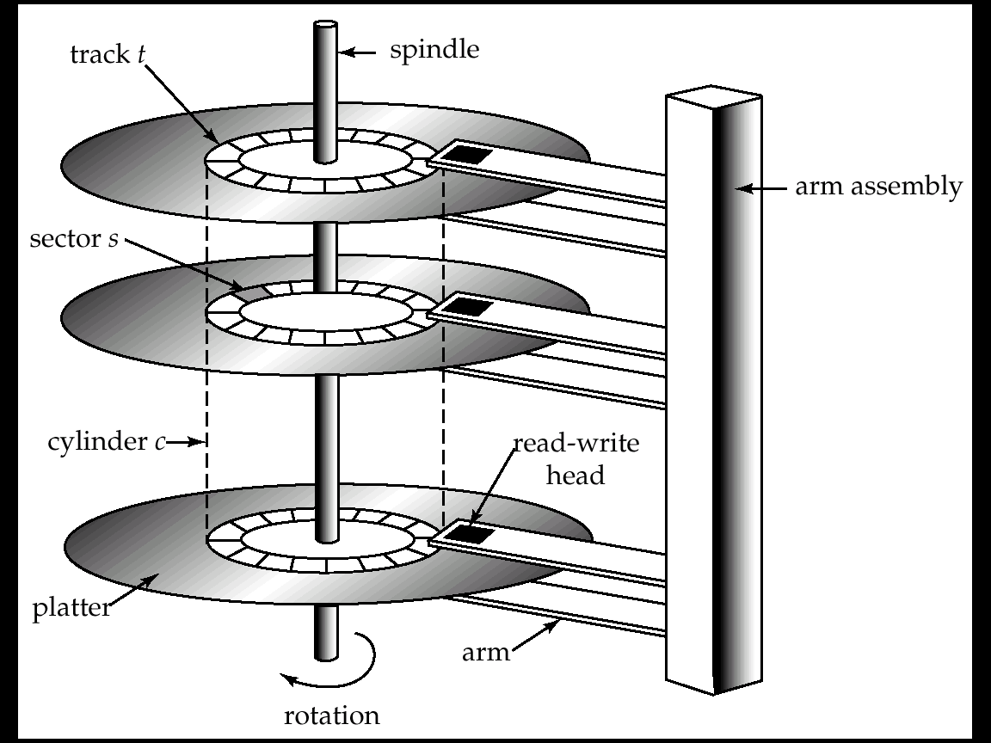
Hard Disk Mechanism

Slide 7
Read-write head
Positioned very close to the platter surface (almost touching it)
Surface of platter divided into circular tracks
Each track is divided into sectors.
A sector is the smallest unit of data that can be read or written.
To read/write a sector
disk arm swings to position head on right track
platter spins continually; data is read/written as sector passes under head
Block: a sequence of sectors
Cylinder i consists of i^{th} track of all the platters
Top view

Slide 8
Performance Measures of Disks
Measuring Disk Speed
Access time – consists of:
Seek time – time it takes to reposition the arm over the correct track.
(Rotational) latency time – time it takes for the sector to be accessed to appear under the head.
Data-transfer rate – the rate at which data can be retrieved from or stored to the disk.
Analogy to taking a bus:
1. Seek time: time to get to bus stop
2. Latency time; time spent waiting at bus stop
3. Data transfer time: time spent riding the bus

Slide 9
Random vs sequential I / O
Ex: 1 KB Block
Random I/O: ∼ 20 ms.
Sequential I/O: ∼ 1 ms.
Rule of Random I/O: Expensive Thumb Sequential I/O: Much less ~10-20 times

Slide 10
Data organization and retrieval
File organization can improve data retrieval time
SELECT *
FROM depositors
WHERE bname=“Downtown”
100 blocks
200 recs/block
Query returns 150 records
Heap
Ordered File
Mianus A-215
Perry A-218
Downtown A-101
....
Brighton A-217
Downtown A-101
Downtown A-110
......
OR
Searching a heap: must search all blocks (100 blocks)
Searching an ordered file:
1. Binary search for the 1st tuple in answer : log₂ 100 = 7 block accesses
2. scan blocks with answer: no more than 2
Total <= 9 block accesses

Slide 11
Data organization and retrieval
But... file can only be ordered on one search key:
Ordered File (bname)
Ex. Select *
From depositors
Where acct_no = “A-110”
Brighton A-217
Downtown A-101
Downtown A-110
......
Requires linear scan (100 BA’s)
Solution: Indexes!
Auxiliary data structures over relations that can improve the search time

Slide 12
A simple index
Index file
Brighton A-217 700
Downtown A-101 500
Downtown A-110 600
Mianus A-215 700
Perry A-102 400
......
A-101
A-102
A-110
A-215
A-217
......
Index of depositors on acct_no
Index records: <search key value, pointer (block, offset or slot#)>
To answer a query for “acct_no= A-110” we:
1. Do a binary search on index file, searching for A-110
2. “Chase” pointer of index record

Slide 13
Index Choices
Primary: index search key =
physical (sort) order search key
vs Secondary: all other indexes
Q: how many primary indexes per relation?
2. Dense: index entry for every search key value
vs Sparse: some search key values not in the index
3. Single-level vs Multi-level (index on the indexes)

Slide 14
Measuring ‘goodness’
On what basis do we compare different indices?
1. Access type: what type of queries can be answered:
selection queries (ssn = 123)?
range queries ( 100 <= ssn <= 200)?
2. Access time: what is the cost of evaluating queries
measured in # of block accesses
3. Maintenance overhead: cost of insertion / deletion? (also in # block accesses)
4. Space overhead : in # of blocks needed to store the index relative to the real data.

Slide 15
Indexing
Primary (or clustering) index on Ssn
-- Dense --
Notes:
As many index pointers as there are tuples in the STUDENT relation.

Slide 16
Indexing
Primary/sparse index on ssn (primary key)
>=123
>=456
Notes:
How to determine the break points in the index?

Slide 17
Indexing
Secondary (or non-clustering) index:
duplicates may exist
Can have many secondary indices
but only one primary index
Address-index
Notes:
As many index pointers as there are tuples in STUDENT.
Problem is this can lead to as many disk reads as there are tuples with a given indexed value.

Slide 18
Indexing
secondary index: typically, with ‘postings lists’
If not on a candidate key value.
Postings lists
Posting lists
useful with duplicates
minimize data reads

Slide 19
Indexing
Secondary / dense index
Secondary index on a candidate key:
No duplicates, no need for posting lists

Slide 20
Primary vs Secondary
1. Access type:
Primary: SELECTION, RANGE
Secondary: SELECTION, RANGE but index must point to posting lists (if not on candidate key).
2. Access time:
Primary faster than secondary for range queries
(no list access, all results clustered together)
3. Maintenance Overhead:
Primary has greater overhead (must alter index + file)
4. Space Overhead: secondary has more.. (posting lists)

Slide 21
Dense vs Sparse
1. Access type:
both: Selection, range (if primary)
2. Access time:
Dense: requires lookup for 1st result
Sparse: requires lookup + scan for first result
3. Maintenance Overhead:
Dense: Must change index entries
Sparse: may not have to change index entries
4. Space Overhead:
Dense: 1 entry per search key value
Sparse: < 1 entry per block

Slide 22
Summary
 | Dense | Sparse
Primary | rare | usual
secondary | usual
All combinations are possible
at most one sparse/clustering index
as many dense indices as desired
usually: one primary index (probably sparse) and a few secondary indices (non-clustering)
secondary / sparse: Which keys to use? Hot items?

Slide 23
ISAM
What if index is too large to search in memory?
2nd level sparse index on the values of the 1st level
>=123
>=456
block

Slide 24
ISAM - observations
What about insertions/deletions?
>=123
>=456
124; peterson; fifth ave.

Slide 25
ISAM - observations
What about insertions/deletions?
overflows
124; peterson; fifth ave.
Problems?

Slide 26
ISAM - observations
What about insertions/deletions?
overflows
124; peterson; fifth ave.
overflow chains may become very long - what to do?

Slide 27
ISAM - observations
What about insertions/deletions?
overflows
124; peterson; fifth ave.
overflow chains may become very long - thus:
shut-down & reorganize
start with ~80% utilization

Slide 28
ISAM - observations
if index is too large, store it on disk and keep index on the index (in memory)
usually two levels of indices, one first- level entry per disk block
typically, blocks: 80% full initially (what are potential problems / inefficiencies?)

Slide 29
So far
… indices (like ISAM) suffer in the presence of frequent updates
alternative indexing structure: B - trees

Slide 30
B-trees
Most successful family of index schemes
(B-trees, B⁺⁻trees, B*-trees)
Can be used for primary/secondary, clustering/non-clustering index.
Balanced “n-way” search trees

Slide 31
B-trees
e.g., B-tree of order 3:
< 6
6
9
>9
>6
< 9
1
3
13
7
records
Key values appear once.
Record pointers accompany keys.
For simplicity, we will not show records and record pointers.

Slide 32
B-tree Nodes
p1
pn
v1
v2
…
v_{n-1}
v<v1
v1 ≤ v < v2
Vn-1 < v
Key values are ordered
MAXIMUM: n pointer values
MINIMUM: ⎡n/2⎤ pointer values
(Exception: root’s minimum = 2)

Slide 33
Properties
“block aware” nodes: each node -> disk page
O(log_{B} (N)) for everything! (ins/del/search)
N is number of records
B is the branching factor ( = number of pointers)
typically, if B = (50 to 100), then 2 - 3 levels
utilization >= 50%, guaranteed; on average 69%

Slide 34
Queries
Algorithm for exact match query?
(e.g., ssn=8?)
< 6
6
9
> 6
>9
< 9
1
3
7
13

Slide 35
Queries
Algorithm for exact match query?
(e.g., ssn=7?)
6
9
< 6
>6
>9
< 9
1
3
7
13

Slide 36
Queries
Algorithm for exact match query?
(e.g., ssn=7?)
< 6
6
9
>9
>6
< 9
1
3
7
13

Slide 37
Queries
Algorithm for exact match query?
(e.g., ssn=7?)
6
9
< 6
>9
>6
< 9
1
3
7
13

Slide 38
Queries
Algorithm for exact match query?
(e.g., ssn=7?)
< 6
6
9
Height of tree = H
(= # disk accesses)
>9
>6
< 9
1
3
7
13

Slide 39
Queries
What about range queries?
(e.g., 5<salary<8)
Proximity/ nearest neighbor searches?
(e.g., salary ~ 8 )

Slide 40
Queries
What about range queries? (e.g., 5<salary<8)
Proximity/ nearest neighbor searches?
(e.g., salary ~ 8 )
< 6
6
9
>9
>6
< 9
1
3
7
13

Slide 41
How Do You Maintain B-trees?
Must insert/delete keys in tree such that the B-tree rules are obeyed.
Do this on every insert/delete
Incur a little bit of overhead on each update, but avoid the problem of catastrophic re-organization (a la ISAM).

Slide 42
B-trees: Insertion
Insert in leaf, if room exists
On overflow (no more room),
Split: create a new internal node
Redistribute keys
s.t., preserves B - tree properties
Push middle key up (recursively)

Slide 43
B-trees
Easy case: Tree T0; insert ‘8’
< 6
6
9
>9
>6
< 9
1
3
7
13

Slide 44
B-trees
Tree T0; insert ‘8’
< 6
6
9
>9
>6
< 9
1
3
7
8
13

Slide 45
B-trees
Hard case: Tree T0; insert ‘2’
< 6
6
9
>9
>6
< 9
1
3
7
13
2

Slide 46
B-trees
Hardest case: Tree T0; insert ‘2’
6
9
1
2
3
7
13
push middle up

Slide 47
B-trees
Hard case: Tree T0; insert ‘2’
Overflow
push middle key up
2
6
9
2
1
3
7
13
Split

Slide 48
B-trees
Hard case: Tree T0; insert ‘2’
6
Final state
2
9
1
3
7
13

Slide 49
B-trees - insertion
Q: What if there are two middles? (e.g., order 4)
A: either one is fine

Slide 50
B-trees: Insertion
Insert in leaf; on overflow, push middle up recursively – ‘propagate split’)
Split: preserves all B - tree properties (!!)
Notice how it grows: height increases when root overflows & splits
Automatic, incremental re-organization (contrast with ISAM!)

Slide 51
Overview
Primary / Secondary indices
Multilevel (ISAM)
B – trees
Definition, Search, Insertion, deletion
B+ - trees
Hashing

Slide 52
Deletion
Rough outline of algorithm:
Delete key;
on underflow, may need to merge
In practice, some implementers just allow underflows to happen…

Slide 53
B-trees – Deletion
Easiest case: Tree T0; delete ‘3’
6
9
< 6
>9
>6
< 9
1
3
7
13

Slide 54
B-trees – Deletion
Easiest case: Tree T0; delete ‘3’
< 6
6
9
>9
>6
< 9
1
7
13

Slide 55
B-trees – Deletion
Case1: delete a key at a leaf – no underflow
Case2: delete non-leaf key – no underflow
Case3: delete leaf-key; underflow, and ‘rich sibling’
Case4: delete leaf-key; underflow, and ‘poor sibling’

Slide 56
B-trees – Deletion
Case1:
delete a key at a leaf – no underflow
(delete 3 from T0)
< 6
6
9
>6
< 9
< 9
1
3
7
13

Slide 57
B-trees – Deletion
Case 2:
delete a key at a non-leaf – no underflow
delete 6 from T0
Delete & promote
6
9
< 6
>6
>9
< 9
1
3
7
13

Slide 58
B-trees – Deletion
Case 2:
delete a key at a non-leaf – no underflow
delete 6 from T0
Delete & promote
< 6
3
9
>6
>9
< 9
1
7
13

Slide 59
B-trees – Deletion
Case 2:
delete a key at a non-leaf – no underflow
delete 6 from T0
FINAL TREE
3
9
< 3
> 3
> 9
< 9
1
7
13

Slide 60
B-trees – Deletion
Case2: delete a key at a non-leaf
no underflow (e.g., delete 6 from T0)
Q: How to promote?
A: pick the largest key from the left sub-tree (or the smallest from the right sub-tree)

Slide 61
B-trees – Deletion
Case1: delete a key at a leaf – no underflow
Case2: delete non-leaf key – no underflow
Case3: delete leaf-key; underflow, and ‘rich sibling’
Case4: delete leaf-key; underflow, and ‘poor sibling’

Slide 62
B-trees – Deletion
Case3:
underflow & ‘rich sibling’
delete 7 from T0
Delete & borrow
< 6
6
9
>9
>6
< 9
1
3
7
13

Slide 63
B-trees – Deletion
Case3:
underflow & ‘rich sibling’
delete 7 from T0
Delete & borrow
6
9
Rich sibling
< 6
>6
> 9
< 9
1
3
13

Slide 64
B-trees – Deletion
Case3: underflow & ‘rich sibling’
‘rich’ = can give a key, without underflowing
‘borrowing’ a key: THROUGH the PARENT!

Slide 65
B-trees – Deletion
Case3:
underflow & ‘rich sibling’
delete 7 from T0
Delete & borrow
< 6
6
9
Rich sibling
> 9
> 6
< 9
1
3
13
NO!!

Slide 66
B-trees – Deletion
Case3:
underflow & ‘rich sibling’
delete 7 from T0
Delete & borrow
< 6
6
9
>9
>6
< 9
1
3
13

Slide 67
B-trees – Deletion
Case3:
underflow & ‘rich sibling’
delete 7 from T0
Delete & borrow
< 6
3
9
> 9
> 6
< 9
1
6
13

Slide 68
B-trees – Deletion
Case3:
underflow & ‘rich sibling’
delete 7 from T0
Delete & borrow, through the parent
FINAL TREE
3
9
< 3
>3
> 9
< 9
1
6
13

Slide 69
B-trees – Deletion
Case1: delete a key at a leaf – no underflow
Case2: delete non-leaf key – no underflow
Case3: delete leaf-key; underflow, and ‘rich sibling’
Case4: delete leaf-key; underflow, and ‘poor sibling’

Slide 70
B-trees – Deletion
Case 4
Underflow & ‘poor sibling’
Delete 13 from T0
< 6
6
9
>9
>6
< 9
1
3
7
13
Merge, by pulling a key from the parent
Exact reversal from insertion:
‘split and push up’, vs. ‘merge and pull down’

Slide 71
B-trees – Deletion
Case 4
Underflow & ‘poor sibling’
Delete 13 from T0
A: merge w/ ‘poor’ sibling
6
< 6
> 6
1
3
7
9

Slide 72
B-trees – Deletion
Case 4
Underflow & ‘poor sibling’
Delete 13 from T0
FINAL TREE
< 6
6
> 6
1
3
7
9

Slide 73
B-trees – Deletion
Case4: underflow & ‘poor sibling’
→ ‘pull key from parent, and merge’
Q: What if the parent underflows?
A: repeat recursively

Slide 74
B-trees in practice
FILE
In practice:
Ssn | … | …
3
7
6
9
1
< 6
6
9
> 6
> 9
< 9
1
3
7
13

Slide 75
B-trees in practice
The formats are:
leaf nodes: (v1, rp1, v2, rp2, … vn, rpn)
Non-leaf nodes: (p1, v1, rp1, p2, v2, rp2, …)
< 6
6
9
> 6
> 9
< 9
1
3
7
13

Slide 76
Overview
primary / secondary indices
multilevel (ISAM)
B – trees
B+ - trees
hashing

Slide 77
B+ trees - Motivation
B-tree – print keys in sorted order:
< 6
6
9
> 6
> 9
< 9
1
3
7
13

Slide 78
B+ trees - Motivation
B-tree needs back-tracking – how to avoid it?
< 6
6
9
> 9
> 6
< 9
1
3
7
13

Slide 79
Solution: B⁺ - trees
Facilitate sequential ops
String all leaf nodes together
AND
replicate keys from non-leaf nodes, to make sure every key appears at the leaf level

Slide 80
B+-trees
B+-tree of order 3:
root: internal node
6
9
< 6
≥ 6
≥ 9
< 9
3
4
6
7
9
13
leaf node
(3, Joe, 23)
(4, John, 23)
Data File
(3, Bob, 23)
…………
…………
…………

Slide 81
B+ tree insertion
INSERTION OF KEY ’K’
insert search-key value to leaf ’L’ such that the keys are in order;
if ( ’L’ overflows) {
split ’L’ and redistribute keys ;
insert (ie., COPY) middle search-key value to parent node ’P’;
if (’P’ overflows) {
repeat the B-tree split procedure recursively;
/* Notice: the B-TREE split; NOT the B+ -tree */
}
}

Slide 82
B+-tree insertion – cont’d
ATTENTION:
A split at the LEAF level is handled by
COPYING the middle key up;
A split at a higher level is handled by
PUSHING the middle key up
Remember: Leaf nodes must be complete – all keys
Interior nodes need not be complete

Slide 83
B+ trees - insertion
Insert ‘8’
> 6
6
9
≥ 6
≥ 9
< 9
1
3
6
7
9
13

Slide 84
B+ trees - insertion
Insert ‘8’
6
9
< 6
≥ 6
≥ 9
< 9
1
3
6
7
9
13
8

Slide 85
B+ trees - insertion
Eg., insert ‘8’
<6
6
9
≥ 9
≥ 6
<9
1
3
6
7
8
9
13
COPY middle (=7) up to parent
; Keep 8 in leaf as well

Slide 86
B+ trees - insertion
Eg., insert ‘8’
< 6
6
9
≥ 9
≥ 6
< 9
7
1
3
6
7
8
9
13
COPY middle key (of 6, 7, 8) up to parent and split
7 and 8 remain in leaves since all keys are present there.

Slide 87
B+ trees - insertion
Non-leaf overflow – just PUSH the middle
Insert ‘8’
<6
6
9
≥ 9
≥ 6
< 9
7
1
3
6
7
8
9
13
COPY middle key up to parent again

Slide 88
B+ trees – insertion
7
Insert ‘8’
< 7
≥ 7
6
9
<6
<9
≥ 9
≥ 6
1
3
6
7
8
9
13
FINAL TREE

