Slide 1
Query Processing

Slide 2
Review
Support for data retrieval at the physical level:
  Indices: data structures to help with some query evaluation:
    SELECTION queries (ssn = 123)
    RANGE queries (100 <= ssn <=200)
  Index choices: Primary vs secondary, dense vs sparse, ISAM vs B+-tree vs Extendible Hashing vs Linear Hashing
Sometimes, indexes not useful, even for SELECTION queries.
And what about join queries or other queries not directly supported by the indices? How do we evaluate these queries?
What decides these implementation choices?
Ans: Query Processor(one of the most complex components of a database system)

Slide 3
QP & O
SQL Query
Query
Processor
Data: result of the query

Slide 4
QP & O
SQL Query
Query
Processor
Parser
Algebraic
Expression
Query Optimizer
Execution plan
misnomer
Evaluator
Data: result of the query

Slide 5
QP & O
Algebraic
Representation
Query
Optimizer
Query Rewriter
Algebraic Representation
Plan Generator
Data Stats
Query Execution Plan

Slide 6
Query Processing and Optimization
Parser / translator (1st step)
Input: SQL Query (or OQL, …)
Output: Algebraic representation of query (relational algebra expression)
Eg SELECT balance
FROM account
WHERE balance < 2500
  ∏_{balance}(σ_{balance<2500}(account))
or
∏_{balance}
σ_{balance<2500}
account

Slide 7
Query Processing & Optimization
Plan Generator produces:
Query execution plan
    Algorithms for operators that read from disk:
      Sequential scan
      Index scan
      Merge-sort join
      Nested loop join
      …..
Plan Evaluator (last step)
Input: Query Execution Plan
Output: Data (Query results)

Slide 8
Query Processing & Optimization
Query Rewriting
Input: Algebraic representation of query
Output: Algebraic representation of query
Idea: Apply heuristics to generate equivalent expression that is likely to lead to a better plan
e.g.: σ_{amount > 2500} (borrower loan)
borrower (σ_{amount > 2500}(loan))
Why is 2nd better than 1st?

Slide 9



Equivalence Rules
1. Conjunctive selection operations can be deconstructed into a sequence of individual selections.
2. Selection operations are commutative.
3. Only the last in a sequence of projection operations is needed, the others can be omitted.
Selections can be combined with Cartesian products and theta joins.
  σ_{θ}(E₁ X E₂) = E₁ _{θ} E₂
  σ_{θ1}(E₁ _{θ2} E₂) = E₁ _{θ1∧ θ2} E₂

Slide 10
Query Processing & Optimization
Plan Generator
Input: Algebraic representation of query
Output: Query execution plan
Idea:
  generate alternative plans for evaluating a query
    σ_{amount > 2500}
  Estimate cost for each plan
  Choose the plan with the lowest cost
COST: approx., counts sources of latency
Sequential scan
Index scan

Slide 11
Query Processing & Optimization
Goal: generate plan with minimum cost
(i.e., fast as possible)
Cost factors:
  CPU time (trivial compared to disk time)
  Disk access time
    main cost in most DBs
  Network latency
    Main concern in distributed DBs
Our metric: count disk accesses

Slide 12
Cost Model
How do we predict the cost of a plan?
Ans: Cost model
  For each plan operator and each algorithm we have a
  cost formula
  Inputs to formulas depend on relations, attributes, etc.
  Database maintains statistics about relations for
  this (Metadata)

Slide 13
Metadata
Given a relation r, DBMS likely maintains the following metadata:
Size (# tuples in r) n_{r}
Size (# blocks in r) b_{r}
Block size (# tuples per block) f_{r}
  (typically b_{r} = ⎡ n_{r} / f_{r} ⎤ )
Tuple size (in bytes) s_{r}
Attribute Values V(att, r)
(for each attribute att in r, # of different values)
Selection Cardinality SC(att, r)
(for each attribute att in r,
expected size of a selection: σ_{att = K} (r ) )

Slide 14
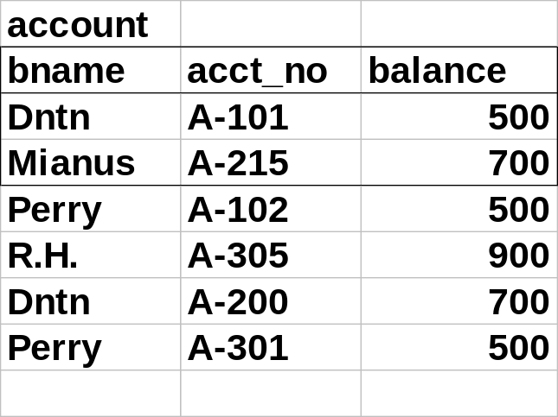
Example
n_{account} = 6
s_{account} = 33 bytes
f_{account} = ⎣4K/33⎦
V(balance, account) = 3
V(acct_no, account) = 6
SC (balance, account) = 2 ( n_{r} / V(att, r))

Slide 15
Some typical plans and their costs
Query: σ_{att = K} (r )
A1 (linear search). Scan each file block and test all records to see whether they satisfy the selection condition.
  Cost estimate (number of disk blocks scanned) = b_{r}
    b_{r} denotes number of blocks containing records from relation r
  If selection is on a key attribute, cost = (b_{r} /2)
    stop on finding record (on average in the middle of the file)
  Linear search can be applied regardless of
    selection condition or
    ordering of records in the file, or
    availability of indices
E_{A1} = b_{r} (if attr is not a key)
b_{r} /2 (if attr is a key)

Slide 16
Selection Operation (Cont.)
Query: σ_{att = K} (r )
A2 (binary search). Applicable if selection is an equality comparison on the attribute on which file is sorted.
  Requires that the blocks of a relation are sorted and stored contiguously.
  Cost estimate:
    ⎡log ₂ (b _{r} )⎤ — cost of locating the first tuple by a binary search on the blocks
    Plus number of blocks containing records that satisfy selection condition
  E_{A2} = ⎡log₂ (b_{r} )⎤ + ⎡SC (att, r) / f_{r}⎤ - 1
What is the cost if att is a key?
less the one you
already found
E_{A2} = ⎡log₂(b_{r})⎤

Slide 17
Example
Account (bname, acct_no, balance)
Query: σ_{bname =“Perry”} ( Account )
n_{account} = 10,000 tuples
f_{account} = 20 tuples/block
b_{account=}= 10,000 / 20 = 500 blocks
V(bname, Account) = 50 values
SC(bname, Account) = ⎡10,000 / 50 ⎤ = 200 tuples per key value
Assume sorted on bname
Cost Estimates (comparing our two algorithms):
A1: E_{A1} = ⎡n_{Account} / f_{Account} ⎤ = ⎡10,000 / 20 ⎤ = 500 I/O’s
A2: E_{A2} = ⎡log₂(b_{Account})⎤ + ⎡SC(bname, Account) / f_{account}⎤ -1
= 9 + 9 = 18 I/O’s

Slide 18
More Plans for selection
What if there’s an index (B+Tree) on att?
We need metadata on size of index (i). DBMS keeps track of:
  Index height: HT_{i}
  Index “Fan Out”: f_{i}
    Average # of children per node (not same as order.)
  Index leaf nodes: LB_{i}
  Note: HT_{i} ~ ⎡log_{fi} (LB_{i} )⎤
Notes:
Note that if you had a root with fanout = 100, log (LB) would = 1
While the number of block reads would be 2.

Slide 19
B+-trees
REMINDER
B+-tree of order 3:
This is a primary index
root: internal node
6
9
< 6
≥ 6
≥ 9
< 9
3
4
6
7
9
13
leaf node
(3, Joe, 23)
(4, John, 23)
Data File
(3, Bob, 23)
…………
…………
…………

Slide 20
B+Tree, Another Look
i
HTi
3
Leaf nodes
2 2 2 2 3 3 3
3 3 3 3 3 3 3
3 3 3 3 4 4 4
Data File
⎡SC(att, r) / f_{r}⎤ = 14 / 7
14 tuples / 7 tuples per block = 2 blocks

Slide 21
More Plans for selection
Query: σ_{att = K} (r )
A3: Index scan, Primary (B⁺-Tree) Index
What: Follow primary index, searching for key K
Prereq: Primary index on att, i
Cost:
  EA3 = HT_{i} + 1, if att is a candidate key
  EA3 = HT_{i} +1+⎡SC(att, r) / f_{r}⎤, if not
Remember for primary index,
data file is sorted => sparse index
Number of blocks containing att=K in data file
Notes:
One more than HT is needed to read the data file.

Slide 22
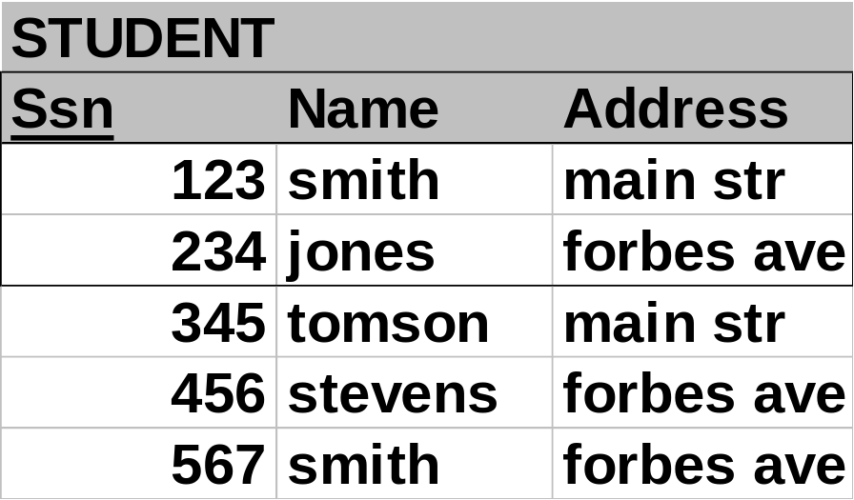
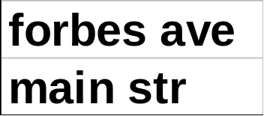
Secondary Indexing
REMINDER
secondary index: typically, with ‘postings lists’
Postings lists

Slide 23
B+Tree, Secondary Index
i
HTi
3
Posting List
2 5 3 4 1 1 3
4 3 2 1 7 3 3
1 2 3 3 4 9 4
Data Blocks
The number of records
with value = 3
= # blocks read
SC(att, r)

Slide 24
Query: σ_{att = K} (r )
A4: Index scan, Secondary Index
Prereq: Secondary index on att, i
What: Follow index, searching for key K
Cost:
If att not a key:
E_{A4} = HT_{i} + BPL + SC(att, r)
bucket read for posting list
YIKES!
Index block
reads
File block reads
(in worst case, each
tuple on different block)
Else, if att is a candidate key: E_{A4} = HT_{i} + 1 (no posting lists)

Slide 25
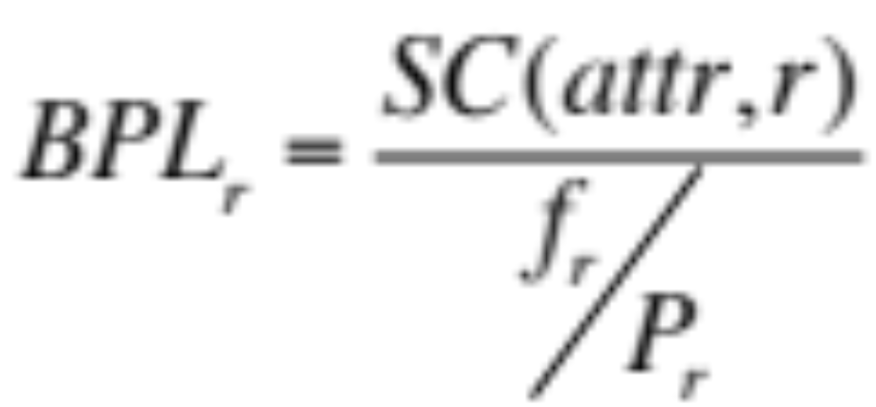
How Big is the Posting List
BPL _{r} = Blocks in Posting List
P_{r} = size of a pointer → NEW
f_{r} = size of a block
Num occurrences
Num pointers in a block

Slide 26
Selections Involving Comparisons
Query: σ_{Att ≥ K} (r )
A5 (primary index, comparison). (Relation is sorted on Att)
    For σ_{Att ≥ K} (r) use index to find first tuple ≥ K and scan relation sequentially from there
    For σ_{Att≤K} (r) just scan relation sequentially until first tuple > K; do not use index
Cost of first: E_{A5} =HT_{i} + ⎡c / f_{r}⎤ (where c is the cardinality of result)
HT_{i}
Leaf nodes
k
Data File
.
k
Primary index =.>
SORTED on Att

Slide 27
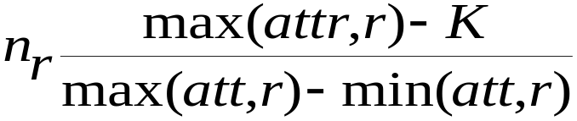
Selections Involving Comparisons (cont.)
Query: σ_{Att ≥ K} (r )
Cardinality: More metadata on r is needed:
    min (att, r) : minimum value of att in r
    max(att, r): maximum value of att in r
Then the selectivity of σ_{Att ≥ K} (r ) is estimated as:
(or n_{r} /2 if min, max unknown)
Intuition: assume uniform distribution of values between min and max
min(attr, r)
K
max(attr, r)

Slide 28
Plan generation: Range Queries
σ_{Att ≥K} (r )
A6: (secondary index, comparison).
Att is a candidate key
Cost: E_{A6} = HT_{i} -1+ #of leaf nodes to read + # of file blocks to read
= HT_{i} -1+ ⎡LB_{i} * (c / n_{r})⎤ + c, if att is a candidate key
      There will be c file pointers for a key.
HT_{i}
Leaf nodes
k, k+1
...
k+m
File
...
k+m
k+1
k

Slide 29
Plan generation: Range Queries
A6: (secondary index, range query). Att is NOT a candidate key
Query: σ_{K} _{≤ Att ≤ K+m} (r )
HT_{i}
Leaf nodes
k, k+1
...
k+m
Posting
Lists
...
File
k
k+1
k+m
k
...
...

Slide 30
Cost: E_{A6} = HT_{i} -1 + # leaf nodes to read +
# file blocks to read +
# posting list blocks to read
= HT_{i} -1+ ⎡LB_{i} * (c / n_{r})⎤ + c + x
where x accounts for the posting lists
computed like before.

Slide 31
Cardinalities
Cardinality: the number of tuples in the query result (i.e., size)
Why do we care?
Ans: Cost of every plan depends on n_{r}
e.g. Linear scan: b_{r} = ⎡ n_{r} / f_{r}⎤
But, what if r is the result of another query?
Must know the size of query results as well as cost
Size of σ_{att = K} (r ) ?
ans: SC(att, r)

Slide 32
Join Operation
Size and cost of plans for join operation
Running example: depositor customer
Metadata:
n_{customer} = 10,000 n_{depositor} = 5000
f_{customer} = 25 f_{depositor} = 50
b_{customer}= 400 b_{depositor}= 100
V(cname, depositor) = 2500
(each depositor has on average 2 accts)
cname in depositor is a foreign key (from customer)
Depositor (cname, acct_no)
Customer (cname, cstreet, ccity)

Slide 33
Cardinality of Join Queries
What is the cardinality (number of tuples) of the join?
E1: Cartesian product: n_{customer} * n_{depositor} = 50,000,000
E2: Attribute cname common in both relations,
2500 different cnames in depositor
Size: n_{customer} * (avg # tuples in depositor with same cname)
= n_{customer} * (n_{depositor} / V(cname, depositor))
= 10,000 * (5000 / 2500)
= 20,000

Slide 34
Cardinality of Join Queries
E3: cname is a key in customer
cname is a foreign key (exhaustive) in depositor
(Star schema case)
Size: n_{depositor} * (avg # of tuples in customer with same cname)
= n_{depositor} * 1
= 5000
key
Note: If cname is a key for Customer but
NOT an exhaustive foreign key for Depositor,
then 5000 is an UPPER BOUND
Some customer names may not match with
any customers in Depositor (have no accounts)

Slide 35
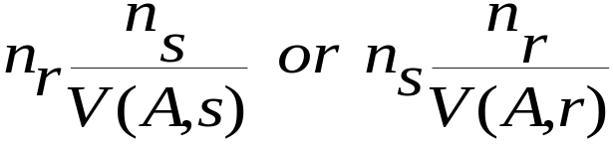
Cardinality of Joins in general
Assume join: R S (common attributes are not keys)
If R, S have no common attributes: n_{r} * n_{s}
If R,S have attribute A in common:
    (take min)
These are not the same when V(A,s) ≠ V(A,r).
When this is true, there are likely to be dangling tuples.
Thus, the smaller is likely to be more accurate.

Slide 36
Nested-Loop Join
Query: R S
Algorithm 1: Nested Loop Join
Idea:
Blocks
of...
t1
u1
t2
u2
t3
u3
R
S
results
Compare: (t1, u1), (t1, u2), (t1, u3) .....
Then: GET NEXT BLOCK OF S
Repeat: for EVERY tuple of R

Slide 37
Nested-Loop Join
Query: R S
Algorithm 1: Nested Loop Join
for each tuple t_{r} in R do
for each tuple u_{s} in S do
test pair (t_{r},u_{s}) to see if they satisfy the join condition
if they do (a “match”), add t_{r} • u_{s} to the result.
R is called the outer relation and S the inner relation of the join.

Slide 38
Nested-Loop Join (Cont.)
Cost:
Worst case, if buffer size is 3 blocks
b_{r} + n_{r} ∗ b_{s} disk accesses.
Best case: buffer big enough for entire INNER relation + 2
b_{r} + b_{s} disk accesses.
Assuming worst case memory availability cost estimate is
  5000 ∗ 400 + 100 = 2,000,100 disk accesses
    with depositor as outer relation, and
  10000 ∗ 100 + 400 = 1,000,400 disk accesses
    with customer as the outer relation.
If smaller relation (depositor) fits entirely in memory (+ 2 more blocks), the cost estimate will be 500 disk accesses.

Slide 39
Join Algorithms
Query: R S
Algorithm 2: Block Nested Loop Join
Idea:
Blocks
of...
t1
u1
t2
u2
t3
u3
R
S
results
Compare: (t1, u1), (t1, u2), (t1, u3)
(t2, u1), (t2, u2), (t2, u3)
(t3, u1), (t3, u2), (t3, u3)
Then: GET NEXT BLOCK OF S
Repeat: for EVERY BLOCK of R

Slide 40
Block Nested-Loop Join
Block Nested Loop Join
for each block B_{R} of R do
for each block B_{S} of S do
for each tuple t_{r} in B_{R} do
for each tuple u_{s} in B_{s} do begin
Check if (t_{r},u_{s}) satisfy the join condition
if they do (“match”), add t_{r} • u_{s} to the result.

Slide 41
Block Nested-Loop Join (Cont.)
Cost:
Worst case estimate (3 blocks): b_{r} ∗ b_{s} + b_{r} block accesses.
Best case: b_{r} + b_{s} block accesses. Same as nested loop.
Improvements to nested loop and block nested loop algorithms for a buffer with M blocks:
  In block nested-loop, use M — 2 disk blocks as blocking unit for outer relation, where M = memory size in blocks; use remaining two blocks to buffer inner relation and output
    Cost = ⎡b_{r} / (M-2)⎤ ∗ b_{s} + b_{r}
  If equi-join attribute forms a key on inner relation, stop inner loop on first match
  Scan inner loop forward and backward alternately, to make use of the blocks remaining in buffer (with LRU replacement)

Slide 42
M-2 to 1 Buffer Split
BUFFER
Output buffer
M = 5
R
S
First round –read 7 blocks
Second round – read 7 blocks
TOTAL: 14 blocks

Slide 43
(M-1)/2 to (M-1)/2 Buffer Split
BUFFER
Output buffer
M = 5
R
S
First round –read 6 blocks
Second round – read 6 blocks
Third round – read 6 blocks
TOTAL: 18 blocks

Slide 44
Join Algorithms
Query: R S
Algorithm 3: Indexed Nested Loop Join
Idea:
Blocks
of...
t1
t2
t3
R
S
results
(fill w/
blocks of
S or index blocks)
Assume A is the attribute R,S have in common
For each tuple t_{i} of R
if t_{i}.A = K then use the index to compute σ_{att = K} (S )
Demands: index on A for S

Slide 45
Indexed Nested-Loop Join
Indexed Nested Loop Join
For each tuple t_{R} in the outer relation R, use the index to look up tuples in S that satisfy the join condition with tuple t_{R}.
Worst case: buffer has space for only one page of R, and, for each tuple in R, we perform an index lookup on s.
Cost of the join: b_{r} + n_{r} ∗ c
  Where c is the cost of traversing index and fetching all matching s tuples for one tuple or r
  c can be estimated as cost of a single selection on s using the join condition.
If indices are available on join attributes of both R and S,
use the relation with fewer tuples as the outer relation.

Slide 46
Example of Nested-Loop Join Costs
Query: depositor customer
(cname, acct_no) (cname, ccity, cstreet)
Metadata:
customer: n_{customer} = 10,000
f_{customer} = 25 b_{customer} = 400
depositor: n_{depositor} = 5000
f_{depositor} = 50 b_{depositor} = 100
V (cname, depositor) = 2500
i is a primary index on cname (dense) for customer
Fanout for i, f_{i} = 20
f_{r} = # tuples / block
b_{r} = # blocks in r

Slide 47
Plan generation for Joins
Alternative 1: Block Nested Loop
1a: customer = OUTER relation
depositor = INNER relation
cost = b_{customer} + b_{customer} * b_{depositor} = 400 +(100 * 400 ) = 40,400
1b: customer = INNER relation
depositor = OUTER relation
cost = b_{depositor} + b_{depositor} * b_{customer} = 100 +(400 *100) = 40,100

Slide 48
Plan generation for Joins
Alternative 2: Indexed Nested Loop
We have an index on cname for customer.
Depositor is the outer relation
Cost:
b_{depositor} + n_{depositor} * c = 100 +(5000 *c )
c is the cost of evaluating a selection cname = K using the index.
Primary index on cname, cname a key for customer
c = HT_{i} +1

Slide 49
Plan generation for Joins
What is HT_{i} ?
cname a key for customer. V(cname, customer) = 10,000
f_{i} = 20, i is dense
LB_{i} = ⎡ 10,000 / 20⎤ = 500
  HT_{i} ~ ⎡log_{fi}(LB_{i})⎤ + 1 = ⎡log₂₀ 500⎤ + 1 = 4
Cost of index nested loop is:
= 100 + (5000 * (4)) = 20,100 Block accesses (cheaper than NLJ)
Notes:
b_{depositor} + n_{depositor} * c

Slide 50
Another Join Strategy
Query: R S
Algorithm 4: Merge Join
Idea: suppose R, S are both sorted on A (A is the common attribute)
A
A
1
2
3
4
p_{R}
p_{S}
2
2
3
5
...
...
Compare:
(1, 2) advance p_{R}
(2, 2) match, advance p_{S} → add to result
(2, 2) match, advance p_{S} → add to result
(2, 3) advance p_{R}
(3, 3) match, advance p_{S} → add to result
(3, 5) advance p_{R}
(4, 5) read next block of R

Slide 51
Merge-Join
GIVEN R, S both sorted on A
Initialization
  Reserve blocks of R, S in buffer reserving one block for result
  Pr= 1, Ps =1
Join (assuming no duplicate values on A in R)
WHILE !EOF( R) && !EOF(S) DO
if B_{R}[Pr].A == B_{S}[Ps].A then
output to result; Ps++
else if B_{R}[Pr].A < B_{S}[Ps].A then
Pr++
else (same for Ps)
if Pr or Ps point past end of block,
read next block and set Pr(Ps) to 1

Slide 52
Cost of Merge-Join
Each block needs to be read only once (assuming all tuples for any given value of the join attributes fit in memory)
Thus number of block accesses for merge-join is
b_{R} + b_{S}
But....
What if one/both of R,S not sorted on A?
Ans: May be worth sorting first and then performing merge join
(called Sort-Merge Join)
Cost: b_{R} + b_{S} + sort_{R} + sort_{S}

Slide 53
External Sorting
Not the same as internal sorting
Internal sorting:
→ minimize CPU (count comparisons)
→ best: quicksort, mergesort, ....
External sorting:
→ minimize disk accesses (what we’re sorting doesn’t fit in memory!)
→ best: external merge sort
WHEN used?
1) SORT-MERGE join
2) ORDER BY queries
3) SELECT DISTINCT (duplicate elimination)

Slide 54
External Sorting
Idea:
1. Sort fragments of file in memory using internal sort (runs). Store runs on disk. (run size = 3 = block size)
2. Merge runs. E.g.:
a
b
c
19
14
33
g
a
d
c
b
e
r
d
m
p
d
a
sort
a
d
g
19
31
24
a
a
b
c
d
d
d
e
g
m
p
r
24
19
31
33
14
16
16
21
3
2
7
14
14
19
14
33
7
21
31
16
24
3
2
16
merge
d
e
g
31
16
24
sort
b
c
e
14
33
16
merge
sort
d
m
r
21
3
16
a
d
d
14
7
21
sort
merge
m
p
r
3
2
16
a
d
p
14
7
2

Slide 55
External Sorting (cont.)
Algorithm
Let M = size of buffer (in blocks)
Sort runs of size M blocks each (except for last) and store.
Use internal sort on each run.
2. Merge M-1 runs at a time into 1 and store as a new run. Merge for all runs. (1 block per run + 1 block for output)
3. If step 2 results in more than 1 run, go to step 2.
........
Run 1
Run 2
Run 3
Run
M-1
Output

Slide 56
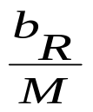
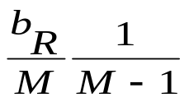
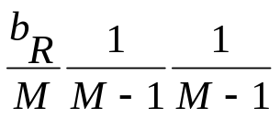
External Sorting (cont.)
Cost: 2 b_{R} * (⎡log_{M-1}(b_{R} / M)⎤ + 1)
Step 1: Create runs
→ every block read and written once
→ cost = 2 b_{R} I/Os
Step 2: Merge
→ every merge iteration requires reading and writing entire file ( = 2 b_{R} I/Os)
→ every iteration reduces the number of runs by factor of M-1
Number of iterations
Iteration #
---------------
1
2
3
.....
Runs Left to Merge
----------------------------
Initial number
of runs
# merge passes =
⎡log_{M-1}(b_{R} / M)⎤

Slide 57
What if we need to sort?
Query: depositor customer
b_{depositor} = 100 blocks; b_{customer} = 400 blocks; 3 buffer blocks
Sort depositor = 2 * 100 * (⎡log₂(100 / 3)⎤ + 1)
= 1400
Same for customer. = 7200
Total: 100 + 400 + 1400 + 7200 = 9100 I/O’s!
Still beats BNLJ (40K), INLJ (20K)
Why not use SMJ always?
Ans: 1) Sometimes inner relation can fit in memory
2) Sometimes index is small
3) SMJ only work for natural joins, “equijoins”

Slide 58
Hash-Join
Applicable for equi-joins and natural joins.
A hash function h is used to partition tuples of both relations
h maps JoinAttrs values to {0, 1, ..., n}, where JoinAttrs denotes the common attributes of r and s used in the natural join.
  r₀, r₁, . . ., r_{n} denote partitions of tuples of r .
    Each tuple t_{r} ∈ r is put in partition r_{i} where i = h(t_{r} [JoinAttrs]).
  r₀,, r₁. . ., r_{n} denotes partitions of tuples of s.
    Each tuple t_{s} ∈s is put in partition s_{i}, where i = h(t_{s} [JoinAttrs]).

Slide 59

Hash-Join (Cont.)

Slide 60
Hash-Join (Cont.)
r tuples in r_{i} need only to be compared with s tuples in s_{i} Need not be compared with s tuples in any other partition, since:
  an r tuple and an s tuple that satisfy the join condition will have the same value for the join attributes.
  If that value is hashed to some value i, the r tuple has to be in r_{i} and the s tuple in s_{i}.

Slide 61
Hash-Join Algorithm
The hash-join of r and s is computed as follows.
1. Partition the relation s using hashing function h. When partitioning a relation, one block of memory is reserved as the output buffer for each partition.
2. Partition r similarly.
3. For each i:
  (a) Load s_{i} into memory and build an in-memory hash index on it using the join attribute. This hash index uses a different hash function than the earlier one h.
  (b) Read the tuples in r_{i} from the disk one by one. For each tuple t_{r} locate each matching tuple t_{s} in s_{i} using the in-memory hash index. Output the concatenation of their attributes.
Relation s is called the build input and r is called the probe input.
Notes:
Use M-2 buffer blocks to buffer inner relation’s ith partition.
Use one buffer block for reading the outer relation’s ith partition.

Slide 62
Hash-Join algorithm (Cont.)
The value n and the hash function h is chosen such that each s_{i} should fit in memory.
  Typically n is chosen as ⎡b_{s}/M⎤ * f where f is a “fudge factor”, typically around 1.2
  The probe relation partitions s_{i} need not fit in memory
Cost of hash join is
3(b_{r} + b_{s}) + 4 ∗ n_{h} block transfers
If the entire build input can be kept in main memory no partitioning is required
  Cost estimate goes down to b_{r} + b_{s}.
Notes:
Here n is the number of partitions.
Recursive partitioning is for the initial partitioning step which can use M-1 blocks of buffer, one for each partition.

