Slide 1
Introduction to SQL

Slide 2
Chapter 3: Introduction to SQL
Overview of the SQL Query Language
Data Definition
Basic Query Structure
Additional Basic Operations
Set Operations
Null Values
Aggregate Functions
Nested Subqueries
Modification of the Database
Notes:
1

Slide 3
History
IBM Sequel language developed as part of System R project at the IBM San Jose Research Laboratory
Renamed Structured Query Language (SQL)
ANSI and ISO standard SQL:
SQL-86, SQL-89, SQL-92
SQL:1999, SQL:2003, SQL:2008
Commercial systems offer most, if not all, SQL-92 features, plus varying feature sets from later standards and special proprietary features.
Not all examples here may work on your particular system.

Slide 4
Data Definition Language
The SQL data-definition language (DDL) allows the specification of information about relations, including:
The schema for each relation.
The domain of values associated with each attribute.
Integrity constraints
And as we will see later, also other information such as
The set of indices to be maintained for each relation.
Security and authorization information for each relation.
The physical storage structure of each relation on disk.

Slide 5
Domain Types in SQL
char(n). Fixed length character string, with user-specified length n.
varchar(n). Variable length character strings, with user-specified maximum length n.
int. Integer (a finite subset of the integers that is machine-dependent).
smallint. Small integer (a machine-dependent subset of the integer domain type).
numeric(p,d). Fixed point number, with user-specified precision of p digits, with n digits to the right of decimal point.
real, double precision. Floating point and double-precision floating point numbers, with machine-dependent precision.
float(n). Floating point number, with user-specified precision of at least n digits.

Slide 6
Create Table Construct
An SQL relation is defined using the create table command:
create table r (A₁ D₁, A₂ D₂, ..., A_{n} D_{n}, (integrity-constraint₁), ..., (integrity-constraint_{k}))
r is the name of the relation
each A_{i} is an attribute name in the schema of relation r
D_{i} is the data type of values in the domain of attribute A_{i}
Example:
create table instructor ( ID char(5), name varchar(20) not null, dept_name varchar(20), salary numeric(8,2))
insert into instructor values (‘10211’, ’Smith’, ’Biology’, 66000);
insert into instructor values (‘10211’, null, ’Biology’, 66000);

Slide 7
Integrity Constraints in Create Table
not null
primary key (A₁, ..., A_{n} )
foreign key (A_{m}, ..., A_{n} ) references r
(A_{m}, ..., A_{n} ) drawn from
primary key of r
Example: Declare ID as the primary key for instructor
.
create table instructor ( ID char(5), name varchar(20) not null, dept_name varchar(20), salary numeric(8,2), primary key (ID), foreign key (dept_name) references department)
primary key declaration on an attribute automatically ensures not null

Slide 8
Basic Query Structure
The SQL data-manipulation language (DML) provides the ability to query information, and insert, delete and update tuples
A typical SQL query has the form: select A₁, A₂, ..., A_{n} from r₁, r₂, ..., r_{m} where P
A_{I} represents an attribute
r_{i} represents a relation
P is a predicate.
The result of an SQL query is a relation.
Notes:
2

Slide 9
The select Clause
The select clause lists the attributes desired in the result of a query
corresponds to the projection operation of the relational algebra
Example: find the names of all instructors: select name from instructor
NOTE: SQL names are case insensitive (i.e., you may use upper- or lower-case letters.)
E.g. Name ≡ NAME ≡ name
Some people use upper case wherever we use bold font.
Notes:
3

Slide 10
The select Clause (Cont.)
SQL allows duplicates in relations as well as in query results.
To force the elimination of duplicates, insert the keyword distinct after select.
Find the names of all departments with instructor, and remove duplicates
select distinct dept_name from instructor
The keyword all specifies that duplicates not be removed.
select all dept_name from instructor
Notes:
4

Slide 11
The select Clause (Cont.)
An asterisk in the select clause denotes “all attributes”
select * from instructor
The select clause can contain arithmetic expressions involving the operations, +, –, ∗, and /, and operating on constants or attributes of tuples.
The query:
select ID, name, salary/12 from instructor
would return a relation that is the same as the instructor relation,except that the value of the attribute salary is divided by12.
Notes:
5

Slide 12
The Where Clause
The where clause specifies conditions that the result must satisfy
Corresponds to the selection predicate of the relational algebra.
To find the names of all instructors in the Comp. Sci. Dept with salary > 80000
select name from instructor where dept_name = ‘Comp. Sci.' and salary > 80000
Comparison results can be combined using the logical connectives and, or, and not.
Notes:
6

Slide 13
The from Clause
The from clause lists the relations involved in the query
Corresponds to the Cartesian product operation
of the relational algebra.
Find the Cartesian product instructor X teaches
select ∗ from instructor, teaches
generates every possible instructor – teaches pair, with all attributes from both relations
Cartesian product not very useful directly, but useful combined with where-clause condition (selection operation in relational algebra)
Notes:
8

Slide 14
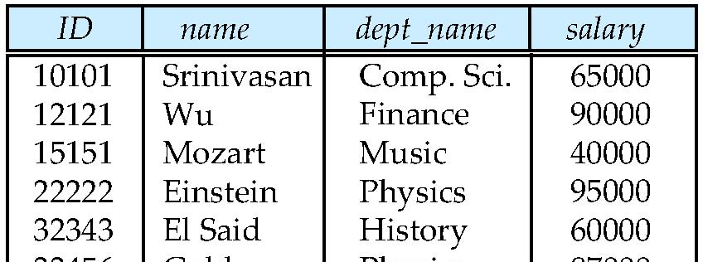
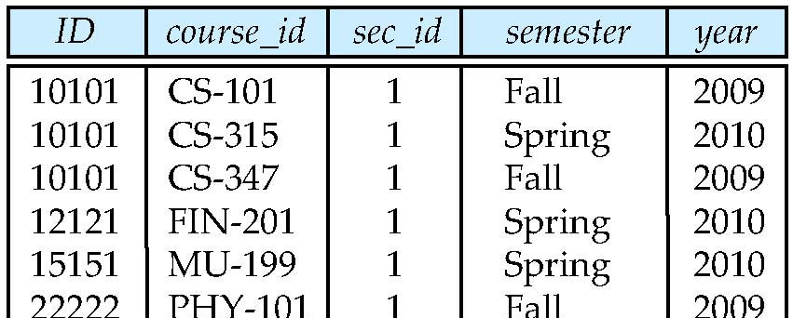
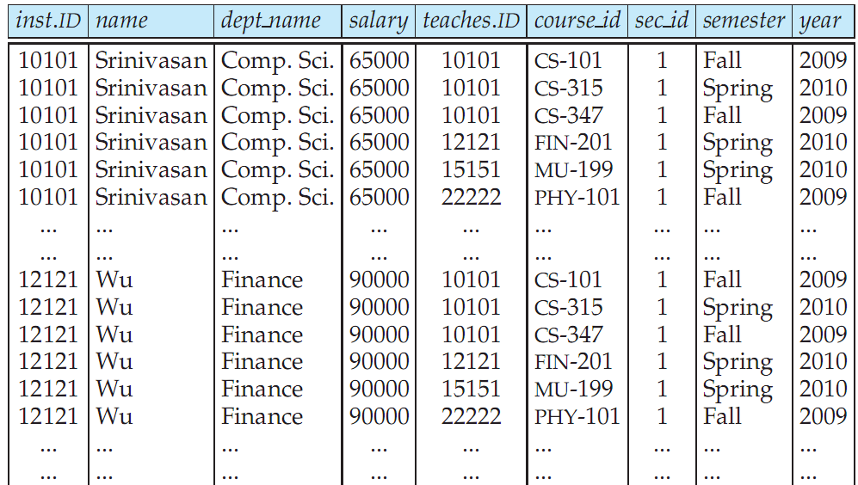
Cartesian Product: instructor X teaches
instructor
teaches

Slide 15
Joins
For all instructors who have taught some course, find their names and the course ID of the courses they taught.
select name, course_id from instructor, teaches where instructor.ID = teaches.ID
Find the course ID, semester, year and title of each course offered by the Comp. Sci. department
select section.course_id, semester, year, title from section, course where section.course_id = course.course_id and dept_name = ‘Comp. Sci.'

Slide 16
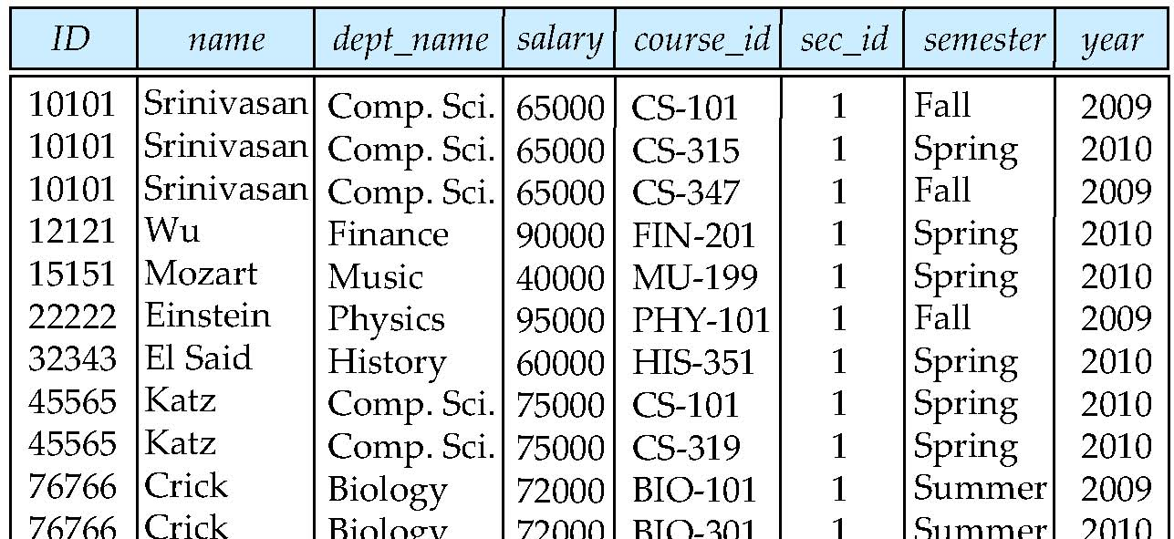
Natural Join
Natural join matches tuples with the same values for all common attributes, and retains only one copy of each common column
select * from instructor natural join teaches;

Slide 17
The Rename Operation
The SQL allows renaming relations and attributes using the as clause:
old-name as new-name
E.g.
select ID, name, salary/12 as monthly_salary from instructor
Find the names of all instructors who have a higher salary than some instructor in ‘Comp. Sci’.
select distinct T. name from instructor as T, instructor as S where T.salary > S.salary and S.dept_name = ‘Comp. Sci.’
Keyword as is optional and may be omitted instructor as T ≡ instructor T
Notes:
9

Slide 18
String Operations
SQL includes a string-matching operator for comparisons on character strings. The operator “like” uses patterns that are described using two special characters:
percent (%). The % character matches any substring.
underscore (_). The _ character matches any character.
Find the names of all instructors whose name includes the substring “dar”. select name from instructor where name like '%dar%’

Slide 19
String Operations (Cont.)
Patterns are case sensitive.
Pattern matching examples:
‘Intro%’ matches any string beginning with “Intro”.
‘%Comp%’ matches any string containing “Comp” as a substring.
‘_ _ _’ matches any string of exactly three characters.
‘_ _ _ %’ matches any string of at least three characters.
SQL supports a variety of string operations such as
concatenation (using “||”)
converting from upper to lower case (and vice versa)
finding string length, extracting substrings, etc.

Slide 20
Ordering the Display of Tuples
List in alphabetic order the names of all instructors select distinct name from instructor order by name
We may specify desc for descending order or asc for ascending order, for each attribute; ascending order is the default.
Example: order by name desc
Can sort on multiple attributes
Example: order by dept_name, name

Slide 21
Where Clause Predicates
SQL includes a between comparison operator
Example: Find the names of all instructors with salary between $90,000 and $100,000 (that is, ≥ $90,000 and ≤ $100,000)
select name from instructor where salary between 90000 and 100000
Notes:
7

Slide 22
Duplicates
In relations with duplicates, SQL defines how many copies of tuples appear in the result.
Multiset versions of some of the relational algebra operators – given multiset relations r₁ and r₂:
1. σ_{θ} (r₁): If there are c₁ copies of tuple t₁ in r₁, and t₁ satisfies selections σ_{θ,}, then there are c₁ copies of t₁ in σ_{θ} (r₁).
2. Π_{A} (r ): For each copy of tuple t₁ in r₁, there is a copy of tuple Π_{A} (t₁) in Π_{A} (r₁) where Π_{A} (t₁) denotes the projection of the single tuple t₁.
3. r₁ x r₂ : If there are c₁ copies of tuple t₁ in r₁ and c₂ copies of tuple t₂ in r₂, there are c₁ x c₂ copies of the tuple t₁. t₂ in r₁ x r₂

Slide 23
Duplicates (Cont.)
Example: Suppose multiset relations r₁ (A, B) and r₂ (C) are as follows:
r₁ = {(1, a) (2,a)} r₂ = {(2), (3), (3)}
Then Π_{B}(r₁) would be {(a), (a)}, while Π_{B}(r₁) x r₂ would be
{(a,2), (a,2), (a,3), (a,3), (a,3), (a,3)}
SQL duplicate semantics:
select A₁,, A₂, ..., A_{n} from r₁, r₂, ..., r_{m} where P
is equivalent to the multiset version of the expression:

Slide 24
Set Operations
Find courses that ran in Fall 2009 or in Spring 2010
(select course_id from section where sem = ‘Fall’ and year = 2009) union (select course_id from section where sem = ‘Spring’ and year = 2010)
Find courses that ran in Fall 2009 and in Spring 2010
(select course_id from section where sem = ‘Fall’ and year = 2009) intersect (select course_id from section where sem = ‘Spring’ and year = 2010)
Find courses that ran in Fall 2009 but not in Spring 2010
(select course_id from section where sem = ‘Fall’ and year = 2009) except (select course_id from section where sem = ‘Spring’ and year = 2010)

Slide 25
Set Operations
Set operations union, intersect, and except
Each of the above operations automatically eliminates duplicates.
To retain all duplicates use the corresponding multiset versions union all, intersect all and except all. Suppose a tuple occurs m times in r and n times in s, then, it occurs:
m + n times in r union all s
min (m,n) times in r intersect all s
max(0, m – n) times in r except all s

Slide 26
Null Values
It is possible for tuples to have a null value, denoted by null, for some of their attributes
null signifies an unknown value or that a value does not exist.
The result of any arithmetic expression involving null is null
Example: 5 + null returns null
The predicate is null can be used to check for null values.
Example: Find all instructors whose salary is null.
select name from instructor where salary is null

Slide 27
Null Values and Three Valued Logic
Any comparison with null returns unknown
Example: 5 < null or null <> null or null = null
Three-valued logic using the truth value unknown:
OR: (unknown or true) = true, (unknown or false) = unknown (unknown or unknown) = unknown
AND: (true and unknown) = unknown, (false and unknown) = false, (unknown and unknown) = unknown
NOT: (not unknown) = unknown
“P is unknown” evaluates to true if predicate P evaluates to unknown
Result of where clause predicate is treated as false if it evaluates to unknown

Slide 28
Aggregate Functions
These functions operate on the multiset of values of a column of a relation, and return a value
avg: average value min: minimum value max: maximum value sum: sum of values count: number of values

Slide 29
Aggregate Functions (Cont.)
Find the average salary of instructors in the Computer Science department
select avg (salary) from instructor where dept_name= ’Comp. Sci.’;
Find the total number of instructors who teach a course in the Spring 2010 semester
select count (distinct ID) from teaches where semester = ’Spring’ and year = 2010
Find the number of tuples in the course relation
select count (*) from course;

Slide 30
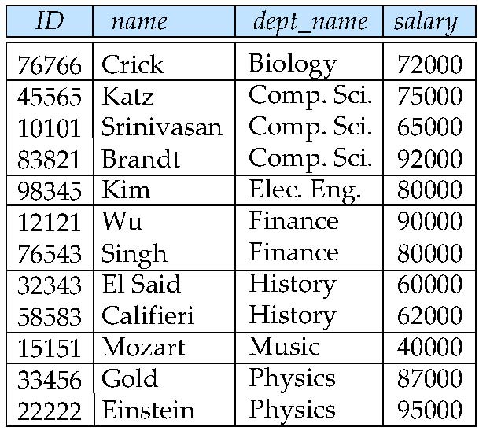
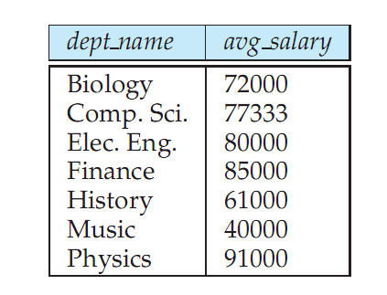
Aggregate Functions – Group By
Find the average salary of instructors in each department
select dept_name, avg (salary) from instructor group by dept_name;
Note: departments with no instructor will not appear in result

Slide 31
Aggregation (Cont.)
Attributes in select clause outside of aggregate functions must appear in group by list
/* erroneous query */ select dept_name, ID, avg (salary) from instructor group by dept_name;

Slide 32
Aggregate Functions – Having Clause
Find the names and average salaries of all departments that have an average salary greater than 42000.
select dept_name, avg (salary)
from instructor
group by dept_name
having avg (salary) > 42000;
Note: predicates in the having clause are applied after the formation of groups whereas predicates in the where clause are applied before forming groups

Slide 33
Null Values and Aggregates
Total all salaries
select sum (salary ) from instructor
Above statement ignores null amounts
Result is null if there is no non-null amount
All aggregate operations except count(*) ignore tuples with null values on the aggregated attributes
What if collection has only null values?
count returns 0
all other aggregates return null

Slide 34
Nested Subqueries
SQL provides a mechanism for the nesting of subqueries.
A subquery is a select-from-where expression that is nested within another query.
A common use of subqueries is to perform tests for set membership, set comparisons, and set cardinality.

Slide 35
Example Nested Queries
Find courses offered in Fall 2009 and in Spring 2010
select distinct course_id
from section
where semester = ’Fall’ and year= 2009 and course_id in (select course_id
from section
where semester = ’Spring’ and year= 2010);
Find courses offered in Fall 2009 but not in Spring 2010
select distinct course_id
from section
where semester = ’Fall’ and year = 2009 and course_id not in (select course_id
from section
where semester = ’Spring’ and year= 2010);

Slide 36
Example Query
Find the total number of (distinct) students who have taken course sections taught by the instructor with ID 10101
select count (distinct ID)
from takes
where (course_id, sec_id, semester, year) in (select course_id, sec_id, semester, year
from teaches
where teaches.ID= 10101);
Note: Some of these queries can be written in a much simpler manner. The formulation above is simply to illustrate SQL features.

Slide 37
Set Comparison
Find names of instructors with salary greater than that of some (at least one) instructor in the Biology department.
select distinct T.name
from instructor as T, instructor as S
where T.salary > S.salary and S.dept_name = ’Biology’;
Same query using > some clause
select name
from instructor
where salary > some (select salary
from instructor
where dept_name = ’Biology’);

Slide 38
Definition of Some Clause
F <comp> some r ⇔ ∃ t ∈ r such that (F <comp> t ) Where <comp> can be: <, ≤, >, =, ≠
0
(5 < some
5
) = true
(read: 5 < some tuple in the relation)
6
0
(5 < some
5
) = false
0
(5 = some
) = true
5
0
(5 ≠ some
5
) = true (since 0 ≠ 5)

Slide 39
Example Query
Find the names of all instructors whose salary is greater than the salary of all instructors in the Biology department.
select name
from instructor
where salary > all (select salary
from instructor
where dept_name = ’Biology’);

Slide 40
Definition of all Clause
F <comp> all r ⇔ ∀ t ∈ r (F <comp> t)
0
(5 < all
5
) = false
6
6
(5 < all
) = true
10
4
(5 = all
) = false
5
4
(5 ≠ all
= true (since 5 ≠ 4 and 5 ≠ 6)
6

Slide 41
Test for Empty Relations
The exists construct returns the value true if the argument subquery is nonempty.
exists r ⇔ r ≠ Ø
not exists r ⇔ r = Ø

Slide 42
Correlation Variables
Yet another way of specifying the query “Find all courses taught in both the Fall 2009 semester and in the Spring 2010 semester”
select course_id from section as S where semester = ’Fall’ and year= 2009 and exists (select * from section as T where semester = ’Spring’ and year= 2010 and S.course_id = T.course_id);
Correlated subquery
Correlation name or correlation variable S
First half of condition
Second half of condition

Slide 43
Not Exists
Find all students who have taken all courses offered in the Biology department.
select distinct S.ID, S.name
from student as S
where not exists ( (select course_id
from course
where dept_name = ’Biology’)
except
(select T.course_id
from takes as T
where S.ID = T.ID));
All Biology Courses
⊆
Courses taken by S
Note that X – Y = Ø ⇔ X ⊆ Y

