Slide 1
VAST 2010 Mini Challenge #1 Award:
VisWorks Text and Network Visual Analytics
Lei Shi, Weihong Qian, Furu Wei and Li Tan
IBM Research - China
Visualizations
  TIARA trend visualization combining river theme and word cloud metaphor
  Peony network visualization with customized node/edge/cluster rendering, styling and data mapping
  Mashups synthesizing text, network, map and document visualizations
Analytics Process
  Data pre-processing: Segmentation, NE (people/location/organization) extraction/cleansing
  Categorization & correlation & summarization: clustering with country info, people/location network generation, time-sensitive keyword summarization
  Data-vis mapping: categorized temporal content – TIARA Vis
  people/location relationships – Peony Network Vis
  Visual analytics: interactive network role/relationship analysis, text content interactive analytics over visual representation

Slide 2
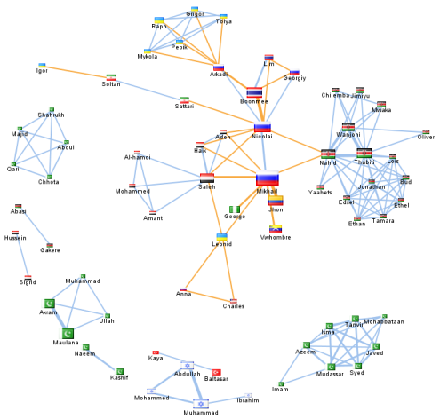
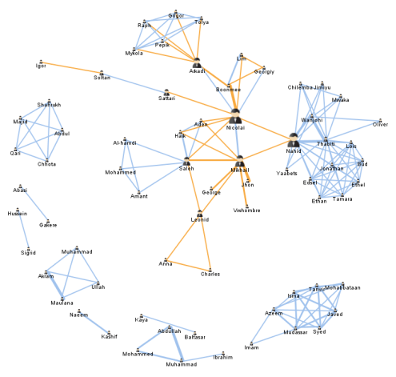
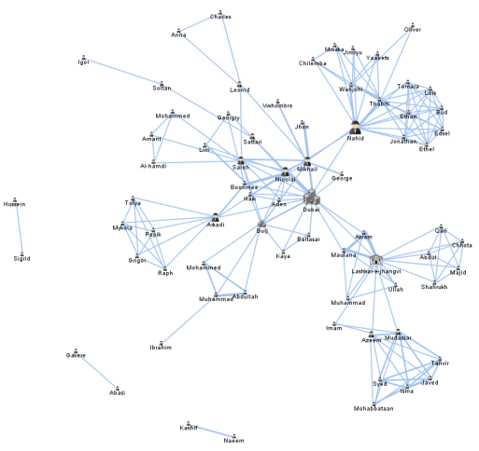
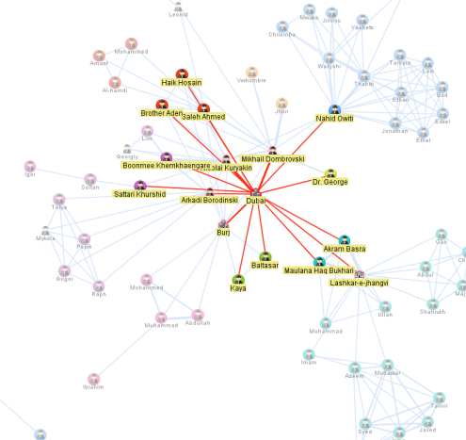
Visual Analytics of Player and Key Location Network
Player networks built from documents by NE extraction and correlation
Network with player’s nationality and inter-country connection highlighted (orange edge), player icon size indicates occurrence in the documents
Same network with player icon size mapped to node betweenness centrality in the graph, key players connecting the groups are revealed
More connected network after adding key locations, icon size still mapped to node betweenness centrality, “Dubai” is bridging disconnected components
Color coding the node icon with player group info, again “Dubai” is connecting different player groups together, it is hypothesized that they will come together at “Dubai” for the final arms dealing

Slide 3
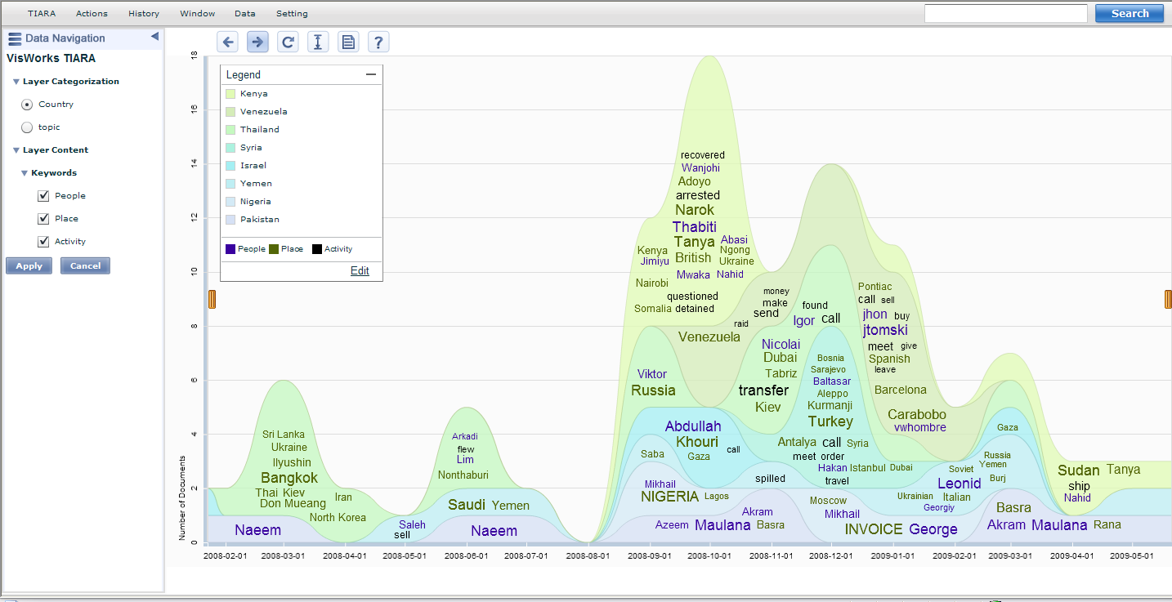
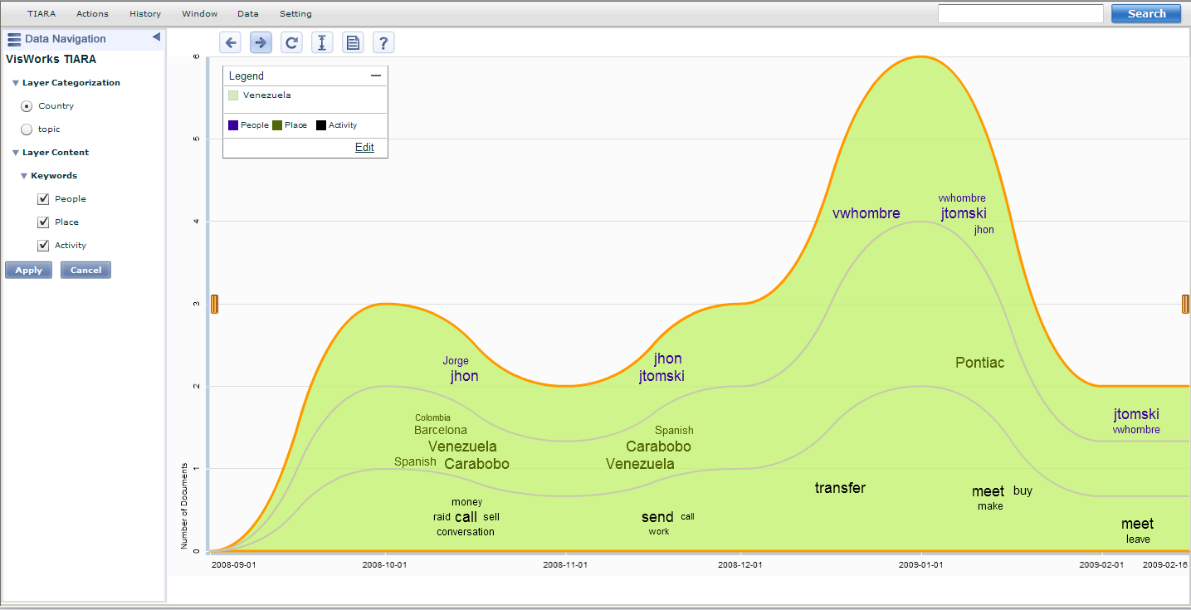
Text Content Summarization & Analytics
Synthesized visualization of people/locations/activities by country (group)
Drill down to one specific country “Venezuela” and the discovery of “call-send-transfer-meet” pattern

Slide 4
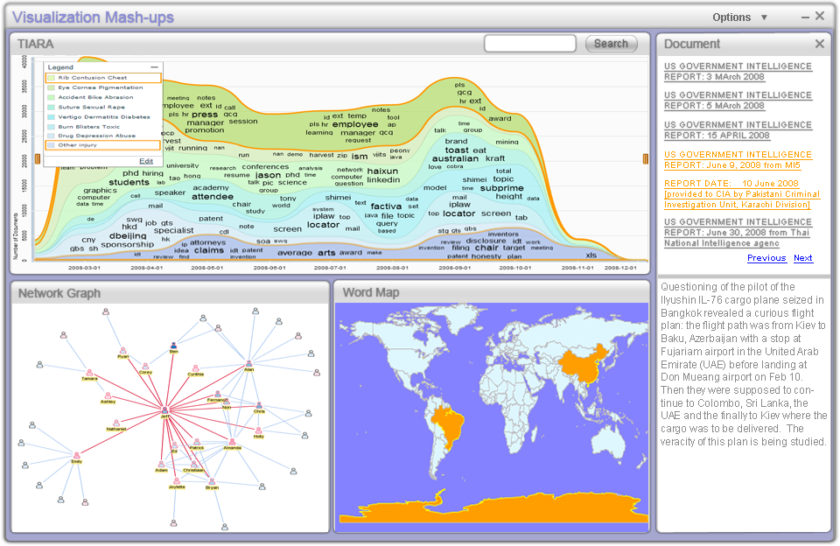
Visualization Mashups for Crime Analysis

