Slide 1
Sentiment Analysis on Tweet Posts
Team 10
Xun Peng
Jiahua Liu

Slide 2
Task Description
A system have to distinguish between Twitter posts that contain adverse drug reaction(ADR) mention versus those that do not.
Automatic classification of adverse drug reaction(ADR) mentioning posts - binary classification

Slide 3
Outline
DataSet
Exploratory Data Analysis
Model Prediction
Data processing and data cleaning
Distributed Representation
Model(CNN and TensorFlow)
Web Service for Model

Slide 4
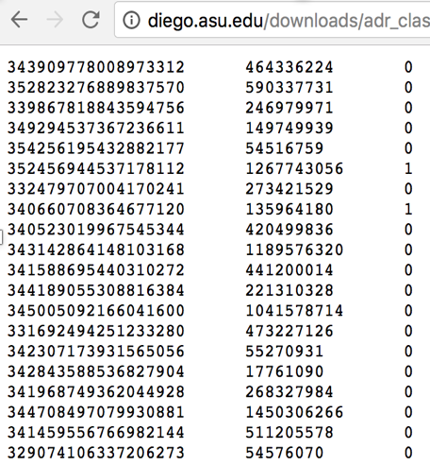
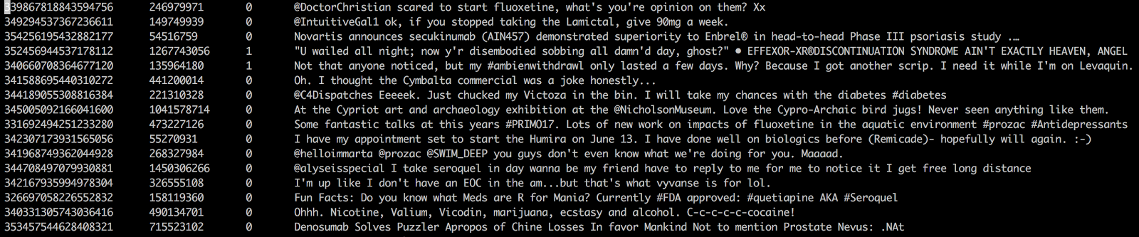
Dataset
columns represent Tweet ID, UserID and the binary annotation indicating the presence or absence of ADRs
Python Crawler

Slide 5
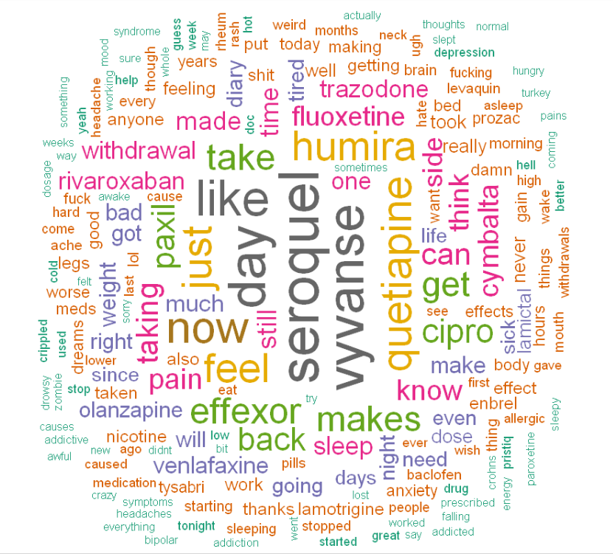
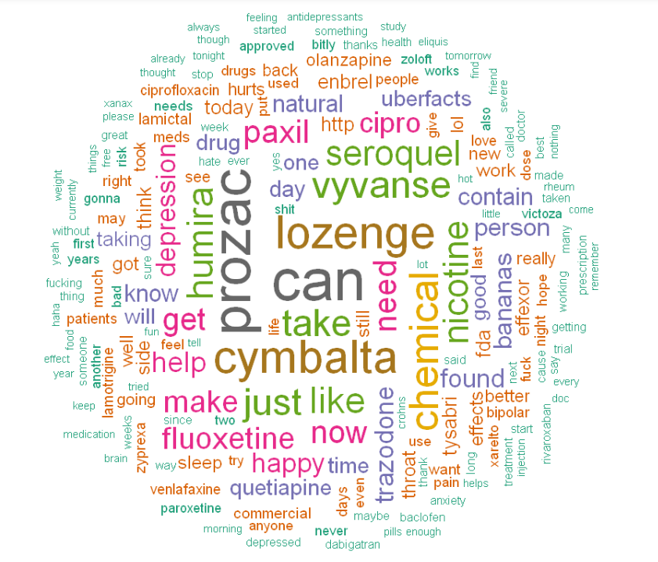
EDA(Exploratory Data Analysis)
ADR Present
ADR Absent

Slide 6
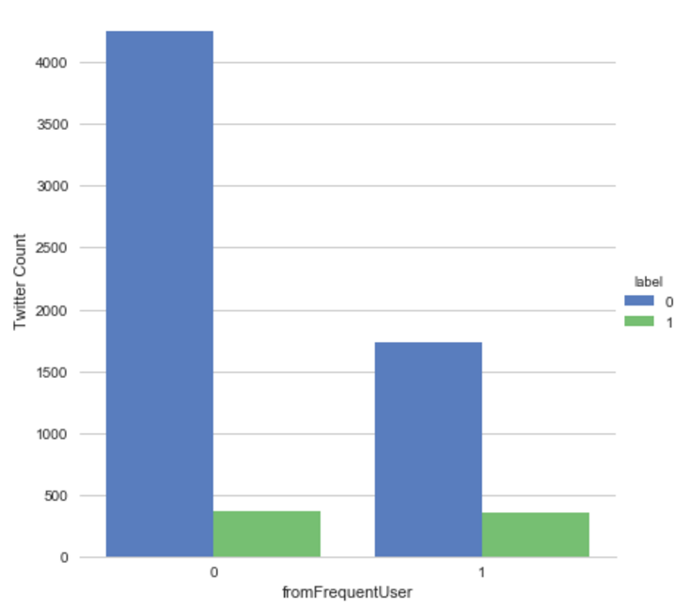
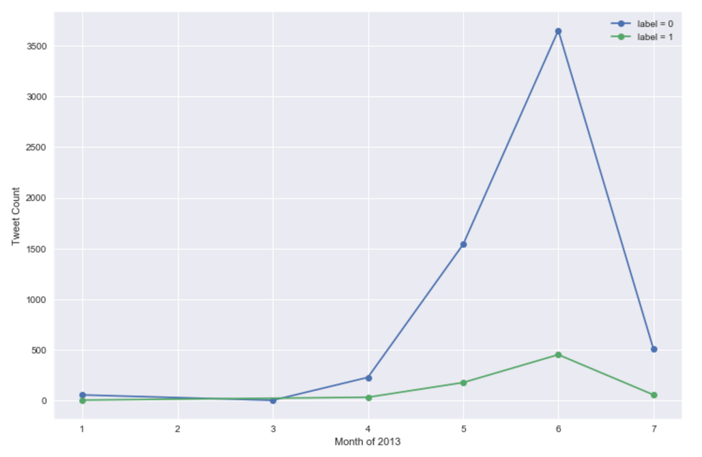
EDA(Exploratory Data Analysis)
User Frequency Analysis
Time-series Analysis

Slide 7
Model Prediction
Data processing and data cleaning
Distributed Representation
Train each word to K-dimensional vector
Model
Convolutional Neural Network(CNN)
TensorFlow

Slide 8
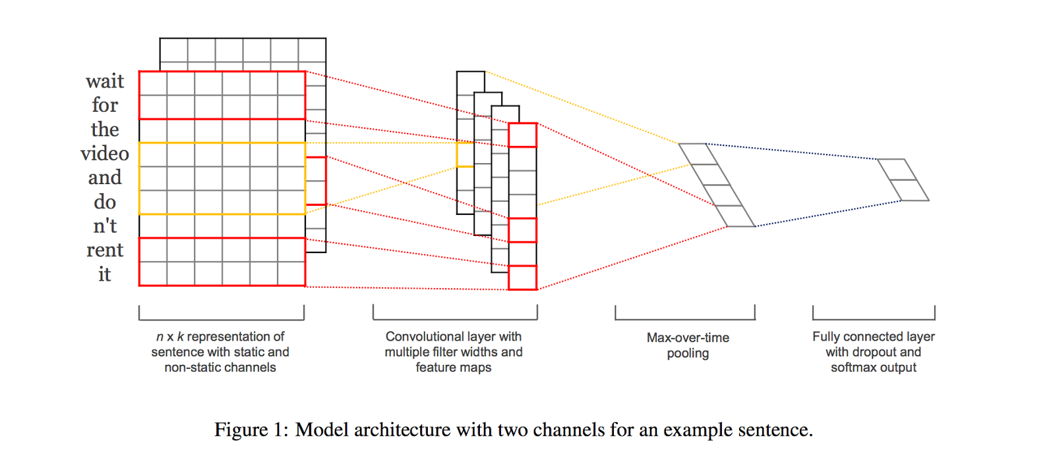
Convolutional Neural Network

Slide 9
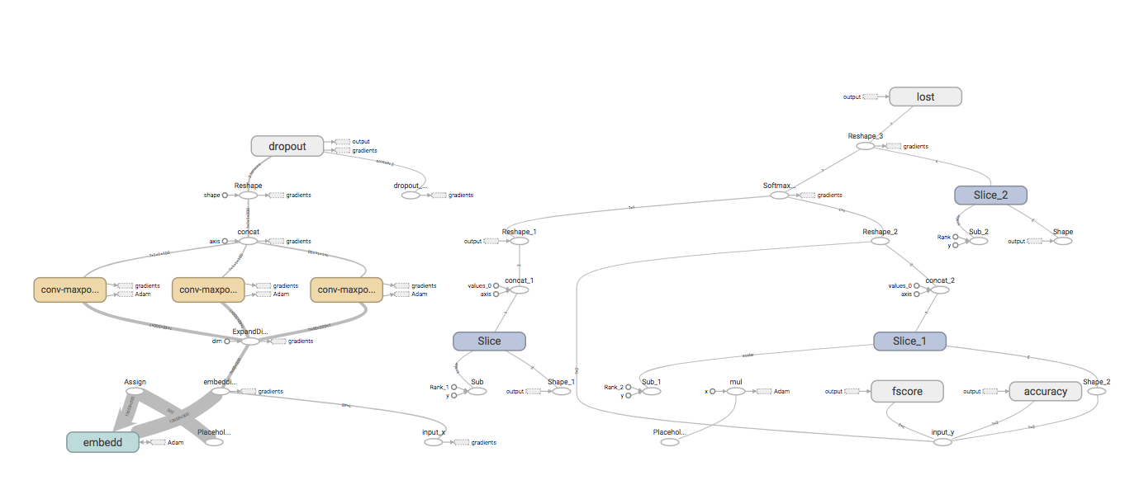
TensorFlow

Slide 10
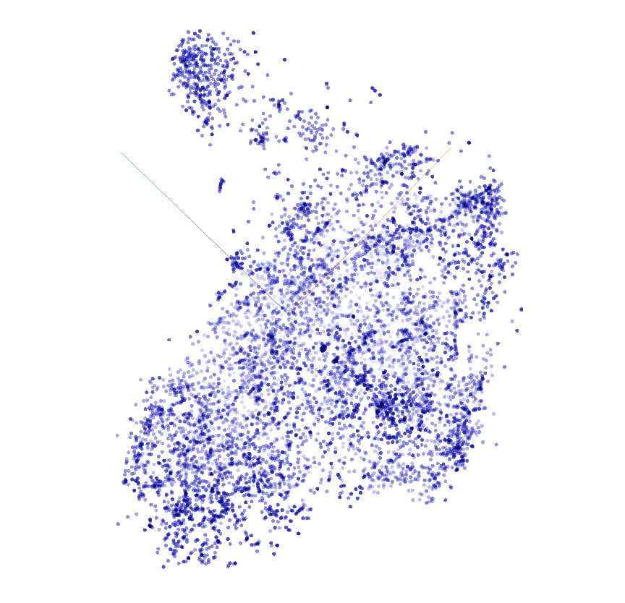
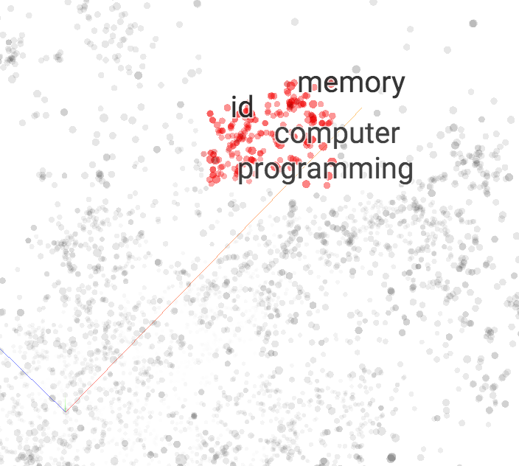
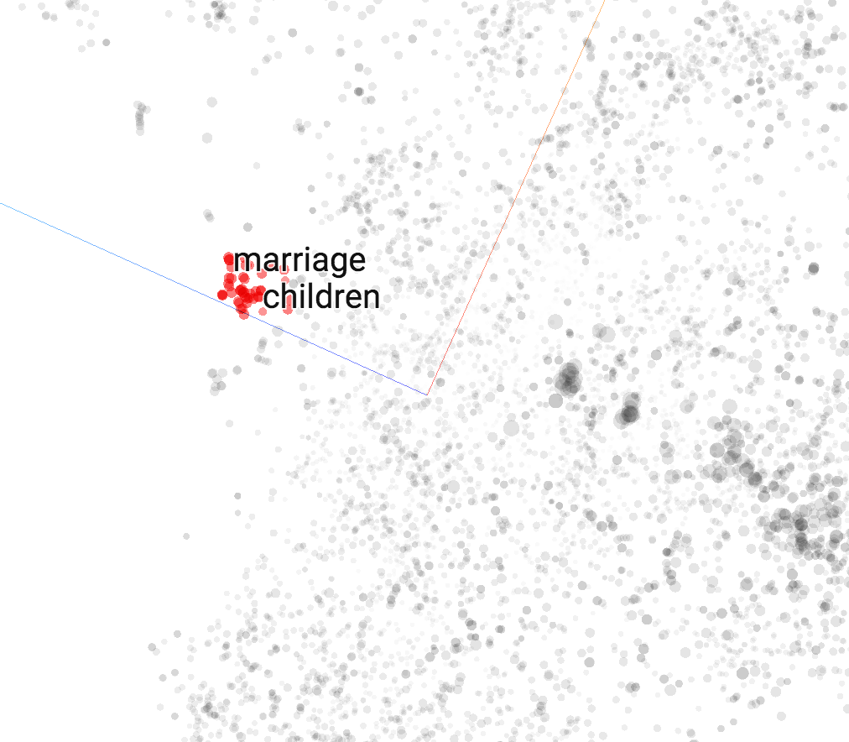
TensorBoard

Slide 11
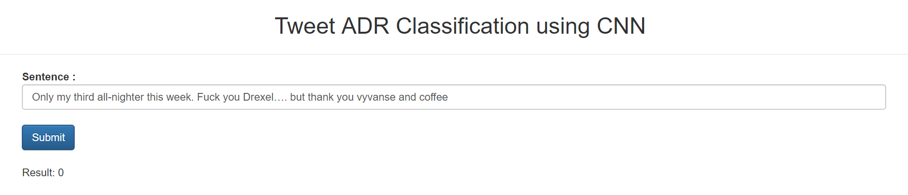
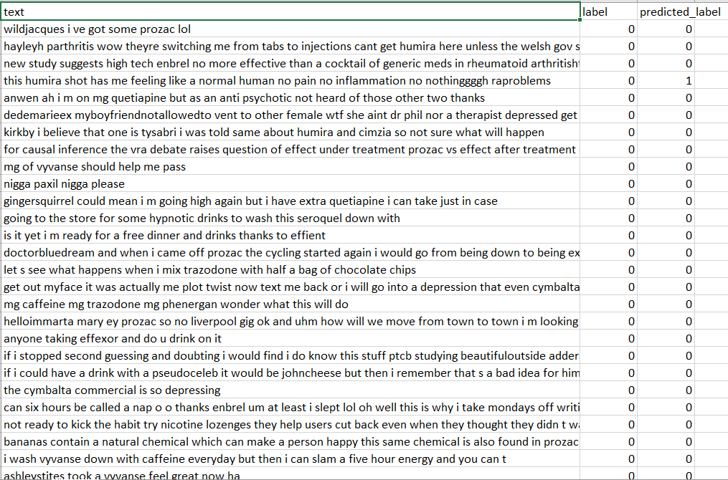
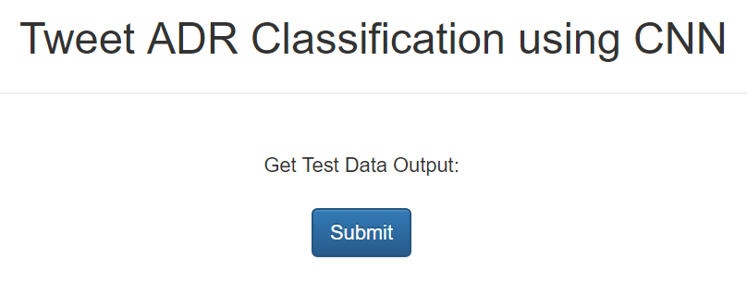
User Interface

Slide 12
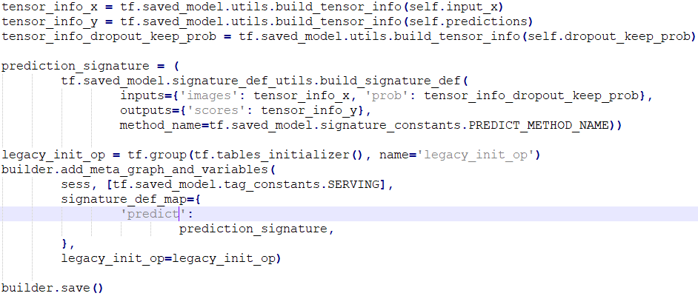
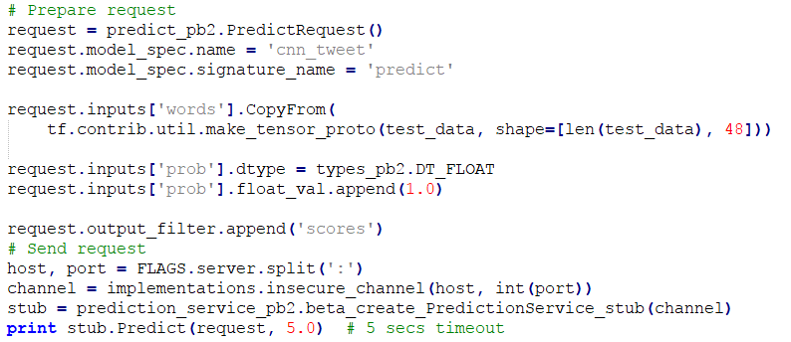
Web Service
MLaaS Using Tensorflow Serving Component
tensorflow_model_server --port=9001 --model_name=cnn_tweet --model_base_path=/tmp/cnn_tweet_model/

Slide 13
Thank you!

