Slide 1

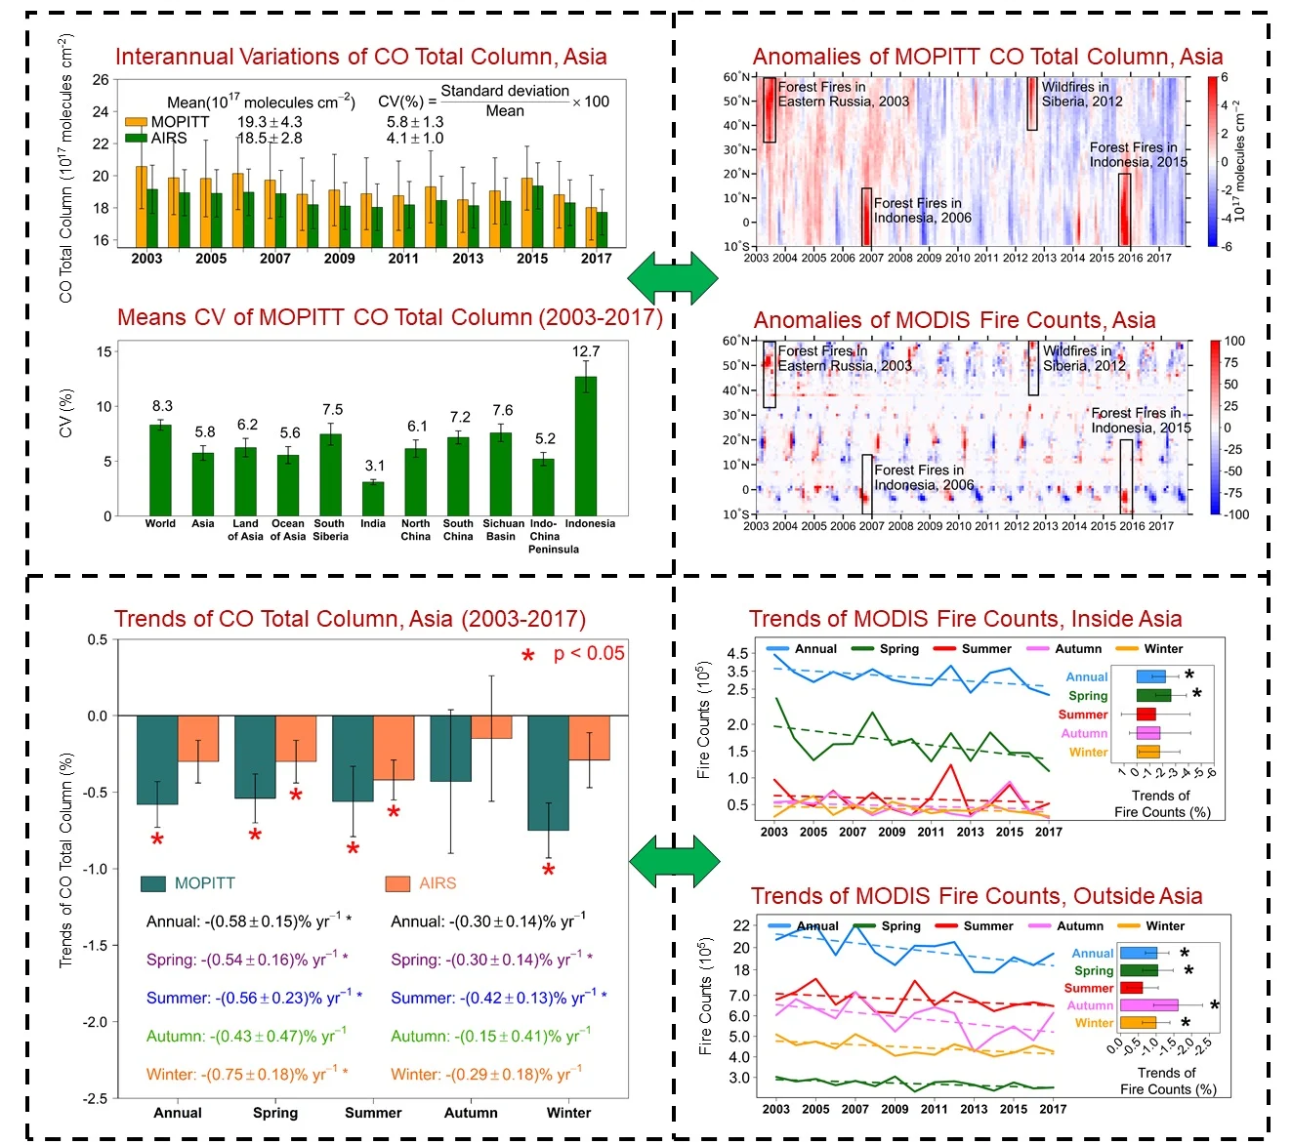
Research Summary
Satellite-Observed Variations and Trends in Carbon Monoxide over Asia and Their Sensitivities to Biomass Burning
The interannual variation of the CO total column in Asia is significantly and strongly correlated with biomass burning. The total column of CO in Asia presents significant inter-annual variability, as demonstrated by a coefficient of variation (CV) of 5.8% in the MOPITT CO total column data.
The trend in total CO columns over Asia aligns with the declining trends in fire counts and CO emissions from fires, both within and outside Asia. From 2003 to 2017, the MOPITT CO total column in Asia decreased at a rate of -0.58±0.15% per year. From 2003 to 2017, the decreasing trend of the total number of MODIS fire count within and outside Asia decreased significantly, suggesting that biomass burning is one of the reasons for the decreasing trend of CO total column in Asia, especially in spring.
Zhang et al. (2020)
1

Slide 2
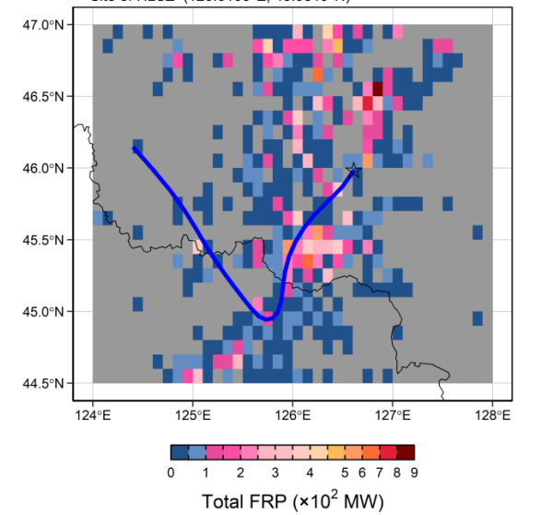
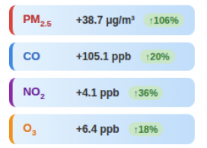
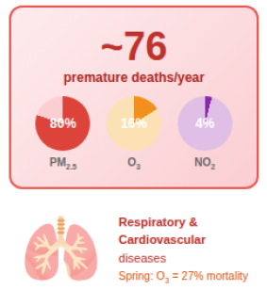

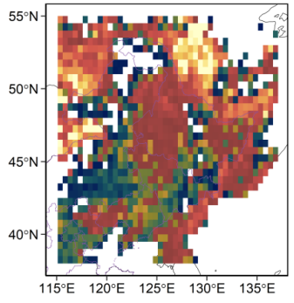
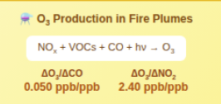
Research Summary
Impact of strong biomass burning in Northeast China: air pollution, correlations among pollutants, and health risk
Biomass Burning in
Northeast China (2014-2020)
Exposure to
Cropland Fires
PM_{2.5}, O₃, and NO₂
Short-term All-cause
Premature Deaths
HYSPLIT+MODIS
18 cities, 121 sites
Impact on Air Quality
Transport
Exposure
Health
Ozone Photochemistry Production
Fire plumes (spring & fall)
Fall enhancements in air pollutants 2-3x than spring
O₃ enhanced only in spring
Low ΔO₃/ΔCO ratio in cropland fires vs tropical fires
841 fire-affected days
Cropland fires: 75%
Zhang et al. (2026) Under review AE
2

Slide 3
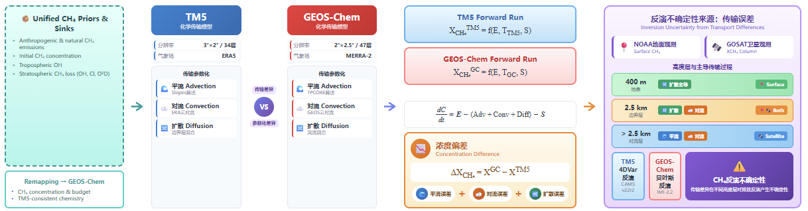
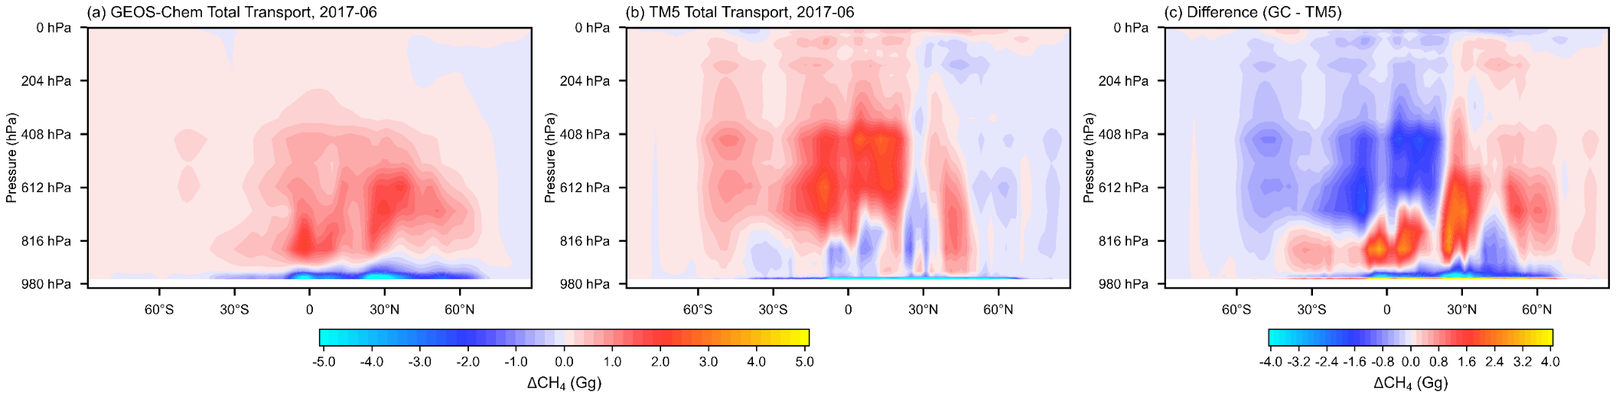
Research Summary
Quantifying transport-induced uncertainties in global methane inversions: a multi-model evaluation using GEOS-Chem and TM5 constrained by surface and satellite observations.
Same CH₄ source → Concentration bias → Inversion bias
Zhang et al. (2026)
3

